Slide 1
CAPITAL PROJECT GRANTS
Webinar Presentation
August 1, 2017

Slide 2
AGENDA
Eligibility & Assessment
Assessment criteria
Questions & Resources
Floor is open
Sector overview
Introduction
Accountability
Conditions
Acknowledgement of funding
How to Apply
Live demo
Key resources to be aware of
Mandatory eligibility
2

Slide 3

INTRODUCTION
Sector Overview
$5 million per year dedicated to capital projects with a total cost
of over $20,000
Up to 50% of the total cost of a project may be funded, to a maximum of $250,000
Matching funds required
Application intake period:
Aug. 1 – Sept. 30, 2017
Notifications and funding to be provided by December 31, 2017

Slide 4
MANDATORY ELIGIBILITY CRITERIA
Organization Eligibility (Section 2.1 and 2.3 of Sector Guide)
Not-for-profit
Primarily for community benefit
Delivers programs that fall within one of the following sectors: Arts & Culture, Sport, Public Safety, Environment, Human & Social Services, Parent Advisory Councils & District Parent Advisory Councils

Slide 5
MANDATORY ELIGIBILITY CRITERIA
Organization Eligibility (Section 2.1 and 2.3 of Sector Guide)
Voting membership more than double the number of board members
Democratically elected board members
Financially stable and demonstrates solid fiscal management
Past recipients of Community Gaming Grants must be up to date and in good standing with their Gaming Account Summary Reports

Slide 6
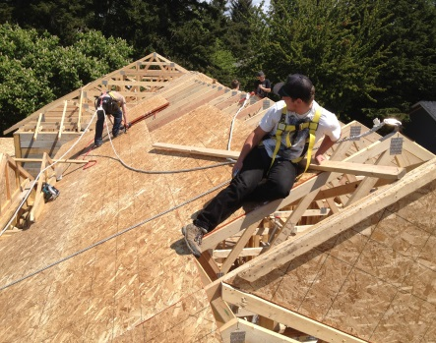
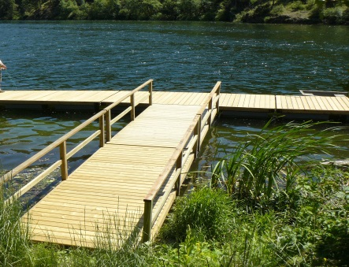
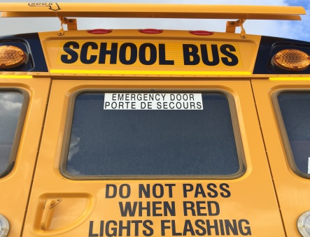
MANDATORY ELIGIBILITY CRITERIA
Project Eligibility (Section 2.2 of Sector Guide)
Capital projects with a total cost of more than $20,000 will be considered in three categories:
Facilities: the construction, renovation or
improvement of facilities
Community Infrastructure: the development of public amenities such as docks, parks or playgrounds
Acquisitions: the purchase of fixed capital assets for long-term ownership and use, including vehicles and equipment

Slide 7
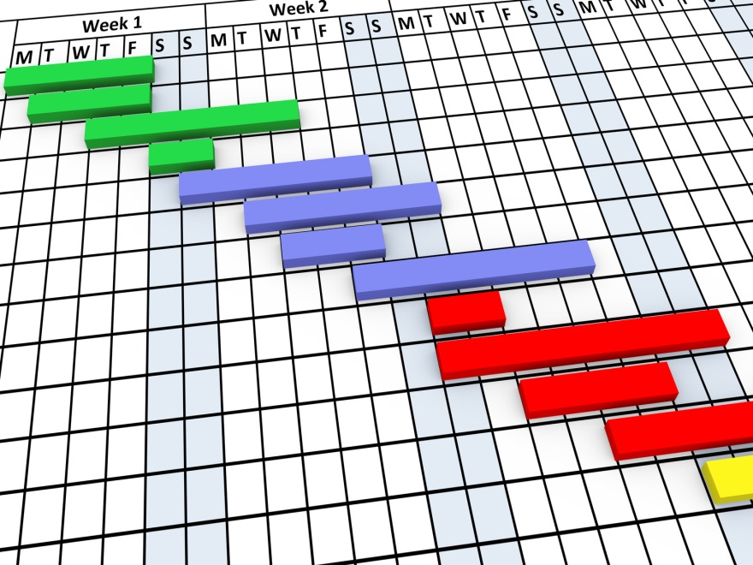
SUPPLEMENTARY DOCUMENTS
In addition to the organization’s constitution, bylaws, board of directors list and financials, applicants will be asked to provide:
Project plan/timeline
Risk management table
Approvals and permits plan
Long-term operations plan
Project budget, including acquired funds
Price quotes

Slide 8

APPLICATION ASSESSMENT
Competitive Application Process
There will be three levels of consideration applied in the assessment of grant applications:
Applicants must meet all Mandatory
Eligibility Criteria (Section 2 of Sector Guide)
Applications that meet the Mandatory
Eligibility Criteria will be marked against the
Assessment Criteria (Section 4 of Sector Guide)
Once the ranking process has been completed,
additional considerations will be applied

Slide 9
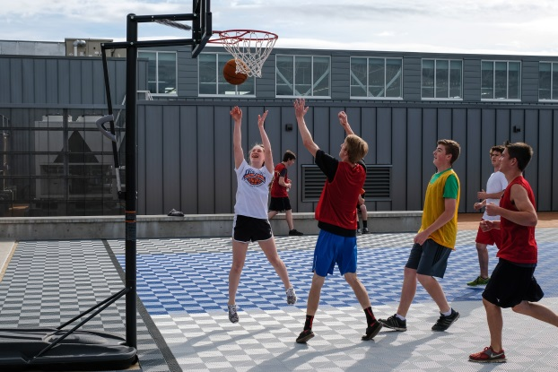
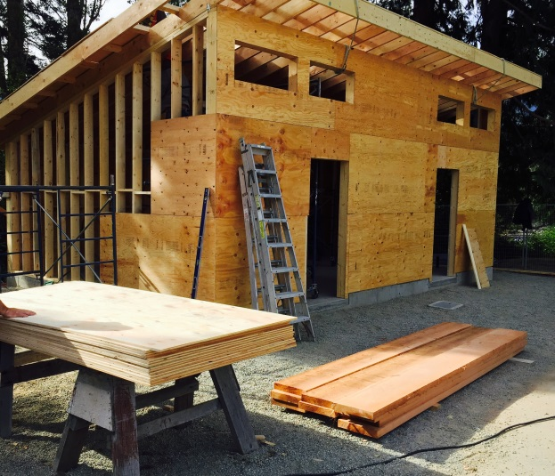
ASSESSMENT CRITERIA
Alignment with Sector Objectives (10%)
Project Feasibility (35%)
Community benefit
Public inclusivity
Project planning
Operational viability

Slide 10
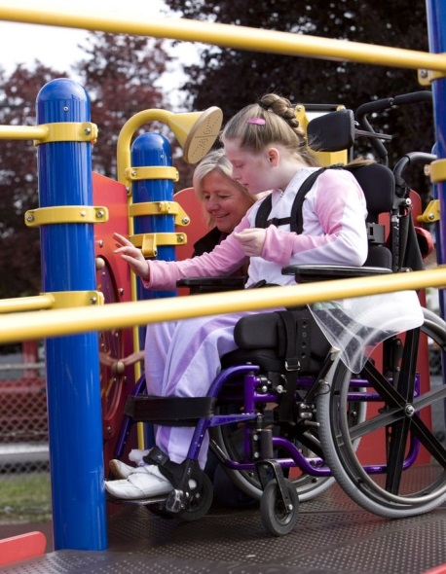
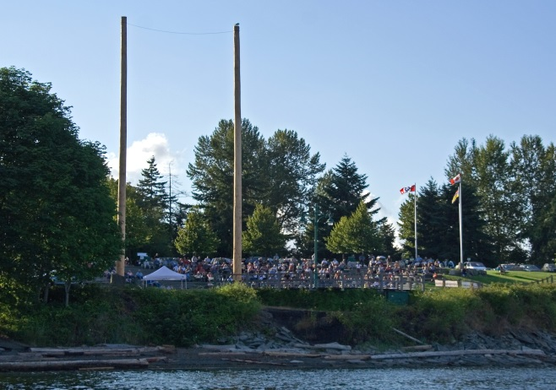
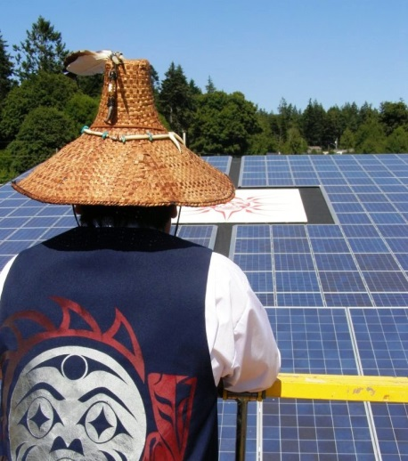
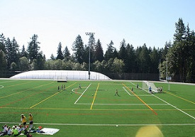
ASSESSMENT CRITERIA
Financial Considerations
(50%)
Special Project Features
(5%)
Financial need
Financial feasibility
Accessibility
Environmental efficiency/added value

Slide 11
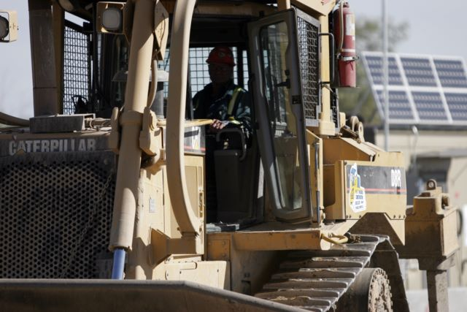

ADDITIONAL CONSIDERATIONS
    Additional consideration will be given to the distribution of grant funding across:
    Geographic regions of B.C.
    Community gaming grant sectors
    Projects of varying size/cost
    Aboriginal not-for-profits
No Reconsiderations
    All decisions are final due to
    competitive process

Slide 12
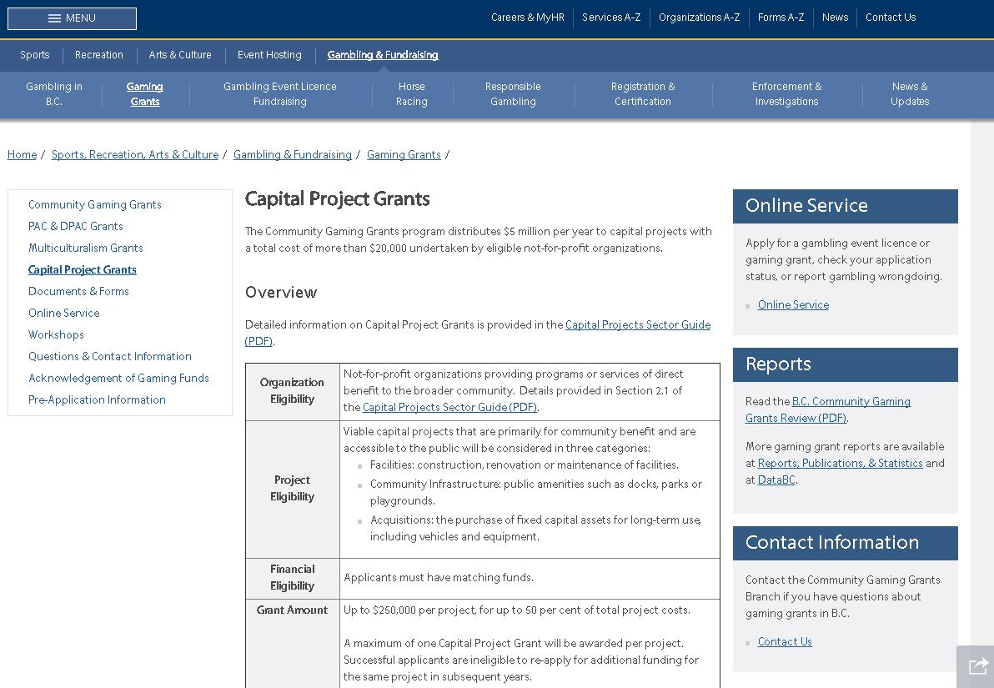
HOW TO APPLY
Submitting an Application
Use the Pre-Application Checklist and Application Tutorial available on the gaming grants
website to prepare
Online application
Notes:
LIVE DEMO

Slide 13

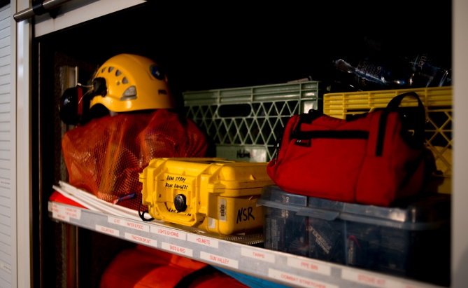
ACCOUNTABILITY
Appropriate use of funding:
Section 5 of Sector Guide
Disbursement of funds:
Section 5 of Sector Guide
Grant Conditions:
Section 6 of Sector Guide
Acknowledgement of funding:
Section 7 of Sector Guide

Slide 14
QUESTIONS
Questions?

Slide 15

RESOURCES
Please read through the Capital Projects Sector
Guide for detailed grant information
Use the resources available to you when putting together your grant application:
  Government website (http://www2.gov.bc.ca/gov/content/sports-culture/gambling-fundraising/gaming-grants/capital-project-grants)
    Sector Guide
    Pre-application checklist
    Application tutorial
    Frequently asked questions
  Community Gaming Grants Branch
    General – communitygaminggrants@gov.bc.ca, or
    call 1-800-663-7867 to be transferred to 250-356-1081
    Community Outreach Manager – CGGOutreach@gov.bc.ca
  BC Association for Charitable Gaming (http://bcacg.com/) and
  local Community Charitable Gaming Associations
  BC Association of Aboriginal Friendship Centres (https://www.bcaafc.com/index.php/member-services/gaming-grants)

