Slide 1
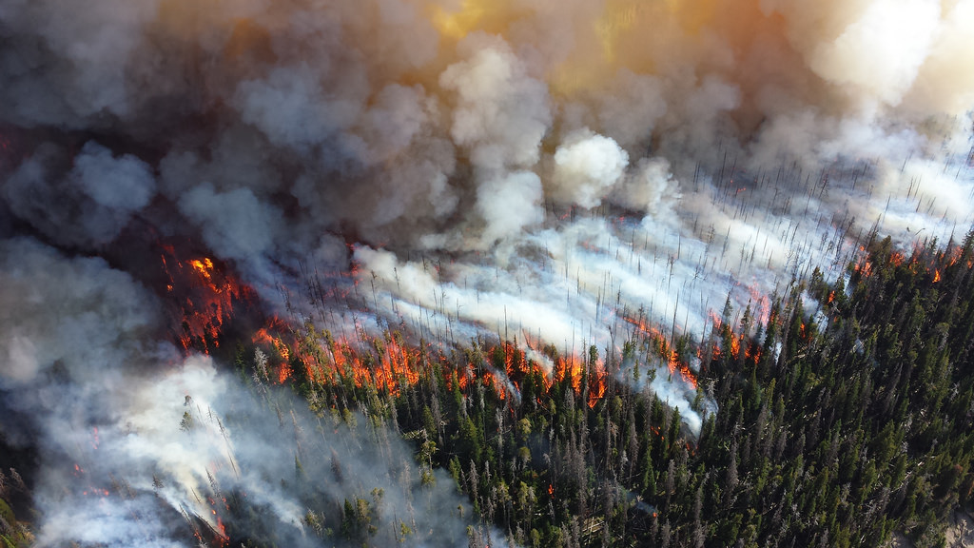
BC Wildfire Service Vendor Portal
Supplier Info Session

Slide 2
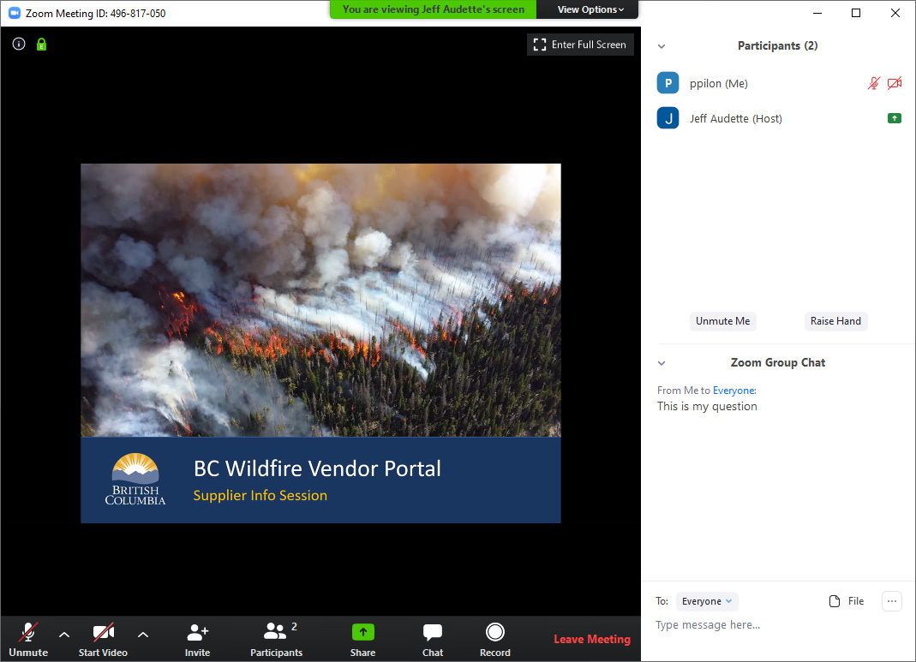
Zoom Meeting Primer
Scroll over image to see options at bottom
Select Chat to see Zoom Group Chat where you can type in questions
Select Participants to see participants list
Use Mute/Unmute to reduce background noise when not talking
Host can mute all
Use raise hand option if you want to want to speak to ask a question
Muted
Mute/
Unmute
Raise
Hand
Type in Questions here
Open Participants Window
Open Chat Window

Slide 3
Agenda
What is the Vendor Portal?
Supplier Onboarding
Aviation Service Requests
Business BCeID
Questions
Project Timeline
What’s Next

Slide 4
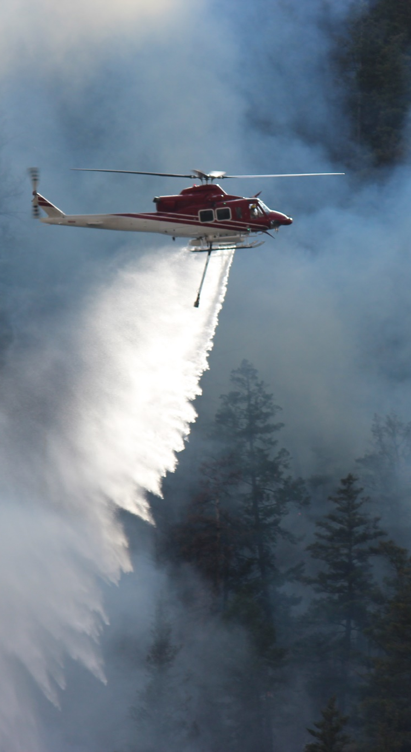
What is the Vendor Portal?
A new streamlined way for Suppliers to interact with the BC Wildfire Service
Self-serve access to BCWS services
Supplier Invitations
Manage Aviation Service Requests
Manage Portal Access Control
Potential Future Options:
Manage Crews & Equipment
Manage Invoices
Manage Manifests

Slide 5
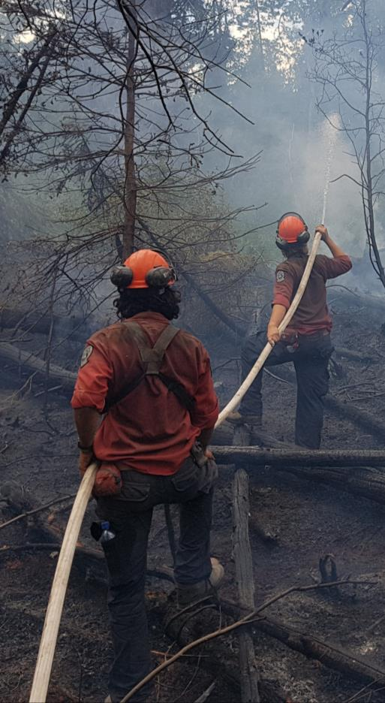
Supplier Onboarding - Requirements
All ASRs will be managed through the Vendor Portal and will require:
A hardware platform that can access the internet - portal will support mobile-friendly devices such as laptops, tablets or mobile phones.
An Internet connection and modern web browser software such as Internet Explorer, Chrome or Safari
A BC Government Business BCeID account for each user that needs access to the Portal
An unique email account for each user
An active agreement with the BC Wildfire Service
Note: FLNRORD flights are not in scope for the Vendor Portal at this time

Slide 6
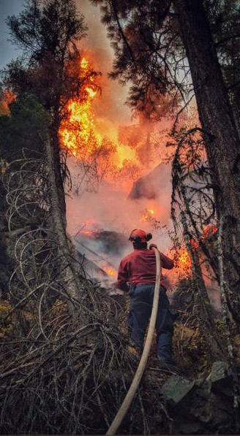
Supplier Onboarding - Invitations
How BC Wildfire Service will onboard Suppliers to Use the Vendor Portal
BCWS will send an initial email invitation to the primary “Admin” user for each Supplier
A registered “Admin” can then send email invitations to other users in their company to give them access to the Vendor Portal
Each Vendor Portal user requires their own Business BCeID account and unique email address

Slide 7
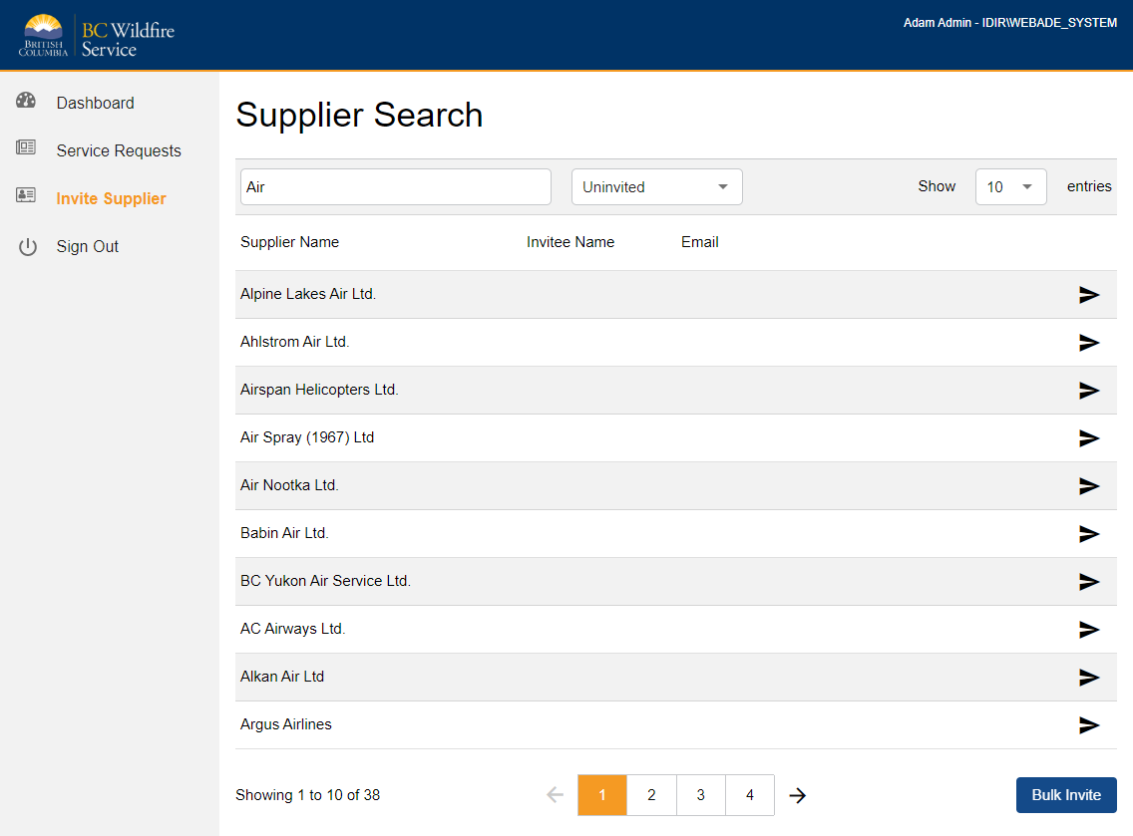
BCWS - Select Supplier to Invite

Slide 8
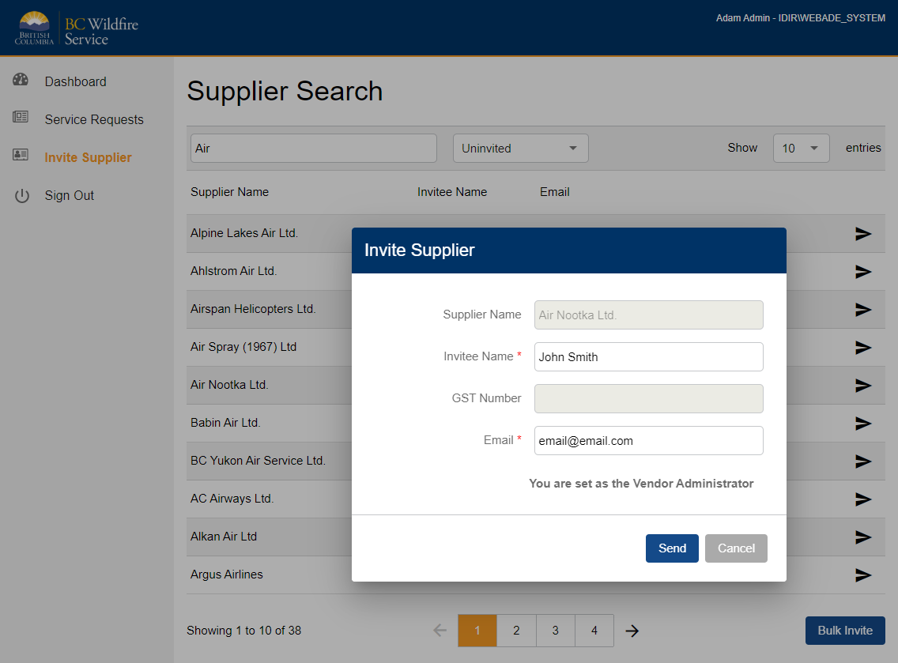
BCWS - Invite Supplier

Slide 9
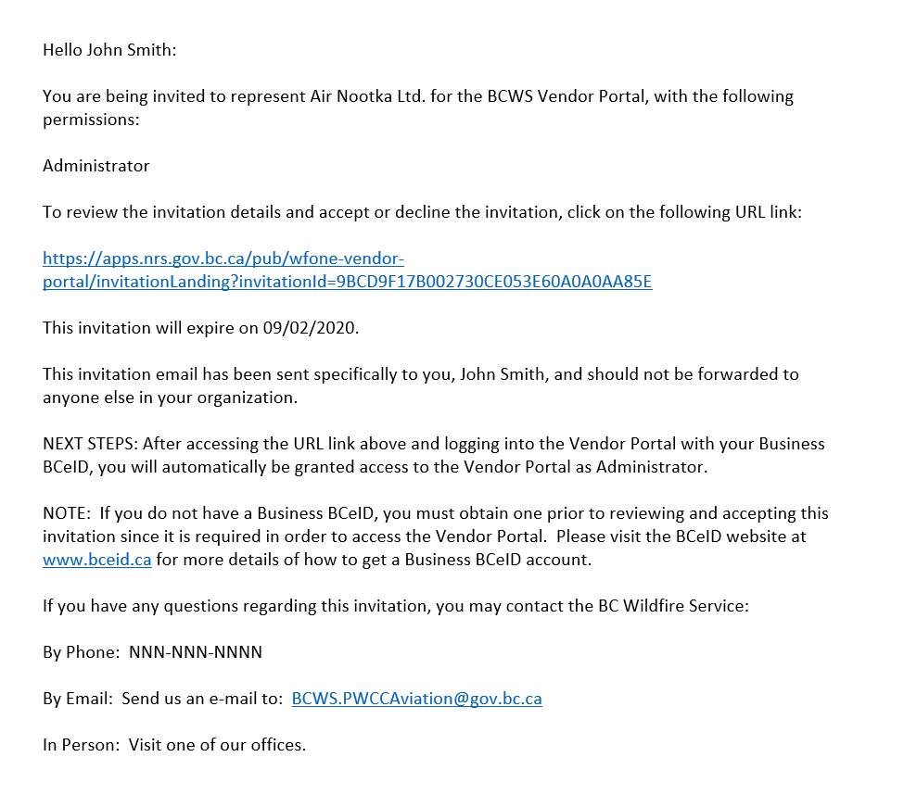
Supplier – Receive Invite Email

Slide 10
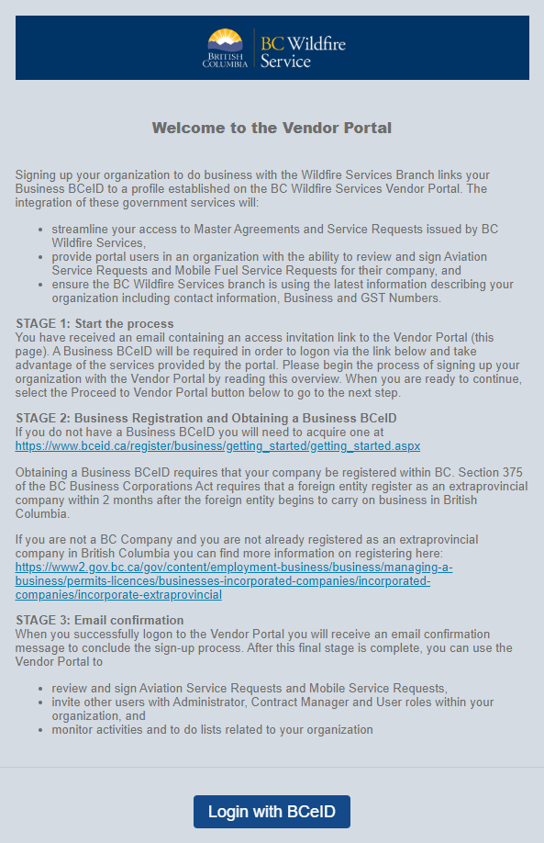
Welcome to Vendor Portal

Slide 11
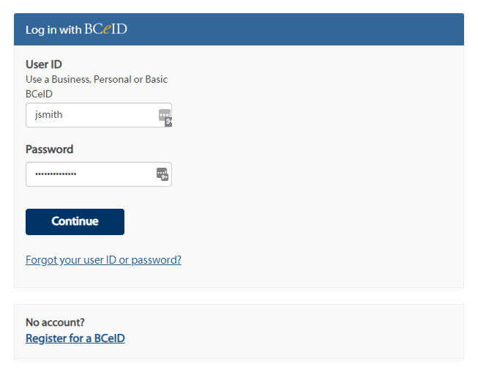
BCeID Login

Slide 12
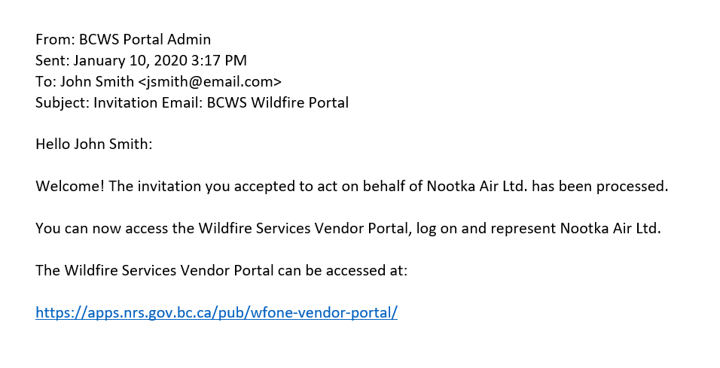
Registration Complete Email

Slide 13
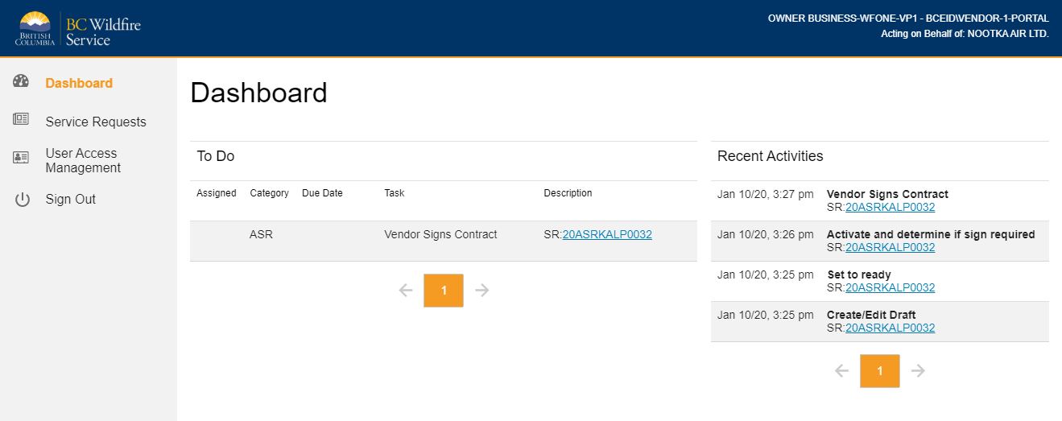
Default Screen - Dashboard

Slide 14
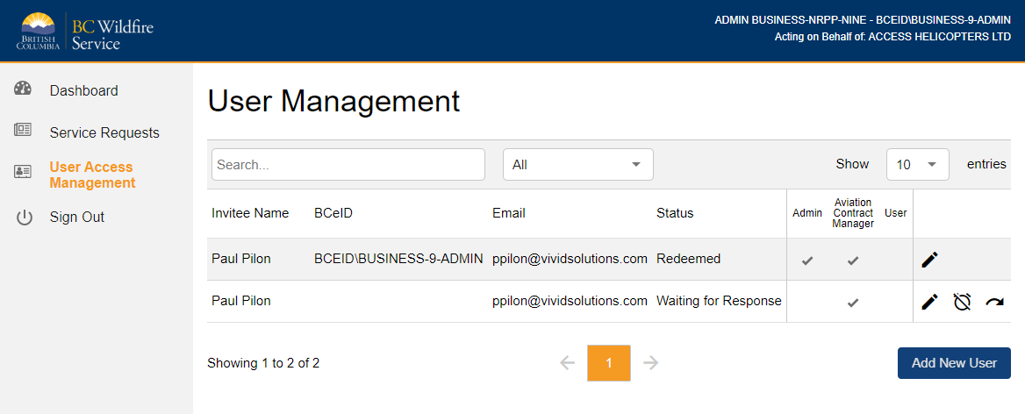
Supplier - Managing User Access
Administrator – Manage other users for your organization
Aviation Contract Manager – Review and Sign/Decline Aviation Service Requests
User – Review Aviation Service Requests only

Slide 15
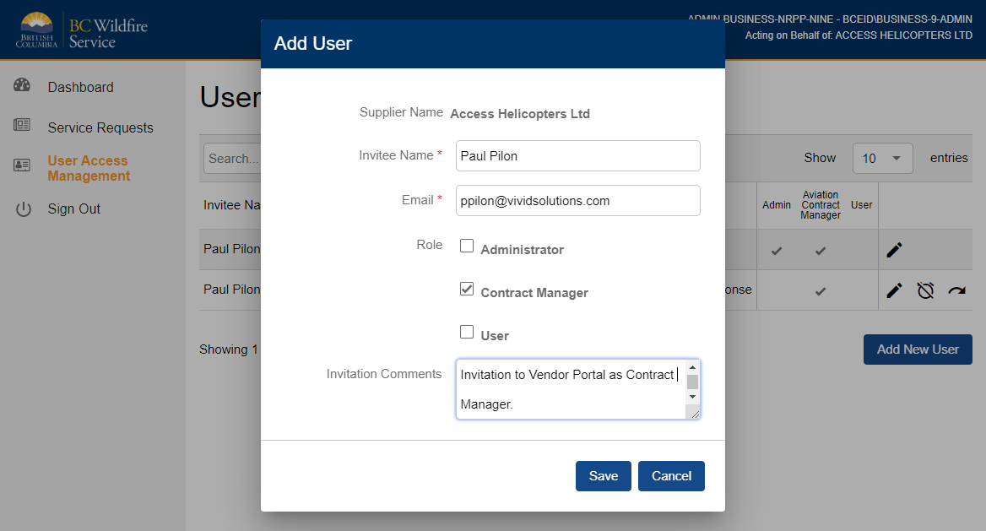
Supplier - Adding a New User

Slide 16
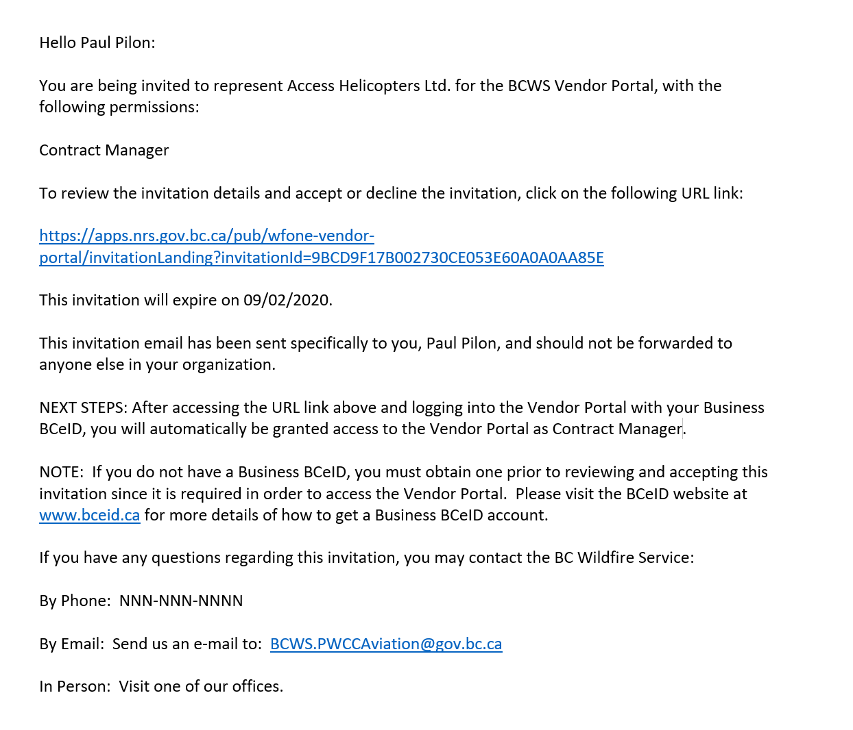
Supplier - Invitation Email

Slide 17





Aviation Service Request - Flow
BCWS Creates New ASR
Set to Ready for Signing
Supplier Email Notification
Supplier Signs ASR
BCWS Email Notification
BCWS Signs ASR
Supplier Email Notification

Slide 18
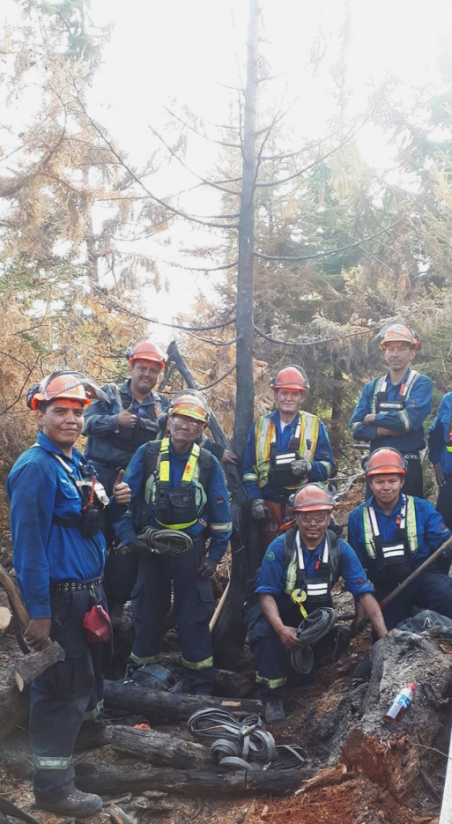
Aviation Service Requests - Signing
ASR signing and acceptance will be managed via the Vendor Portal
Email notifications are sent to Suppliers when an ASR is ready to be signed
The Aviation Contract Manager role restricts which users can sign ASRs for a Supplier
Signing an ASR will be a simple “push button” process
Signed ASRs will remain available to view online for future reference

Slide 19
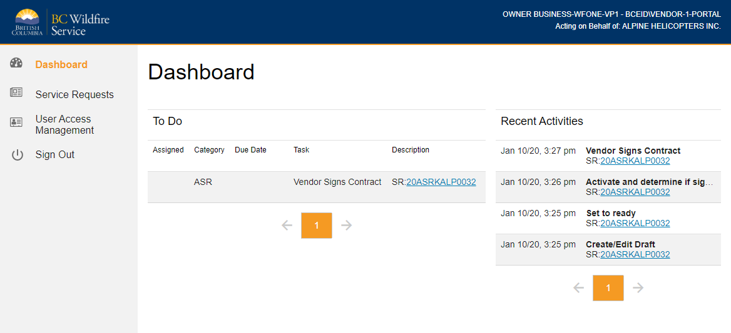
Vendor Portal Dashboard
To Do – List of Service Requests that need to be reviewed and signed by Supplier
Recent Activities – Dated list of the workflow stages of Service Requests

Slide 20
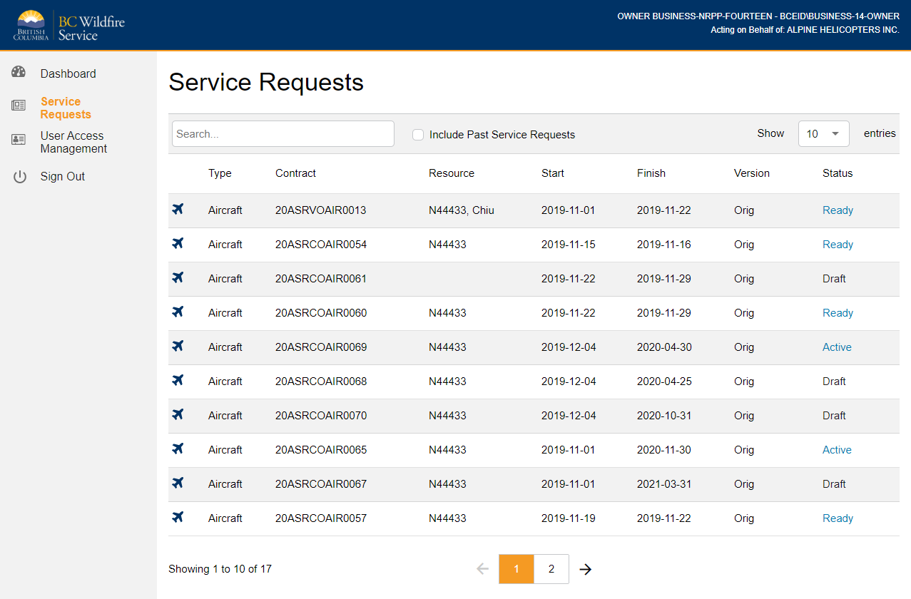
View Service Requests

Slide 21
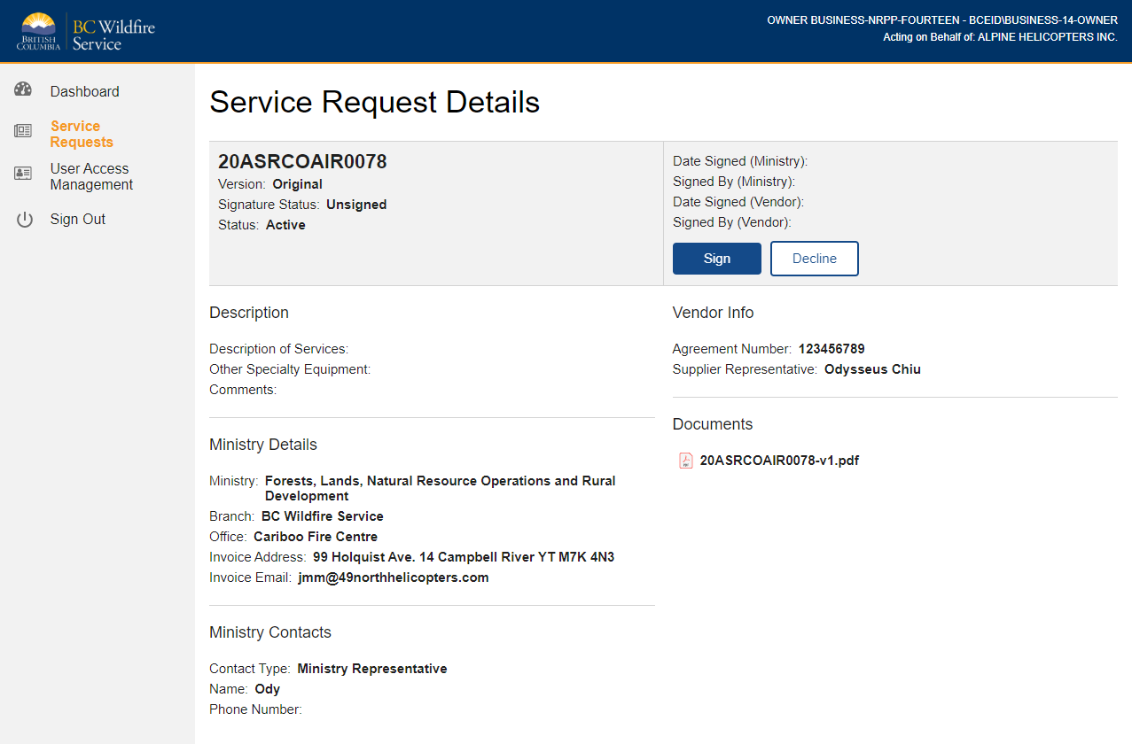
Service Request Details

Slide 22
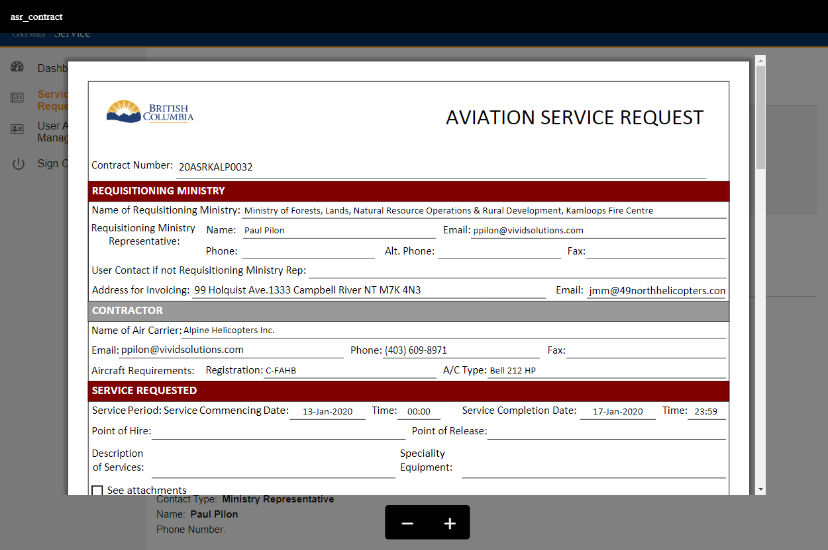
View ASR PDF

Slide 23
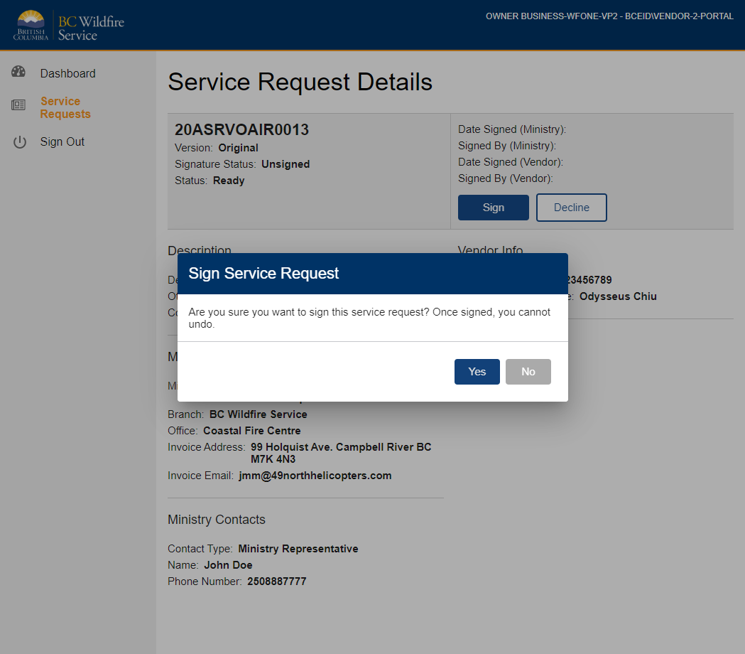
Sign Service Request

Slide 24
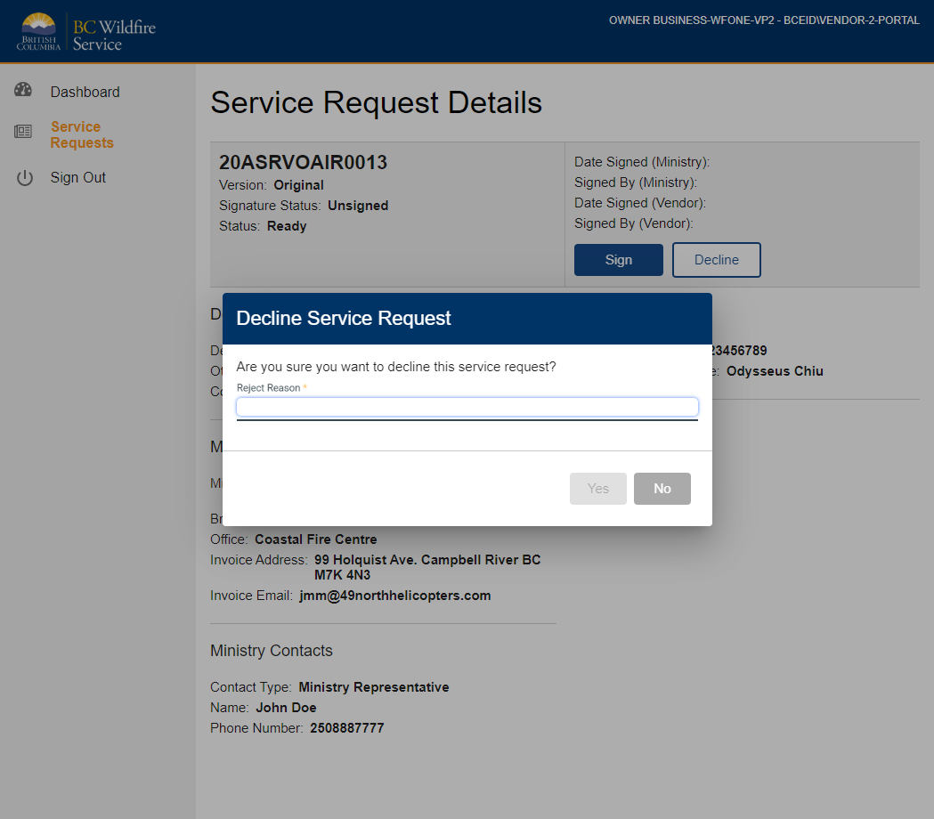
Decline Service Request

Slide 25
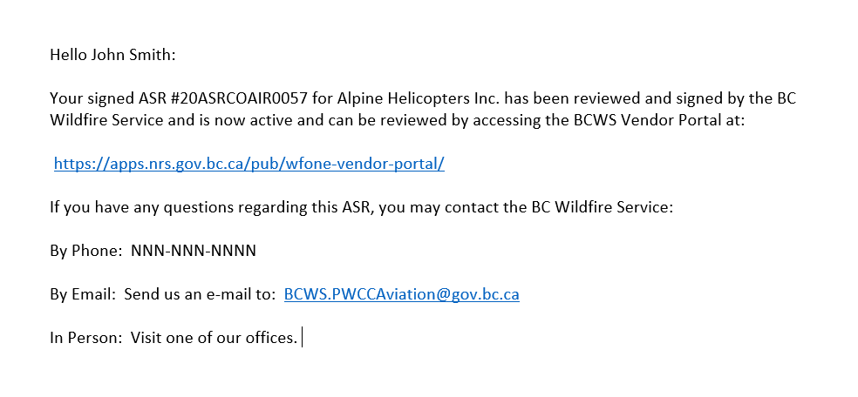
Confirmation email - ASR Signed by BCWS

Slide 26

Portal Questions?

Slide 27

What is a BCeID?
BCeID is an electronic credential that can be issued to a company to enable staff from that company to do business digitally with the Province of British Columbia.
Notes:
Lauren

Slide 28
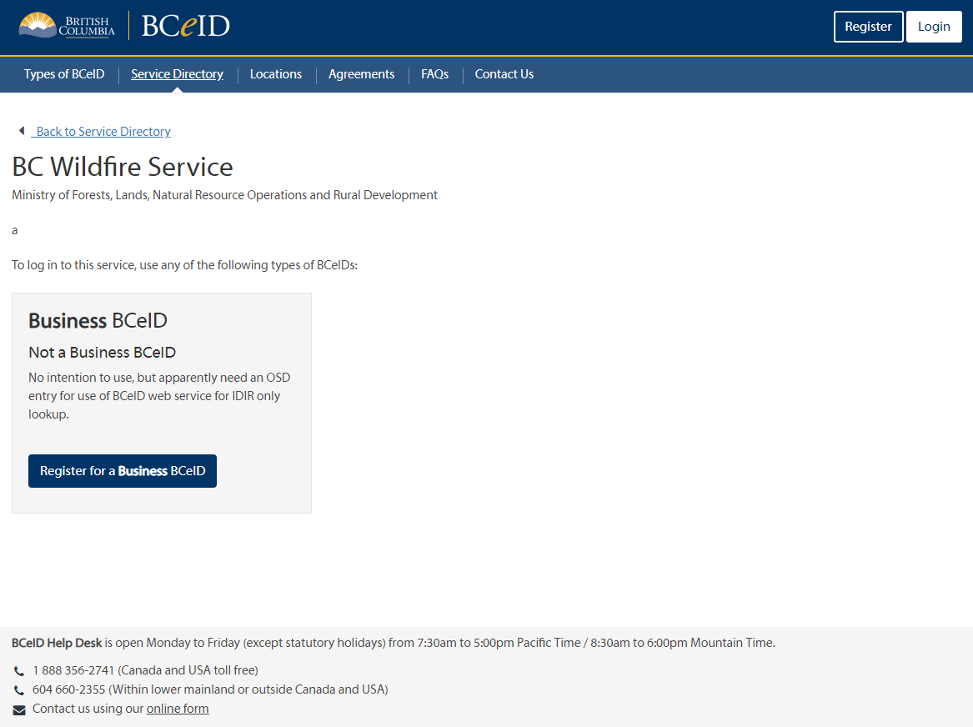
How to Register for a Business BCeID
Notes:
Lauren

Slide 29
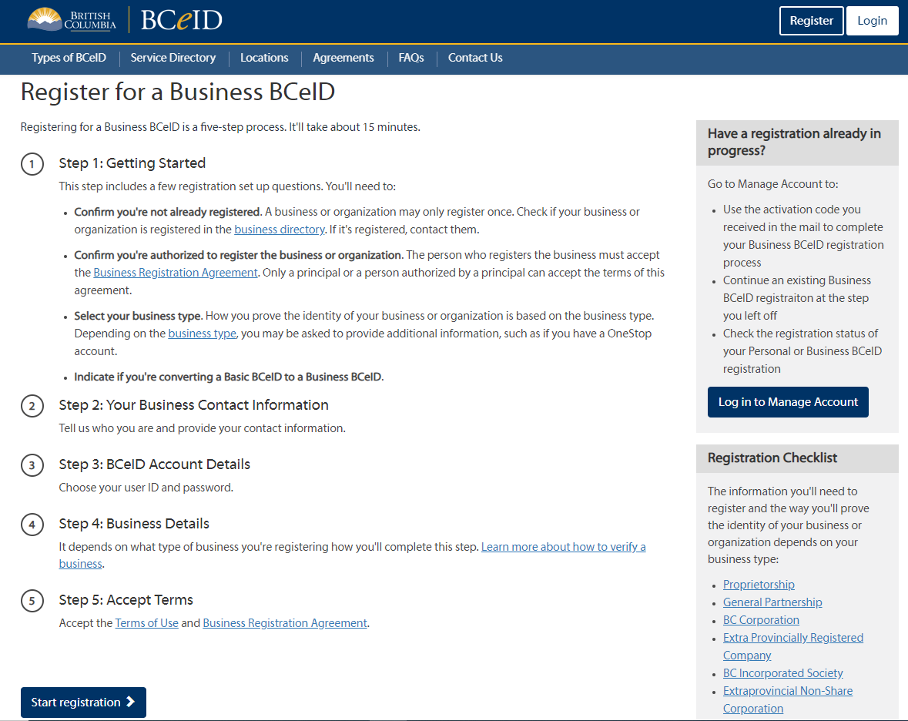
Register for a Business BCeID
Notes:
Lauren

Slide 30
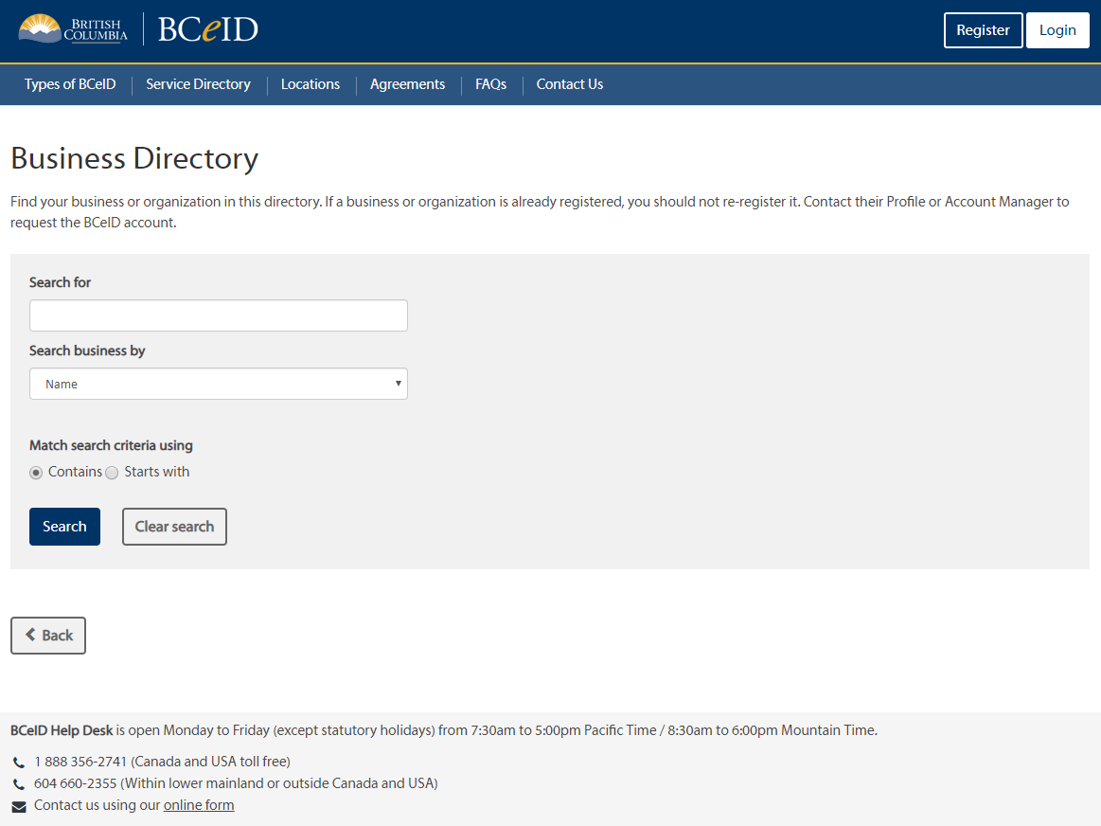
Business Directory
Notes:
Lauren

Slide 31
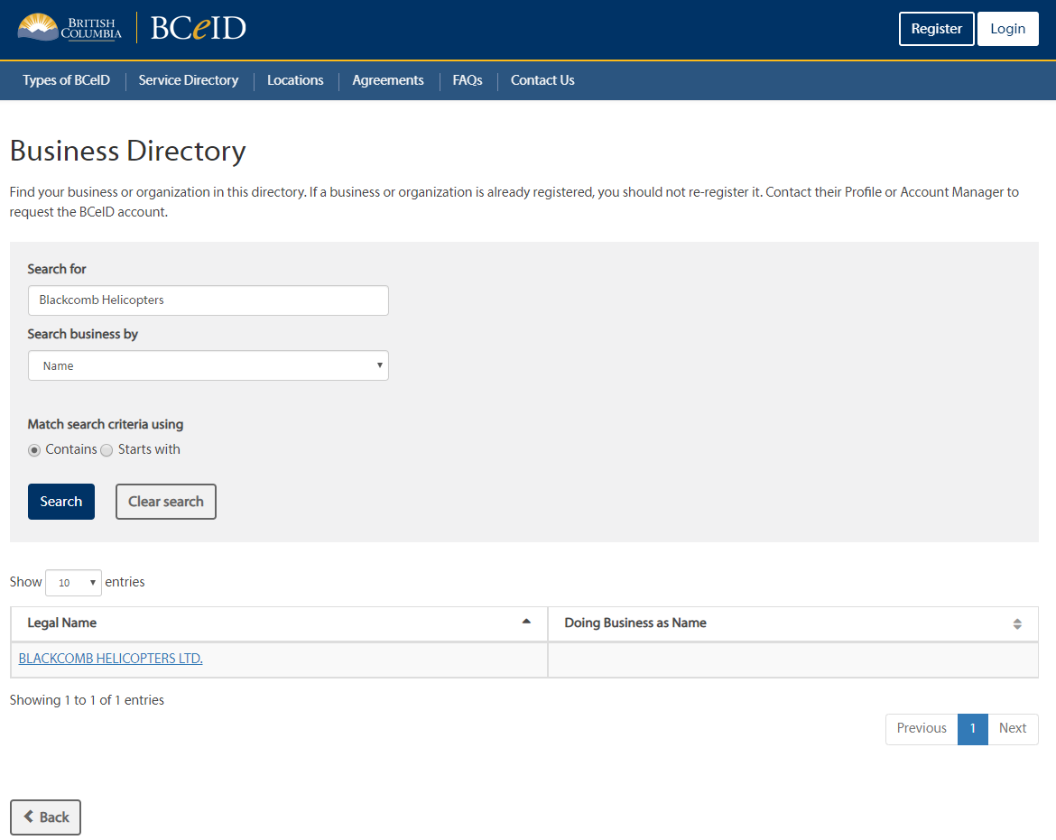
Business Directory
Notes:
Lauren

Slide 32
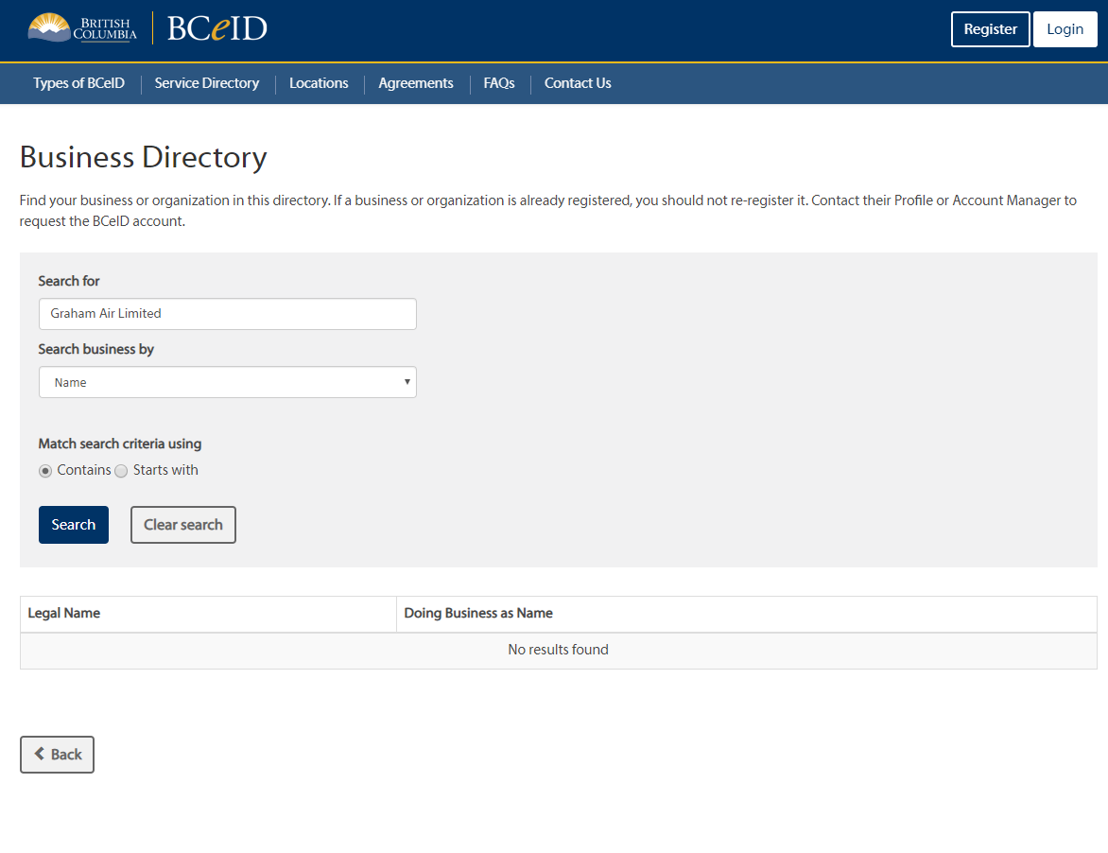
Business Directory
Notes:
Lauren

Slide 33
Register for a Business BCeID
Notes:
Lauren

Slide 34
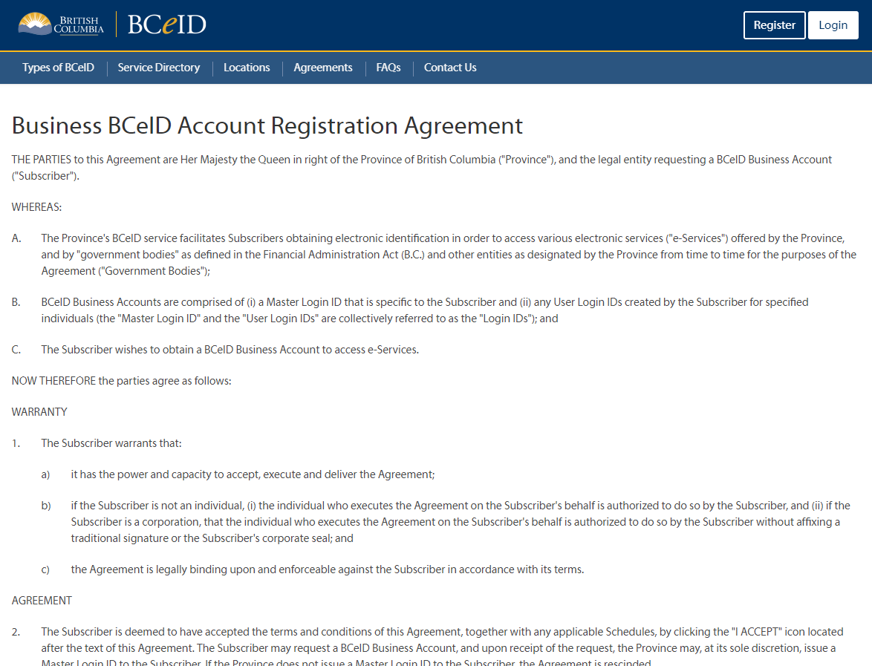
Account Registration Agreement
Notes:
Lauren

Slide 35
Register for a Business BCeID
Notes:
Lauren

Slide 36
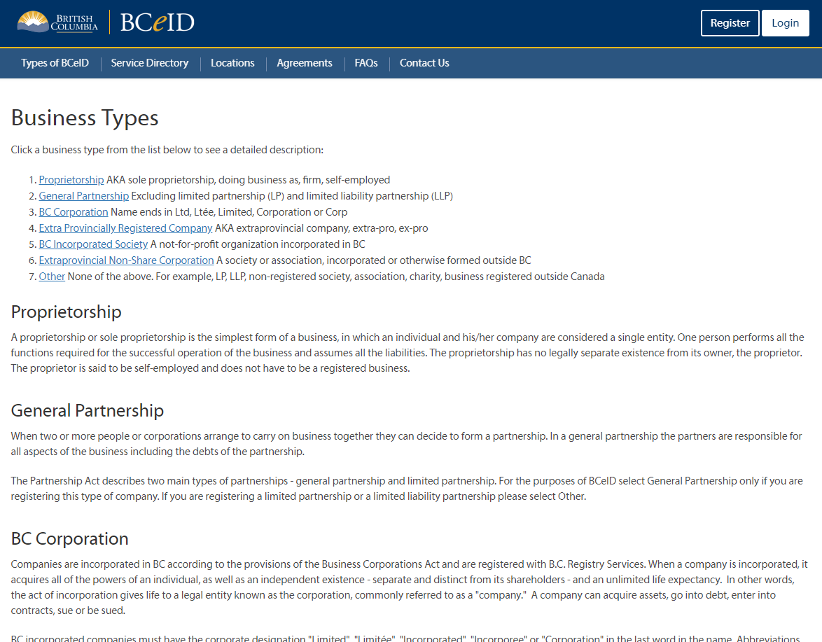
Business Types
Notes:
Lauren

Slide 37
Business Contact Information
Notes:
Lauren

Slide 38
BCeID Account Details
Notes:
Lauren

Slide 39
Business Details
Notes:
Lauren

Slide 40
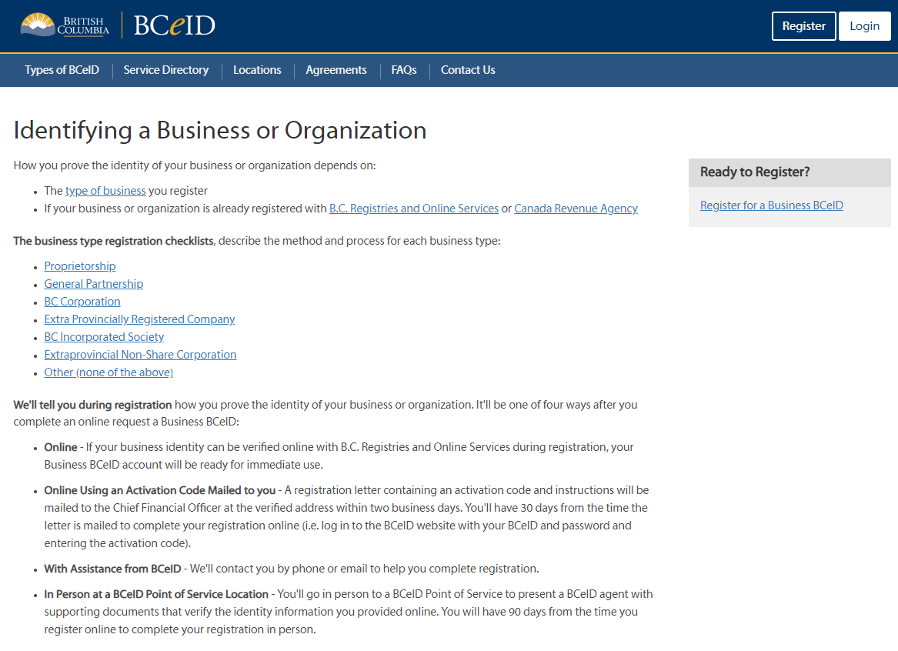
Identify a Business or Organization
Notes:
Lauren

Slide 41
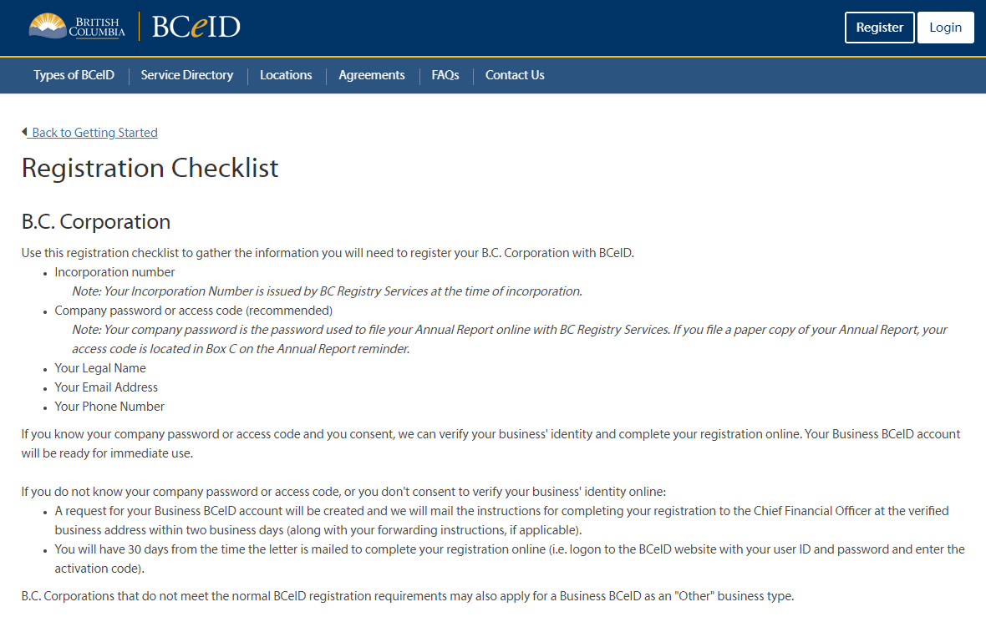
BC Corporation
Notes:
Lauren

Slide 42
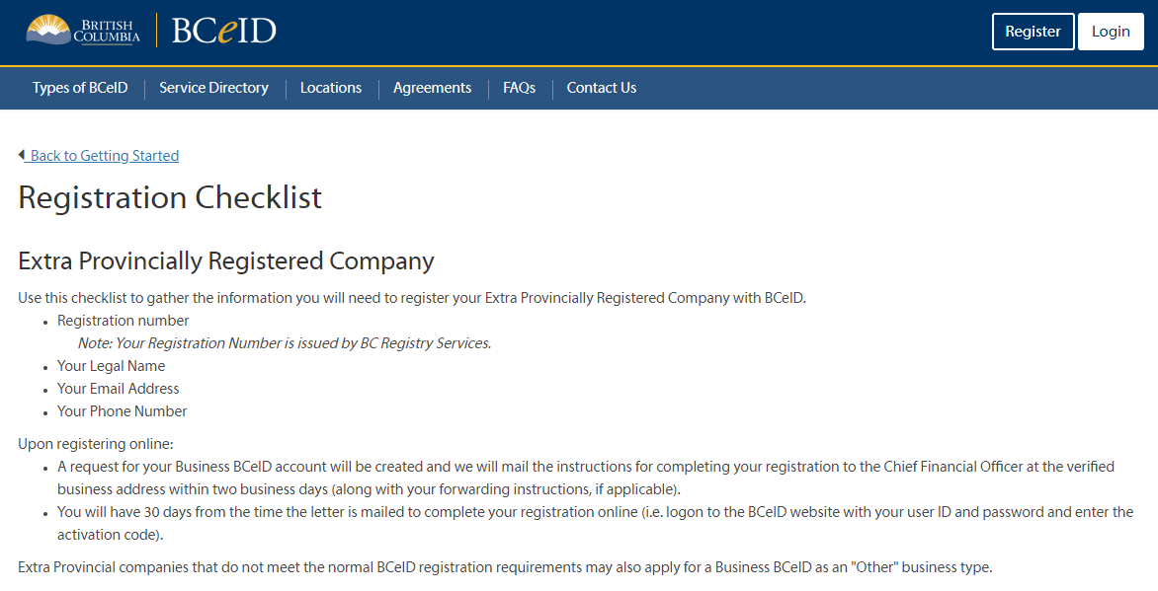
Extra Provincially Registered Company
Notes:
Lauren

Slide 43
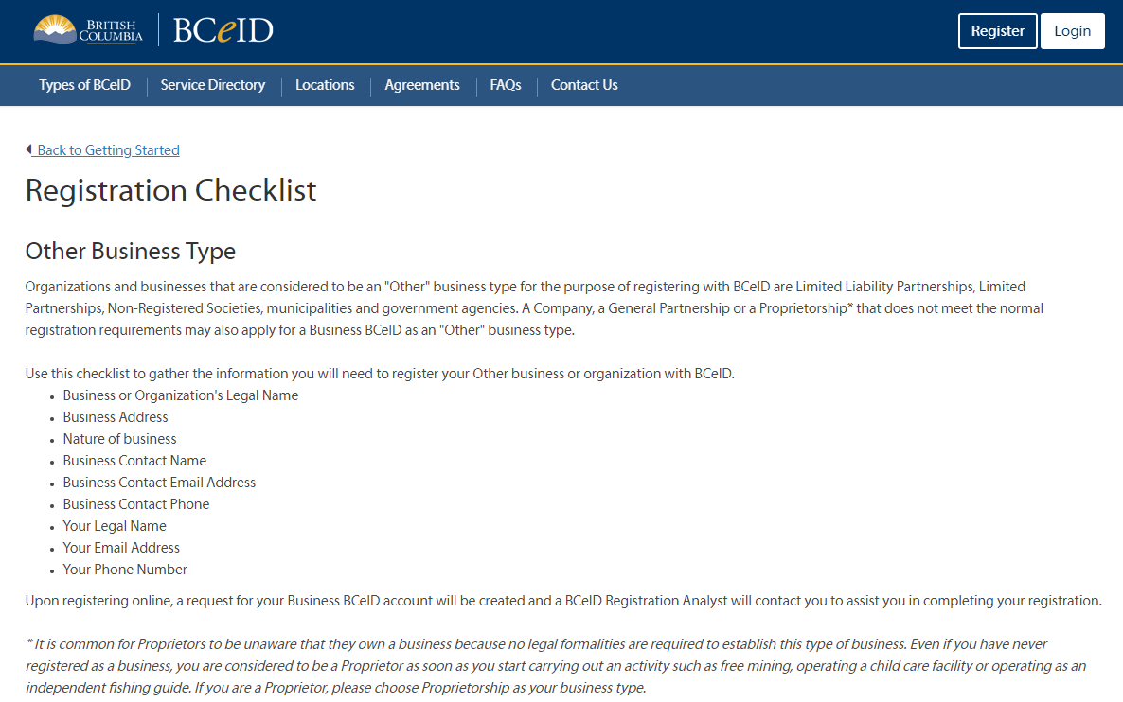
Other
Notes:
Lauren

Slide 44
Accept Terms
Notes:
Lauren

Slide 45
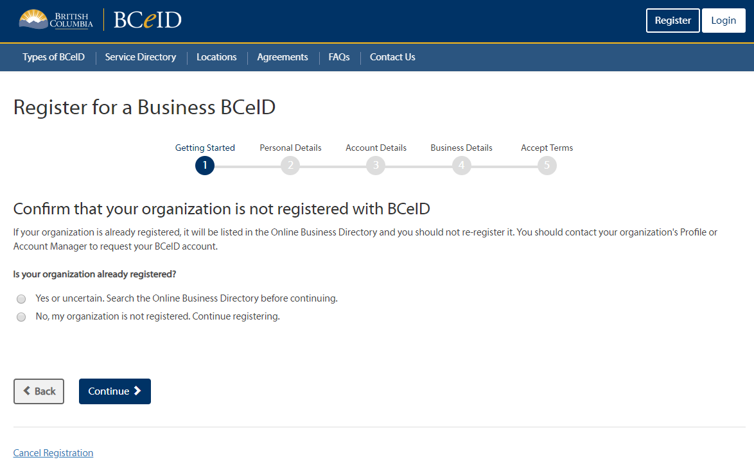
Start Registration
Notes:
Lauren

Slide 46
Log in to Manage Account
Notes:
Lauren

Slide 47
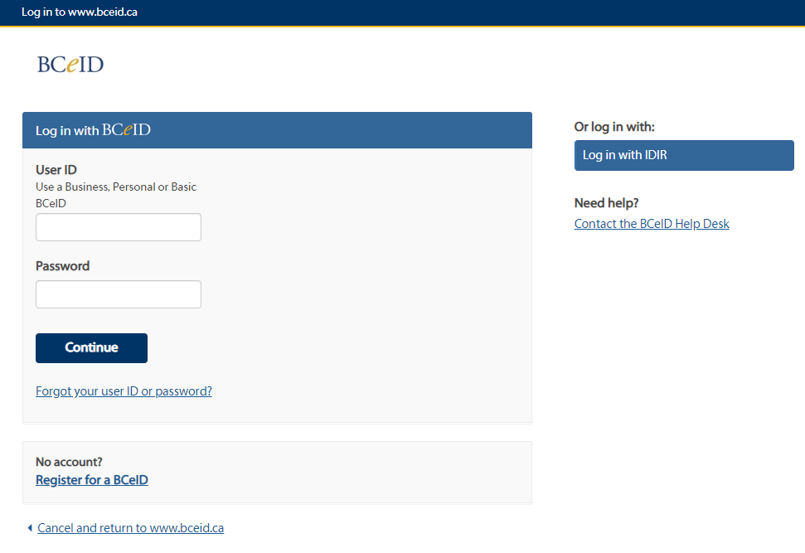
Login Screen
Notes:
Lauren

Slide 48
BCeID Help Desk Information
BCeID Help Desk is open Monday to Friday (except Statutory holidays) from 7:30am to 5:00pm Pacific Time.
1 888 356-2741 (Canada and USA toll free)
604 660-2355 (Within lower mainland or outside Canada and USA)
Or contact them using their online form
Notes:
Lauren

Slide 49
BCeID Questions?

Slide 50
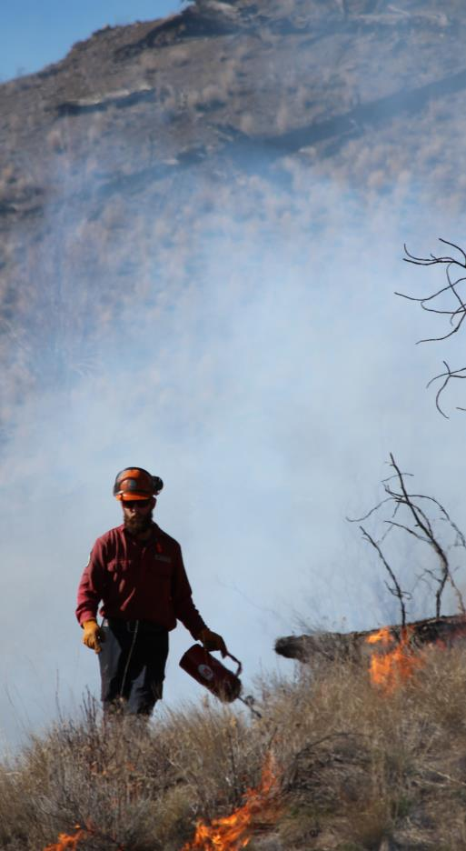
Project Timeline
BCeID Registration
Now
April 2020
Vendor Portal Onboarding
Signing ASRs
2020/2021

Slide 51

What’s Next?
Verify you have a Business BCeID
Start BCeID Registration if you need one
Create BCeID accounts for employees that will be signing ASRs
Stay Tuned for Updates!!!
Any further questions contact: BCWS.PWCCAviation@gov.bc.ca

Slide 52

Thank you

