Slide 1

Fraud Awareness for ESS

Slide 2

Objectives & Outcomes
Once you have completed this module, you will…
Be able to define fraud
Have a better understanding of fraud as it relates to Emergency Support Services (ESS) & Evacuation Registration and Assistance (ERA)
Understand responsibilities as a Public Safety Lifeline Volunteer (PSLV)
Know how to recognize and report
Notes:
Welcome to EMCR Fraud Awareness for ESS.
In this presentation we will define fraud and discuss it in relation to Emergency Support Services and the Evacuee Registration and Assistance tool, ERA. We will also provide practical tips for awareness to help better recognize fraud, discuss responsibilities as a Public Safety Lifeline Volunteer, and give you ways to report suspected fraud.

Slide 3

What is Fraud?
Wrongful or criminal deception intended to result in financial or personal gain.
Intentional misrepresentation of the truth with the objective of gaining a benefit.
Notes:
There are two straightforward definitions of fraud:
The wrongful or criminal deception intended to result in financial or personal gain.
And
Intentional misrepresentation of the truth with the objective of gaining a benefit.
As a responder the focus is always on delivering ESS with care and empathy, however we do need to remember some people will attempt to take advantage of any situation for personal gain. Under no circumstance will the responder be asked to police a potential situation, this is to simply make us aware of certain aspects of potential fraud.

Slide 4

Examples of attempted fraud & ESS
Unconfirmed ESS events
Exaggerating or changing number of family members
Doctoring referral forms
Using a fake address
Notes:
Examples of attempted fraud during evacuation events usually occur at the ground level and can be difficult to recognize. One example could be unconfirmed ESS events, those without a task number, being referenced by an evacuee in an attempt to receive supports; an evacuee may state greater losses or exaggerate or change number of family members to increase money amount to be transferred.
A most recent example involved an altered referral form where a fraudster was able to change the supplier names and amounts. Next, they visited multiple suppliers and started to purchase gift cards. With the help of the suppliers and good communication, the person was tracked down.
It was found out during the incident that the fraudster used a fake address to indicate they lived in the affected area.
Emailing referrals directly to an individual is strictly prohibited, they should only be sent directly to a supplier from a local government or Indigenous governing body email address . If an evacuee requests it be sent to them, this could be a red flag and it is best to report this up to a supervisor or RC manager.
Another example in the past was claiming to be someone else to receive a second ESS claim. The use of the BC Services card makes this one more difficult but nonetheless, it can be attempted.

Slide 5

Wise practices
Interview with care, accuracy and awareness
Know the local area/engage a Community Navigator
Never send referrals directly to evacuees
Support suppliers training i.e local ESS number to call for clarification
Notes:
Some wise practices recommended to help mitigate the opportunity for someone to attempt fraud are:
Interview with care, accuracy and awareness – Patience and empathy should always guide the conversation and you should identify any concerns to a supervisor. Be sensitive that family make ups can vary, however one flag to be mindful of is the adding of new family members to a file.
Be aware of the current situation in the area, for example, evacuation alerts, orders, and other local knowledge that could be helpful in flagging potential fraud attempts such as fake addresses or areas that may not be on alert.
There could be a community navigator you can access to ask about certain things should you want to clarify anything or find out more local knowledge.
As the example in the previous slide mentioned, Absolutely never send a referral directly to an evacuee.,
It can happen that fraud is not suspected or seen by the responder, however suppliers may have the ability to notice something wrong so support for suppliers training is recommended. Give them a number to call, provide them with knowledge of rates and allowed expenditures

Slide 6

Responsibility
Public Safety Lifeline Volunteer - Code of Conduct Policy 1.02
Volunteers will carry out their duties to the best of their abilities
Volunteers represent provincial and local governments
Notes:
As a responder your responsibility when representing your local government, EMCR and the government of British Columbia, is bound to the Public Safety Lifeline Volunteer code of conduct.
This is Policy 1.02
This policy was developed in consultation with representatives from each of the five PSLV Disciplines, Tasking Agency representatives, and Local Government, to establish volunteer expectations through a Code of Conduct. The purpose is to identify standards of behaviour by which all volunteers registered with EMCR must abide. This can be found on the emergency management policies website.

Slide 7
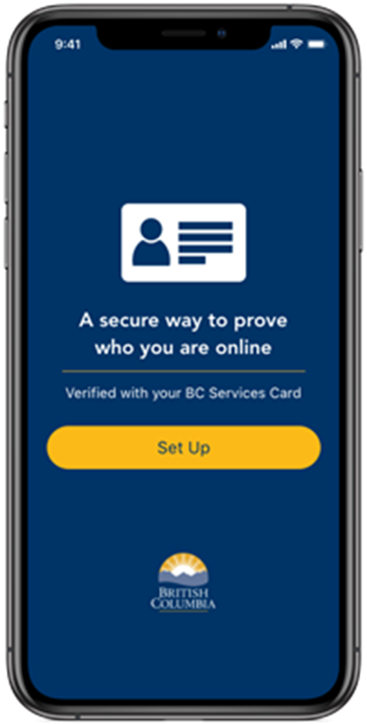
Fraud & ERA – Current Processes
BC Services card app is required by evacuee for Interac e-Transfer
BCeID is required by responder to access the system
Active task number is needed to issue supports
Notes:
There are current processes currently in place that helps limit access and provides oversight to transactions on ERA
In terms of the ability to access the tool and provide supports,
A BC Services Card app is needed for authentication as a recipient to receive an e-transfer. This helps confirm identity and address.
A BCeID is needed as a responder to issue the electronic money transfers. This supports the training and financial risk and control for the volunteers in relation to their ability to send government funds to evacuees.
Another layer of the financial risk and control piece is responders can only use ERA and issue supports when signed into active task number.
All these play an important role in mitigating fraud attempts and controls the ability to send and receive funds to those recognized by the system.

Slide 8
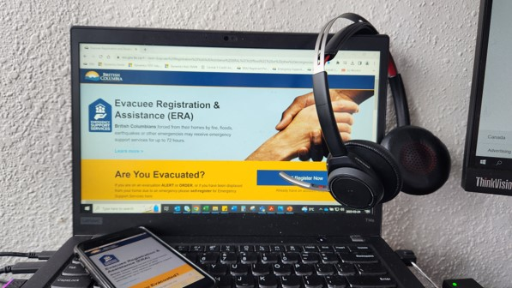
Fraud & ERA – Current Processes
Flagging mechanisms are in place for overpayment or double payment.
An EMCR expense authority manually reviews any flagged transaction.
An EMCR expense authority has the ability to cancel transactions.
Notes:
In addition to access,
Several automated alerts are in place to prevent overpayment and double payment. These get flagged by the system and manually reviewed by an EMCR expense authority.
This is another level of security built into the ERA system that can prevent fraud while also catching any mistakes that can occur in the process.
For example:
Any amount above what is eligible is flagged and manually reviewed by EMCR expense authority ,
Responders issuing two e-transfers for same support or recipient in same time frame will be flagged and manually reviewed by EMCR expense authority. This is not always a fraud attempt and actually quite often just an innocent oversight or typo.
However, in keeping with the financial risk and control piece of training and the ability to e-transfer, all electronic transfers are reviewed throughout the day and on the weekends during response activities.

Slide 9

What to do when you suspect fraud.
Report to supervisor or Reception Centre manager.
ess.reporting@gov.bc.ca
This email is monitored regularly by EMCR staff and should be used after an internal discussion has occurred
Notes:
If there is fraud suspected, under no circumstances should you confront the evacuee. Volunteers are not expected to police or take responsibility for fraud attempts. There are two straightforward approaches for a responder to take.
Within a reception centre there is a defined reporting structure so know who your supervisor or Reception Centre manager is when you start your shift and you can report suspicions to them.
The first step is to bring concerns to a reception centre manager
In addition, EMCR has a reporting email that is monitored regularly by EMCR staff. Talk internally about your questions or concerns, then you can use the reporting email.

Slide 10
Fraud Awareness for ESS
Notes:
Thank you for watching this presentation on fraud awareness.

