Slide 1
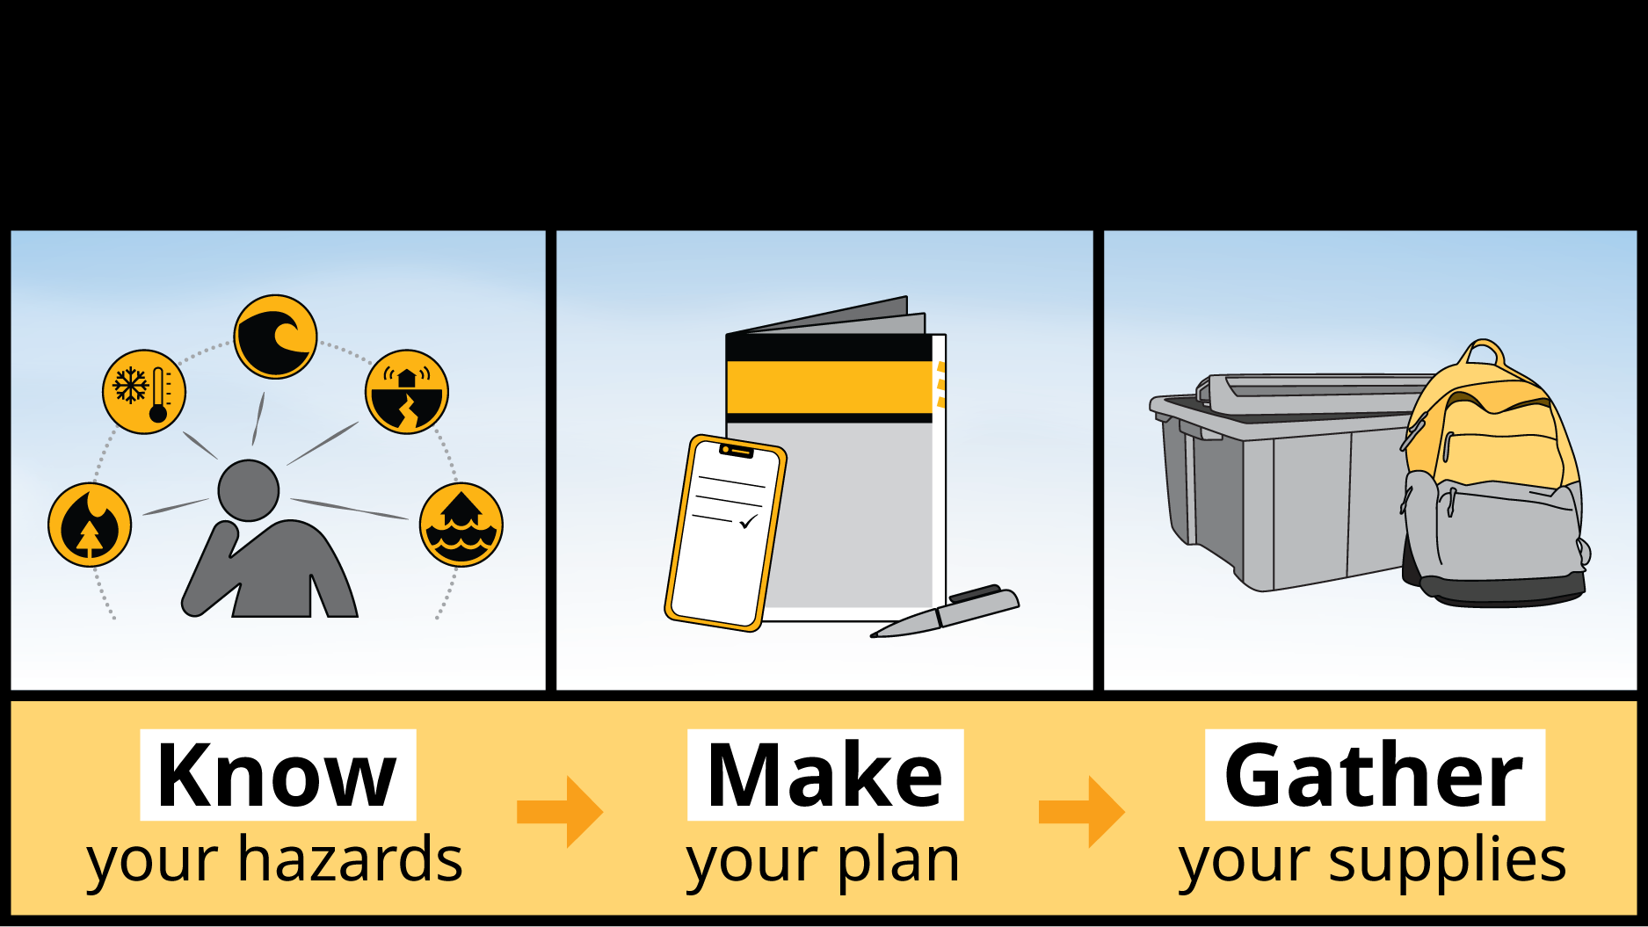
Personal Preparedness Workshop
Notes:
Introduction slide:
Presenter(s) introduce themselves
Acknowledge speaking from the Traditional Territory and Ancestral Homeland of the local First Nation(s)
Describe the topic of the presentation

Slide 2
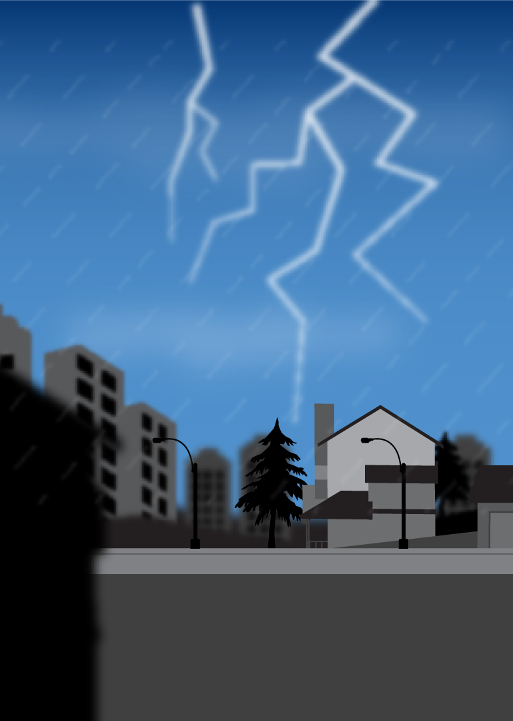

Have you ever thought about how to prepare for an emergency?
What if you:
Didn’t have electricity or water for 3 days to 2 weeks?
Had to leave your home on short notice?
Needed to contact your family and get official information during an emergency?
Notes:
After introductions, begin a group brainstorming question:
Find out what group is already doing, and add sense of urgency to those who haven’t done anything
For the most part, there are no right/wrong answers – you will be elaborating on the answers throughout the presentation

Slide 3
of British Columbians say they have an emergency response plan, although
only 13% describe their plan as “complete”
54%
Notes:
PreparedBC conducted a Personal Preparedness Survey in December 2017 to understand whether British Columbians are ready for emergencies. The results showed that many aren’t.
Overall, 54% of British Columbians say their household has an emergency response plan, although only 13% describe their plan as 'complete’. Among those with a plan, only about one-third (36%) say that at least some of the plan is written down.
After discussion, ask:
How many of you think having an emergency plan and emergency supplies is important?
2. How many of you have actually created an emergency plan and emergency kit? Would you be able to use it if an emergency happened tomorrow?
Being prepared could mean that you need to shelter in place for a minimum of 3 days to 2 weeks, or it could mean you need to evacuate your home on short notice. In either scenario, your stay at home or at a shelter will be much more bearable with a plan in place and your own emergency supplies.

Slide 4
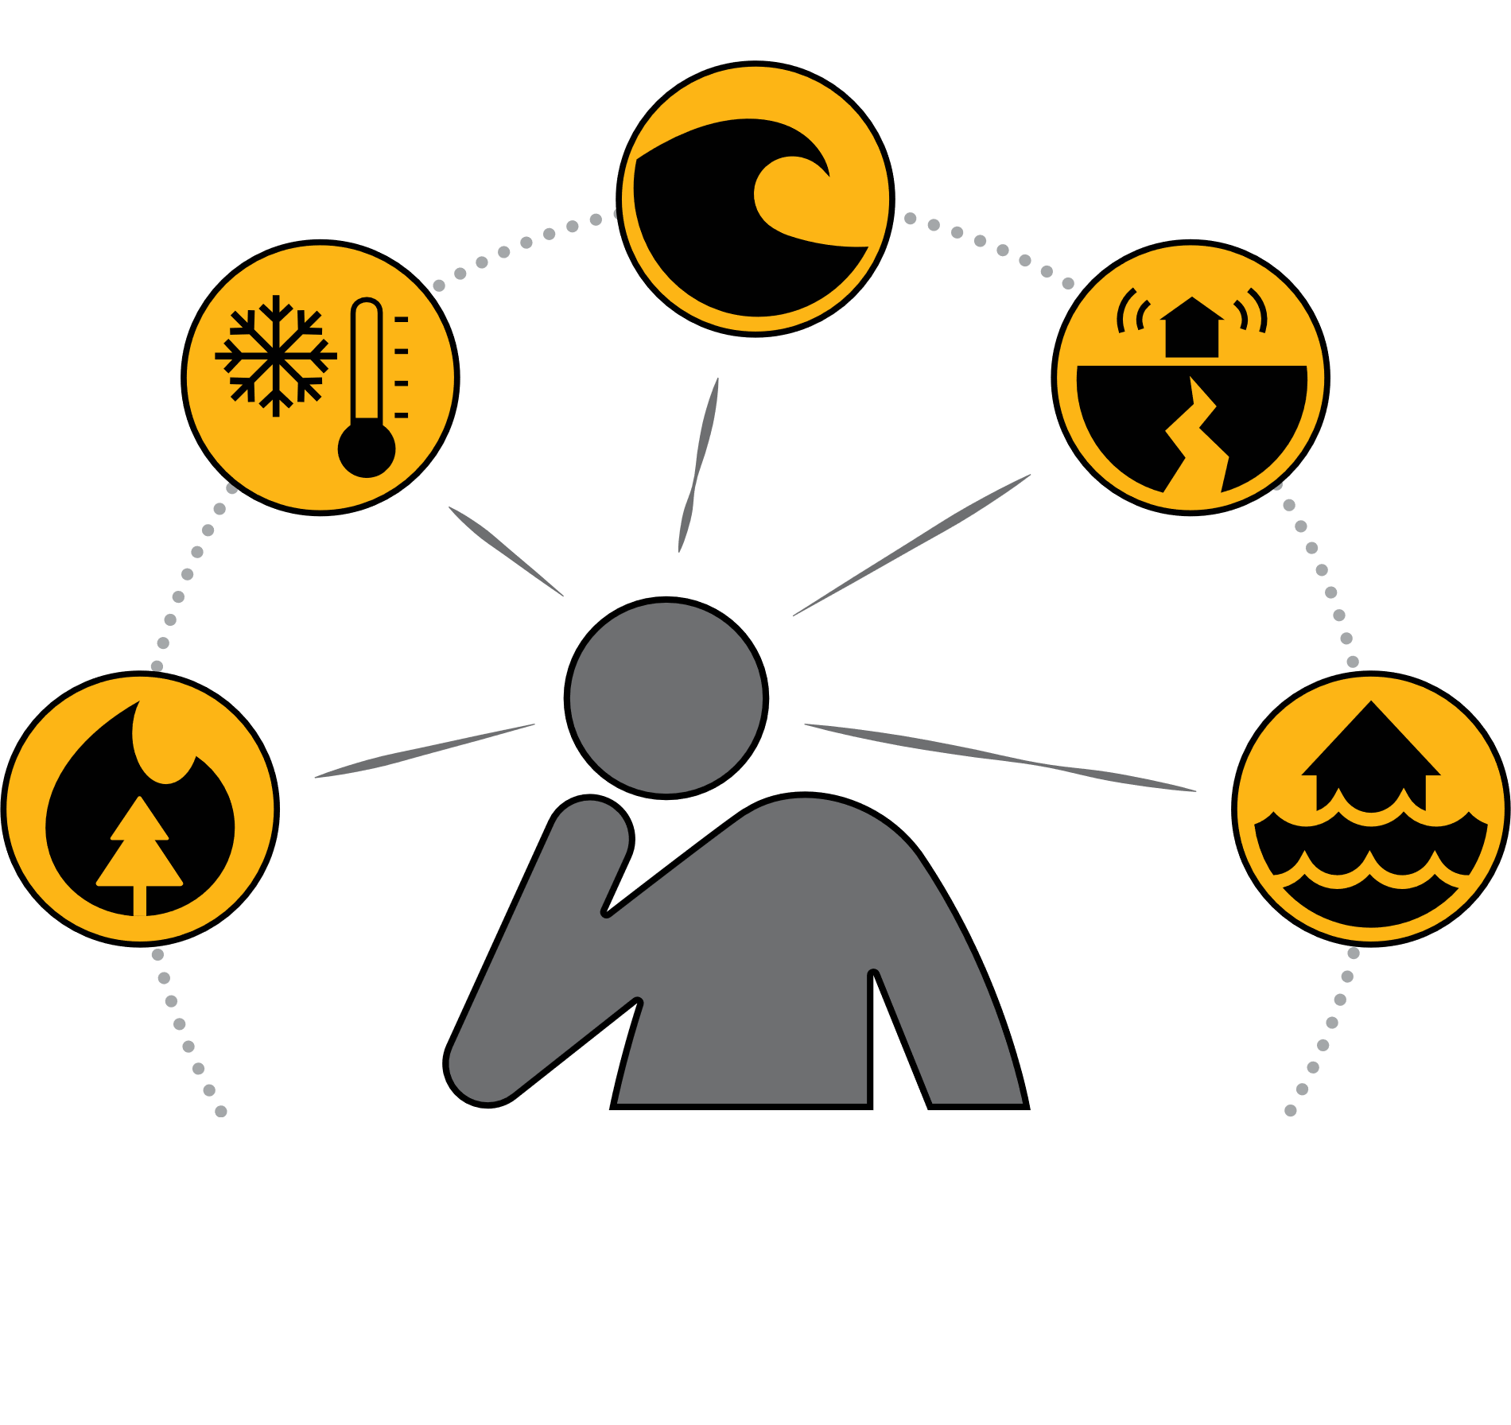
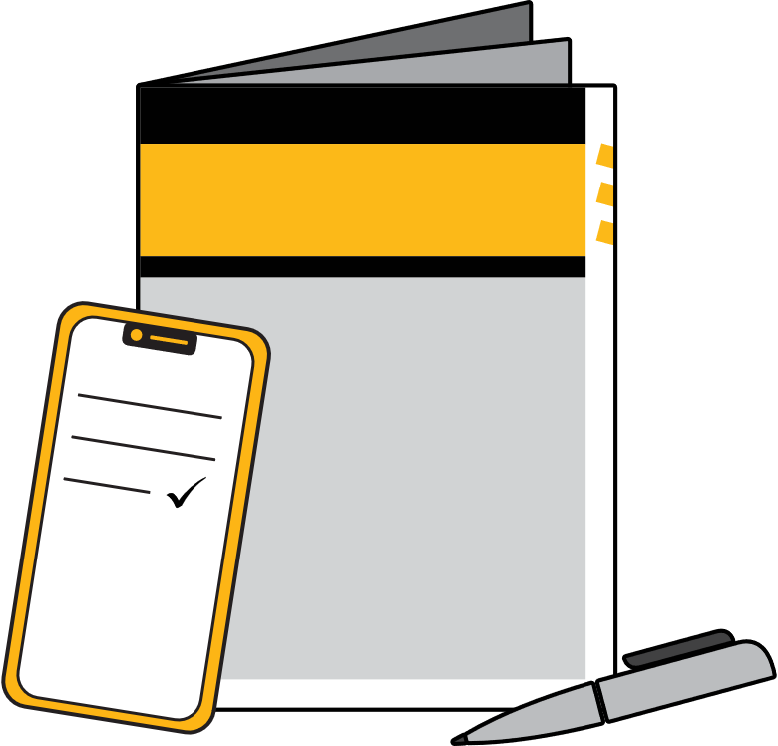
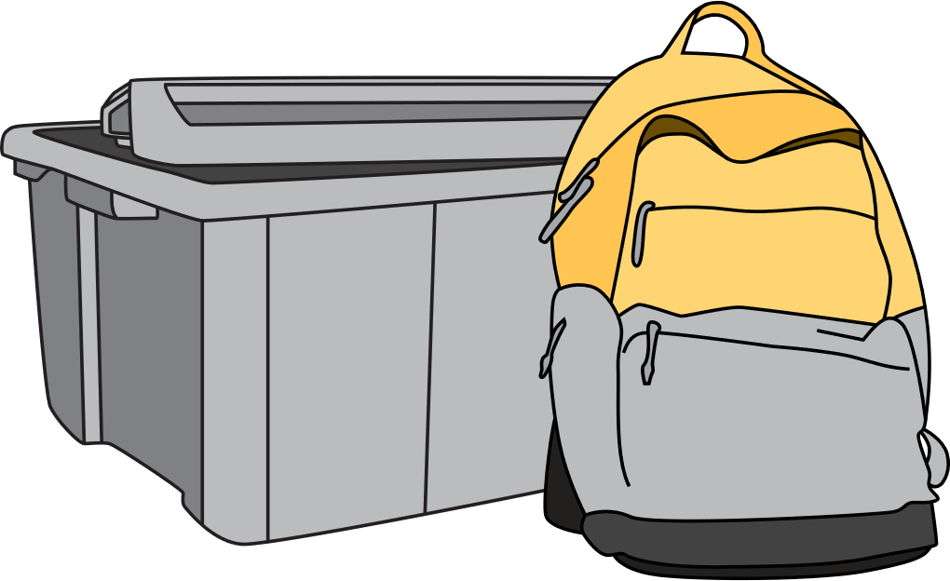
The 3 steps to preparedness:
Know your hazards
Make your plan
Gather your supplies
Notes:
Today we will go over three simple steps to getting prepared for an emergency:
Know your hazards
Make your plan
Gather your supplies

Slide 5
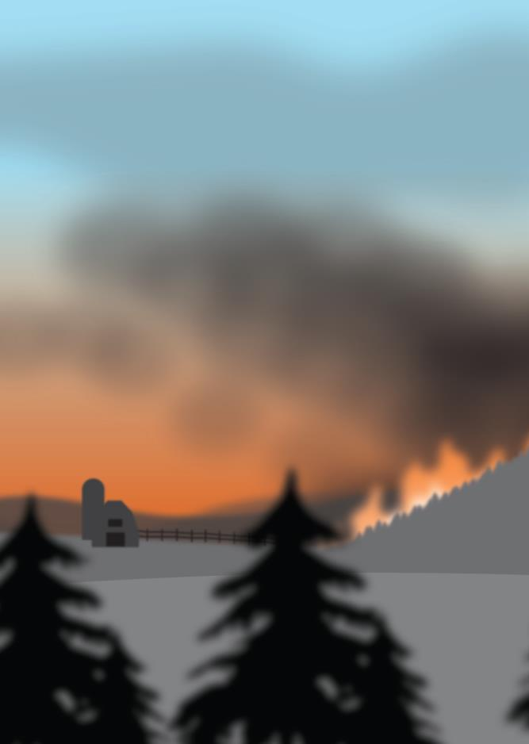
Common misconceptions:
Most emergencies are short-lived
I won’t ever have to deal with an emergency where I live
There are a lot of emergencies I just can’t prepare for
Preparing takes too much time
Notes:
1. Most forms of emergencies are short lived
Use recent examples.
2. I won’t ever have to deal with an emergency where I live
There are many different types of hazards in BC to prepare for. The hazards you need to prepare for will vary depending on where you live, but emergencies can happen anywhere
Tip to presenter: If possible, give examples of incidents in your local area
3. There are a lot of emergencies I just can’t prepare for
There are common consequences that can happen in any emergency such as loss of power, water and telephone service or access to food and medical supplies
If you know your hazards, have a plan, and build a kit you will be prepared for most scenarios
4. Preparing takes too much time
Buying or assembling a kit is easy, and can be even easier when assembled over a period of time

Slide 6
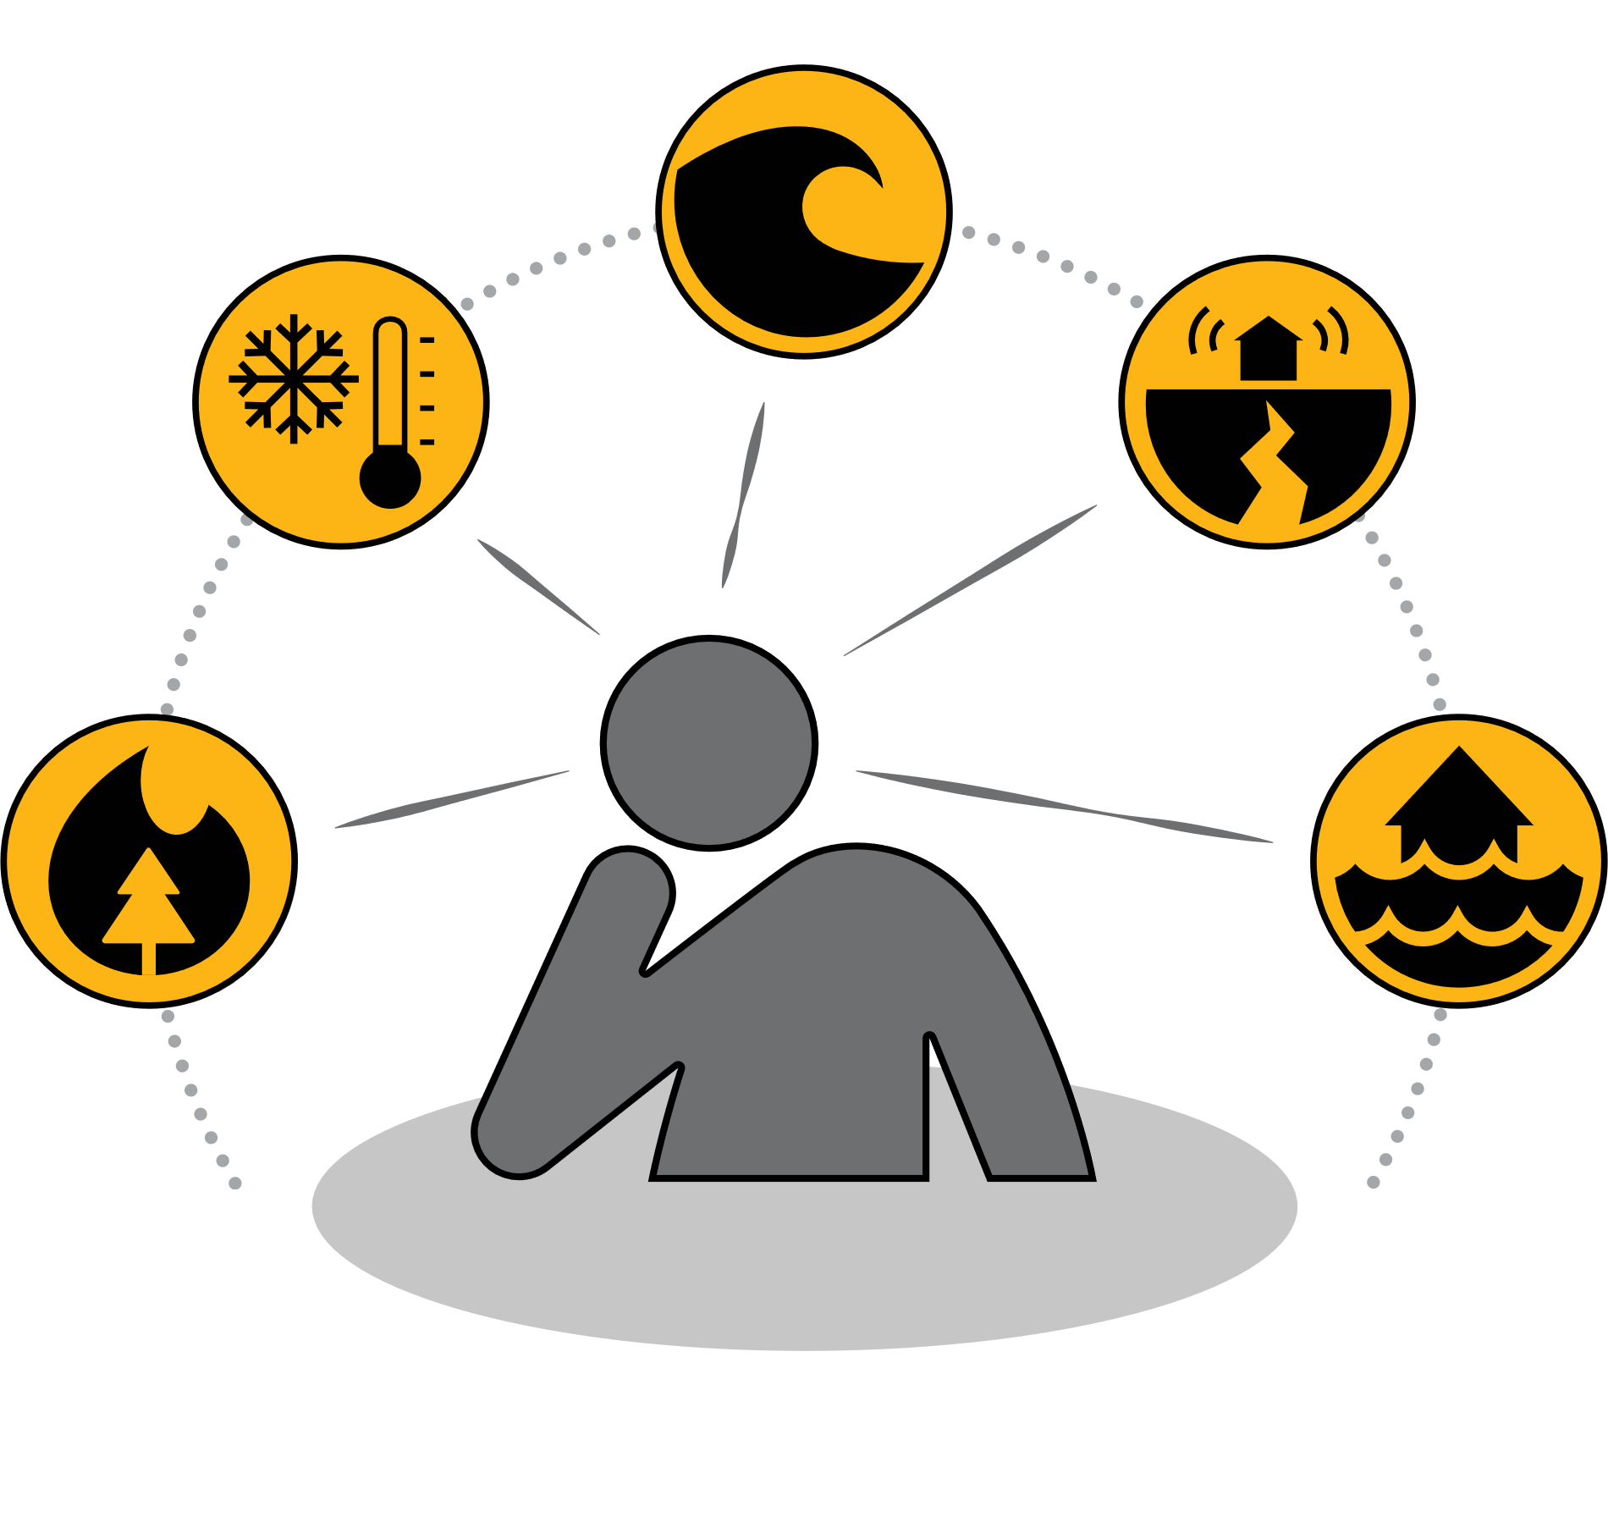
Know your hazards
Notes:
We all face different hazards depending on where we live – For example, not every community is at-risk for tsunamis.
Therefore, it is important to know what hazards may happen near you or where you work and play so you can plan accordingly.
Ask the audience to brainstorm what hazards are present where they live.

Slide 7





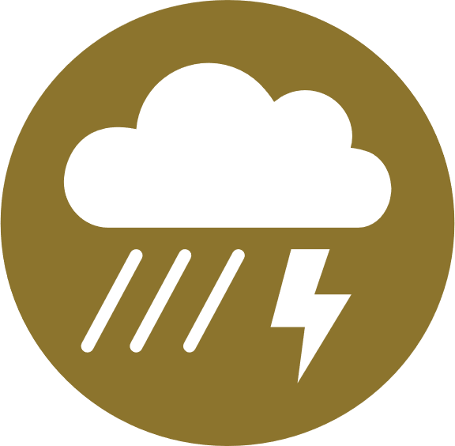
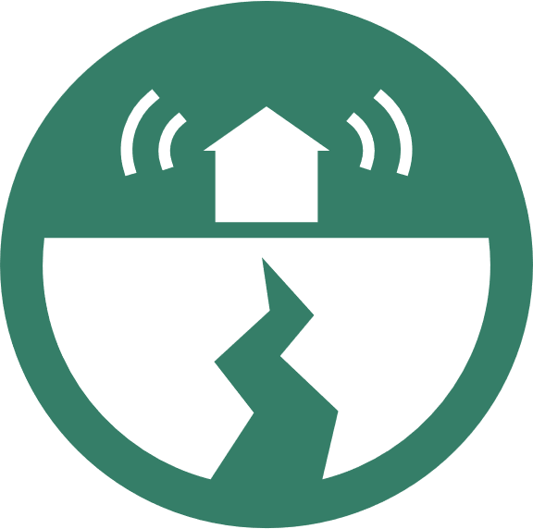



Common hazards in BC:
Floods
Wildfires
Earthquakes
Tsunamis
Disease Outbreaks
Severe Weather
Power Outages
Landslides
Drought
Hazardous Material Spills
Notes:
These are some of the most common hazards in BC. The ones that are most important for you to prepare for will depend on where you live. For example, coastal communities like Tofino, Skidegate and Prince Rupert need to be prepared for tsunamis and earthquakes, while Interior communities like Kelowna, Cache Creek and Williams Lake will be more concerned about floods and wildfires.
Below are some examples of each hazard, in case you are asked or have time to run through them. Feel free to substitute these examples for local examples relevant to your audience.
Floods
In 2018, severe flooding occurred in and around the city of Grand Forks, damaging more than 400 homes and 100 businesses.
Wildfires
In 2023 BC experienced one of its worst fire seasons on record, prompting a Provincial State of Emergency. More than 1.6 million hectares of land burned, and tens of thousands of people were forced to evacuate over the course of the summer.
Earthquakes
Earthquakes are common in B.C., with an average of 3,000 reported each year. Most are too small to be felt, but earthquakes strong enough to cause structural damage can occur once per decade.
The most destructive earthquake known to date in BC occurred on January 26, 1700. A powerful magnitude 9 earthquake struck off the coast of BC, and without warning was followed by a catastrophic tsunami that devastated the village of Loht’a. With no time to respond, all 5,000 residents of Loht’a were lost to this devastating event.
Seismologists predict that there is a 1-in-10 chance that the next “big one” will hit BC within the next 50 years.
Tsunamis
The most destructive tsunami known to date in BC occurred on January 26, 1700. A powerful magnitude 9 earthquake struck off the coast of BC, and without warning was followed by a catastrophic tsunami that devastated the village of Loht’a. With no time to respond, all 5,000 residents of Loht’a were lost to this devastating event.
On January 23, 2018, a M7.9 earthquake struck about 250 km southeast of Chiniak, Alaska, prompting a Tsunami Warning to be put in place for the entirety of BC’s coastline. Fortunately, a tsunami never reached BC’s coast and the Tsunami Warning was cancelled, but the event served as a good reminder that the possibility is real.
Disease Outbreaks
The COVID-19 pandemic prompted BC to declare a provincial state of emergency on March 18, 2020. As this is an ongoing event, refer to bccdc.ca for the latest statistics and info about this event.
Severe Weather
A windstorm that hit the South Coast on December 20, 2018 was the most damaging storm in BC Hydro’s history. The storm left more than 750,000 customers without power. Over 550,000 customers had their power restored with the first 24 hours, but power wasn’t fully restored to all impacted customers until December 31.
Power Outages
Smaller, localized power outages can happen for any number of reasons, but once again, the windstorm that hit the South Coast on December 20, 2018 was the most damaging storm in BC Hydro’s history. The storm left more than 750,000 customers without power. Over 550,000 customers had their power restored with the first 24 hours, but power wasn’t fully restored to all impacted customers until December 31.
Landslides
A landslide severely impacted the community of Johnsons Landing in 2012, causing four deaths and completely destroying four homes.
Drought
Drought is a recurring climate event caused by low snow, hot and dry weather and a delay in rainfall.
During a drought, impacted areas may experience a water shortage.
Your First Nation or local government may restrict the water use for certain activities.
It is important that you follow those restrictions and conserve water wherever possible. Every drop matters.
Hazardous Material Spills
Hazardous material spills can occur on land or in water, and involve substances such as chemicals, radiation, biohazard materials, oil and gas, propane, flammable materials, industrial products and mixed waste.

Slide 8
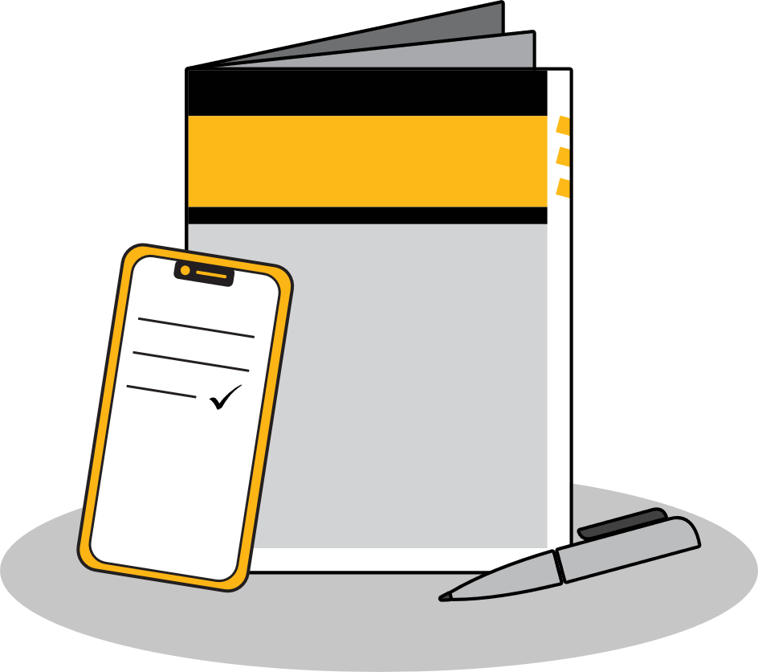
Make your plan
Notes:
Another step to preparedness is to make an emergency plan.
An emergency plan is a guide for how you and your loved ones will respond to a disaster. Knowing what to do will reduce anxiety and help keep you focused and safe.
The next slides will walk you through some considerations that should be included in your plan. You can also download a fill-in-the-blanks template from preparedbc.ca or (if applicable) or complete your plan online at PreparedBC.ca/EmergencyReady or pick up a hardcopy from the presenter after this presentation.

Slide 9
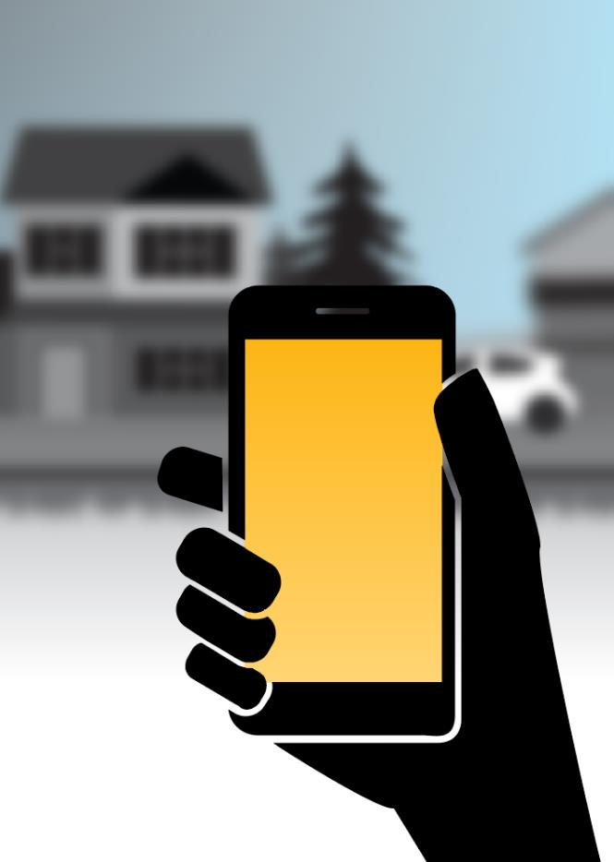
Know how you will communicate
Save a list of people you can call for help
One contact should live far away
One contact should live nearby
Notes:
Being able to communicate is vital during an emergency.
Save or write a list of people you can call for help during an emergency
Ideally, one contact should live far enough away that they won’t be affected by the same emergencies
It’s also helpful to have at least one contact who lives in your community

Slide 10
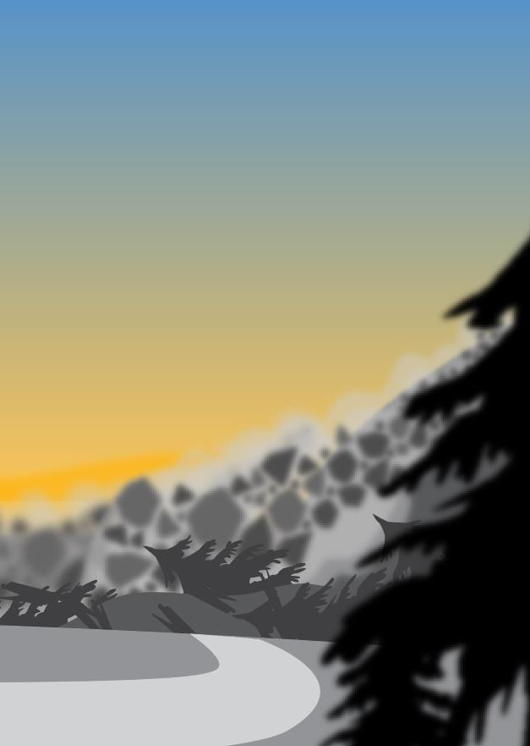
Know where to find information
Always start with local sources
Find out how they will share information:
  On a website?
  On social media?
  Through a phone number?
  Through local radio stations?
Notes:
To make good decisions during an emergency, you need good information.
Always start with local sources, and find out how they will share information:
On a website?
On social media?
Through a phone number?
Through local radio stations?

Slide 11
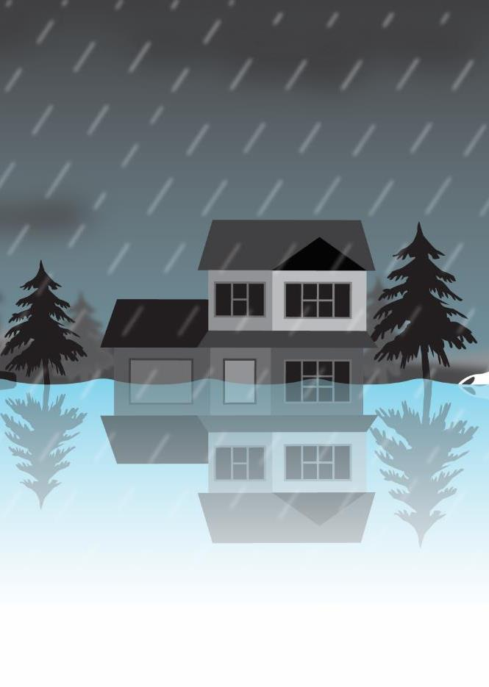
Know where to find information
You can also check Emergency Info BC:
  Online at EmergencyInfoBC.ca
  On X at @EmergencyInfoBC
Notes:
Depending on the emergency, you can also check provincial channels for information.
EmergencyInfoBC shares information about large-scale emergencies:
Online at EmergencyInfoBC.ca
On X at @EmergencyInfoBC

Slide 12

Save your health information
Care card numbers
Family doctors
Medications
Medical equipment
Any other important health info
Notes:
You should write down any relevant health information for the people you live with, such as your care card number, family doctors, medications, medical equipment and other health information

Slide 13
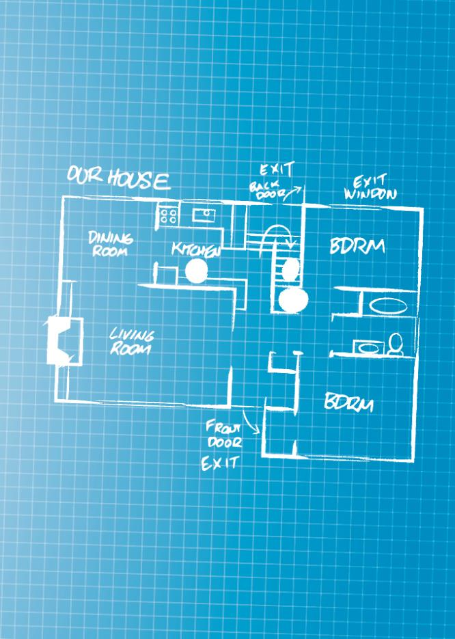
Considerations around your home
Emergency exits
Escape routes from your neighborhood
Contact info for utilities and landlord
How to shut your utilities off safely
Notes:
Your home plan should also include information on the building you live in – this will come in especially handy if you ever need to evacuate it on short notice, and will also be helpful if you have to shelter in-place.
Know and map your home’s emergency exits – if you live in an apartment or condominium, also make a note of the building map and know all your available exit routes
Identify escape routes from your neighbourhood in case you need to evacuate
Save or write down the contact info of your utility companies and landlords
Know where to find your utilities and how to shut them off safely (more info on next slide)

Slide 14
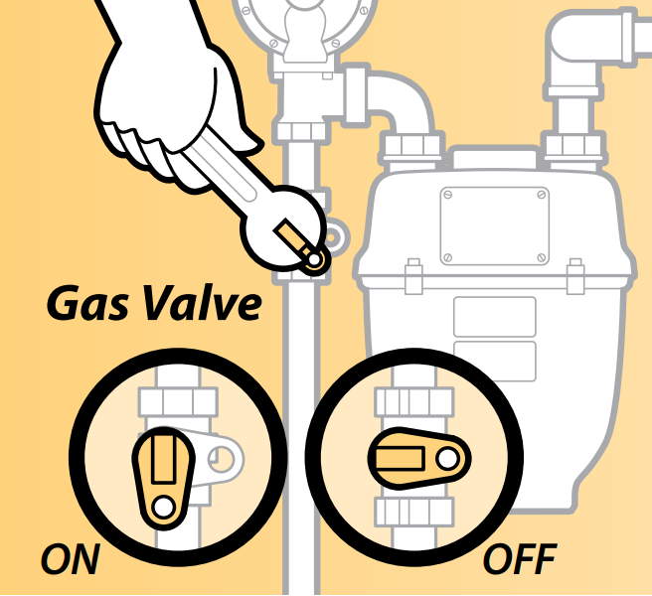
Natural gas:
DON’T shut off your natural gas if you’re evacuating
If your gas is shut off, don’t try to turn it back on
Only a licensed gas contractor can do so safely
Notes:
Do not shut off your natural gas if you’re leaving your home due to an emergency.
If fire or emergency officials require that the gas should be turned off, they will request your service provider to do so.
If your gas is shut off at the meter, don’t try to turn it back on. Only a licensed gas contractor can do that safely.

Slide 15
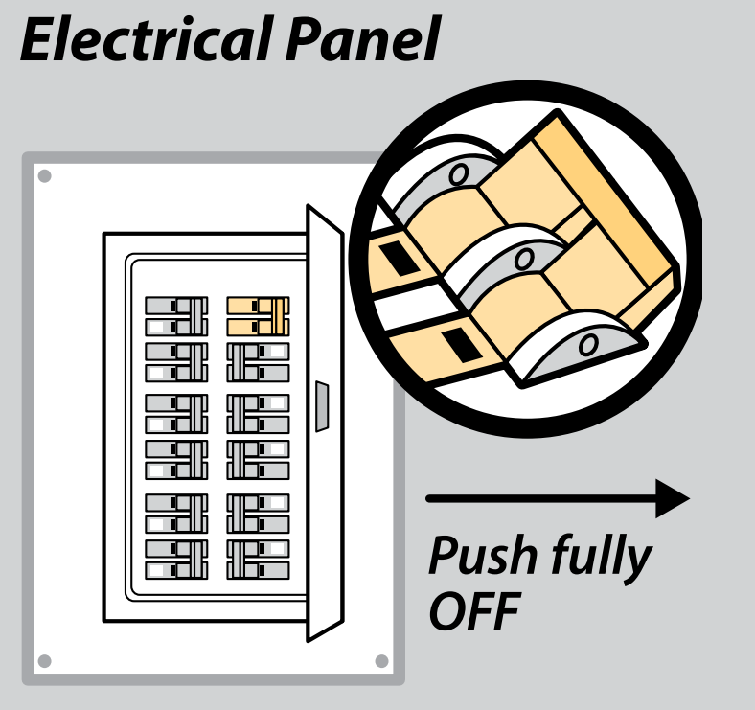
Electrical panel:
Locate your main circuit breakers (usually a pair) and flip them to OFF
This will shut off power to your entire home
Notes:
To shut off power to your entire house, locate your main circuit breakers (usually a pair) and flip them to OFF

Slide 16
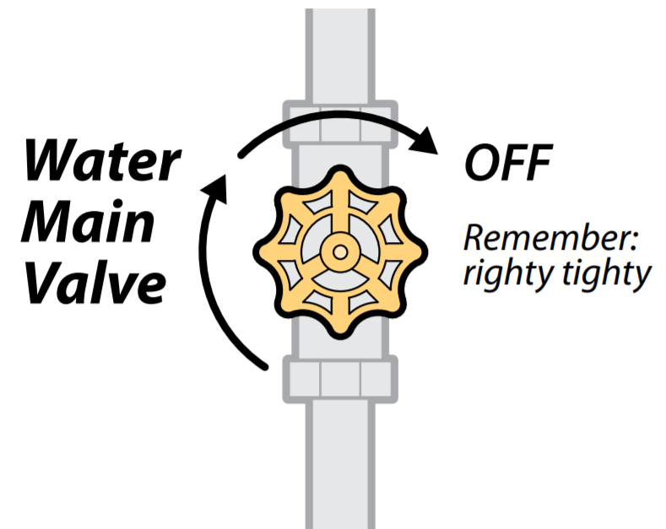
Water main valve:
Locate your water main valve and rotate it clockwise
Notes:
To shut off your water lines, locate your water main valve and rotate it clockwise.

Slide 17
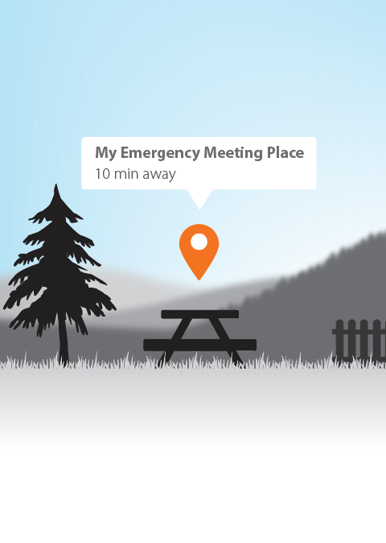
Emergency meeting places
One meeting place close to home
Another meeting place outside of your neighbourhood
Notes:
During an emergency, such as a flood, it’s important to meet up with family and friends – if possible - to make sure everyone is safe. You might not be together when disaster strikes.
You can make it easier to find each other by choosing emergency meeting places ahead of time. Pick one spot close to your home, such as a nearby hill or a neighbour’s house. Then pick an alternate spot away from your immediate neighbourhood, such as a library or community building.

Slide 18
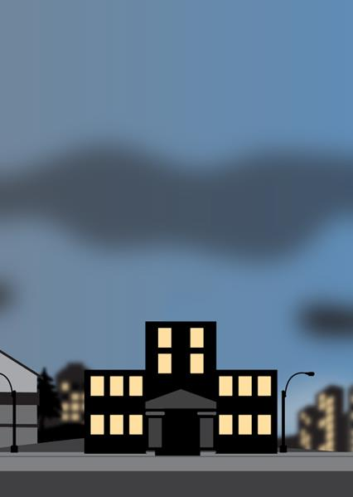
Planning for school-aged children
Know your school’s emergency policies
Designate someone to pick up your children
Save the school’s contact info
Encourage schools to run the Master of Disaster youth education program
PreparedBC.ca/MasterOfDisaster
Notes:
If you have school-aged children, you also need to plan for the possibility that they might still be in school when an emergency occurs.
Know your school’s emergency policies
Designate someone you know to pick up your children if you are unable
Save or write down the contact info for the school(s) your children attend
Encourage schools to run Master of Disaster: a free classroom program designed to help young people learn about emergency preparedness. The program teaches youth in grades 4 to 8 about hazards in BC—like floods, wildfires, earthquakes and tsunamis—and shows them how to get prepared, both personally and at home. (More info at preparedbc.ca/masterofdisaster)

Slide 19

Planning for pets
Know the locations of “pet-friendly” shelters / hotels
Pack grab-and-go bags with extra pet food and water
Save the most recent information about your pets
Designate a neighbour to check on your pets
Notes:
Pets are part of the family too! If you have pets, make sure you include them in your plan.
Know the locations of “pet-friendly” shelters / hotels in case you need to evacuate quickly
Pack extra pet food and water in your emergency kit
Save or write down the most recent information for all your pets, including vet information
Consider designating a neighbour to check on your pets in case you can’t
If applicable, more tips like these ones can be found in the PreparedBC Pet Preparedness Pamphlet. This can be downloaded at preparedbc.ca, and the presenter may wish to offer out physical copies at this point if they are available.

Slide 20
Additional planning considerations
Extra supply of prescriptions
Manual backup for electric wheelchairs
Include service animals in your preparation
Extra batteries for hearing aids
Include a pen and writing pad if verbal communication is difficult
Notes:
Other considerations when planning for people with a disability or special needs:
If you rely on a prescription, ask your care provider how to keep an extra supply or valid prescription
If someone you live with relies on a motorized wheelchair, have a manual backup one
Ensure that service animals are part of your preparations
If someone you live with uses hearing aids, stock extra batteries
If someone you live with has difficulty communicating verbally, have a writing pad and pencils handy
If applicable, more tips like these ones can be found in the PreparedBC Guide for People with Disabilities. This can be downloaded at preparedbc.ca, and the presenter may wish to offer out physical copies at this point if they are available.

Slide 21
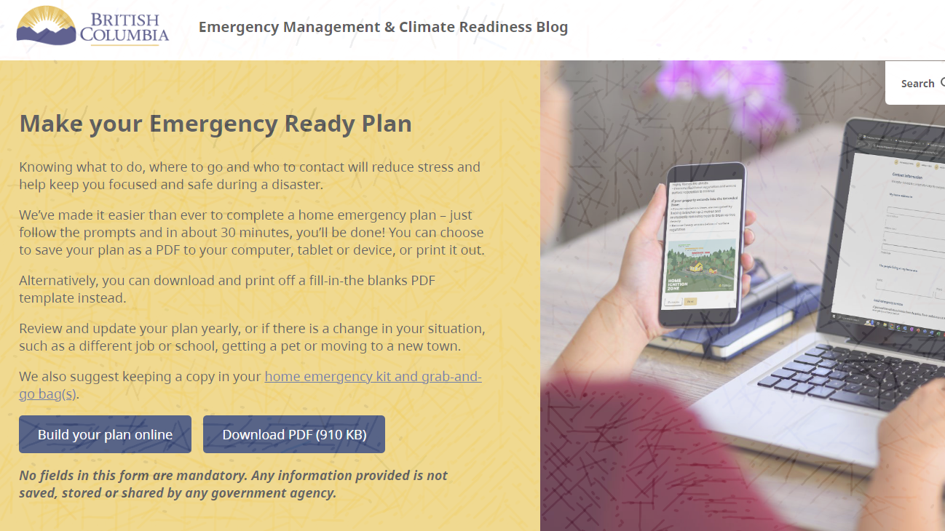
Build Your Emergency Ready Plan
PreparedBC.ca/EmergencyReady
Notes:
You can use PreparedBC’s Emergency Ready online planner to make your plan.
This is an easy-to-use, interactive tool that helps you build a personalized emergency plan.
The planner will walk you through each step of home emergency preparedness, making it even easier for you to be ready.

Slide 22
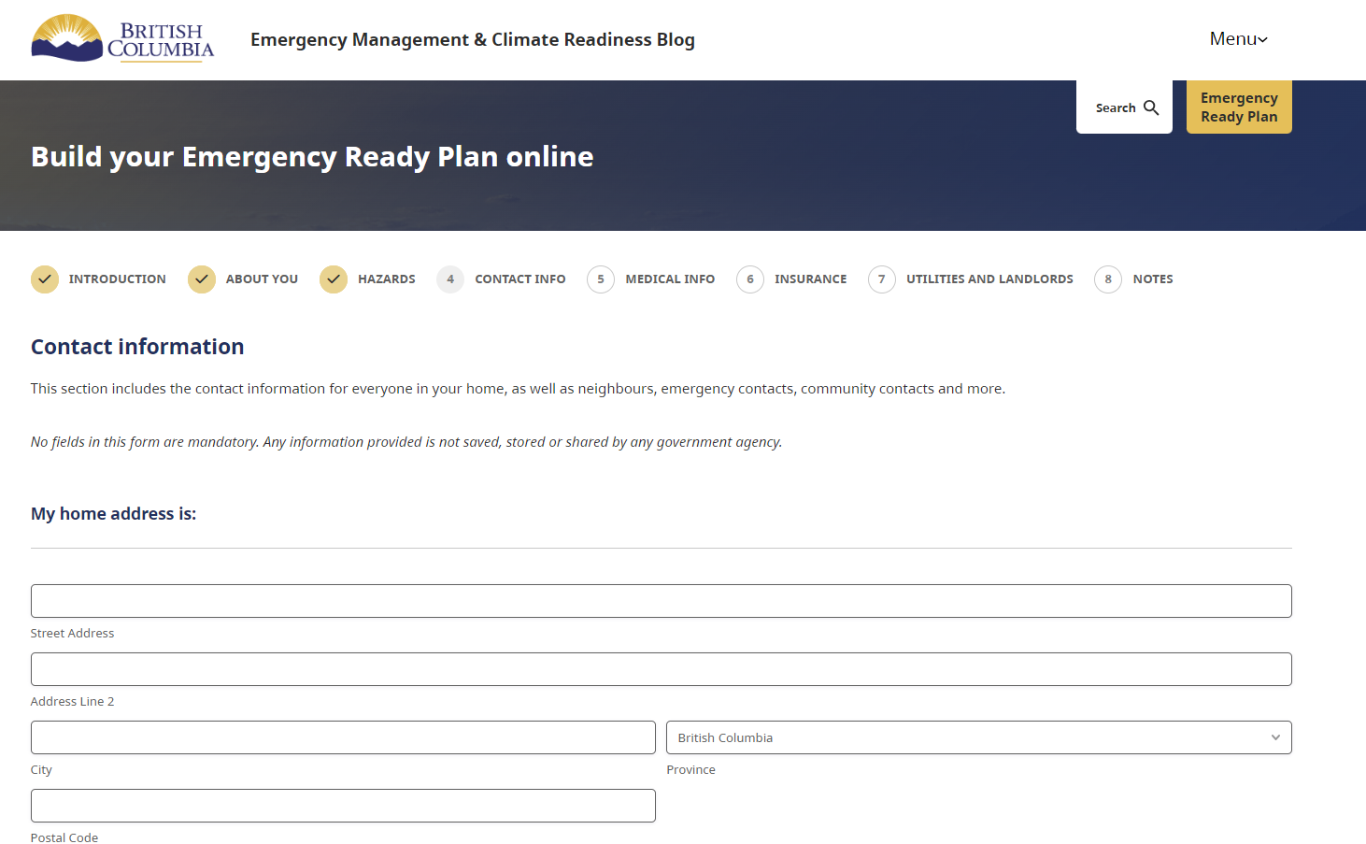
Notes:
As you move through your Emergency Ready Plan, you’ll be asked questions and given prompts that help tailor the plan to your unique needs, such as local hazards, disabilities or mobility issues, pets or animals, number of school-aged children, older adults, etc.
The plan can be accessed through any browser. Once complete, you can save the plan as a PDF or print it out.
If you prefer to hand-write your plan, a fill-in-the-blanks Home Emergency Plan PDF copy is also available on PreparedBC.ca for download or print.
At this point, presenter may hand out print copies of PreparedBC fill-in-the-blanks home emergency plan.

Slide 23
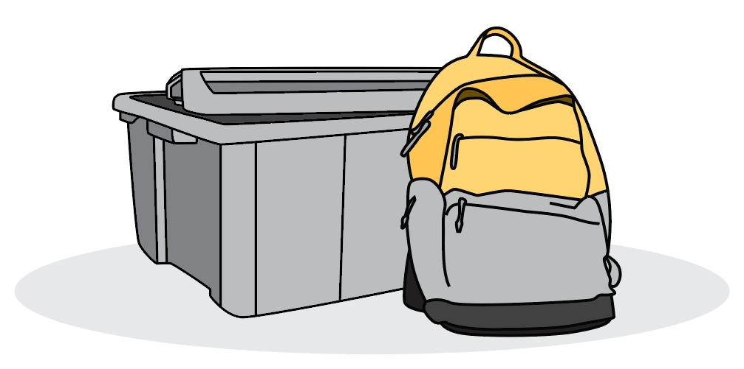
Gather your supplies
Notes:
Now that you have your emergency plan, it’s time to gather your emergency supplies.
Having the right supplies on hand will give you piece of mind, safety and comfort during an emergency situation.
There are two types of kits – a home emergency kit for sheltering in place, and a smaller grab-and-go bag you can take with you in case you need to evacuate on short notice.

Slide 24
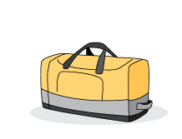
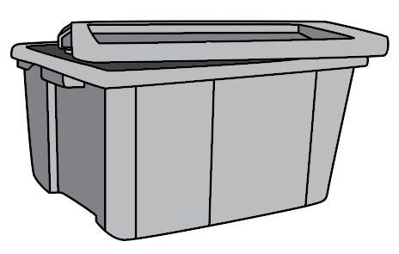
Relevant hazards:
Earthquakes
Disease Outbreaks
Severe Weather
Power Outages
Hazardous Material Spills
Home Emergency Kits
Minimum of 3 days to 2 weeks worth of supplies to keep everyone comfortable until services resume.
Notes:
A home emergency kit should contain a minimum of 3 days to 2 weeks worth of supplies to keep everyone comfortable until services safely resume.
Scenarios where a kit would be necessary are during emergencies when it may be safest to stay at home: earthquakes, disease outbreaks, severe weather/storms, power outages, and hazardous material spills.

Slide 25









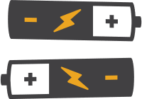


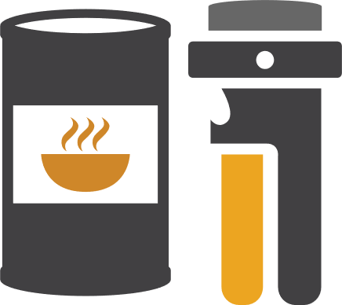



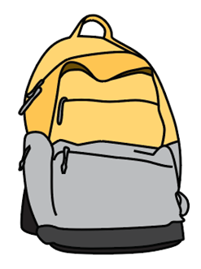
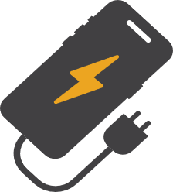
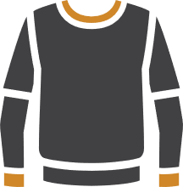
Home Emergency plan
Battery-powered or hand-crank radio
Whistle
Supply check list
Battery-powered or hand-crank flashlight
Emergency blanket
Copies of important documents
Extra batteries
First-aid kit & medications
Seasonal clothing
Whistle
Emergency blanket
Sturdy footwear
Mask
Garbage bags
Copy of your emergency plan
Copies of important documents
Cash
Water
Non-perishable food
Phone charger, power bank
Battery-powered or hand-crank radio
Battery-powered or hand-crank flashlight
Extra Batteries
Garbage bags & moist towelettes
Water
Non-perishable
food
First aid kit & medications
Mask
Personal toiletries
Comfort & entertainment items
Cash
Phone charger & power bank
Seasonal clothing and sturdy footwear
Notes:
Put your supplies in one or two containers, such as plastic bins or duffel bags. Store them in an area of your home that’s easy to get to, such as a hall closet, spare room or garage.
Items to include:
Copy of your home emergency plan, copies of important documents, such as insurance papers
Water: four litres per person, per day for drinking and sanitation
Non-perishable food: three-day to two-week supply, with a manual can opener
Cash in small bills
Phone charger, battery bank or inverter
Battery-powered or hand-crank radio
Battery-powered or hand-crank flashlight
Extra batteries
First-aid kit and medications
Personal toiletries and items, such as an extra pair of glasses or contact lenses
Seasonal clothing and sturdy footwear
Whistle
Emergency blanket
Garbage bags and moist towelettes for personal sanitation
Dust masks if you live in an area that's prone to earthquakes
Comfort and entertainment items, such as a board game or a book to keep you busy and comfortable

Slide 26

Relevant hazards:
Floods
Wildfires
Tsunamis
Landslides
Grab-and-Go Bags
A smaller version of an emergency kit you can take with you if you need to leave immediately.
Notes:
You may need to leave immediately in the event of an emergency. Be ready to go by having a smaller version of your emergency kit in an easy-to-access place in your home. In addition to having one at home, create grab-and-go bags for your workplace, school and vehicle.
Scenarios where a kit would be necessary are during emergencies when you need to evacuate quickly or on short notice: floods, wildfires, tsunamis and landslides.

Slide 27

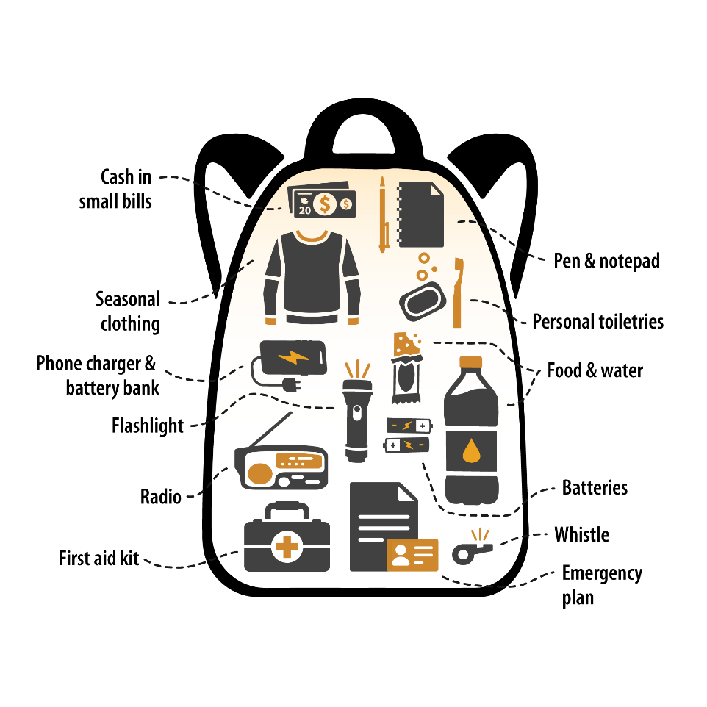
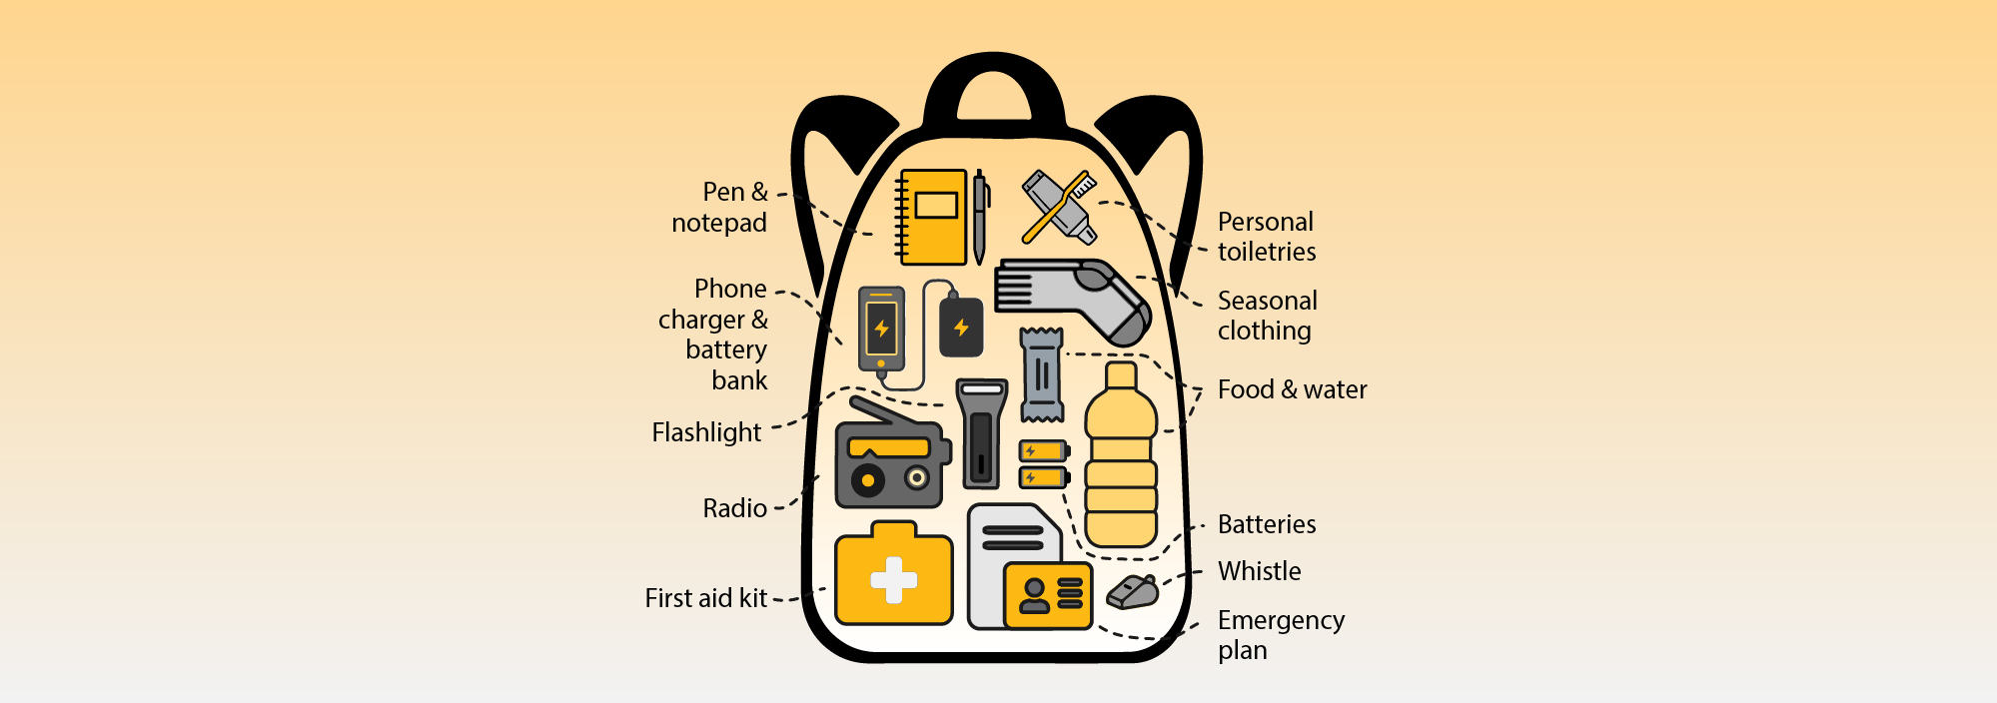
Grab-and-go bag
Notes:
Items to include in a grab-and-go bag:
Food (ready to eat) and water
Phone charger and battery bank
Small battery-powered or hand-crank radio
Battery-powered or hand-crank flashlight
Extra batteries
Small first-aid kit and personal medications
Personal toiletries and items, such as an extra pair of glasses or contact lenses
Copy of your emergency plan, copies of important documents, such as insurance papers
Cash in small bills
Local map with your family meeting place identified
Seasonal clothing and an emergency blanket
Pen and notepad
Whistle

Slide 28
The 3 steps to preparedness:
Know your hazards
Make your plan
Gather your supplies
Notes:
The steps we reviewed today will help you get yourself and your loved ones prepared for an emergency.
By knowing your hazards, making your plan, and gathering your supplies, you are taking responsibility for your safety and increasing your resilience.
At this point, feel free to take any questions from the audience.

Slide 29
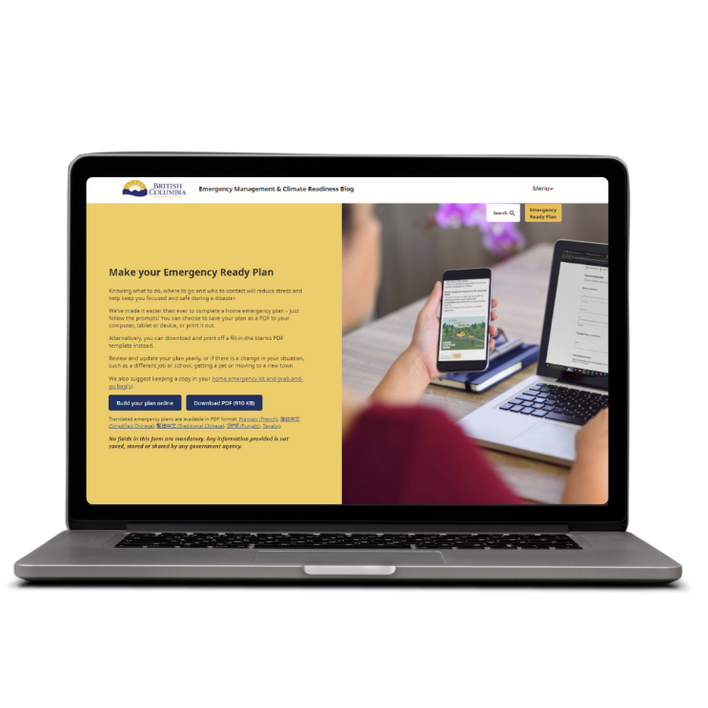
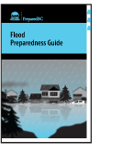
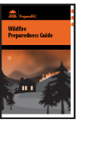
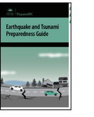
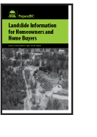
Learn more
Find information online at PreparedBC.ca
Follow PreparedBC on X, Facebook, and Instagram
Make your plan at PreparedBC.ca/EmergencyReady
Notes:
For more information on how to get prepared, including planning templates you can download and fill out, visit PreparedBC.ca
Be sure to follow PreparedBC on X, Facebook, and Instagram to get the greatest and latest preparedness tips
The first thing you can do today to get prepared for emergencies is to make your plan. Visit PreparedBC.ca/EmergencyReady to make your plan.
Also feel free to mention any locally available preparedness resources, events, etc. on this slide.

