Slide 1
Community Evacuation
Table-Top Exercise

Slide 2
Territorial Acknowledgement
Notes:
Take a moment to acknowledge the traditional territory you are on.

Slide 3
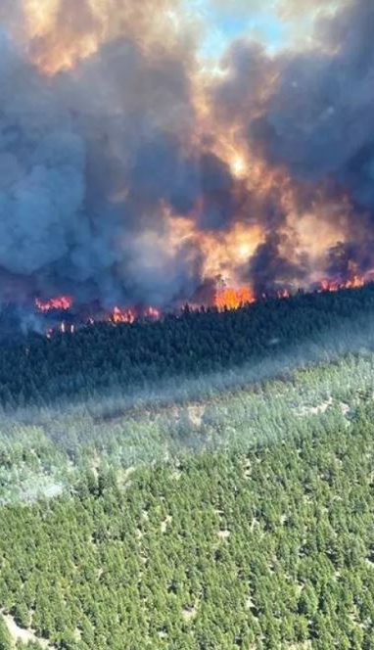
Exercise Agenda
Facility Briefing
Introductions
Tabletop Introduction, Principals, Expectations
Exercise
Exercise Hotwash
Notes:
Photo - Sparks Lake Wildfire 2021

Slide 4
Table-top Exercise Objectives
Objectives
Use an emergency scenario to practice your community emergency procedures and evacuation plan
Uncover community strengths and gaps
Foster relationships and mutual aid agreements with partners
To be better prepared should an evacuation situation occur for your community

Slide 5

Why Exercise?
Proactive planning tool – testing a plan or program
Establish interagency relationships prior to the event.
Develop a common understanding of each participant’s role during an event.
Develop common, unified goals and objectives.
Ensure the emergency program or policy can address a range of possible scenarios.

Slide 6

What is a Tabletop Exercise?
An exercise that allows participants to discuss a simulated incident or emergency. The exercise allows individuals to clarify their roles and responsibilities, as well as validate or improve response plans.
Notes:
A tabletop exercise is a fictional scenario, based on reality, that allows participants to talk through the steps they would take in that event. The discussion allows participants to apply their emergency plans to the scenario and clarify roles and responsibilities. A tabletop can also expose gaps and inefficiencies in the emergency plans and needs for the team. A tabletop can often leave participants with more questions than answers, but a question is the first step in creating a more robust and efficient emergency plan.

Slide 7

Tabletop Exercise Guiding Principals
Tabletop exercises can be used to validate plans, especially in testing for weaknesses in procedures.
React to information as if it were a real event
Testing systems and processes – not individuals
Focus on decision points that need to be made
The end goals:
  Understand the response process and policy
  Identify gaps and Improve plans and procedures
  Further develop readiness and be more prepared
Notes:
*Ensure your participants know this is a safe atmosphere to make mistakes and consider challenges and opportunities.
Tabletop Exercise Guiding Principles
No fault exercise – There are no right or wrong answers
React to information as if it were a real event
Testing systems and processes – not individuals
Focus on decision points that need to be made
The end goals:
Understand the response process and policy.
Identify gaps.
Further develop readiness

Slide 8
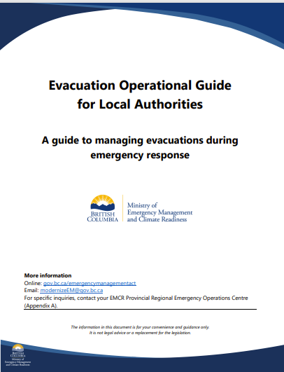
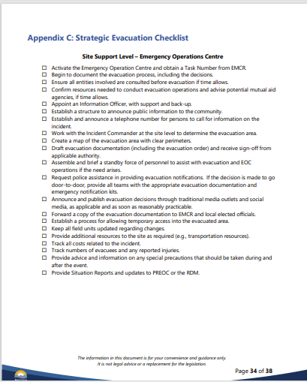
Tabletop References: EMCR Evacuation Guide
https://www2.gov.bc.ca/assets/gov/public-safety-and-emergency-services/emergency-preparedness-response-recovery/local-government/response-operations/evacuation_operational_guide.pdf
Notes:
Evacuation Checklist is Appendix C of the larger Evacuation Operational Guide for First Nations and Local Authorities in British Columbia. (amended in 2024, 38 pages)
The operational guide provides general templates and supportive actions that can be used to plan and execute a community evacuation.
The legalities in the guide do not apply to First Nations communities but the guide is available for use. The templates are available in word documents to be adapted for your community’s use.

Slide 9
Tabletop References: EMCR Policies
Policy 2.14 – Community Navigator - First Nations Community Navigator for Emergency Support Services
  An individual identified by a community to act as a liaison between the EOC, ESS, support agencies and evacuees
  A Community Navigator advocates for complex or unique evacuee needs
Policy 2.15 – Cultural Activity Locations Support
  To provide support for the establishment of culturally safe spaces for evacuees to gather while they are on Evacuation Order
  Service Agencies such as FNHA may support in these locations with mental health services
Notes:
A Community Navigator can be anyone who is known to the community and has knowledge of the community. Could be an elder, religious leader, knowledge keeper, or that person that everyone trusts, etc.

Slide 10
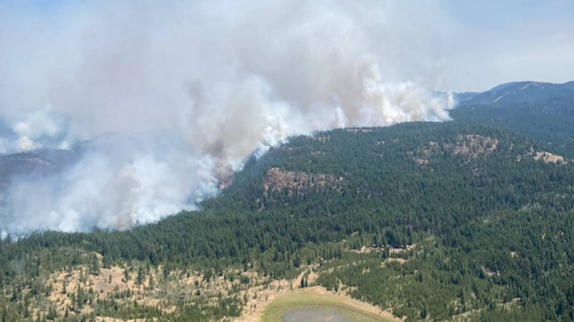
Evacuation Exercise Scenario
Notes:
Photo: White Rock Lake Fire 2021
Generate a wildfire situation that pertains to your community.
A common scenario would be that a wildfire is approaching your community from one direction. The fire is out of control but BC Wildfire services believe they have the conditions to hold it. They recommend an Evacuation Alert. Later, the winds pick up in a dangerous way and attempts to hold the fire fail. This leads to the recommendation for an Evacuation Order.

Slide 11
Community Background (1 of 2)
Consider the population of your community:
For example: Remote? Population? First Nations members?
Consider access and transportation options:
For example: Access to the community is by a 1-hour drive down a forest service road to a major highway. There is an open area in the community for helicopter access
Consider challenges to transportation:
For example: There are at least 8 households in the community that do not have access to transportation
Consider your critical infrastructure, community buildings, heritage sites:
For example: hospitals, schools, energy plants, bridges, longhouse

Slide 12
Community Background (2 of 2)
Consider challenges to communications
Consider environment and topography unique to your community:
For example: Community is in a wooded, mountain region with a large stream/valley, etc
Consider Cultural Safety and Heritage of your community:
For example: give special consideration to vulnerable individuals, animals, places or things.
Identification of a community navigator (cultural advisor, cultural liaison)

Slide 13

Inject #1 – Evacuation Alert
You receive a call from the EMCR PREOC and BC Wildfire to inform you there is a fire in your area.
BC Wildfire is recommending an Evacuation Alert be placed on your community due to the nature of the fire.
Notes:
A note: Multi-way calls (between BC Wildfire, EMCR and community) are intended to give information that is to be disseminated into the community or communities affected by a specific fire.
Coordination calls are more general and will usually have all agencies and fire-affected communities in an EMCR region. There may be several fires discussed on a coordination call.

Slide 14

Discussion Question #1
You are the Community Emergency Program Coordinator, what are your first steps after receiving the information about the need to place an Evacuation Alert on the community?
Notes:
Prompts for your group members:
Activate EOC:
Inform leadership and pull team together
Prepare Evacuation Alert and get it signed off
Prepare mapping and public information plan
Update website and create news release
Consider a BC Emergency Alert (Also know as Broadcast Intrusive Alert)
Get support from EMCR:
Ask for a task number
Ask for a spot forecast
Get connected with support agencies – Ministry of Transportation and Infrastructure (MOTI), Ministry of Agriculture, First Nations Health Authority/ local Health Authority, First Nations Emergency Services Society, Canadian Armed Forces, etc.
Get EOC and EOC team ready for evacuation:
Ensure all EOC team members have taken care of their family/home – they may not be able to go back if an Order is issued
Ensure EOC is not in the Alert area or move the EOC out of the Alert area
Plan for a mobile EOC if Alert area expands
Evacuation Pre-Planning:
Talk to BCWS about trigger points – know how long it will take to evacuate, and when to call an evacuation
Get messaging to community about the hazard and how to protect their homes
Spot forecasts – call ECCC and BC Wildfire for assistance
Consider issuing a broadcast intrusive alert
Call nearby communities and let them know you may be evacuating
Evacuation route planning – where are the fires? What roads could be impacted? (Talk to BCWS Incident Commander or MOTI through EMCR for assistance)
Contact MOTI to help with signage and traffic control for evacuation route
Protect/ FireSmart critical infrastructure – the bridge, community buildings
Public works team – activate them to work on the evacuation routes, FireSmart, etc.
Runners for elders/people without phones to inform them about Evac Alert and help them get ready
Provide a list of items for evacuees to take with them
Provide signs for homes that indicate whether they have evacuated or not
Contact security companies to provide security for homes/businesses if community is evacuated
Livestock – pre-evacuate during alert stage
Signage
Get ready for Emergency Support Services:
Contact neighboring communities for ESS supports
Create a communication plan for evacuees – How will the community keep in touch with evacuees?
Identify runners for elders/people without phones to inform them about Evacuation Alert and help them get ready
Identify vulnerable households and help them prepare/ plan for special evacuations
Pre-evacuation for vulnerable folks – use extraordinary evacuee form
Potentially planning for a helicopter to quickly evacuate vulnerable people
Bring in health team and school team to prepare for evacuation and provision of ongoing care for patients and students

Slide 15

Inject #2 – Evacuation Order
BC Wildfire is now recommending an Evacuation Order be issued by the community.
It is 6PM and BC Wildfire recommends putting the Evacuation Order in place at 10AM the next day.

Slide 16

Discussion Question #2
What are the planning considerations and actions needed for a community evacuation?
Notes:
Prompts for your group members:
Issuing the Evacuation Order:
Issue as soon as possible, advance notice is better
Ensure messaging is clear and consistent and answers all the questions – When to leave, Where to go, What to take, How to get there, Why there is danger, etc.
Send runners to homes to explain the order if there is time – ensure elders, anyone with disabilities gets a runner to assist them
Move your EOC:
Find an alternate location for your EOC and set up there – could be in the community if it is safe, could be in the host community
Consider a virtual EOC – create a communication plan to keep EOC team in touch with each other
Emergency Support Services:
Send Community Navigator(s) ahead of evacuees to host community
Establish a position within the EOC to coordinate with Community Navigator and host community
Guidance for evacuees:
How to ready their homes
How to prepare their pet for evacuation
What to bring with them
Essential clothes
Food/water for journey
Medications
Managing the evacuation:
Create a plan for tracking evacuees and communication with evacuees
Plan for traffic control along the evacuation route
Consider the need to provide gas or gas cards
Do you have security for evacuation areas?
Managing the evacuation route:
What if a vehicle breaks down on the road?
Is the road clear? Does it need grading, etc. for vehicles to pass through
What about people who will not leave?
Hand out shelter in place guidelines
Establish check-in procedures
Make a list of homes/ people staying behind
Involve them in the response if possible – get updates for those who have left the community
Provide them with means to escape, if possible – i.e. cars with gas in the tank
Consider that schools/retirement homes/hospitals/hospice may have to evacuate – where are they going to and what special needs are required

Slide 17
Inject #3 – Evacuation
Community evacuation began shortly after 10 AM
Community members were evacuated to the nearest reception centre
Evacuation occurred via highway, some community members were sent by a rented bus
Accommodations will vary by member needs
The First Nations Community Navigator was able to meet the community members at the reception centre

Slide 18

Discussion Question #3
What is your EOC team doing to support community members while they are evacuated?
Notes:
Prompts for your group members:
Community Navigator/ EOC Team Support for evacuees
Community Nurse to check in with those who have medical conditions/needs
Create Communication Plans:
With EOC team
Establish a single point of contact for BC Wildfire/ EMCR and other partners – could be a phone number, doesn’t need to be a single person
Hold regular briefings at alternate EOC location or hold regular virtual meetings
With evacuees
Establish a buddy system – have evacuees check in with each other
Evacuee updates - establish an official webpage for updates for evacuees
With those staying behind (security, maintenance team, fire fighters, those who wouldn’t leave, etc)
Keep in touch with people staying behind daily through phone or radio
Establish communications between BC Wildfire and security
Community Leadership
Continue regular meetings, and ensure messaging for evacuees is approved by leadership
Working with Partners
If accepting donations, decide whether you will take physical donations, taking physical items can create a larger issue of coordination and storage
Cash is the best donation
Maintain contact with EMCR, FNHA and FNESS for services
Establish a Resiliency Centre/ Host Gatherings
Bring partners together such as FNHA and Red Cross into one place so community can access services from a single place rather than going to multiple places
Plan community dinners, activity days for kids and elders, to bring community together
Bring in traditional healers/ foods for community members to access
Advance Planning
Consider the possibility for long term evacuation – get in touch with partners for assistance in planning
Consider re-entry planning ahead of time, and line up activities the EOC will need to complete before the community will return

Slide 19
Inject #4 – Re-Entry
It has been a week since the community was evacuated
It is now 10 AM, BC Wildfire has given the recommendation to rescind the Evacuation Order 10 AM tomorrow
The Evacuation Order is being lifted by Chief and Council in 24 hours
2 homes that were in a heavily wooded area were lost to the fire, the school has sustained smoke damage, and the water treatment plant was without power for several days
Rapid Damage Assessments have been completed by FNESS and community staff
  All homes have been without power for a week
  There is food spoilage in many homes and some smoke impacts
  The band office, health centre and church have no damage

Slide 20

Discussion Question #4
What are your planning considerations for re-entry?
Notes:
Prompts for your group members:
Communication plan for re-entry information:
Update website with re-entry plans, info on what to expect
Create a dedicated phone number for evacuees to call for information
Put notices along the way back to community – gas stations, etc.
Plan for re-entry in stages
Break community into areas based on geography, impacts, etc. to complete assessments and bring the community back slowly
Plan for transportation - buses for those who do not drive, assistance for elders etc
Preparing the community services and infrastructure for re-entry:
Water station – testing, function
Band office – bring staff back first
Ensure roads, bridges, and other infrastructure are safe
Complete geotechnical analysis on affected lands if required
Call BC Wildfire for assistance with a Post Wildfire Natural Hazard Assessment
Complete assessment on the school, plan for repairs, set up temporary school space
Preparing homes for members coming back:
Complete rapid damage assessments and determine which homes are inhabitable
Utility assessments – power, water, sewage
Fridges – ensure they are clean or replaced – coolers for homes who might have to wait for replacements
Air quality assessment – check for mold, smoke, etc.
If homes are uninhabitable:
Contact the home’s inhabitants directly, possibly plan for a tour or salvage if possible (with professionals)
Call EMCR to discuss housing options
Consider security for these homes to reduce risk
EOC Team
Debriefing interviews for EOC Team
Complete an After-Action Review
EMCR online re-entry resources – Considerations for Community Re-entry on Indigenous Communities Emergency Operations webpage
Bring the community together
Bring in a trauma counsellor – talk with FNHA about mental health supports
Host a community dinner and coming home celebration
Community hunt to restock freezers

Slide 21
Exercise Hot Wash
What do you think worked well and what can be improved in this exercise scenario?
What agencies were required to work together in this scenario?
What further training will your team require to handle a scenario like this?
Any further questions, comments, concerns?
Notes:
* A hot wash is completed to evaluate the effectiveness of the exercise, not the plan. This will allow participants to reflect on the process of exercising and make suggestions for your next exercise.

Slide 22
T’ooyaksim
Nisga’a
Kukstemc
Shuswap
Mussi cho
Dene
stutwiniitscw
Nuxalk
Walus
Bella Bella
Soga sénláʼ
Danezāgé’
Thank you!
Hay ce:p qa
Musqueam
Lim Limt
Okanagen
Guneshcheesh
Tlingit
kʷukʷstéyp
Nłeʔkepmxcín
Kwukstam’x kawx
Lilwat
Haawaa
X̱aad Kil / X̱aaydaa Kil (Haida)
Merci
Mechif (Metis)
Hey chexw
Squamish

