Slide 1
Evacuation Workshop

Slide 2
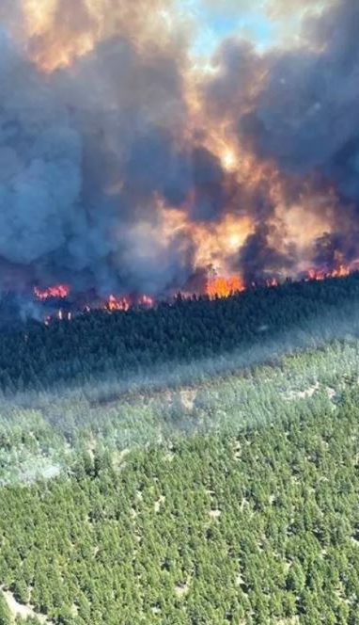
Workshop Agenda – Example Timings
0900-0915: Workshop Introduction & Guiding Principles
0915-1200: Evacuation Planning Workshop
1200-1300: Lunch
1300-1400: Evacuation Planning Workshop (cont’d)
1415-1500: Workshop Debrief
Notes:
Photo - Sparks Lake Wildfire 2021

Slide 3

What is a Workshop?
low-stress environment free from operational constraint to collaboratively examine a problem and build specific products, such as a draft outline of a plan or policy.
Notes:
Workshops are an ideal way to:
Collect or share information
Get new or different perspectives
Evaluate new ideas, processes, or procedures
Problem solving of complex issues
Obtain consensus
Team building
Produce new emergency procedures
Produce mutual aid and assistance agreements
Develop Improvement Plans

Slide 4
Objectives of this Evacuation Workshop
Use reference material to progress towards reviewing an evacuation plan specific to your community
Foster relationships and mutual aid agreements with partner communities
To be better prepared should an evacuation situation occur for your community
Notes:
Please spread out at the tables and consider the conversations we will have throughout the day.

Slide 5
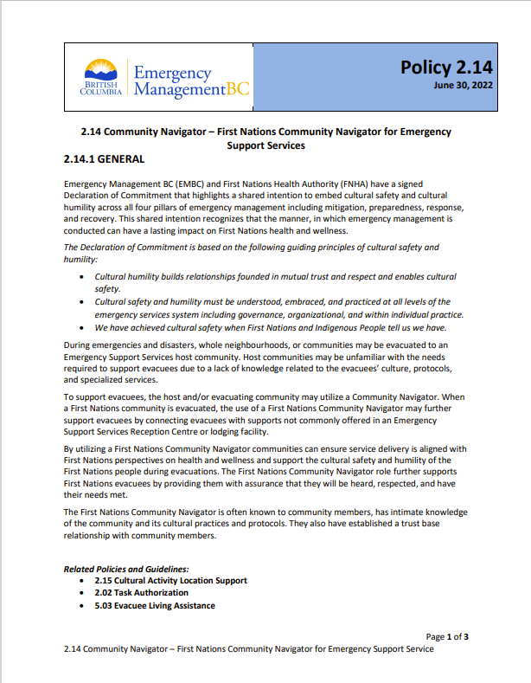
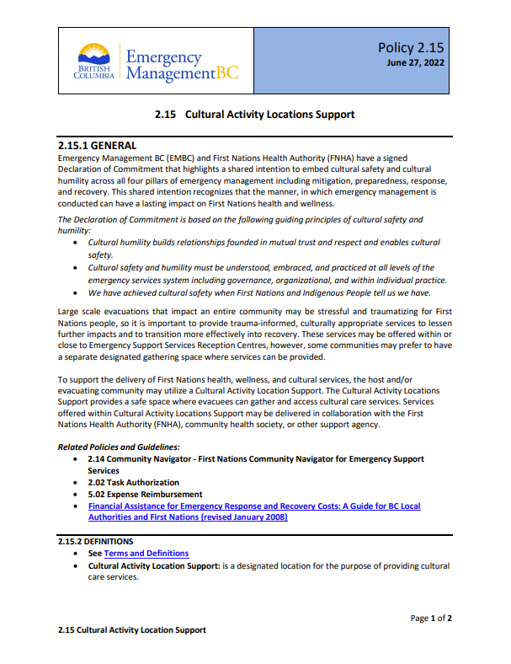
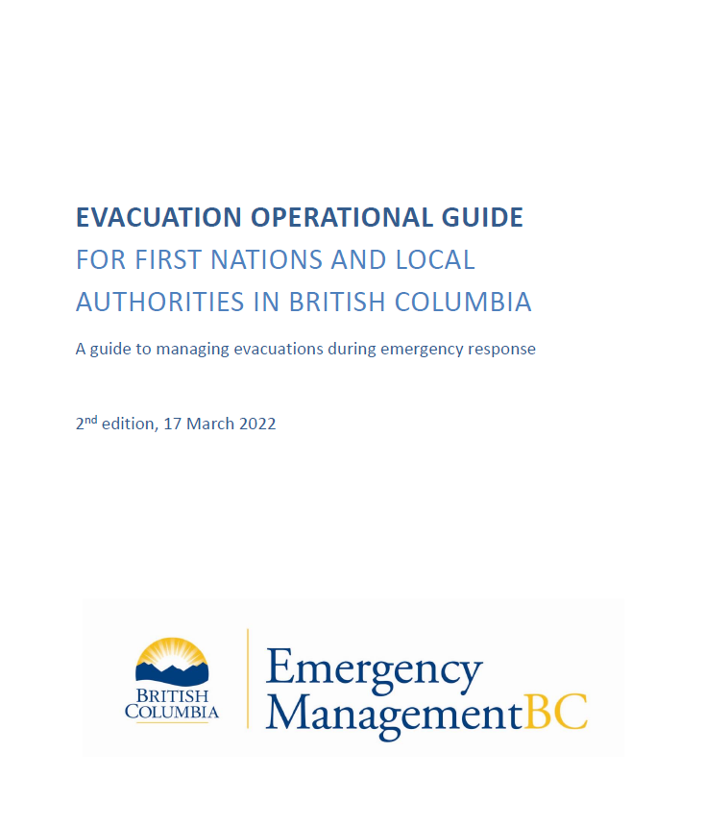
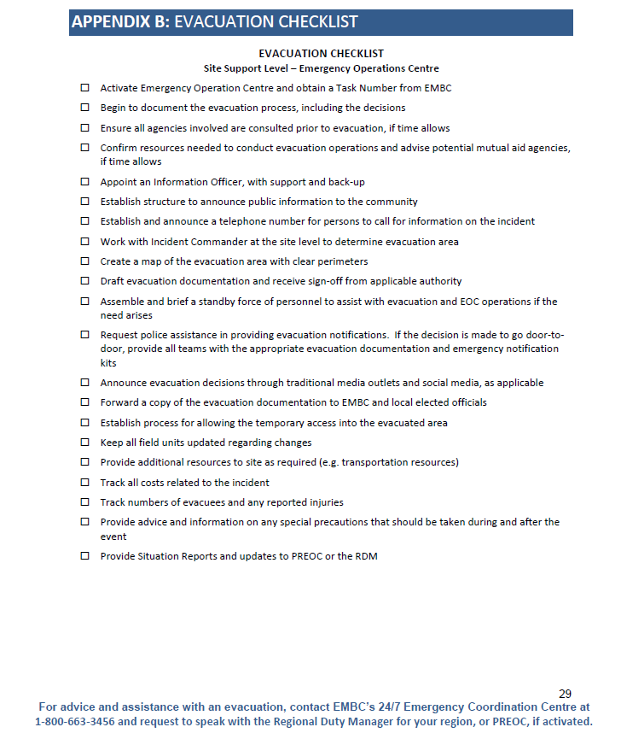
References
Notes:
Evacuation Checklist is Appendix B of the larger Evacuation Operational Guide for First Nations and Local Authorities in British Columbia. (2022, about 45 pages long)
Provide a refresh on these with focus on the region

Slide 6
Policy 2.14 – Community Navigator
A Community Navigator supports evacuees and is often someone known to the community, with intimate knowledge of their culture and practices. It is a good idea to identify your Community Navigator before an emergency. This allows the opportunity to connect with ESS teams in surrounding communities and build familiarity and relationships.
Notes:
Policy 2.14: June 2022. 3 pages long.

Slide 7
Policy 2.15 – Cultural Activity Location
A Cultural Activity Location is a space where an evacuating community can gather and access cultural care services. These services may be delivered in collaboration with the First Nations Health Authority (FNHA), community health society, or other support agency. Communities may wish to prepare and keep a cultural care kit that can be evacuated with the community to provide supplies that are important for the continuity of culture (ie. traditional foods, medicines etc.).
Notes:
Policy 2.15: June 2022. 2 pages long.

Slide 8
Evacuation Checklist Approach
Detailed examination of specific line items
Fill in the gaps
Individualize it to your community
Based on workshop discussions, have notes specific to your community in advance of this year’s fire season
Notes:
explain evac checklist as an excerpt from Evacuation Operational Guidelines
Aim is to take notes to make it community-specific

Slide 9
Community Background (1 of 2)
Consider the population of your community:
For example: Remote, First Nation community: 112 population
  11 elders (4 with mobility issues)
  15 children aged 6 months to 17 years
Consider Cultural Safety and Heritage of your community:
For example: give special consideration to vulnerable individuals, animals, places or things.
Identification of a community navigator (cultural advisor, cultural liaison)

Slide 10
Community Background (2 of 2)
Consider access and transportation options:
For example: Access to the community is by a 1-hour drive down a forest service road to a major highway. There is an open area in the community for helicopter access
Consider challenges to transportation:
For example: There are at least 8 households in the community that do not have access to transportation
Consider your community buildings and cultural heritage preservation:
For example: band office, health centre, school, longhouse, carving sheds, regalia
Consider environment and topography unique to your community:
For example: Community is in a wooded, mountain region with a large stream/valley, etc

Slide 11
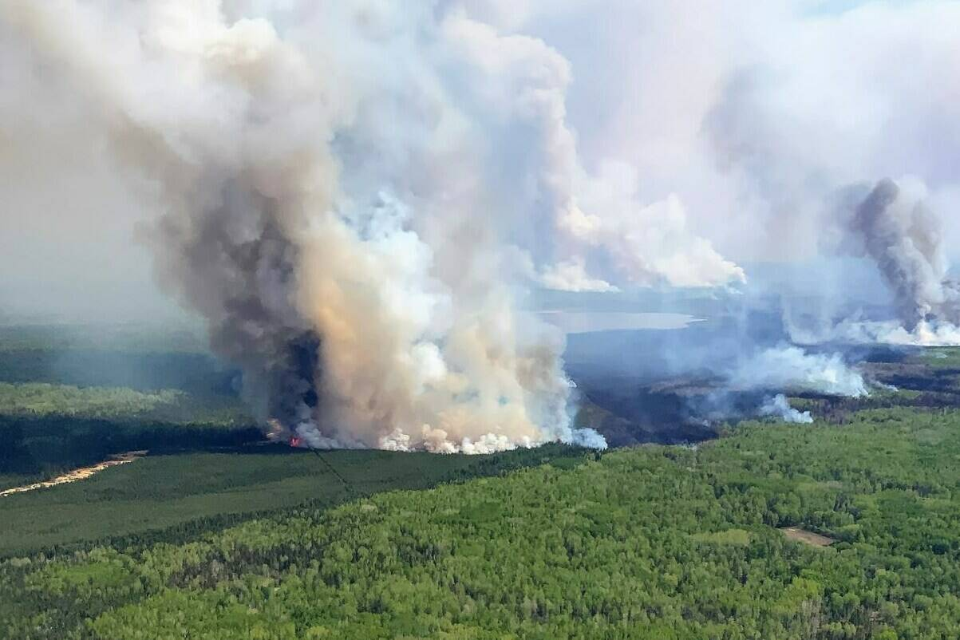
Fire Scenario
An area restriction is put in place for Whitefish Lake Wildfire, 28 Aug 2023 (Black Press Media file folder)

Slide 12

Part #1 – Evacuation Alert
You receive a call from the EMCR VIC PREOC to inform you there is a fire in your area.
A multi way call is scheduled and takes place.
During the operational call, BC Wildfire is recommending an Evacuation Alert be placed on your community due to the nature of the fire.

Slide 13

Discussion Question #1
You are the Community Emergency Program Coordinator, this a good opportunity to review the Evacuation Checklist.
Are there any checklist items you can prepare for in case the situation deteriorates?
Notes:
Have a look at the handout and brainstorm in plenary. Consider the points we covered in the Community Background slides and think of things you can start to prepare for. Group discussion. Feel free to start with brainstorming, but feel free to reference the checklist handout.
What are some things you can think about – 5-10 min.

Slide 14
The complete Evacuation Checklist (see handout)
Activate Emergency Operation Centre and obtain a Task Number from EMCR
Begin to document the evacuation process, including the decisions
Ensure all agencies involved are consulted prior to evacuation, if time allows
Confirm resources needed to conduct evacuation operations and advise potential mutual aid agencies, if time allows
Appoint an Information Officer, with support and back-up
Establish structure to announce public information to the community
Establish and announce a telephone number for persons to call for information on the incident
Work with Incident Commander at the site level to determine evacuation area
Create a map of the evacuation area with clear perimeters
Draft evacuation documentation and receive sign-off from applicable authority
Assemble and brief a standby force of personnel to assist with evacuation and EOC operations if the need arises
Request police assistance in providing evacuation notifications. If the decision is made to go door-to-door, provide all teams with the appropriate evacuation documentation and emergency notification kits
Announce evacuation decisions through traditional media outlets and social media, as applicable
Forward a copy of the evacuation documentation to EMBC and local elected officials
Establish process for allowing the temporary access into the evacuated area
Keep all field units updated regarding changes
Provide additional resources to site as required (e.g. transportation resources)
Track all costs related to the incident
Track numbers of evacuees and properties (homes) and any reported injuries
Provide advice and information on any special precautions that should be taken during and after the event
Provide Situation Reports and updates to PREOC or the RDM
Notes:
This will be handout, so this slide can be kept hidden unless it is requested to be put up on screen

Slide 15
Evacuation Checklist – the items which will be discussed
Activate Emergency Operation Centre and obtain a Task Number from EMCR
Begin to document the evacuation process, including the decisions
Ensure all agencies involved are consulted prior to evacuation, if time allows
Confirm resources needed to conduct evacuation operations and advise potential mutual aid agencies, if time allows
Appoint an Information Officer, with support and back-up
Establish structure to announce public information to the community
Establish and announce a telephone number for persons to call for information on the incident
Work with Incident Commander at the site level to determine evacuation area
Create a map of the evacuation area with clear perimeters
Draft evacuation documentation and receive sign-off from applicable authority
Assemble and brief a standby force of personnel to assist with evacuation and EOC operations if the need arises
Request police assistance in providing evacuation notifications. If the decision is made to go door-to-door, provide all teams with the appropriate evacuation documentation and emergency notification kits
Announce evacuation decisions through traditional media outlets and social media, as applicable
Forward a copy of the evacuation documentation to EMCR and local elected officials
Establish process for allowing the temporary access into the evacuated area
Keep all field units updated regarding changes
Provide additional resources to site as required (e.g. transportation resources)
Track all costs related to the incident
Track numbers of evacuees and properties (homes) and any reported injuries
Provide advice and information on any special precautions that should be taken during and after the event
Provide Situation Reports and updates to PREOC or the RDM
Notes:
The bolded items will be reviewed in greater detail.

Slide 16

Part #2 – Band Council Resolution/Evacuation Order
You receive a call from the EMCR PREOC to inform you the fire situation has deteriorated.
A multi way call is scheduled and takes place.
During the multi way call, BC Wildfire is recommending that the Evacuation Alert be upgraded to an Order on your community due to the increased fire activity.
Notes:
Think about who from your community should be on that call. (Chief and EPC... so that they can have all the information)

Slide 17

Part #2 – Band Council Resolution/Evac Order
Using the checklist, let's consider the planning considerations and actions needed for the evacuation of your community
Worksheet available to take notes
Notes:
We will not cover all of the checklist items but rather plan to focus on several key ones.

Slide 18
Question #2: Activate Emergency Operation Centre and obtain a Task Number from EMCR
Obtain Task Number from EMCR
How/when do you activate your EOC?
Notes:
-considering the wildfire scenario: take a minute to reflect on how you could activate your EOC for a community evacuation.
-5 minutes at tables. Will poll the tables.
(please take notes so you can take these back to your community evacuation planning considerations at a later date)

Slide 19
Question #3: Ensure all agencies involved are consulted prior to evacuation
Who needs to be involved before your community evacuates?
  Evacuation team roles and responsibilities
  Roles and responsibilities of EM Partners/agencies
  Do you have contact information for these agencies?
Notes:
Breakout group 10 min
Consider in plenary tables – quick recap from each of the table
Please take notes so you can take these back to your community evacuation planning considerations at a later date

Slide 20
Question #4: Confirm resources needed to conduct evacuation operations and advise potential mutual aid agencies
What resources does your community need?
  Evacuee registration (ESS Support)
  Accommodation, food (traditional) and incidentals
  Transportation and evacuation assistance
  How will community navigators and cultural activity locations be established?
  other
Notes:
30 minutes – big breakout
Please take notes so you can take these back to your community evacuation planning considerations at a later date

Slide 21
Question #5: Create a map of the evacuation area with clear perimeters
What considerations are needed when creating your community evacuation map in the event of a wildfire?
  Safety considerations
  Evacuation area
  Community egress routes
  Access and egress points
  Critical Infrastructure and cultural assets
Notes:
Take a look at your community maps
20 – breakout – BCWS consult avail? If so ask BCWS to describe interactions with communities during these processes
- what considerations are needed when creating your community evacuation map in the event of a wildfire?
Public map used to inform your community members
work with BC wildfire to determine, community navigator for consideration
Consider clear perimeters considering egress routes and local knowledge
Please take notes on your worksheet so you can take these back to your community evacuation planning considerations at a later date

Slide 22
Question #6: Draft evacuation documentation and receive sign-off from applicable authority
First Nations are not required to issue formal SOLEs, and do not need sign off from the Minister of Emergency Management and Climate Readiness to execute an Evacuation Alert, Order, or Rescind in their community.
What is your communities process to tap into emergency powers necessary for an evacuation order?
Forward documentation to EMBC
Notes:
Group discussion. 15 minutes.
Slide 16 – inject #2 is that BCR/SOLE for evacuation order.
What is your communities process to tap into emergency powers necessary for an evacuation order?
What is your communities process for an evacuation Alert/ Order/ Rescind documentation?
Who are your sign off authority?
Who is delegated with the responsibility of signing these documents?
First Nations are not required to issue formal SOLEs, and do not need sign off from the Minister of Emergency Management and Climate Readiness to execute an Evacuation Alert, Order, or Rescind in their community. It is a wise practice for First Nations to issue written Evacuation Alert/Orders/Rescinds to communicate with their members, the public and Provincial and Federal partners.
What information do you include on an Evacuation Alert/Order/Rescind?
Addresses and map of affected areas
Date and time of effect
Reception center address(es) and phone number(s)
Suggested list of what to bring
Information about pets
How to FireSmart/ prepare a home for evacuation
Please take notes on your worksheet so you can take these back to your community evacuation planning considerations at a later date

Slide 23
Question #7: Announce evacuation decisions through traditional media outlets and social media
How are you ensuring accurate messaging within your community?
  Social media (Facebook, X (Twitter), Community website)
  Newsletters
  Door to door notification – Health staff
  Radio (VHF, media, etc.)
  Get creative – think outside the box
Notes:
Slide 16 – inject #2 is that BCR/SOLE for evacuation order.
Group discussion 5-10 minutes – take a minute to think about your community’s communication means.
How will you deal with incorrect information?

Slide 24
Question #8: Establish process for allowing the temporary access into the evacuated area
Does your community have a plan for establishing temporary access back into an evacuation order area?
  Need to return for animals/ industry
  Security
  Permit approvals
Notes:
Examples of re-entry permit process?
Room discussion 10 minutes
Slide 16 – inject #2 is that BCR/SOLE for evacuation order.

Slide 25
Question #9: Track numbers of evacuees and properties (homes) and any reported injuries
How does your community track evacuees and properties that are impacted?
  # homes/ properties
  # people
  Who has stayed behind?
  Who is responsible to tracking and reporting these numbers?
Notes:
Slide 16 – inject #2 is that BCR/SOLE for evacuation order.
Room discussion 10 minutes. Tips or practices to share.
How does your community track and report how many homes, people, who has stayed behind?
Why is this important to track?
Again these are topics that this workshop has focused on – as the conversations have indicated there are a number of considerations when we are working on evacuation plans.

Slide 26
Part #3 – Re-Entry
It has been a week since the community was evacuated
It is now 10 AM, BC Wildfire has given the recommendation to rescind the Evacuation Order 10 AM tomorrow
The Evacuation Order is being lifted by Chief and Council in 24 hours
Notes:
Prompts for your group members:
Communication plan for re-entry information:
Update website with re-entry plans, info on what to expect
Create a dedicated phone number for evacuees to call for information
Put notices along the way back to community – gas stations, etc.
Plan for re-entry in stages
Break community into areas based on geography, impacts, etc. to complete assessments and bring the community back slowly
Plan for transportation - buses for those who do not drive, assistance for elders etc
Preparing the community services and infrastructure for re-entry:
Water station – testing, function
Band office – bring staff back first
Ensure roads, bridges, and other infrastructure are safe
Complete geotechnical analysis on affected lands if required
Call BC Wildfire for assistance with a Post Wildfire Natural Hazard Assessment
Complete assessment on the school, plan for repairs, set up temporary school space
Preparing homes for members coming back:
Complete rapid damage assessments and determine which homes are inhabitable
Utility assessments – power, water, sewage
Fridges – ensure they are clean or replaced – coolers for homes who might have to wait for replacements
Air quality assessment – check for mold, smoke, etc.
If homes are uninhabitable:
Contact the home’s inhabitants directly, possibly plan for a tour or salvage if possible (with professionals)
Call EMCR to discuss housing options
Consider security for these homes to reduce risk
EOC Team
Debriefing interviews for EOC Team
Complete an After-Action Review
EMCR online re-entry resources – Considerations for Community Re-entry on Indigenous Communities Emergency Operations webpage
Bring the community together
Bring in a trauma counsellor – talk with FNHA about mental health supports
Host a community dinner and coming home celebration
Community hunt to restock freezers

Slide 27

Discussion Question #10
What are your planning considerations for re-entry?
Notes:
Prompts for your group members:
Reference the Community Re-entry considerationsGuide: chrome-extension://efaidnbmnnnibpcajpcglclefindmkaj/https://www2.gov.bc.ca/assets/gov/public-safety-and-emergency-services/emergency-preparedness-response-recovery/local-government/recovery/community_re-entry_considerations_reference_guide.pdf
Communication plan for re-entry information:
Update website with re-entry plans, info on what to expect
Create a dedicated phone number for evacuees to call for information
Put notices along the way back to community – gas stations, etc.
Plan for re-entry in stages
Break community into areas based on geography, impacts, etc. to complete assessments and bring the community back slowly
Plan for transportation - buses for those who do not drive, assistance for elders etc
Preparing the community services and infrastructure for re-entry:
Water station – testing, function
Band office – bring staff back first
Ensure roads, bridges, and other infrastructure are safe
Complete geotechnical analysis on affected lands if required
Call BC Wildfire for assistance with a Post Wildfire Natural Hazard Assessment
Complete assessment on the school, plan for repairs, set up temporary school space
Preparing homes for members coming back:
Complete rapid damage assessments and determine which homes are inhabitable
Utility assessments – power, water, sewage
Fridges – ensure they are clean or replaced – coolers for homes who might have to wait for replacements
Air quality assessment – check for mold, smoke, etc.
If homes are uninhabitable:
Contact the home’s inhabitants directly, possibly plan for a tour or salvage if possible (with professionals)
Call EMCR to discuss housing options
Consider security for these homes to reduce risk
EOC Team
Debriefing interviews for EOC Team
Complete an After-Action Review
EMCR online re-entry resources – Considerations for Community Re-entry on Indigenous Communities Emergency Operations webpage
Bring the community together
Bring in a trauma counsellor – talk with FNHA about mental health supports
Host a community dinner and coming home celebration
Community hunt to restock freezers

Slide 28
Workshop Review
Were you able to consider aspects of the Evacuation Checklist with the needs of your community in mind?
Are you able to leave this workshop with some greater information to assist with the steps required to evacuate your community?
Do you feel like you are better prepared heading into this upcoming season?
Any further questions, comments, concerns?

Slide 29
Thank you!

Slide 30
Exercise Timeline
Presentation Timeline:
0900-0910: Intro, agenda, workshops, objectives.
0910-0925: Reference overview and 2.14 / 2.15 review. Will canvass for questions from the crowd. Anticipate a discussion.
0925-0930: Evacuation checklist approach. Mention the notes page.
0930-0940: Community background (2 slides) plus 5 minutes time to think about your own communities. Notes page has blank area at end to capture any highlights.
0940-1000: Part 1 Evacuation Alert. Fire scenario. Question 1. In tables, will discuss and review. Reports from table.
1000-1005: Part 2 BCR/Evac Order.
1005-1020: Question 2 (15 minutes) : Activate Emergency Operation Centre and obtain a Task Number from EMCR
1020-1030: Question #3 (10): Ensure all agencies involved are consulted prior to evacuation
1030-1055: break
1050-1120: Question #4 (30): Confirm resources needed to conduct evacuation operations and advise potential mutual aid agencies
1120-1140: Question #5 (20): Create a map of the evacuation area with clear perimeters
1140-1155: Question #6 (15): Draft evacuation documentation and receive sign-off from applicable authority
1200-1300: lunch
1300-1315: Question #7 (15): Announce evacuation decisions through traditional media outlets and social media
1315-1325: Question #8 (10): Establish process for allowing the temporary access into the evacuated area
1325-1340: Question #9 (15): Track numbers of evacuees and properties (homes) and any reported injuries
1340-1400: Part #3 – Re-Entry with Question #10.
1400-1415: break
1415-1500: workshop review

