Slide 1
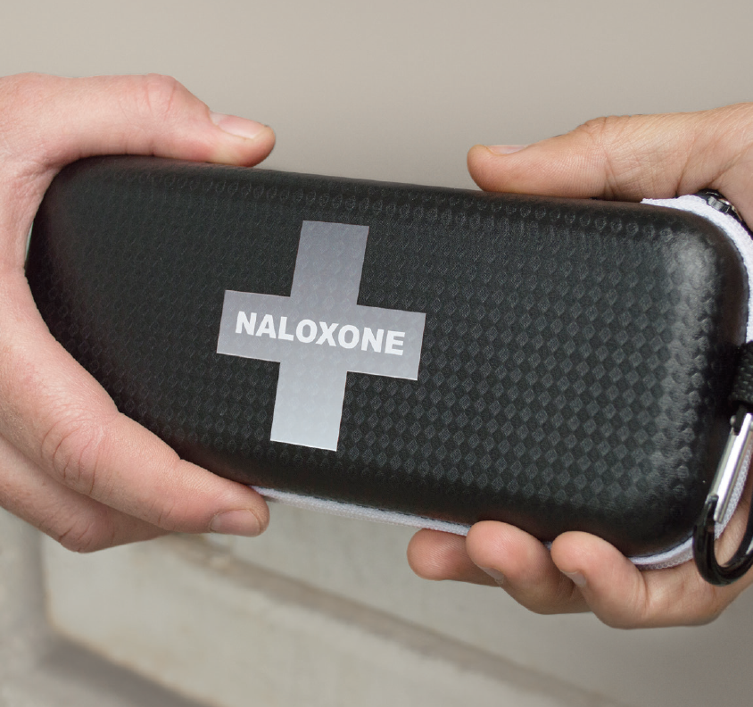
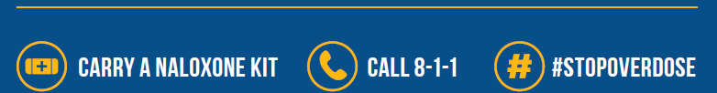
OVERDOSES ARE HAPPENING IN YOUR COMMUNITY
Learn more:
gov.bc.ca/overdose or call 8-1-1

Slide 2

GET HELP TALKING TO YOUR KIDS ABOUT DRUGS.
Learn more:
gov.bc.ca/overdose or call 8-1-1

Slide 3
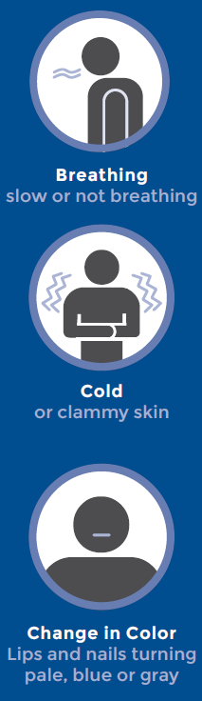
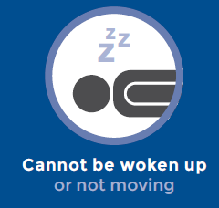
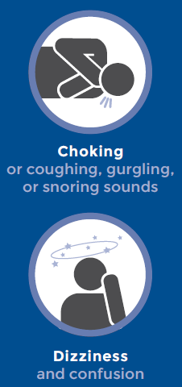
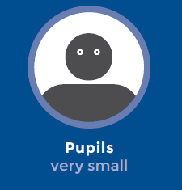
SIGNS OF AN
OVERDOSE
Learn how to spot an overdose and what to do. If you see any signs of an overdose.
CALL 9-1-1
gov.bc.ca/overdose

