Slide 1
Problem Statement
3. Focus is not always applied to the parts of the procurement lifecycle that add maximum value
Potential value in terms of cost-quality-time
Plan
Pre-Award: Solicit
Pre-Award: Select and Negotiate
Award
Administer and Manage
Close Out and Evaluate
Low
High
Low
Medium
Medium
High
Governance
Maturity levels vary at each stage in the lifecycle
Low
Low-Med
Low
Low
Low-Med
Medium
Human Resources
Low-Med
Medium
Low
Low
Medium
Low-Med
Tools and Practice

Slide 2
What is Procurement?
Procurement: All phases of the process to engage external entities in the exchange of taxpayer funding for goods and services through a contractual arrangement
Plan
Pre-Award
Award
Close Out and Evaluate
Administer and Monitor
Plan
Assess internal requirements, available budgets, industry trends, etc. and create documents such as feasibility studies, cost benefit analyses and/or business cases.
Pre-Award
The appropriate solicitation method is issued (ITQ, ITT, RFP, RFQ, etc), documents are prepared and submitted by vendors, and offers are evaluated. Includes negotiation of major deliverables, timelines and costs.
Award
The requesting organization reviews and discusses terms of agreement with successful vendor(s) and enters into a binding contract signed by both parties.
Goods and services are provided, payments are received by vendors. Includes change management, issues, performance management and reporting. Determine overall contract results, formulate future requirements, record contractor performance and that of the contract management team.
Administer and Monitor
Close Out and Evaluate

Slide 3
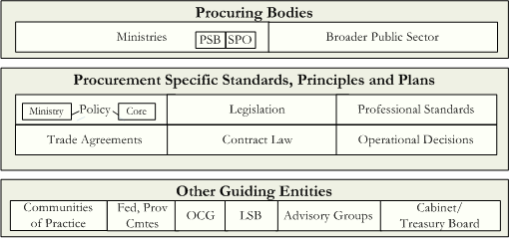
Problem Statement
1. Government is not achieving best value due to disconnected roles and responsibilities in procurement
Many groups involved
in various phases of procurement...
Characterized by:
Mixed centralized/ decentralized model
Independence
Varied interests
Varied practices
Duplication
Lack of sharing
Lack of visibility
Lack of collaboration
Reactive rather than strategic responses
Culture of constraint

