Slide 1

British Columbia Exploration and Mining 2021
Gordon Clarke
BCGS Mineral Development Office
AME Roundup 2022

Slide 2
Outline
Mining Production
Exploration Expenditures
Significant Events
Exploration Highlights
British Columbia Geological Survey Activities
Summary

Slide 3
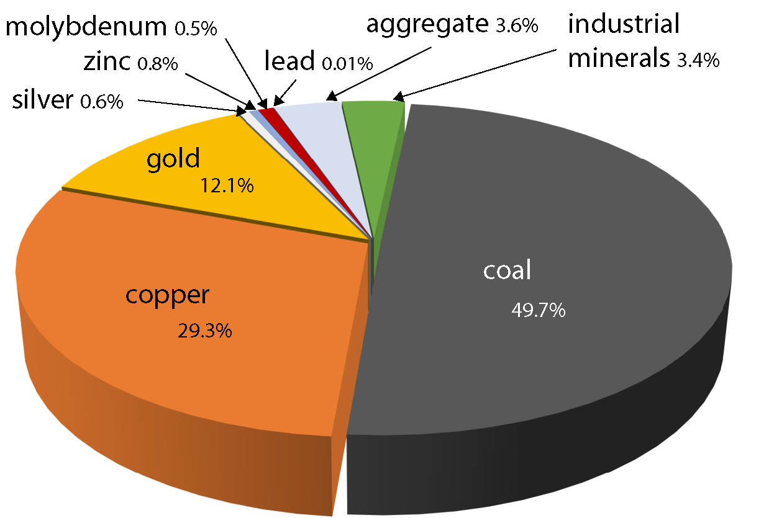

British Columbia Mining Production 2021
Canada’s largest producer of copper and coal. Canada’s only producer of molybdenum
Production value increase of $5.3 Billion from 2020 estimated production of $7.3 Billion*
Forecast Mine Production Value $12.6 Billion
Source: NRCAN and BC EMLC
*Forecast vs preliminary estimate
Notes:
.

Slide 4
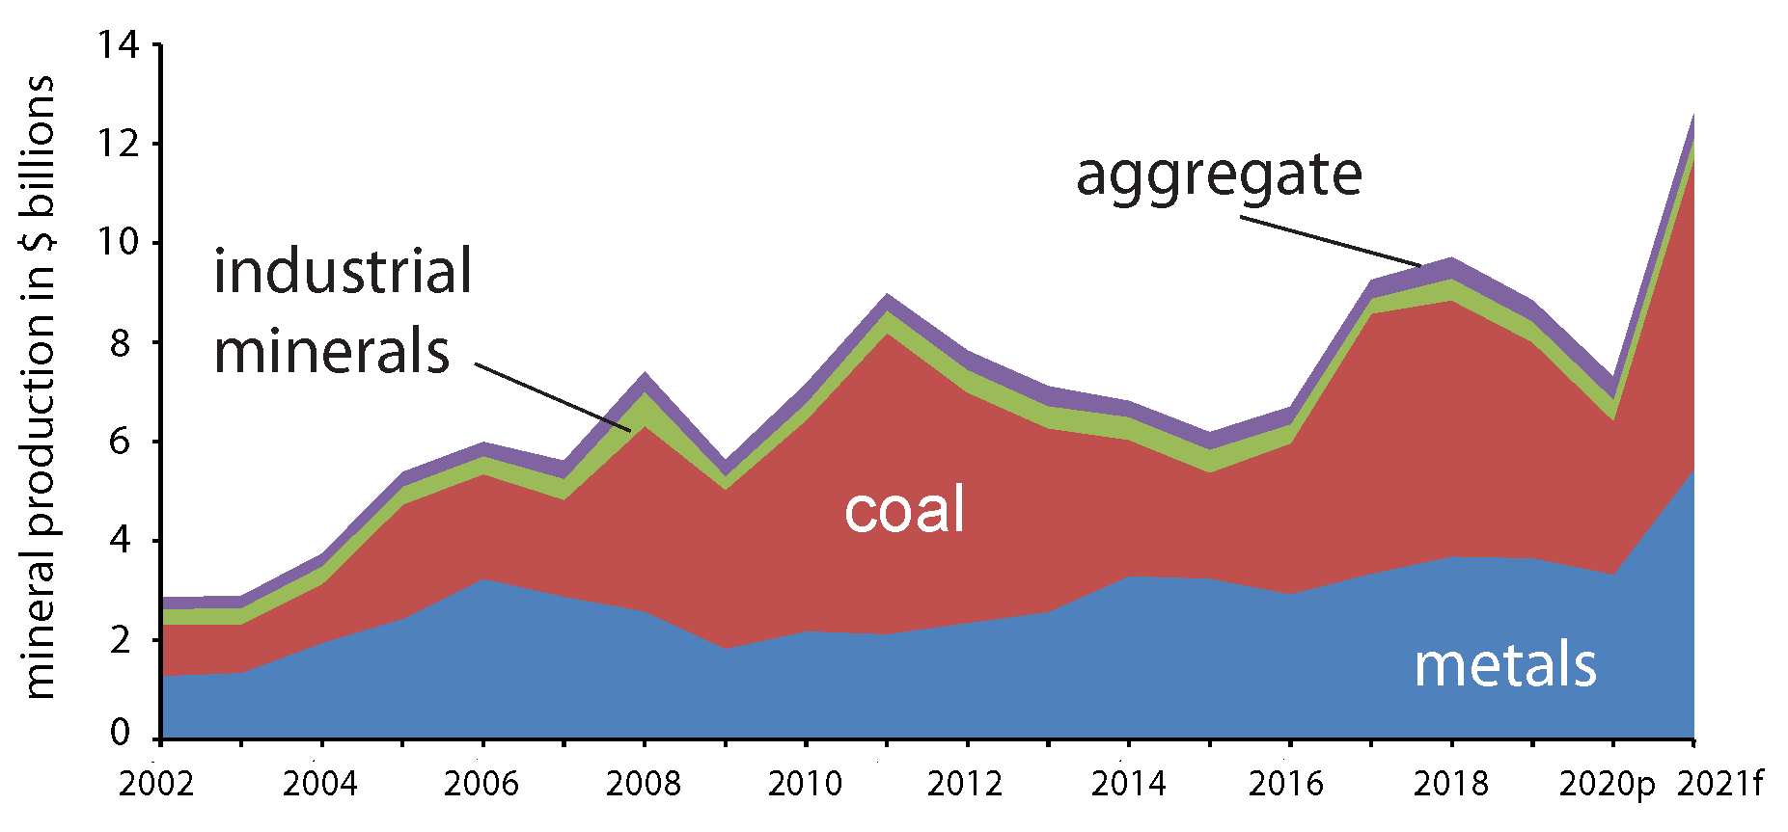
Mining Production 2002-2021
Increase of $5.3 Billion vs 2020 preliminary estimate.
Note preliminary estimates can drop from forecast values. 2020 forecast was $2 billion higher.
Increase due to increase in commodity prices, particularly for coal and copper, most significantly coal.
Coal price Jan. 2021 - 140 US$/t
Coal price Sept. 2021 - 408 US$/t
Coal price Jan. 2022 - 350 US$/t
$12.6 Billion (forecast)
Value of British Columbia mineral production by year 2002-2021

Slide 5
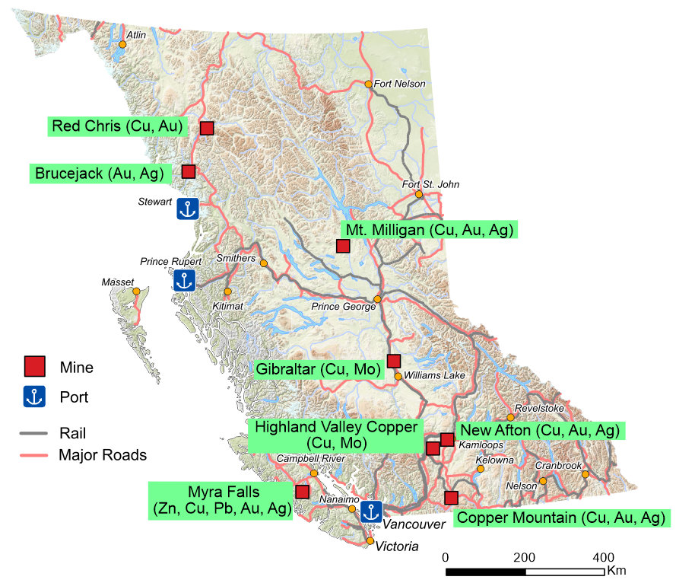
British Columbia Metal Mines 2021
All of British Columbia’s currently operating metal mines are porphyry deposits with the exceptions of:
Myra Falls
Brucejack
Bonanza Ledge II
Elk
Myra Falls, New Afton Brucejack, and Bonanza Ledge II are the only underground operations.
Bonanza ledge II (650 tpd) and Elk (approx. 200 tpd) are small scale operations.
Bonanza Ledge II (Au)
Elk (Au, Ag)

Slide 6
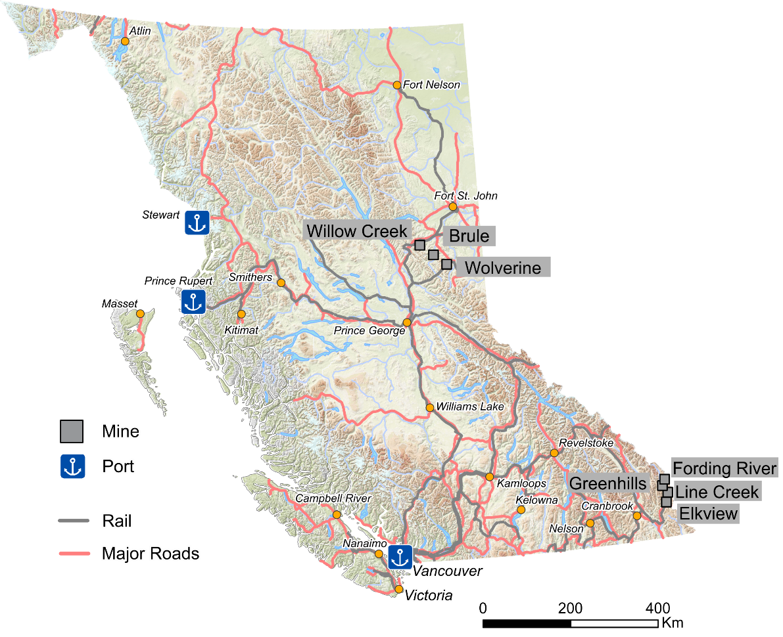
British Columbia Coal Mines 2021
Conuma Coal Resources Limited operated three mines in the northeast.
The four mines in the southeast are operated by Teck Coal Limited.
All are open pit operations.
The coal is metallurgical grade and BC exports are typically 25-30 million tonnes per year.
Conuma and Teck benefited this year from high metallurgical coal prices.

Slide 7
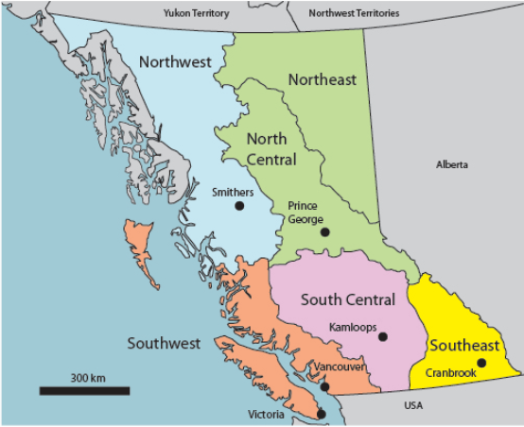
Regional Geologists
Five Regional Geologists in BC based in regional offices (2 vacant positions)
Since June 2020 RG’s are now in the BCGS (4 positions previously in the Health, Safety and Permitting branch)
BCGS/MDO co-ordinates their geoscience outputs and publishes the annual Overview of Exploration and Mining in BC publication
Regional geologists and the MDO collect mineral exploration data for the Ernst & Young (EY) survey of BC mineral and coal exploration

Slide 8
Regional Geologist Staffing Update and BCGS Job Postings
Smithers Office Update
Nate Corcoran who is the current Regional Geologist in Prince George is transferring to the Smithers office.
Active date start of April 1st.
BCGS Job Postings
Current Posted Positions
· Geomatics Geoscientist (Victoria based)
· Geomatics Specialist (Victoria based)
· Regional Geologist (Prince George based)
Upcoming Posting
· Minerals Geologist (Victoria based)
Review and apply at:
https://www2.gov.bc.ca/gov/content/industry/mineral-exploration-mining/british-columbia-geological-survey/employment-opportunities

Slide 9
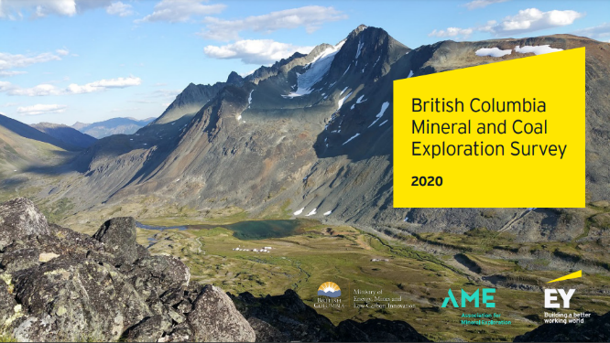
Ernst &Young LLP 2021 Mineral and Coal Exploration Survey
Joint initiative between the Province of British Columbia, Ministry of Energy Mines and Low Carbon Innovation, the Association for Mineral Exploration and EY LLP
Full report to be released in April

Slide 10
2021 The Year of
Continued COVID
Forest Fires
Severe Flooding
Forest fires and flooding disrupted exploration programs in southern British Columbia
Despite this, the province experienced a near record in mineral exploration expenditures
High volumes of samples, late programs and Covid protocols meant a backlog at assay labs. Many projects are still expecting assays results for 2021 work

Slide 11
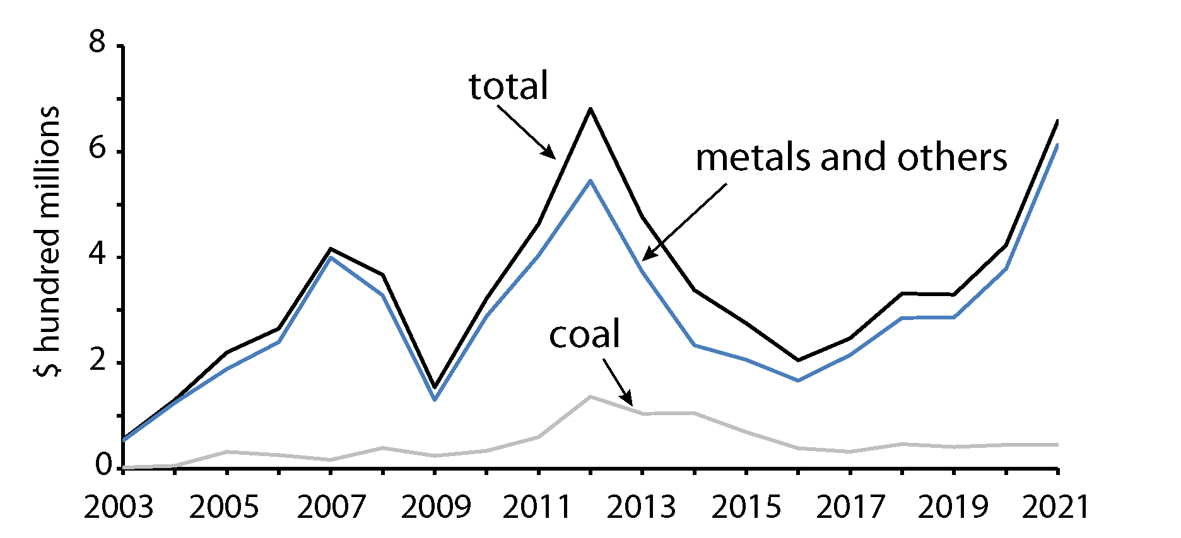
Exploration Expenditures 2021
Total for 2021 $659.8 million
$629.2 million Metal + other
$30.6 million – Coal
Increase of $237.1 million vs 2020
Metal + other is the highest recorded
In 2012 metal plus other was $544.9 million
In 2012 coal was $136.1 million

Slide 12
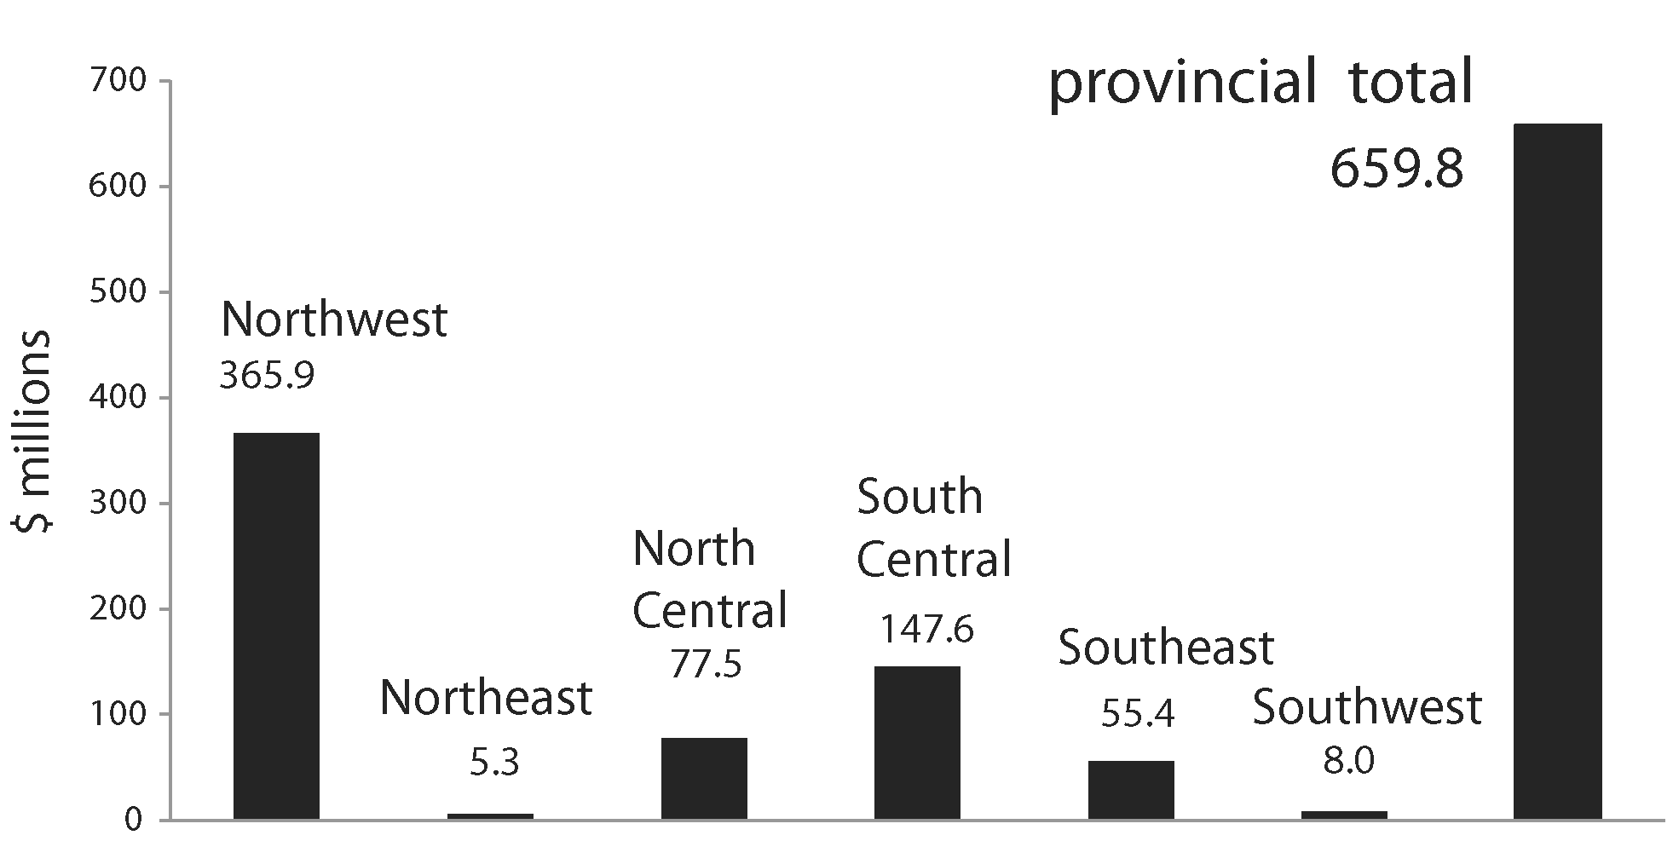
Exploration Expenditures by Region 2021

Slide 13
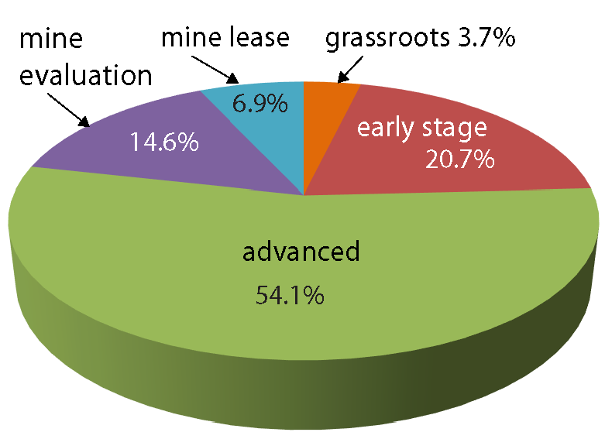
Exploration Expenditures by Category 2021
Provincial Average

Slide 14
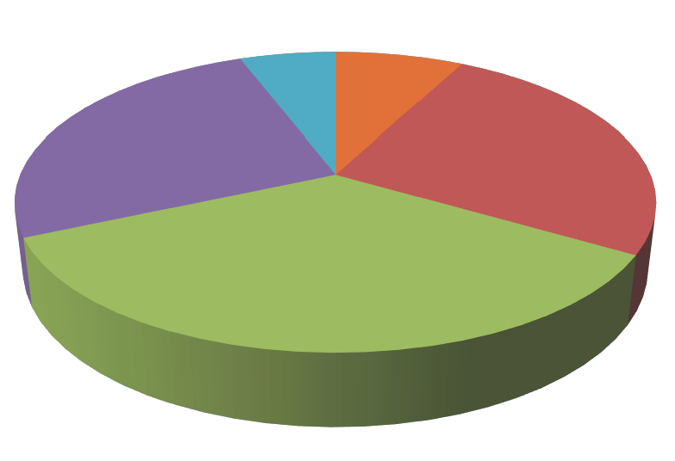
Exploration Expenditures by Category (2020 vs 2021)
5.8%
7.7%
25.8%
25.7%
35.0%
2020 Provincial Average 2021 Provincial Average
Combined grassroots and early stage decrease 24.4% (2021) vs 33.4% (2020)

Slide 15
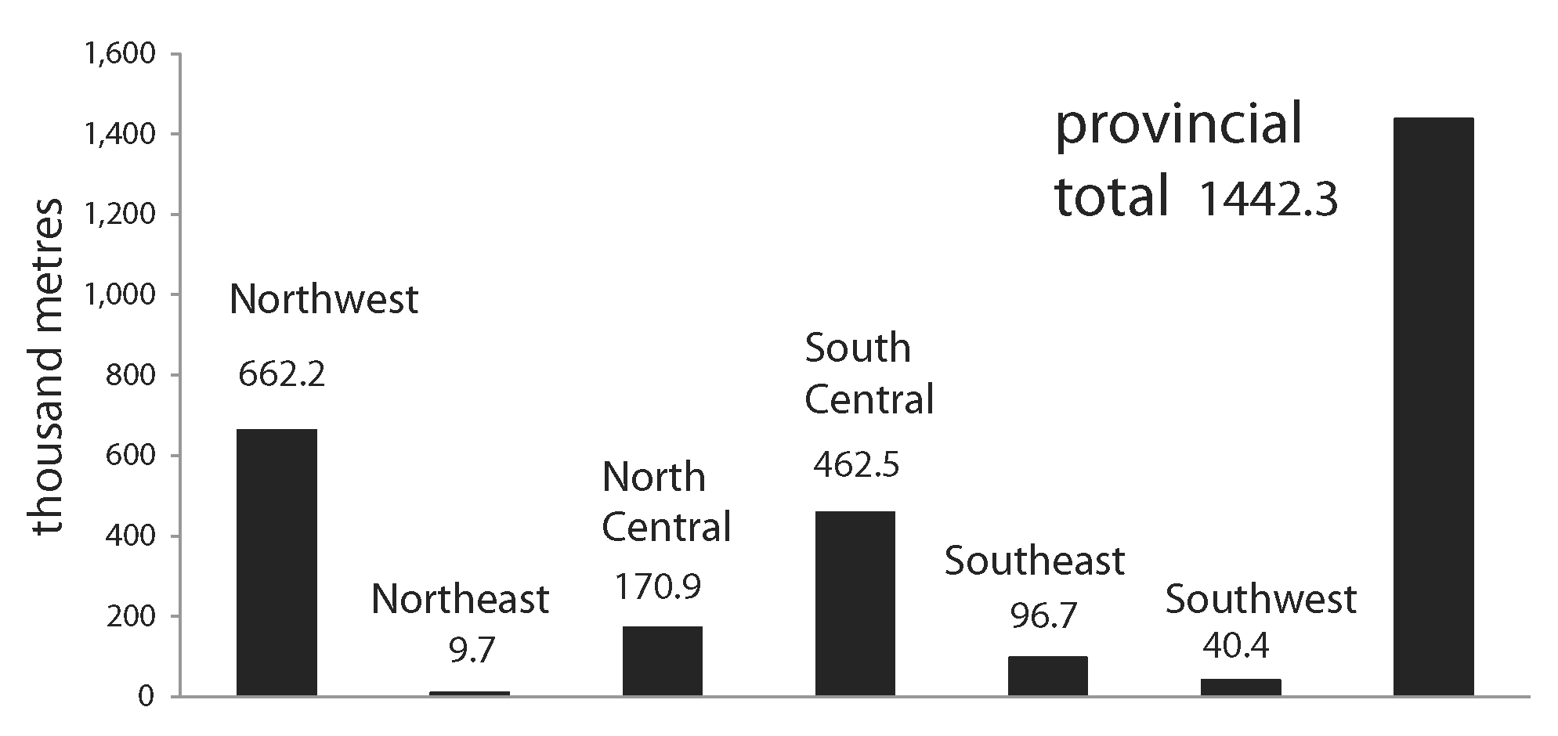
Exploration Drilling
Increase of 451,000 m over 2020 total

Slide 16
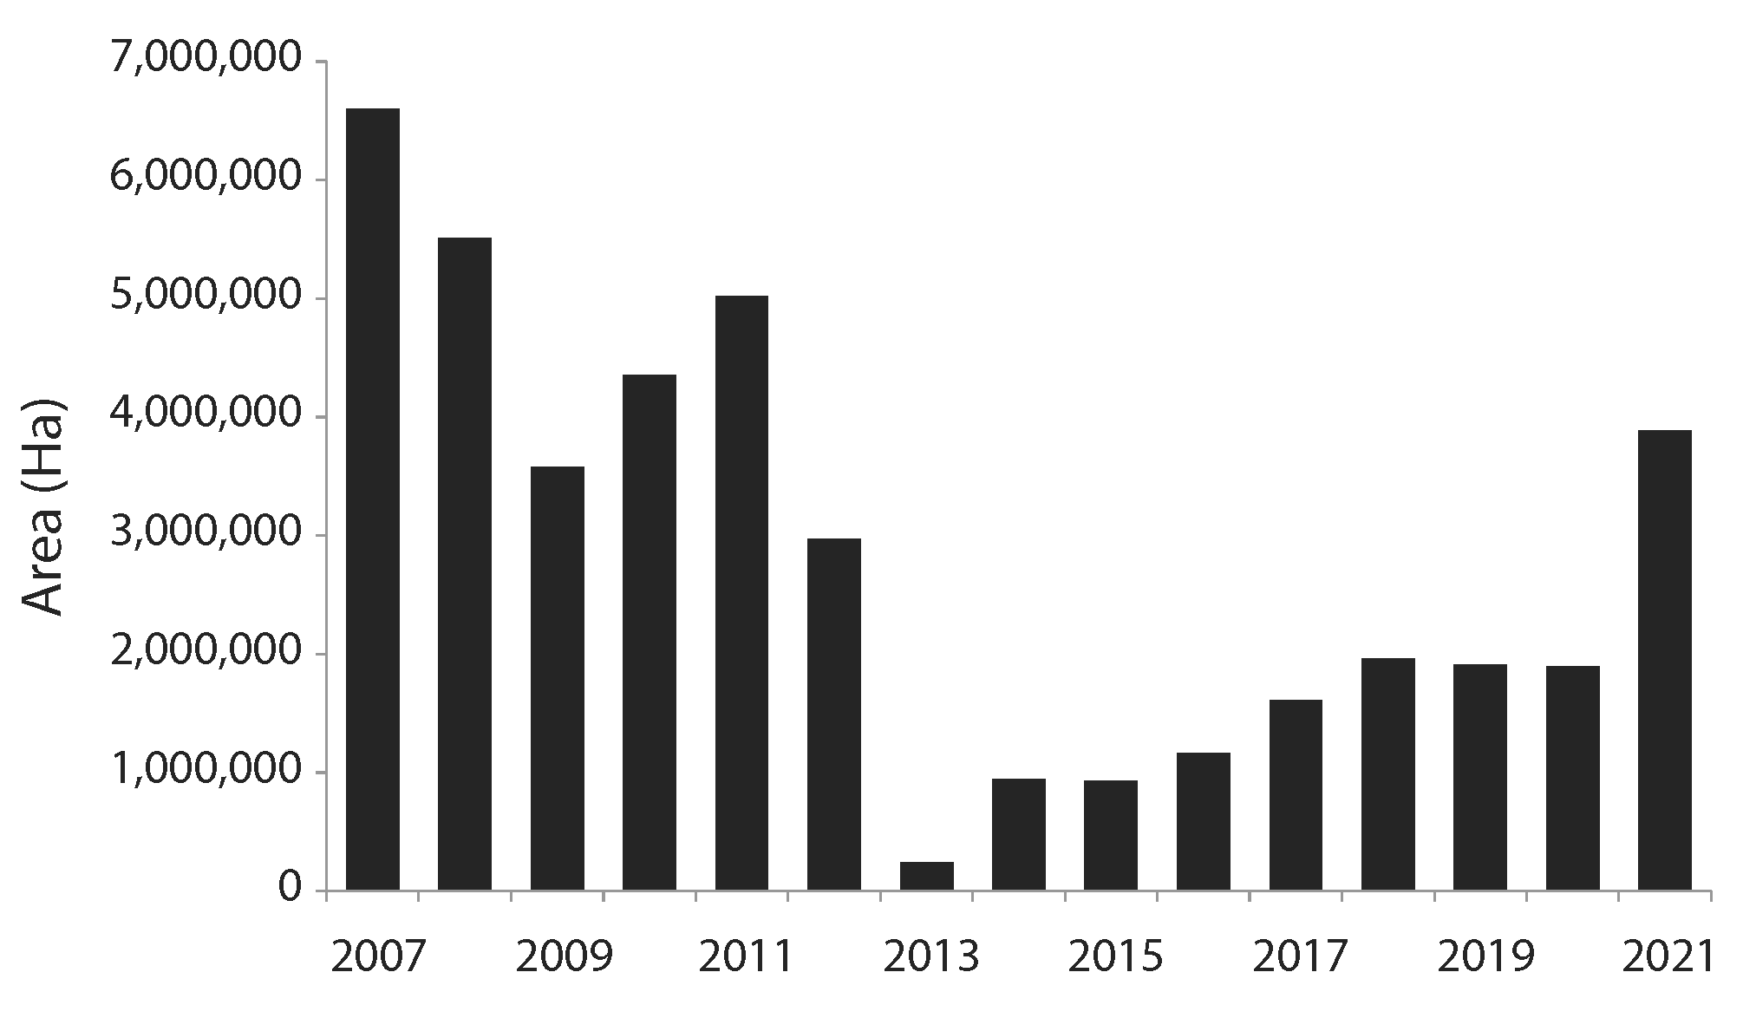
New Mineral Claims (ha)
2021 total 3.9 million (ha)
Increase of ~ 2.0 million (ha) vs 2020

Slide 17
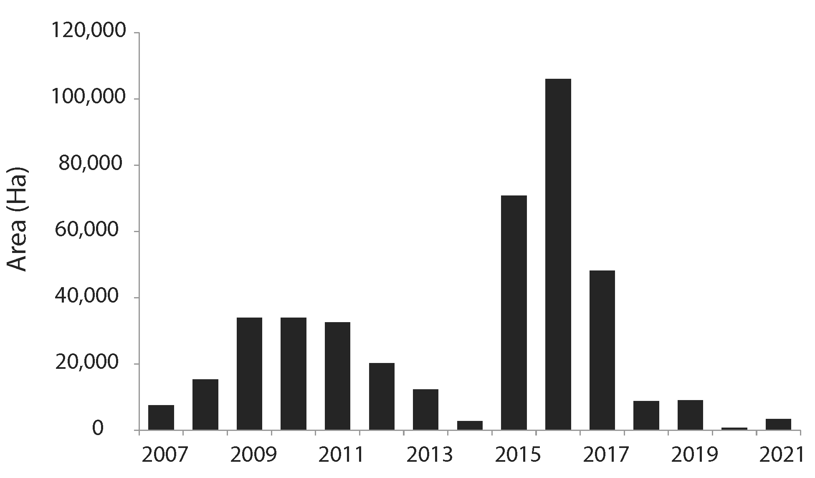
New Coal Licenses Issued (ha)
2021 issued 3,462 (ha)
2020 issued 811 (ha)
2019 issued 9,045 (ha)
2018 Issued 8,852 (ha)
2017 Issued 48,118 (ha)
2016 Issued 105,991 (ha)
2015 Issued 70,806 (ha)
2014 Issued 2,839 (ha)

Slide 18
Significant Events 2021
Mine development
Acquisitions and Earn Ins
Resource Announcements
Economic Studies

Slide 19
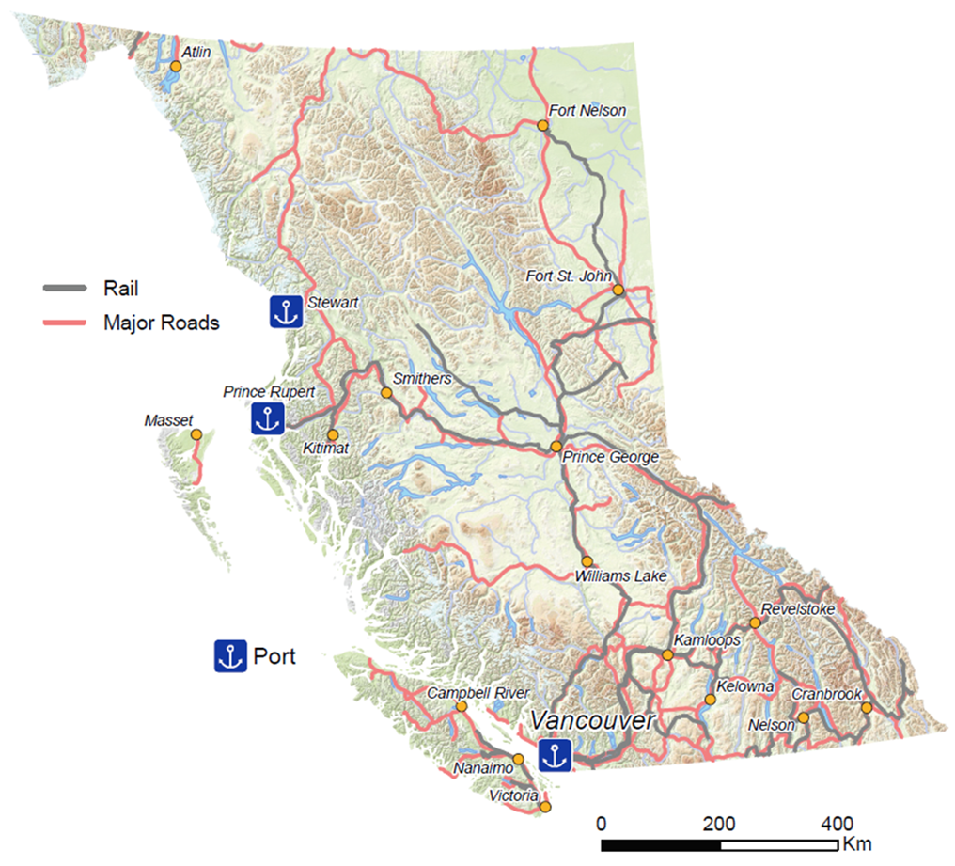
Significant Events
Mine Development Projects
  Premier Gold (Ascot Resources Ltd.)
  Received Mines Act permit for construction and operation in December
  Full scale construction to start
  8-year LOM
  Production target Q1 2023
  Horse Creek Silica (Sinova Global)
  Site preparation
  Planned production up to 400,000 tpy
  Kootenay West (CertainTeed Gypsum Canada Inc.)
  Mine construction continuing
  Planned production 400,000 tpy
Premier Gold (Au, Ag)
Horse Creek Silica (Silica)
Kootenay West (Gypsum)

Slide 20
Significant Events (cont.)
Acquisitions and Earn Ins
  Newmont Corporation purchases GT Gold Corp. for estimated $456 million
  Assets include the Saddle North deposit
  Hochschild Mining PLC announced their intent to earn a 60% interest in the Snip Gold project from Skeena Resources Limited by spending approximately $100 million during the option period
  Newcrest Mining Limited offers to purchase the Brucejack mine from Pretium Resources Inc. for approximately $3.5 billion
Saddle North (Cu, Au, Ag)
Snip Gold (Au, Ag)
Brucejack (Au, Ag)

Slide 21
Significant Events (cont.)
Resource Announcements
  Lawyers ( Benchmark Metals Inc.)
  Filed an updated Resource estimate
  Indicated 40.3 Mt at 1.19 g/t Au, 38.7 g/t Ag
  Inferred 16.2 Mt at 1.19 g/t Au, 34.7 g/t Ag
  Treaty Creek (Tudor Gold Corp. 60%, Teuton Resources Corp. 20%, American Creek Resources Ltd. 20%)
  Filed an initial Resource estimate
  Meas & Ind 815.7 Mt at 0.66 g/t Au, 3.6 g/t Ag, 0.06% Cu
  Inferred 311.7 Mt at 0.72 g/t Au, 4.0 g/t Ag, 0.05% Cu
Lawyers (Au, Ag)
Treaty Creek (Au, Ag)

Slide 22
Significant Events (cont.)
Resource Announcements (cont.)
  Schaft Creek (Teck Resources Limited 75%, Copper Fox Metals Inc. 25%)
  Filed an updated Resource estimate
  Meas & Ind 1.35 Bt at 0.26% Cu, 0.16 g/t Au, 0.017 % Mo, 1.25 g/t Ag
  Inferred 343.6 Mt at 0.17% Cu, 0.11 g/t Au, 0.013 g/t Mo, 0.84 g/t Ag
  Stardust (Northwest Copper Corp.)
  Filed a new Resource estimate
  Indicated 1.31 Mt at 1.65% Cu, 1.82 g/t Au, 33.2 g/t Ag
  Inferred 3.09 Mt at 1.10% Cu, 1.54 g/t Au, 24.9 g/t Ag
  (at a US $105/t cut-off)
Schaft Creek (Cu, Au, Mo, Ag)
Stardust (Cu, Au, Ag)

Slide 23
Significant Events (cont.)
Resource Announcements (cont.)
  Lac La Hache (Engold Mines Ltd.)
  New Resource estimates for the G1 and Spout copper deposits
    G1 (underground) - Inferred 1.71 Mt at 1.25% Cu, 6.45 g/t Ag, 0.19 g/t Au, 30.94% magnetite
    Spout (open pit) - Indicated 6.5 Mt at 0.33% Cu, 1.34 g/t Ag, 0.05 g/t Au, 11.63% magnetite. - Inferred 7.66 Mt at 0.27% Cu, 0.99 g/t Ag, 0.04 g/t Au, 9.50% magnetite
    Spout (underground) - Inferred 0.39 Mt 1.00% Cu, 2.58 g/t Ag, 0.13 g/t Au, 10.33% magnetite
    Revised Resource for the Aurizon South gold deposit - Inferred 1.99 Mt at 2.32 g/t Au, 0.6% Cu, 5.37 g/t Ag
  Shovelnose Gold (Westhaven Gold Corp.)
  Recently filed an initial Resource estimate
  Indicated 841,000 oz at 2.47 AuEq
  Inferred 277,000 oz at 0.94 g/t AuEq
Lac La Hache (Cu, Au, Ag, magnetite)
Shovelnose Gold (Au, Ag)

Slide 24
Significant Events (cont.)
Resource Announcements (cont.)
  Wicheeda (Defense Metals Corp.)
  Filed an update Resource estimate (part of PEA)
  Indicated 5.0 Mt at 2.95% TREO
  Inferred 29.5 Mt at 1.83% TREO
  Revel Ridge (Rokmaster Resources Corp.)
  Filed an updated Resource estimate
  Meas & Ind 6.7 Mt at 50 g/t Ag, 3.69 g/t Au, 1.93% Pb, 3.68% Zn
  Inferred 6.0 Mt at 37 g/t Ag, 4.7 g/t Au, 1.19% Pb, 2.20% Zn
Wicheeda (LREE)
Revel Ridge (Au, Ag, Pb, Zn)

Slide 25
Significant Events (cont.)
Resource Announcements (cont.)
  Spanish Mountain (Spanish Mountain Gold Ltd.)
  Filed an updated Reserve and Resource estimate (part of PFS)
  Proven & Probable 95.9 Mt at 0.76 g/t Au, 0.71 g/t Au
  Meas & Ind 294.2 Mt at 0.50 g/t Au, 0.72 g/t Ag
  Inferred 18.3 Mt at 0.63 g/t Au, 0.76 g/t Ag
  Jersey Emerald (Apex Resources Inc.)
  Filed an updated Resource estimate
  Indicated 1.47 Mt at 0.173% WO₃, 0.05 g/t Au, 0.021% Mo
  Inferred 5.13 Mt at 0.227% WO₃, 0.081 g/t Au, 0.026% Mo
Spanish Mountain (Au, Ag)
Jersey Emerald (W, Mo, Au)

Slide 26
Significant Events (cont.)
Economic Studies
  Schaft Creek (Teck Resources Limited 75%, Copper Fox Metals Inc. 25%)
  Preliminary Economic Assessment filed
    After-tax NPV of US$842.1 million and IRR of 12.9%
    21-year LOM
    Recommends advancing to PFS
  Eskay Creek (Skeena Resources Limited)
  Prefeasibility Study filed
    After-tax NPV of C$1.4 billion and IRR 56%
    9.8-year LOM
    Based on open pit resource
    Project has underground exploration potential
Schaft Creek (Cu, Au, Mo, Ag)
Eskay Creek (Au, Ag)

Slide 27
Significant Events (cont.)
Economic Studies (cont.)
  Kutcho (Kutcho Copper Corp.)
  Feasibility Study filed
    After-tax NPV of C$461 million and IRR of 25%
    11-year LOM (open pit and underground)
  Wicheeda (Defense Metals Corp.)
  Preliminary Economic Assessment filed
    After-tax NPV of C$512 million and IRR of 16%
    16-year LOM (open pit)
Kutcho (Cu, Zn, Au, Ag)
Wicheeda (LREE)

Slide 28
Significant Events (cont.)
Economic Studies (cont.)
  Blackwater Gold (Artemis Gold Inc.)
  Feasibility Study filed
    After-tax NPV of C$2.15 billion and IRR of 32%
    22-year LOM (open pit)
    Issued a Mines Act Permit allowing start of early construction
  Spanish Mountain (Spanish Mountain Gold Ltd.)
  Prefeasibility Study filed
    After-tax NPV of C$655 million and IRR of 22%
    14-year LOM (open pit)
  North Island (Northisle Copper and Gold Inc.)
  Preliminary Economic assessment filed
    After-tax NPV of C$1.06 billion and IRR of 19%
    22-year LOM (open pit)
Spanish Mountain (Au, Ag)
Blackwater Gold (Au, Ag)
North Island (Cu, Mo, Au, Re)

Slide 29

Selected Exploration Highlights 2021
Silvertip (Ag, Zn, Pb)
Silvertip Mine (Coeur Mining Inc.)
Still on care and maintenance, but large drilling program carried out
New flat lying manto mineralization discovered
Results included 10.8 m grading 445.7 g/t Ag, 19.4% Zn, 7.5% Pb
Potential restart on a larger scale than previous operations
Red Chris Mine (70% Newcrest Mining Limited, 30% Imperial Metals Corporation)
Deep drilling east of current mineral resource continues to return high grade intersections
Results included 254 m grading 1.1% Cu and 1.0 g/t Au
Red Chris (Cu, Au, Ag)

Slide 30

Selected Exploration Highlights 2021 (cont.)
Ranch (Thesis Gold Inc.)
16,000 m diamond drilling
Results include 34 m grading 19.56 g/t Au (including 7 m grading 82.48 g/t Au) and 25 m grading 9.53 g/t Au
Brucejack Mine (Pretium Resources Inc.)
Resource expansion drilling north of the Valley of Kings deposit defines a new area referred to as the North Block zone
  High grade intersections reported including 12.0 m grading 80.7 g/t Au with a 1.0 m intersection grading 941.0 g/t Au; and 15.0 m grading 493.2 g/t Au, with a 1.0 m intersection grading 7,360 g/t Au
3.5 km north of the mine another new discovery called the Marmot zone
  More high grade interesections, results include 53.5 m grading 72.5 g/t Au, including 6,700 g/t Au along 0.5 m, 5.8 m grading 46.1 g/t Au, and 38.0 m grading 22.8 g/t Au.
Ranch (Au, Ag)
Brucejack (Au, Ag)

Slide 31
Selected Exploration Highlights 2021 (cont.)
  Lawyers ( Benchmark Metals Inc.)
  70,000 m of diamond drilling and 10,000 m of RC drilling
  Drilling delineated along-strike, near-surface continuation of gold and silver mineralization for 300 m between the Cliff Creek and Dukes Ridge deposits
  Highlight results included 68.58 m of 3.07 g/t Au and 11.72 g/t Ag; 41.15 m of 1.31 g/t Au and 30.77 g/t Ag; and 25.91 m of 2.40 g/t Au and 47.99 g/t Ag
  Eskay Creek (Skeena Resources Ltd.)
  Approximately 40,000 m of drilling
Lawyers (Au, Ag)
Eskay Creek (Au, Ag)

Slide 32
Selected Exploration Highlights 2021 (cont.)
  Kwanika (Kwanika Copper Company (NorthWest
  Copper Corp. 69%, Posco International Corporation 31%))
  11,000 m of diamond drilling to expand the resource and better define high grade mineralization
  Results included 230.5 m grading 0.70% Cu, 0.84 g/t Au, 2.3 g/t Ag, and 235.45 m with grades of 2.0% Cu, 1.21 g/t Au, and 5.3 g/t Ag, which includes 153.25 m at 2.84% Cu, 1.69 g/t Au, 7.5 g/t Ag
  Wicheeda (Defense Metals Corp.)
  5,300 m of diamond drilling for resource expansion
  Mineralization intersected outside of known resource
Kwanika (Cu, Au, Ag)
Wicheeda (LREE)

Slide 33
Selected Exploration Highlights 2021 (cont.)
  Decar Nickel District (FPX Nickel Corp.)
  Project includes the Baptiste deposit
    Indicated 2.0 Bt 0.122% Ni
    Inferred 593 Mt 0.114% Ni
  2,700 m of diamond drilling
  Results from the new Van target included total nickel of 0.21% along 287 m, 0.197% along 270 m, 0.207% along 101 m, and 0.215% along 103 m
  Potential for a new standalone deposit rivaling Baptiste
  Ootsa (Surge Copper Corp.)
  41,000 m of diamond drilling
  Results have potential to expand the deposit and to improve grade within existing volumes
  Results for West Seel deposit included 495 m grading 0.25% Cu, 0.21 g/t Au, 3.4 g/t Ag, and 0.021% Mo
Decar Nickel District (Ni)
Ootsa (Cu, Au, Ag, Mo)

Slide 34
Selected Exploration Highlights 2021 (cont.)
  Cariboo Gold (Osisko Development Corp.)
  152,000 m of diamond drilling
  Property consolidates several historic gold mines
  Permitted to begin underground development at Cow Mountain which is separate from Bonanza Ledge II
  Blackdome Elizabeth (Tempus Resources Ltd.)
  7,740 m of diamond drilling
  Early highlight results include 3.4 m (true thickness) grading 34.4 g/t Au and 1.28 m grading 68.30 g/t Au. A newly discovered vein, which returned 1.0 m grading 33.7 g/t Au and 0.5 m grading 26.4 g/t Au, has been traced along a 380 m strike length
Cariboo Gold (Au, Ag)
Blackdome Elizabeth (Au, Ag)

Slide 35
Selected Exploration Highlights 2021 (cont.)
  Bralorne (Talisker Resources Ltd.)
  100,000 m of diamond drilling
  Results to be used for a resource estimate expected this year
  Numerous narrow high-grade intersections reported along with lower grade near-surface intersections
  MPD (Kodiak Copper Corp.)
  22,000 m of diamond drilling completed
  30,000 m was planned but work suspended due to fall flooding
  Continued to report good results for drilling of deep porphyry targets
  Results included 504 m grading 0.37% Cu, 0.15 g/t Au, 1.11 g/t Ag
Bralorne (Au, Ag)
MPD (Cu, Au)

Slide 36
Selected Exploration Highlights 2021 (cont.)
  North Island (Northisle Copper and Gold Inc.)
  Diamond drilling of 4 target areas
  Recent results for the Northwest Expo target confirm gold-rich copper porphyry 480 m strike, 360 m down dip, 86 m width
  Results include 84.8 m grading 0.92 g/t Au, 0.19% Cu, 0.005% Mo, 0.17 g/t Re
  Shovelnose (Westhaven Gold Corp.)
  41,000 m of diamond drilling
  Results included 41.55 m grading 8.17 g/t Au, 34.64 g/t Ag and 27.85 m grading 7.51 g/t Au, 83.94 g/t Ag
North Island (Cu, Mo, Au, Re)
Shovelnose (Au, Ag)

Slide 37
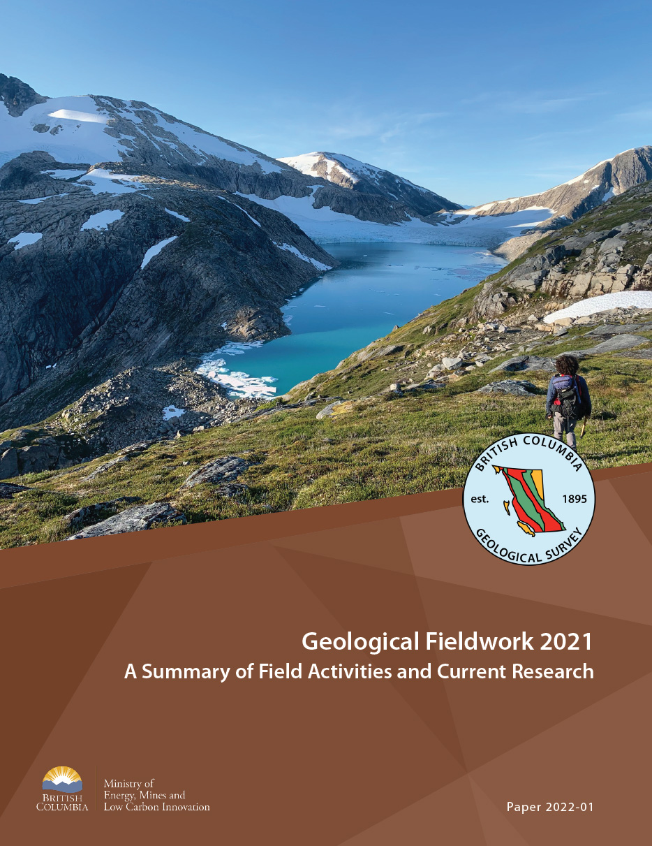
British Columbia Geological Survey
field and office programs continue despite covid and fires
results released in annual Fieldwork volume
www.gov.bc.ca/geologicalsurvey

Slide 38
BCGS Talks
Monday afternoon
Adrian Hickin - An Introduction to the Pan-Canadian Geoscience Strategy
Rebecca Hunter - Upper Hazelton VMS systems: new insights from the Kitsault area
Evan Orovan - Mineral potential modeling as a strategic planning tool in British Columbia
Tuesday morning
Travis Ferbey - Acquiring multi-sensor UAV data for a geological field program
Luke Ootes - Absent or present? The role of ancient crust in Cu-Au rich environments
Posters
Please visit the poster session

Slide 39
Summary
Mine production is a key component of British Columbia’s economy
Mining and exploration programs reached new heights in 2021
Exploration programs continue to produce excellent results
Advanced exploration adds to British Columbia’s mineral inventory
British Columbia continues to attract large investment dollars for both exploration and established mines

Slide 40
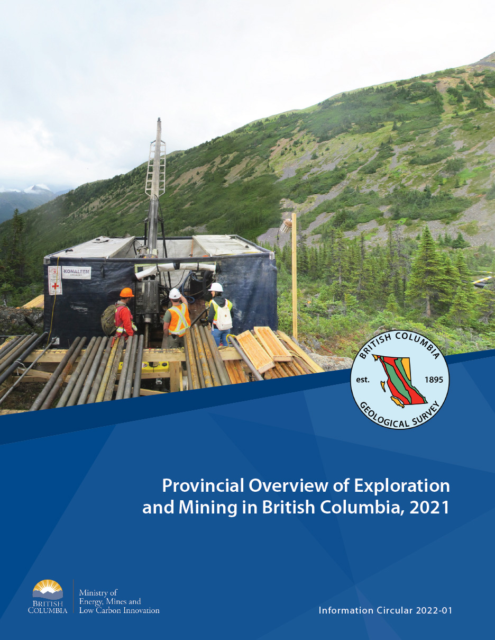
New Publications Now Available
https://www2.gov.bc.ca/gov/content/industry/mineral-exploration-mining/british-columbia-geological-survey/publications
Notes:
.

Slide 41
We are back in person
Please stop by our Booth in the Exhibit Hall
BC Ministry of Energy, Mines, and Low Carbon Innovation
Booth Number 419/421

Slide 42
Thank You

