Slide 1

British Columbia Exploration and Mining 2020
Gordon Clarke
BCGS Mineral Development Office
AME Roundup 2021

Slide 2
Outline
Mining Production
Exploration Expenditures
Significant Events
Exploration Highlights
British Columbia Geological Survey Activities
Summary

Slide 3
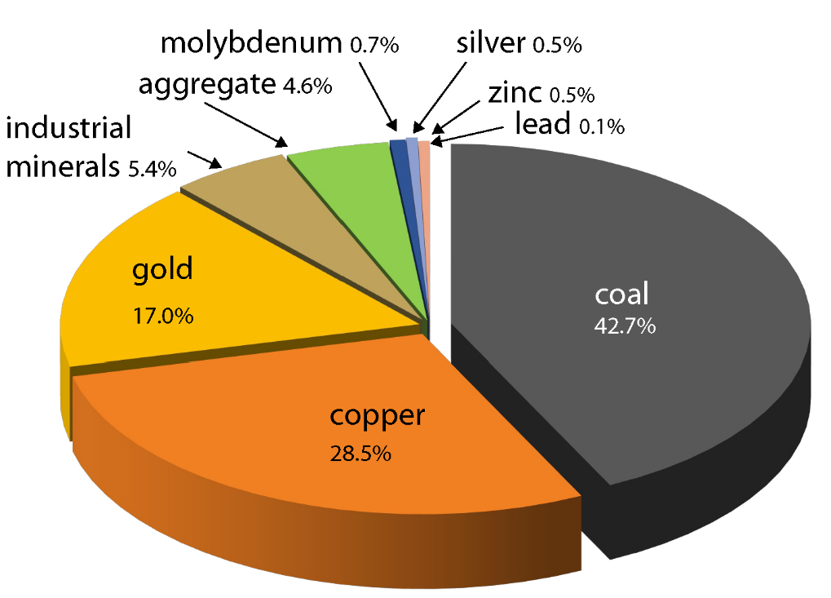

British Columbia Mining Production 2020
Canada’s largest producer of copper and coal. Canada’s only producer of molybdenum.
Production value increase of $0.48 Billion from 2019 estimated production of $8.8 Billion*
Forecast Mine Production Value $9.28 Billion
Source: NRCAN and BC EMLC
*Forecast vs preliminary estimate
Notes:
.

Slide 4
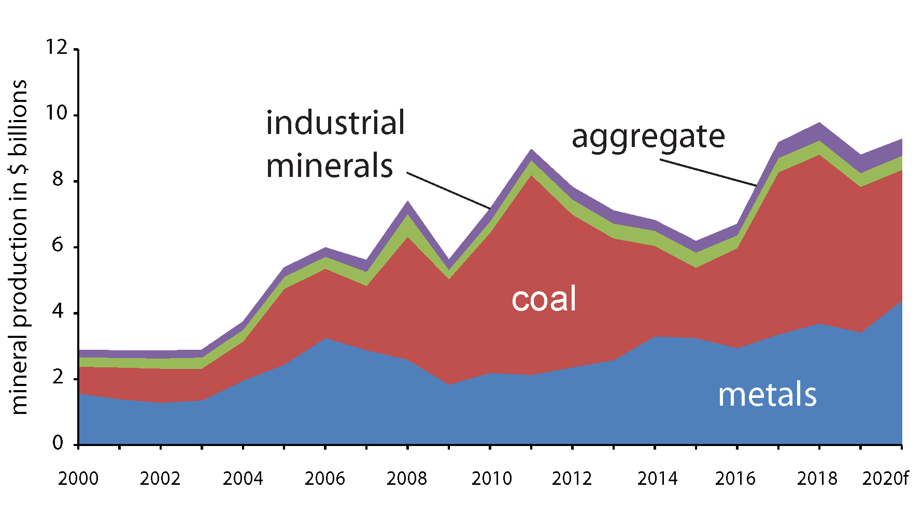
Mining Production 2000-2020
Increase of $0.48 Billion vs 2019 preliminary estimate
$9.28 Billion (forecast)
Value of British Columbia mineral production by year 2000-2020

Slide 5
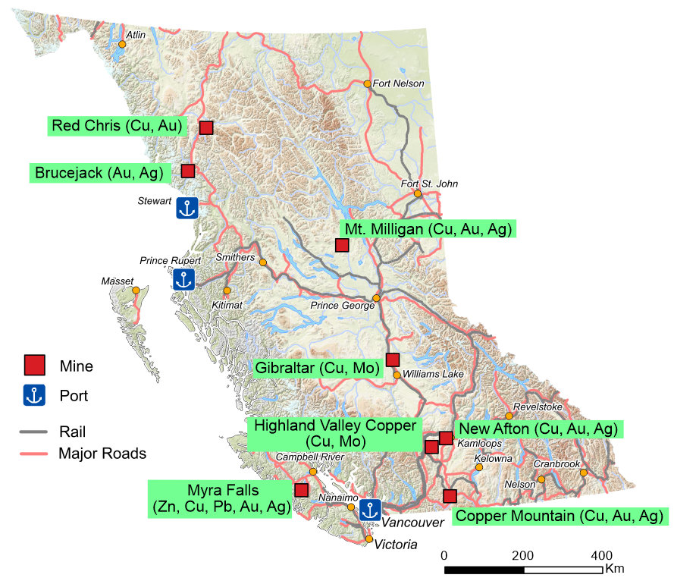
British Columbia Metal Mines 2020
All of British Columbia’s currently operating metal mines are porphyry deposits with the exceptions of:
Myra Falls - Volcanogenic Massive sulphide
Brucejack – Epithermal
Myra Falls, New Afton and Brucejack are the only underground operations.
Silvertip placed on temporary shutdown in February.
Silvertip (Ag, Pb, Zn)

Slide 6
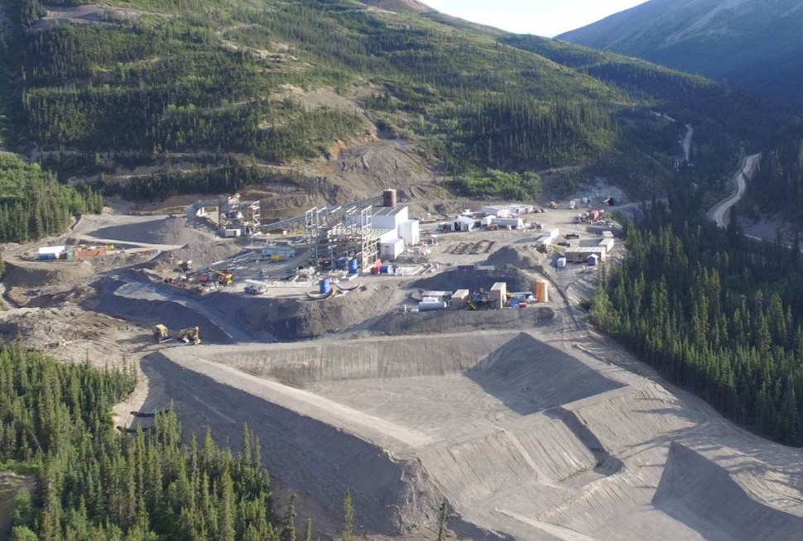
But there is some good news regarding
Coeur Mining Inc.’s Silvertip mine:
An aggressive exploration program is being carried out, 60,000 m of drilling
A mill expansion is being evaluated
Drilling has located new zones with resource grade assay results
Possible restart in late 2021
Silvertip Mine

Slide 7
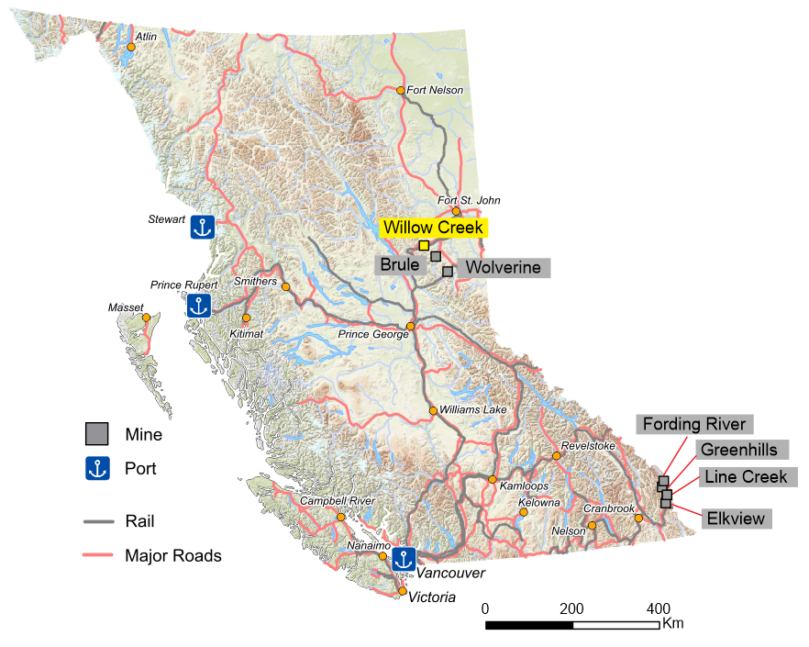
British Columbia Coal Mines 2020
Conuma Coal Resources Limited operated three mines in the northeast during 2020 but Willow Creek was shut down in July.
The four mines in the southeast are operated by Teck Coal Limited.
All are open pit operations.
The coal is metallurgical grade and BC exports are typically 25-30 million tonnes per year.

Slide 8
Ernst &Young LLP 2020 Mineral and Coal Exploration Survey
Joint initiative between the Province of British Columbia, Ministry of Energy Mines and Low Carbon Innovation, the Association for Mineral Exploration and EY LLP
Full report was released in March, 2021

Slide 9
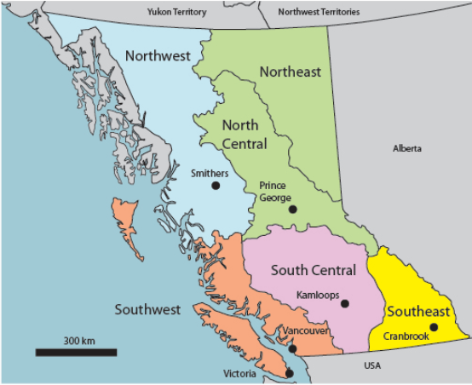
Regional Geologists
Five Regional Geologists in BC based in regional offices (2 vacant positions)
Since June they are now in the BCGS (4 positions previously in the Health, Safety and Permitting branch)
BCGS/MDO co-ordinates their geoscience outputs and publishes the annual Overview of Exploration and Mining in BC publication
Regional geologists and the MDO collect mineral exploration data for the Ernst & Young (EY) survey of BC mineral and coal exploration

Slide 10
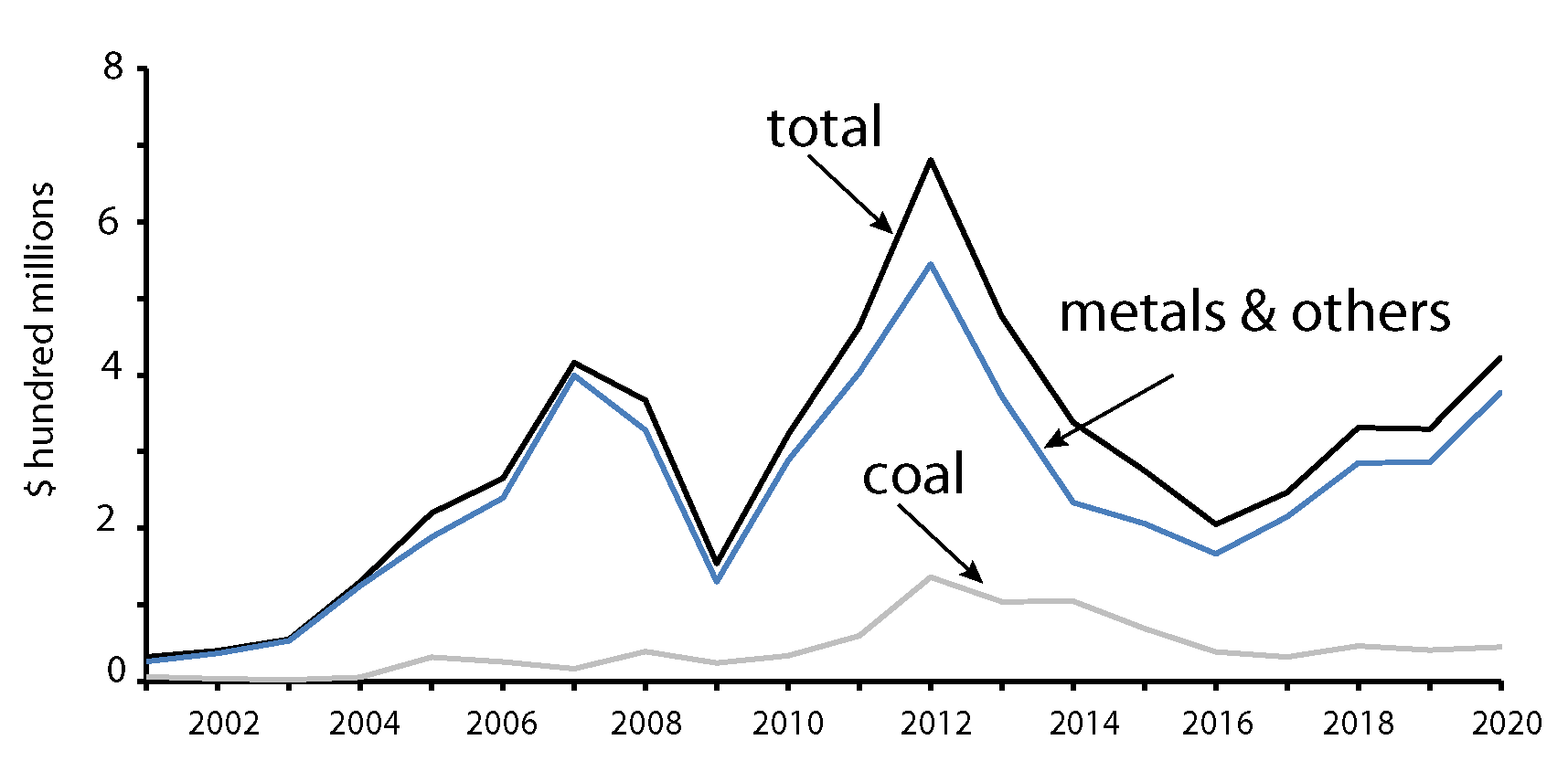
Exploration Expenditures 2020
Total for 2020 $422.7 million
$378 million Metal + other
$44.7 million – Coal
Increase of $93.2 million vs 2019

Slide 11
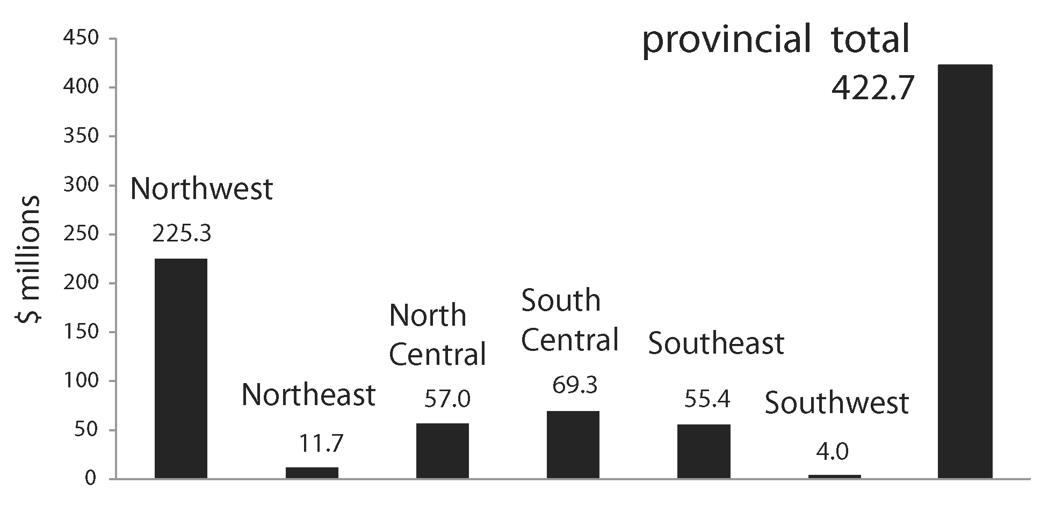
Exploration Expenditures by Region 2020

Slide 12
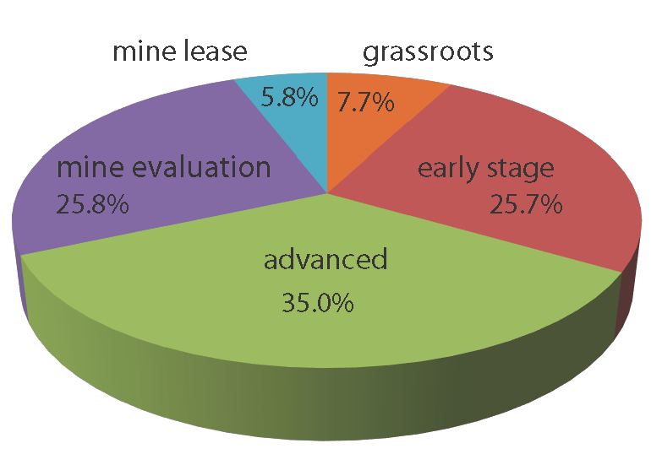
Exploration Expenditures by Category 2020
Provincial Average

Slide 13
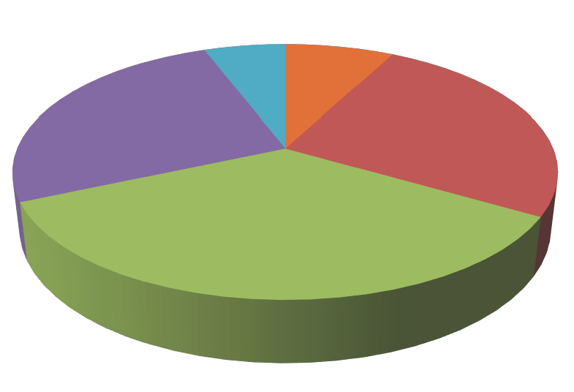
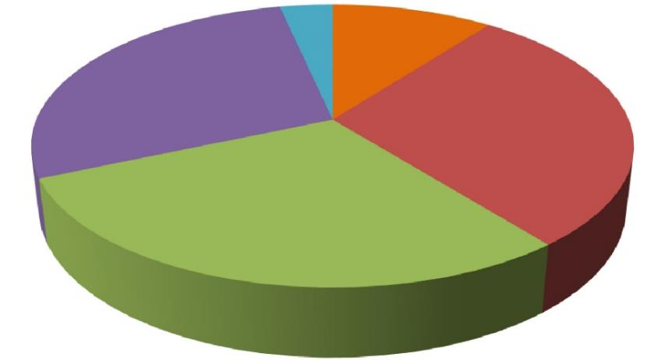
Exploration Expenditures by Category (2019 vs 2020)
3.4%
5.8%
7.7%
10.5%
27.9%
25.8%
25.7%
29.3%
28.9%
35.0%
2019 Provincial Average 2020 Provincial Average
Combined grassroots and early stage decrease 33.4% (2020) vs 39.8% (2019)

Slide 14
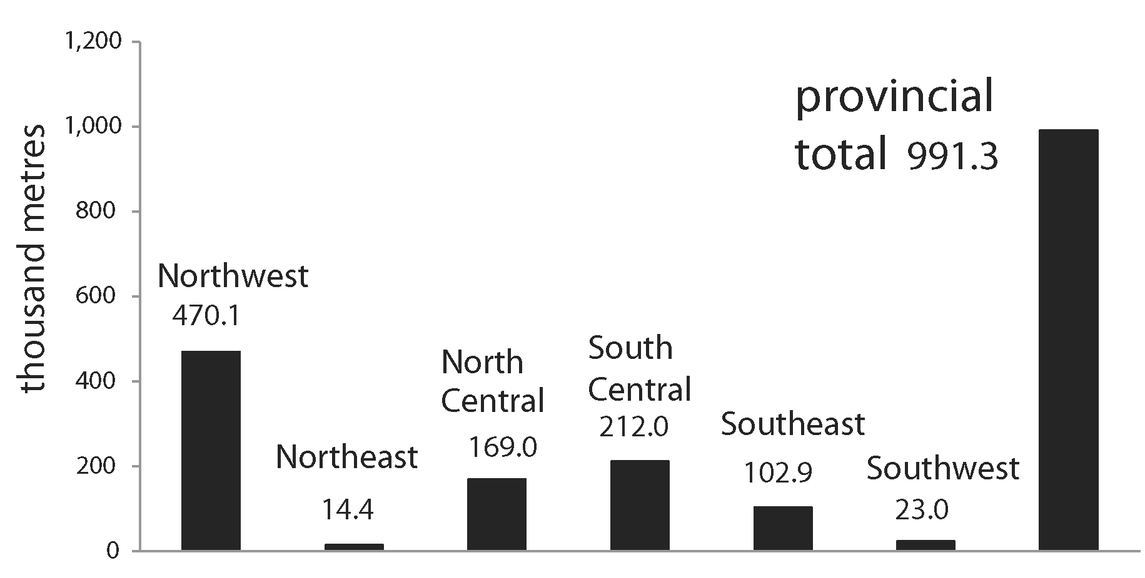
Exploration Drilling
Increase of 281,600 m over 2019 total

Slide 15
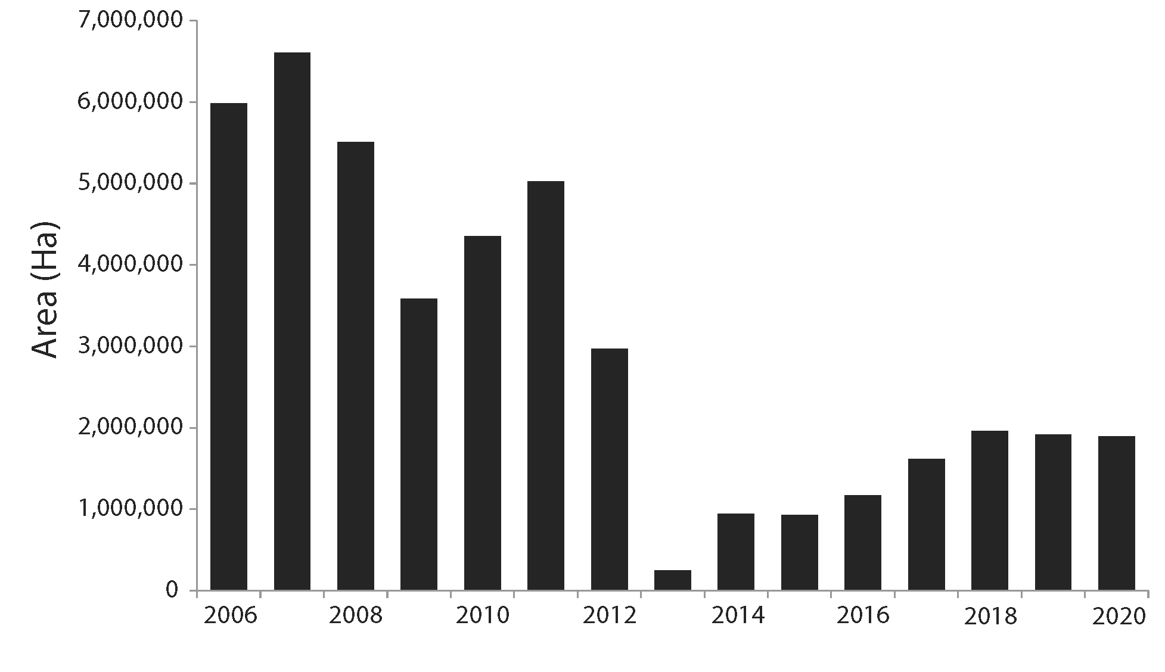
New Mineral Claims (ha)
2020 total 1,895,560 (ha)
Slight decrease of ~ 18,023 (ha) vs 2019
2013 total 246,156 (ha)

Slide 16
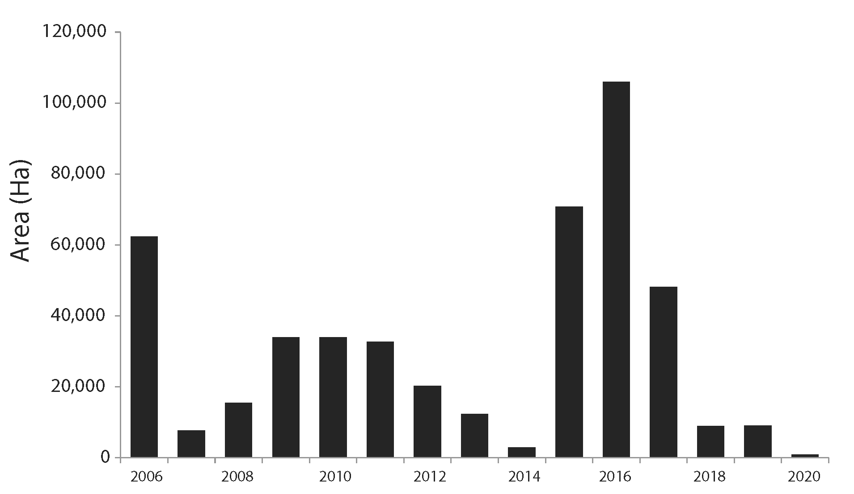
New Coal Licenses Issued (ha)
2020 issued 811 (ha)
2019 issued 9,045 (ha)
2018 Issued 8,852 (ha)
2017 Issued 48,118 (ha)
2016 Issued 105,991 (ha)
2015 Issued 70,806 (ha)
2014 Issued 2,839 (ha)

Slide 17

Significant Events 2020
Covid-19
In early March the Covid-19 threat was recognized.
The British Columbia Government reacted quickly to support mining and exploration in the province.
March 26, Mining and Exploration were deemed essential services
March 27, the Chief gold commissioner issued a blanket time extension for all claims and leases, as well as all coal licenses and leases, giving more time for recorded holders to register work, make cash in lieu of work payments and make rental payments
June 11, Guidance was provided for mining and exploration camps on developing a Covid-19 infection prevention and control protocol

Slide 18
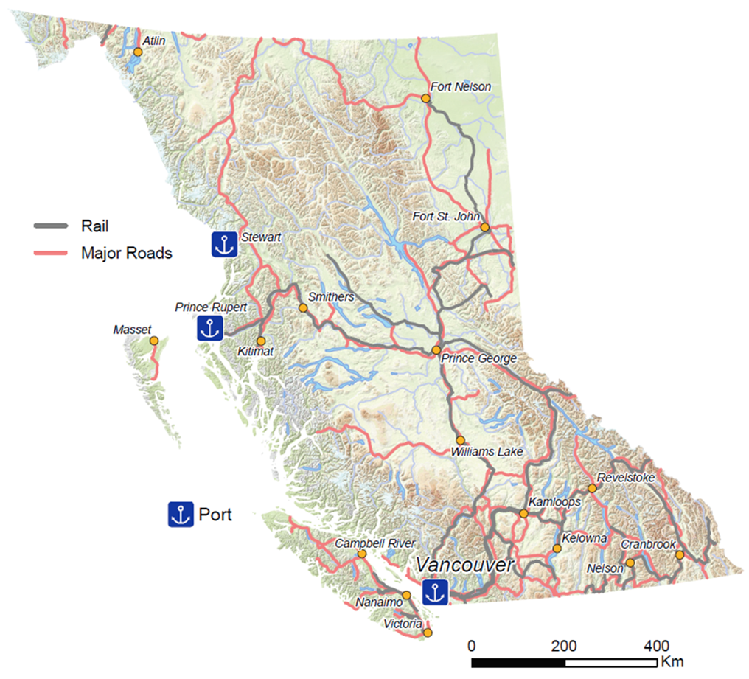
Significant Events 2020 (cont.)
Acquisitions and Mergers
Seabridge Gold Inc. purchased the Snowfield deposit from Pretium Resources Inc. for $100 million US.
  M+Ind resources of 25.9 Moz Au, 75.8 Moz Ag, 2.98 Blbs Cu, 258.3 Mlbs Mo, and 22.5 Moz Re
Artemis Gold Inc. purchased the Blackwater Gold project from New Gold Inc. for approx., $210 M
  8 M oz Au Proven & Probable
  62.3 M oz Ag Proven & Probable
Snowfield (Au, Ag, Cu, Mo, Re)
Blackwater (Au, Ag)

Slide 19
Significant Events 2020 (cont.)
Acquisitions and Mergers (cont.)
Serengeti Resources Inc. and Sun Metals Corp. entered into an agreement whereby Serengeti would acquire all issued shares of Sun Metals. The transaction would consolidate the contiguous copper-gold exploration and development assets of the Kwanika and Stardust projects.
Surge Copper Corp. entered into an option agreement with Centerra Gold Inc. whereby Surge can acquire a 70% interest in the Berg deposit for $5 million in shares and $8 million in spending commitments.
Stardust (Ag, Pb, Zn)
Kwanika (Cu, Au, Ag)
Berg (Cu, Mo, Ag)

Slide 20
Significant Events 2020 (cont.)
Mineral Resource Announcements
Skeena Resources Limited released a maiden resource for their Snip gold project
  244,000 oz Au Indicated (grade 14.0 g/t)
  402,000 oz Au Inferred (grade 13.3 g/t)
GT Gold Corp. released a maiden resource for their Saddle North copper-gold project
  Indicated Resource of 298 Mt grading 0.28% Cu, 0.36 g/t Au and 0.8 g/t Ag for a total of contained 1.81 Blb of Cu, 3.47 Moz of Au and 7.58 Moz of Ag
  Inferred Resource of 543 Mt grading 0.25% Cu, 0.31 g/t Au and 0.7 g/t Ag for a total of contained 2.98 Blb of Cu, 5.46 Moz of Au and 11.64 Moz of Ag
  Amenable to open pit as well as bulk underground mining methods
Saddle North(Cu, Au, Ag)
Snip (Au, Ag)

Slide 21
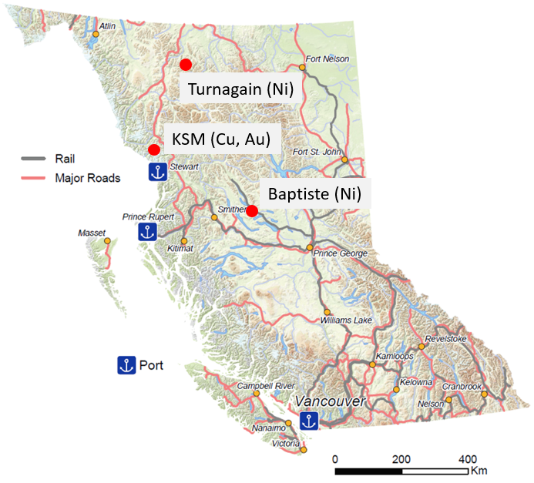
Significant Events 2020 (cont.)
Economic Studies
Seabridge Gold Inc. released a PEA for their KSM copper-gold project
  Incorporated drilling from the Iron Cap deposit
  44 year mine life
  Life of mine production 27.6 Moz Au, 17.0 Blbs Cu
Giga Metals Corp. released a PEA for their Turnagain nickel project
  35 year mine life
  1.2 Mt of Ni in concentrate at a grade of 18% Ni, 1% Co
FPX Nickel Corp. released a PEA for their Baptiste nickel project
  35 year mine life
  Annual production 99 Mlbs Ni

Slide 22
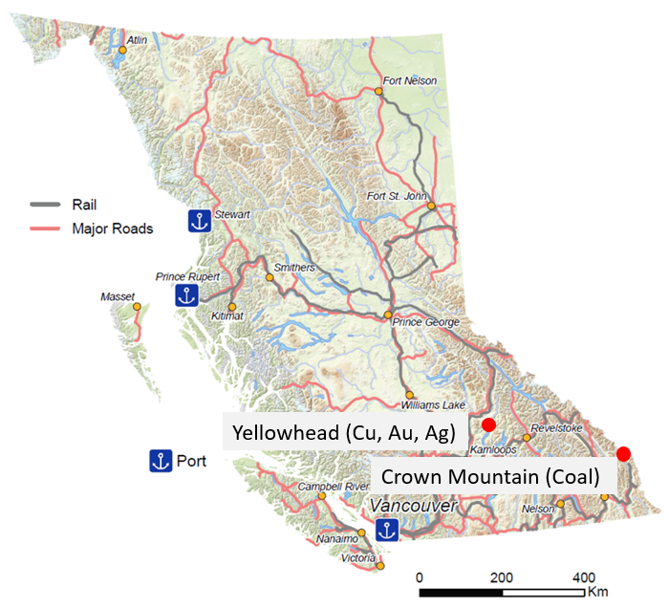
Significant Events 2020 (cont.)
Economic Studies (cont.)
Taseko Mines Ltd. released an updated feasibility study for their Yellowhead Copper project. Plan to restart EA
  817 Mt Proven & Probable 0.29% CuEq
  25 year mine production
  4.4 Blbs Cu, 440,000 oz Au, 19 Moz Ag
Jameson Resources Limited released a bankable feasibility study for their Crown Mountain coal project
  15 year mine production
  57.5 Mt Run of Mine coal
  85% hard coking coal, 15% pulverised coal injection coal

Slide 23

Selected Exploration Highlights 2020
Newmont Lake Project (Enduro Metals Corporation)
Sampling of archived unsampled drill core returned significant assays including 3.18 g/t Au and 3.66 g/t Ag over 144 m
6,000 m drilling program
New drilling intersects include 31.09 g/t Au, 6.54 g/t Ag and 1.07% Cu over 8.85 m
Treaty Creek Project (Tudor Gold Corp.)
Approx. 40,000 m of drilling
Multiple bulk tonnage grade intersections including 2.04 g/t Au and 4.13 g/t Ag over 348 m
Rocky Creek Project (CTI Plus Resources Ltd.)
3154 m of RC drilling, 818 m of DD
Trenching, sampling for coal quality testing
Newmont Lake (Au, Ag, Cu)
Treaty Creek (Au, Ag)
Rocky Creek (Coal)

Slide 24
Exploration Highlights 2020 (cont.)
E&L Project (Garibaldi Resources Corp.)
Mineralization consists of massive sulphides containing Ni and Cu in addition to Au, Ag and PGE’s
New drilling extended the strike length of mineralization by 650 m
Recent drilling results include 151.6 m grading 0.56% Ni and 0.61% Cu
Lawyers Project (Benchmark Metals Inc.)
Project has four discrete zones (Cliff Creek, Duke’s Ridge, Phoenix and AGB) targeted for their bulk tonnage potential
For 2020 a 100,000 m drill program planned
Results include 57.91 m grading 1.90 g/t Au and 91.96 g/t Ag and 128.1 m grading 1.65 g/t Au and 110.02 g/t Ag
Results are to be used to prepare a global resource estimate and a PEA in early 2021
Lawyers (Au, Ag)
E&L (Ni, Cu)

Slide 25

Exploration Highlights 2020 (cont.)
Stardust Project (Sun Metals Corp.)
High grade Cu-Au project
Drilling establishes continuity between zones along a 900 m corridor
Results include 44 m grading 1.57% Cu, 1.08 g/t Au, 28.2 g/t Ag
Ootsa Project (Surge Copper Corp.)
Late season 10,000 m drill program to test IP anomaly on the Seel trend
Highlights include 700 m grading 0.23% Cu, 0.16 g/t Au, 0.031% Mo and 3.1 g/t Ag
Additional 5,000 m of drilling planned for 2021
Ootsa (Cu, Au, Mo, Ag)

Slide 26
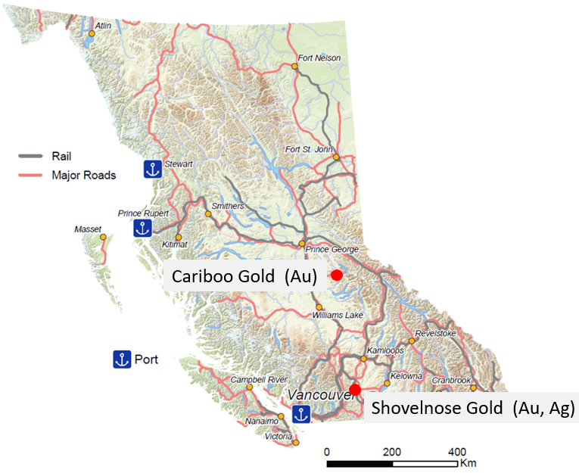
Exploration Highlights 2020 (cont.)
Cariboo Gold Project (Osisko Development Corp.)
Proposed underground gold mine
Entered EA fall 2019
59,000 m drill program this year
New discoveries announced adjacent to main deposits
Recent drilling includes 5.95 m grading 9.99 g/t Au (Valley Zone) and 12.80 m grading 20.66 g/t Au (Lowhee Zone)
Shovelnose Gold Project (Westhaven Gold Corp.)
43,000 m drill program completed
Continued success including 7.78 m grading 14.8 g/t Au and 39.40 g/t Ag at newly discovered Franz Zone

Slide 27
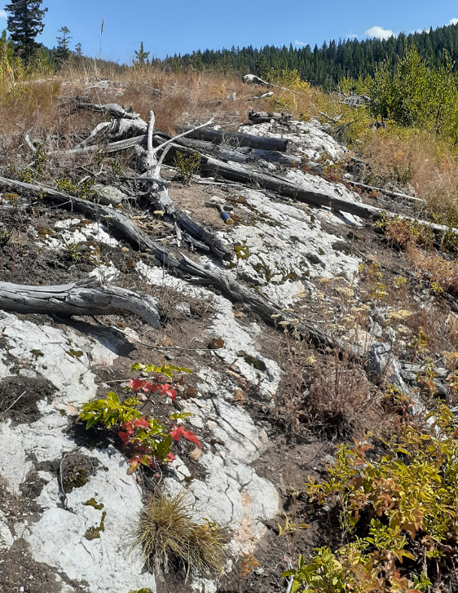
Exploration Highlights 2020 (cont.)
Mark Twain May 31, 1897
“The report of my death was an exaggeration”
Similarly Prospecting is not dead
Franz Zone outcrop found by Westhaven Gold Corp. while prospecting along strike from their South Zone discovery
Located approximately 2.8 km to the northwest of the South Zone

Slide 28

Exploration Highlights 2020 (cont.)
Deep drilling on porphyry targets highlights untapped potential
Red Chris Mine (70% Newcrest Mining Limited, 30% Imperial Metals Corporation)
Deep drilling has discovered new high grade pods. Results include 394 m grading 0.86% Cu and 1.6 g/t Au starting at 650 m, and include a 166 m interval grading 1.5% Cu and 3.0 g/t Au from 806 m down the hole
Huckleberry Mine (Imperial Metals Corporation)
Deep drilling at the former mine intersected 361 m grading 0.35% Cu from 368 to 729 m. Included 0.52% Cu over 99 m
MPD Project (Kodiak Copper Corp.)
Deep drilling returned 282 m grading 0.70% Cu and 0.49 g/t Au from 263 m to 545 m downhole
Teck Resources Limited makes a $10.5 M investment
Red Chris (Cu, Au, Ag)
Huckleberry (Cu, Mo)
MPD (Cu, Au)

Slide 29
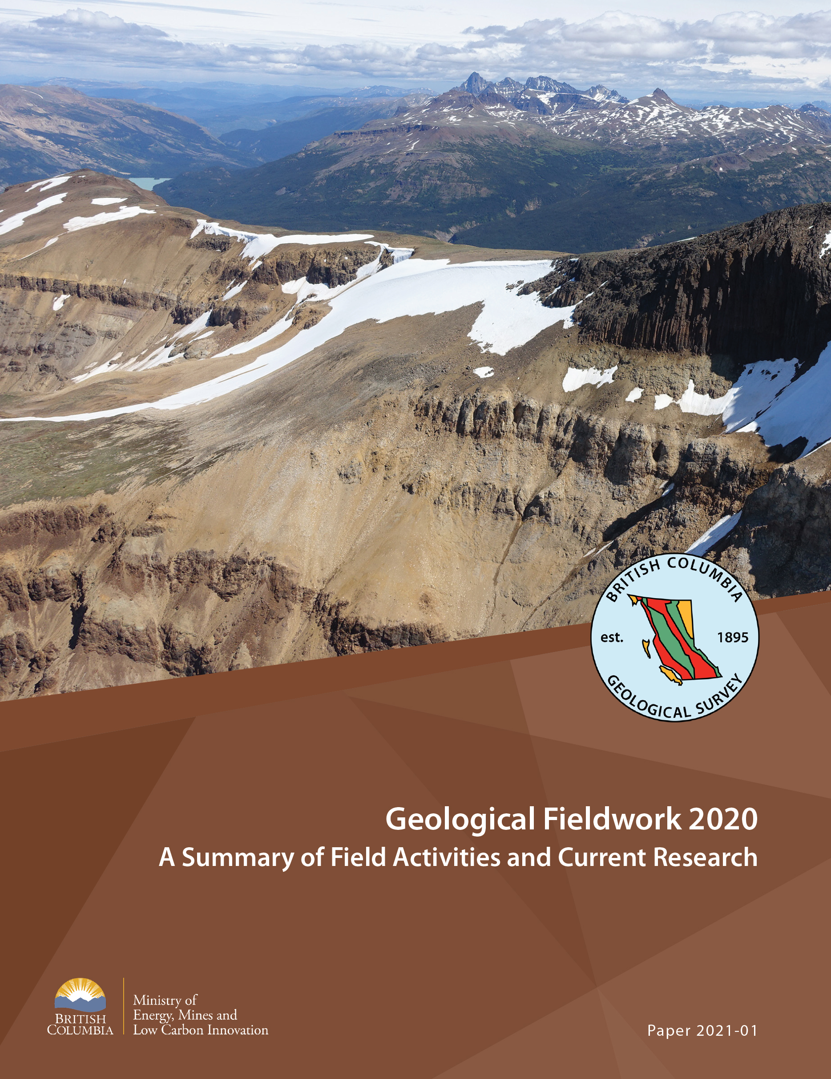
British Columbia Geological Survey
Covid-19 restricted summer field activity. Nonetheless projects continued and the Survey staff maintained a full workload and publication output.
Activities are highlighted in Geological Fieldwork 2020 and can be accessed online or we can mail a hardcopy on request.
Deposits studies and exploration methods
Critical Minerals (REE, Nb, Ta)
MVT and carbonatite geochemistry
Cost effective heavy mineral exploration methodology
CO₂ sequestration and awaruite (Ni) potential in the Decar area
Regional mapping and compilation
Bedrock and surficial geology of the northern Hogem batholith,
Geology of Polaris, Decar, Turnagain and Tulameen
Geology and stratigraphy of the Kitsault area
Bedrock geology compilation of Bonaparte Lake to Quesnel River
Bedrock geology of southern Nicola arc compilation and stratigraphy
Compilation of NW BC geology
Databases
Updates to databases at the BC Geological Survey

Slide 30
Summary
Mine production is a key component of British Columbia’s economy
Mining and exploration programs continued throughout 2020
Exploration programs continue to produce excellent results
British Columbia may have avoided a global trend of declining exploration expenditures and activity due to the resourcefulness of mineral explorers and the innate mineral endowment of the province coupled with the provincial government declaring exploration and mining as essential services during the Covid-19 pandemic

Slide 31
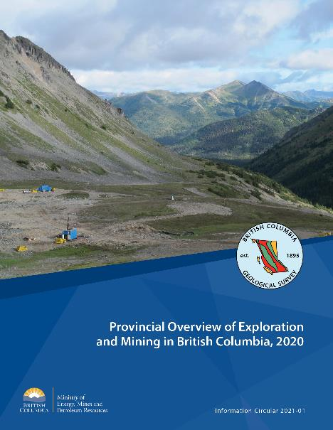
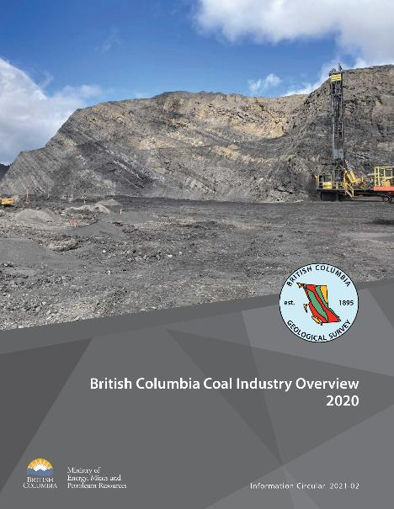
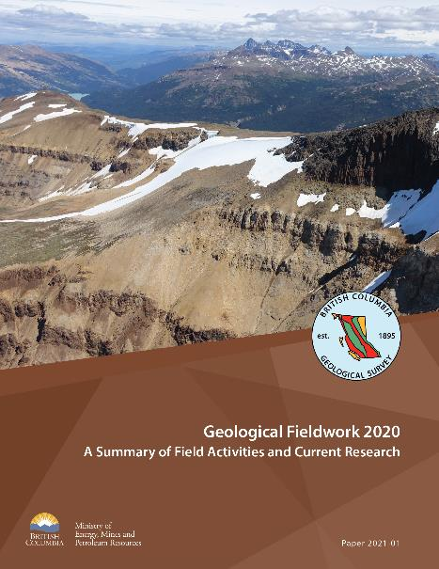
New Publications Now Available
https://www2.gov.bc.ca/gov/content/industry/mineral-exploration-mining/british-columbia-geological-survey/publications
Notes:
.

Slide 32
Thank You

