Slide 1
Cutting Permit and
Road Permit:
Development to Application
Forest Tenures Branch
Kevin Kilpatrick, Senior Tenures Forester, RPF
Erin Lindberg, Timber Tenures Forester, RPF
Shelley Zupp, Business Application Manager
Forest Science, Planning and Practices Branch
Aaren Ritchie-Bonar, Values Coordinator, RPF
Area Pricing
Bruce Sullivan, South Area Pricing Section Lead, RPF
Fred von Westarp, Coast Area Pricing Section Head, RPF

Slide 2
Introduction
Purpose
Target Audience
Introduce presenters
Notes:
Acknowledgment
Purpose:
General overview of legislated requirements
Provide overview of amendments to FA April 1, 2024, regarding CP/RP discretion
Wildfire Timber Salvage Admin and Guidance – authorizations for timber salvage
Location of tools and resources
Diving into permitting process/review and scenarios to share
Development to application–internal staff, licensees, consultants, and First Nations
Scenarios – RP sections/segments
FOM – spatial differences – boundaries, roads
Wildfire
Q&A half hour at end

Slide 3
Implementation of CP/RP Forest Act Part 3.1 and 8.0
CP/RP Administration Process
Operational Scenarios (Interactive Q&A)
Questions/Takeaways
Existing Tools and Resources

Slide 4
Agreements and Authorizations
Notes:
Cutting Authorities
What are they
Cutting Permits, Road Permits and Licence to Cut
Legislation Reference
CP/RP are a type of agreement under FA s12, issued in accordance with Forest Act Part 3.1 and 8.0, Regulations
They are no longer a permit issued through a licence agreement
Common understanding
Cutting Permits are the primary (and only) cutting authority for major tenure holders to cut all timber including damaged, at risk or green timber.
Road Permits are the primary authority to construct, use, maintain and deactivate a road for a forest agreement holder to access timber on Crown land, or private land associated with an agreement (TFL/WL)
Licence to Cut can be issued in many forms (FLTC, OLTC, MLTC, FSLTC, FUP) but cannot be issued to an existing forest tenure holder,
usually associated with timber salvage or to further an agreement with FN (i.e. FTOA, WSOA)
Can be issued with a CP or may be a cutting authority
A Blanket Salvage Cutting Permit is a form of a Cutting Permit for a defined purpose.
Authorities issued under the FA,FPC,FRPA are for forestry purposes and do not allow the holder to use these authorities to make money.
Tenures are issued for the purpose of harvesting an AAC they do not permit the holder to use the tenure for another purpose, nor can they refuse another party from occupying the land,
All authorities issued under the FA/LA are non-exclusive
All agreements are legal documents, these have been reviewed and approved by our legal counsel, the black text cannot be altered.
All authorities other than an SUP are issued on Crown land. SUP can only be issued in the Provincial Forest.
BSCP (Blanket Salvage Cutting Permit)
Is a CP specifically for the purpose of salvaging damage timber, for area of =< 15ha or 5,000m3
RUP are issued by the DM/TSM for industrial use of a FSR
They may include maintenance obligations or a fee to pay for maintenance
They do not authorize harvesting of trees
Other forms of authorizations include:
OLTC (Occupant Licence to Cut) may provide cut and remove, or cut only, may include conditions, must have a right to occupy i.e. SUP or LA tenure
FRPA s52 does not permit the removal of timber, may include conditions, must have a right to occupy i.e. SUP or LA tenure
SNRFL/ReNRFL Supplemental Non-Replaceable Forest Licence/Restricted Non-Replaceable Forest Licence – non-replaceable, target value added manufacturing, use undercut volume/forest service reserve volume in a s
specified area or species type,

Slide 5
Notes:
Application is received by email or ESF (Electronic Submission Form)
Primary Mandatory review – must have a complete application, met FOM requirements, valid licence agreement, approved FSP
Secondary Mandatory review – FA Part 13 – designated area with Ministerial Order, FA Part 15 – established Special Purpose Area, CP/RP Refusal Regulation -located within an BCTS operating area and the TSM has identified a conflict with planned or issued TSL or FSP results and strategies.
Rationales are optional of issued without conditions and recommended for issued with conditions or refuse to issue

Slide 6
Cutting Permits, Forest Act Part 3.1
Considerations
  Forest Act, section 52.03
Mandatory Refusal
  Forest Act, section 52.05, Part 13, Part 15
  Forest and Range Practices Act, section 5, 15.1
Information Request
  Forest Act, section 52.04
Discretionary Issuance
  Forest Act, section 52.08, 52.09
Transition
  Forest Act, section 52.13
  Forest Statues Amendment Act 2023, section 172 to 177
Notes:
General
A CP is the primary and only authority to harvest timber for a person who holds a licence (in good standing)
A CP cannot exceed the term of a licence or be greater than 4 years
A CP must be in a form and manner specified by the Minister
A CP can be transferred as part of licence transfer or a subdivision/consolidation. It cannot be transferred independent of an agreement
DM decision regarding the issuance of a CP/RP are not appealable and would require a judicial
Considerations:
DM must consider the impact harvesting will have on
management and conservation of forest resources – this is broad and includes recreation, visuals, wildlife water, timber supply etc
cultural heritage resources as defined in FA s1, includes both indigenous and non-indigenous interests and values
public health and safety
prescribed matters – non in place today. A regulation is required and must reference FA s52.03
Mandatory Refusal
Refusal of CP/RP Regulation - Located within a BCTS operating area and impacts planned or issued TSL, or ability to achieve results and
strategies in the approved FSP
License has been suspended or cancelled or expired
Have not met the FOM requirements and/or the CP is not consistent with the approximate location and shape of the blocks advertised on the FOM
The applicant does not have an approved FSP. Note harvest of the area described in the CP must be consistent with the FSP in place at the time
the CP was issued.
Part 13 Designated Area (FA s169) - Ministerial Order under FA s171 has suspended issued CP and RP and the issuance of a CP/RP
Part 15 Special Purpose Area – upon establishment in accordance with FA s181-183 suspends issued CP and RP and the issuance of a CP/RP
Information Request
DM can request additional information at any time for the licences that is applicable to the area under the CP
DM can also gather information from Agencies
Information request should be applicable to the decision, to assist the DM with making an informed decision on the issuance of the CP
Discretion
DM can add conditions for:
timing of harvest
reserve of timber for a specified purpose
type of machinery and use of machinery
access to and within a cut block(s)
DM can add conditions that are consistent with or more restrictive than legislation, the FSP or the agreement
Rationale should be provided to the applicant
CP holder must comply with the conditions
Discussion with the applicant should occur prior to the decision
FA s15, 36, 43.4, 43.56, 46 – may not issue a CP if another agreement has been suspended, cancelled or expired. A CP may not be issued for
issues of non-compliance, or not meeting the terms and conditions of an agreement, this also applies to replacements of the forest tenure licence
Transition
All CP submitted prior to April 1, 2024, must be approved under the old rules, regardless of when it approved
Does not require a FOM, limited ability to add conditions, still have ability to request information,
Transition requirements are addressed through the Forest Statute Amendment Act (FSAA) 2023
All issued CP prior to April 1, 2024 are considered a CP under FA s52.03, all postponement are considered a postponement under FA s52.11

Slide 7
CP Postponements, Amendments, Extensions and Surrenders
CP Amendments:
  Forest Act, Part 3.1
  Must be approved by the District Manager
CP Extensions:
  Forest Act, s52.10
  Maximum 1 year, extension plus original term of the CP cannot exceed a total of 4 years or the term of the licence
CP Postponements:
  Forest Act, s 52.11, Cutting Permit Postponement Regulation
  Maximum 2 years, may be renewed, cannot exceed the combined term of the licence and postponement.
  Can be for access, directed by the Minister to harvest at risk timber
  Cannot be for economic or market conditions
  Cannot be for old growth
  Cannot be extend or renewed if the holder of the CP requests the postponement to be cancelled or rescinded.
  Cut and remove is not permitted during the term of the postponement but obligations continue
CP Surrender
  Surrender Regulation
  CP can be surrendered prior to the commencement of harvest without a waste assessment
  CP can be surrendered after the commencement of harvest standing waste would apply
CP Transfer/reassignment
  CP cannot be transferred or reassigned except as part of a subdivision/consolidation or a licence transfer

Slide 8
CP/RP Suspension/Cancelation/Expiration
CP/RP Suspension
  Forest Act Part 13, s170(2)
  Ministerial Order
    May suspend/vary permits, licences and plans
    May stop the issuance of CP/RP
  Obligations continue under a suspension
CP/RP Cancelation
  Forest Act, s52.12, 119.3
  Occurs upon the cancellation/surrender/expiration of the associated licence agreement
  RP must be deactivated or transferred if the holder no longer holds a valid licence
Notes:
Suspensions
Part 13 s 170(s)
Minister’s order may require the suspension of existing CP, and no further issuance of CP/RP
Cancelation
If a person does not have rights to harvest timber they cannot be issued, or continue to hold a RP

Slide 9
Road Permits, Forest Act Part 8.0
Considerations
  Forest Act, section 115
Mandatory Refusal
  Forest Act, section 117, Part 13, Part 15
  Forest and Range Practices Act, section 5, 15.1
Information Request
  Forest Act, section 116
Discretionary Issuance
  Forest Act, section 118
Transition
  Forest Statues Amendment Act 2023, section 179 to 180
Notes:
General
A RP is the primary authority to construct, use, maintain and deactivate a Road to access granted harvesting rights
A RP must be in a form and manner specified by the Minister
A RP can be transferred as part of licence transfer or a subdivision/consolidation. It can be transferred independent of an agreement
DM decision regarding the issuance of a CP/RP are not appealable and would require a judicial
Considerations:
DM must consider the impact harvesting will have on
management and conservation of forest resources – this is broad and includes recreation, visuals, wildlife water, timber supply etc
cultural heritage resources as defined in FA s1, includes both indigenous and non-indigenous interests and values
public health and safety
prescribed matters – non in place today. A regulation is required and must reference FA s52.03
Mandatory Refusal
Refusal of CP/RP Regulation - Located within a BCTS operating area and impacts planned or issued TSL, or ability to achieve results and
strategies in the approved FSP
License has been suspended or cancelled or expired
Have not met the FOM requirements and/or the CP is not consistent with the approximate location and shape of the blocks advertised on the FOM
The applicant does not have an approved FSP. Note harvest of the area described in the CP must be consistent with the FSP in place at the time
the CP was issued.
Part 13 Designated Area (FA s169) - Ministerial Order under FA s171 has suspended issued CP and RP and the issuance of a CP/RP
Part 15 Special Purpose Area – upon establishment in accordance with FA s181-183 suspends issued CP and RP and the issuance of a CP/RP
Information Request
DM can request additional information at any time for the licences that is applicable to the area under the CP
DM can also gather information from Agencies
Information request should be applicable to the decision, to assist the DM with making an informed decision on the issuance of the CP
Discretion
DM can add conditions for:
timing of harvest
reserve of timber for a specified purpose
type of machinery and use of machinery
access to and within a cut block(s)
DM can add conditions that are consistent with or more restrictive than legislation, the FSP or the agreement
Rationale should be provided to the applicant
CP holder must comply with the conditions
Discussion with the applicant should occur prior to the decision
FA s15, 36, 43.4, 43.56, 46 – may not issue a CP if another agreement has been suspended, cancelled or expired. A CP may not be issued for
issues of non-compliance, or not meeting the terms and conditions of an agreement, this also applies to replacements of the forest tenure licence
Transition
All RP submitted prior to April 1, 2024, must be approved under the old rules, regardless of when it approved
Does not require a FOM, limited ability to add conditions, still have ability to request information,
Transition requirements are addressed through the Forest Statute Amendment Act (FSAA) 2023.
A RP issued prior to the effective date is a RP under Forest Act s115

Slide 10
RP Amendments, Transfers, Reassignments and Timber Rights
RP Amendments:
  Forest Act, Part 8.0
  Must be approved by the District Manager
  Applies to an approved section of a RP
RP Transfers
  Forest Act, s 54
  RPs can be transferred from one licensee to another licensee independent of a licence transfer, as part of a licence transfer, subdivision/consolidation
RP Reassignment
  RP can be reassigned from one licence to another licence if both are held by the same person/company
RP Timber Rights
  Forest Act s 119.1
  An RP can be issued with the right to cut and remove timber or to cut and deck the timber

Slide 11
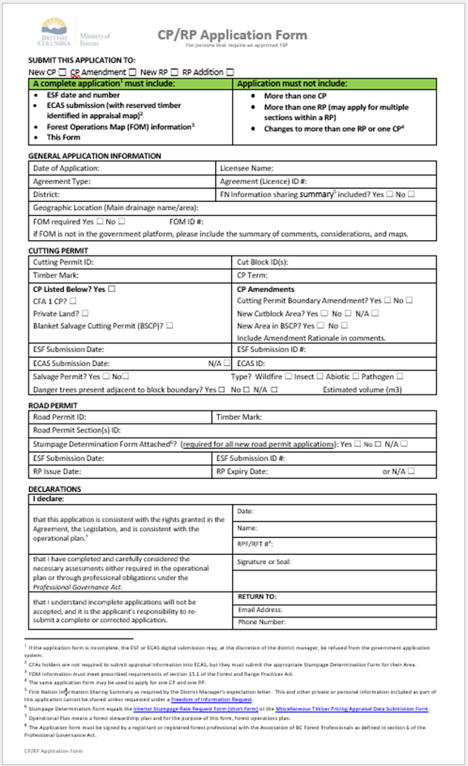
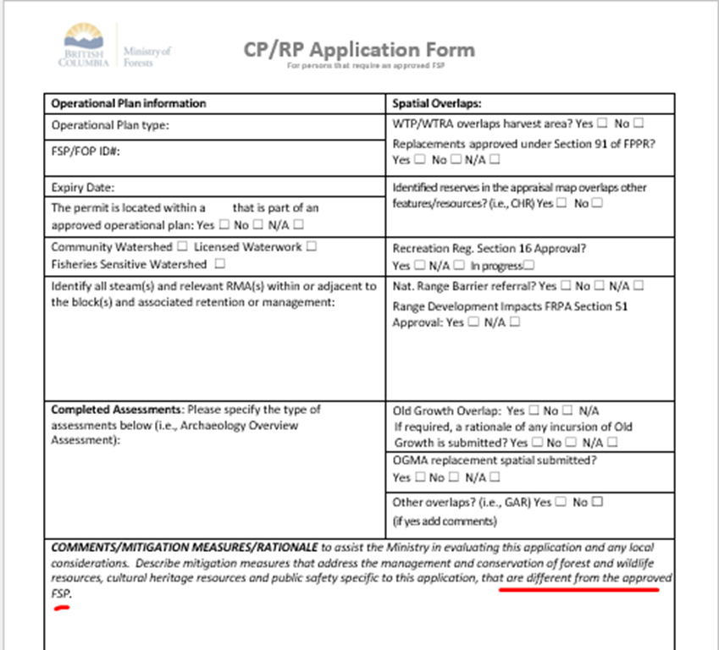
The Application
Notes:
Required Content:
FA s52.08 and 116
Form and manner defined by the Minister delegated to the Director of FTB.
Same application form for CP and RP, can submit one application form for both CP and RP
Not all new sections added to an existing RP is a new application
Mandatory requirements:
Must complete and sign the form by a forest professional
Must have met the FOM requirements FRPA s 15.1
Must have completed an ECAS submission (Appraisal)
Must have and identify the forest agreement
Must have and identify the approved FSP/WLP
Optional requirement not required with the application but will facilitate a more efficient review
FN Engagement Summary
Description of how the plan manages and conserves:
Forest resources
Cultural heritage resources
Public health and safety
Highlight values associated with the area under the CP/RP, i.e. old growth, wildlife feature or habitat, Karst etc
Must be signed by a registered forest professional

Slide 12
The Cutting Permit
Main Body
  Licence #
  CP #
  Timber Mark
  Issued and end date
  District Manager signature and effective date
Schedule A
  Site specific terms and conditions
Schedule B
  Identification of (permanent) reserved timber
Schedule C
  Mandatory agreement content
Exhibit A
  All cutblocks under the permit
Notes:
Cutting Permit
Content FA s 52.08
Main Body
Extracted much of the content from the licence agreement
1.0 Exercising of Rights, Cutting Permit Area and Term
2.0 Roads
3.0 Other Terms and Conditions
Standard limits on the harvesting of trees within the described area
4.0 Waste Assessment
5.0 Timber Mark
6.0 Timber Charged to a Specified Licence
Method of scale
District Manager Signature
1.02 The term of this Cutting Permit begins on the date the Minister or their delegate signs this Permit (Effective Date) until the earlier of:
the expiry date shown below the signature; or
the four year anniversary of the Effective Date.
Includes the following
Associated Licence #, CP #
Term, timber mark
Schedule A
additional terms and conditions specific to the CP or portions of the CP
Schedule B
Reserved timber (permanent) could use the appraisal map which identifies streams and retention areas.
If there is nor reserved timber to be identified spatially the schedule could just refer to the appraisal
Schedule C
Mandatory Agreement Content (formerly part of a licence agreement)
Reporting – harvest performance
Liabilities and Indemnity – specifies the government is not held responsible for any issues associated with the permit
Court Determined Aboriginal Rights and Title – describes the responsibility of the CP holder in the event of a court determination or a discover of an Aboriginal issue/resource/value
Expiry, Surrender, (Suspension) (or) Cancellation – describes what is permitted in the event of a licence expiration, surrender or suspenson
Waiver limited scope and use of a waiver as it relates to the CP
Notice requirements for notice must be in writing and the rules on the purpose and application of a notice
Miscellaneous – additional rules on the permit and its limitations to both the holder and the SDM
Exhibit A – map of all cut blocks under the CP

Slide 13
The Road Permit
Main body
  RP #,
  Associated Licences and Timber Marks
  Terms and Conditions
  District Manager Signature and effective date
Schedule A
  2 tables
    RP sections identification, status, timber rights, deactivation date (if applicable) and section conditions,
    RP list of various conditions that may be applied to one or more sections
    District Manager Signature
Exhibit A
  Road section(s)
Notes:
Road Permit
Content FA s 118
Main Body (the entire road length)
Extracted much of the content from the licence agreement
1.0 Grant of Rights, Road Permit Area and Term
3.0 Other Terms and Conditions
Standard limits on the constructions, use, maintenance and deactivation within the described area
4.0 Timber Mark
5.0 Waste Assessment
6.0 Roadway Timber Charges to a Specified Licence
Roadway Timber
Encumbered Roadway Timber
Mandatory Agreement Content (formerly part of a licence agreement)
7.0 Reporting – harvest performance
8.0 Liabilities and Indemnity – specifies the government is not held responsible for any issues associated with the permit
9.0 Court Determined Aboriginal Rights and Title – describes the responsibility of the CP holder in the event of a court determination or a discover of an Aboriginal issue/resource/value
10.0 Expiry, Surrender, (Suspension) (or) Cancellation – describes what is permitted in the event of a licence expiration, surrender or suspenson
11.0 Waiver limited scope and use of a waiver as it relates to the CP
12.0 Notice requirements for notice must be in writing and the rules on the purpose and application of a notice
13.0 Miscellaneous – additional rules on the permit and its limitations to both the holder and the SDM
14.0 Definition
District Manager Signature
1.02 The term of this Road Permit begins on the date the Minister or their delegate signs this Permit (Effective Date) until the earlier of:
the expiry date shown below the signature; or
Includes the following
RP #, Associated Licence # (for cut control purposes),
timber mark
Schedule A Road Permit Section (issued with each new RP application)
additional terms and conditions specific to RP sections
Expiration date, timber mark, timber rights, status, conditions by section,
Exhibit A
map of RP (sections)

Slide 14
Road Permit Sections and Segments
RP (sections) are to be submitted as one continuous section
  Do not divide the sections based on road activities (engineered costs estimates) or change in constructions
  Licensee determined
  Contains one or more segments
RP segments are created for administrative boundaries
  Smallest element of a road permit used to define change in administrative boundary
  System generated
Notes:
Creating additional sections burdens the government data

Slide 15
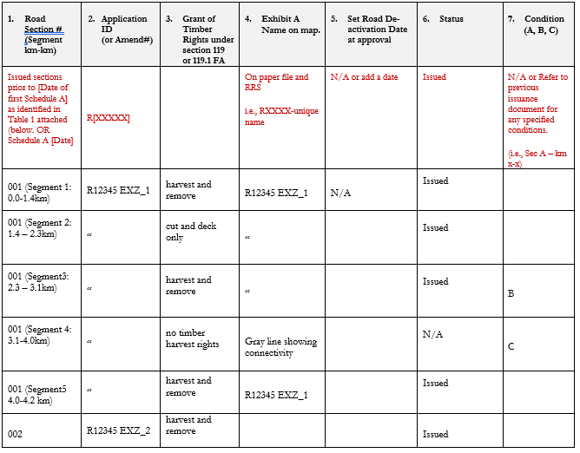
The Road Permit Schedule A Table 1.01
Notes:
Road Permit
Content FA s 118
Main Body (the entire road length)
Extracted much of the content from the licence agreement
1.0 Grant of Rights, Road Permit Area and Term
3.0 Other Terms and Conditions
Standard limits on the constructions, use, maintenance and deactivation within the described area
4.0 Timber Mark
5.0 Waste Assessment
6.0 Roadway Timber Charges to a Specified Licence
Roadway Timber
Encumbered Roadway Timber
Mandatory Agreement Content (formerly part of a licence agreement)
7.0 Reporting – harvest performance
8.0 Liabilities and Indemnity – specifies the government is not held responsible for any issues associated with the permit
9.0 Court Determined Aboriginal Rights and Title – describes the responsibility of the CP holder in the event of a court determination or a discover of an Aboriginal issue/resource/value
10.0 Expiry, Surrender, (Suspension) (or) Cancellation – describes what is permitted in the event of a licence expiration, surrender or suspenson
11.0 Waiver limited scope and use of a waiver as it relates to the CP
12.0 Notice requirements for notice must be in writing and the rules on the purpose and application of a notice
13.0 Miscellaneous – additional rules on the permit and its limitations to both the holder and the SDM
14.0 Definition
Signature and Seal
Includes the following
RP #, Associated Licence # (for cut control purposes),
timber mark
Schedule A Road Permit Section (issued with each new RP application)
additional terms and conditions specific to RP sections
Table 1 columns:
Identifies the section and or segment #
RP #
Choose an item – rights to timber (cut and remove, cut and deck, no timber harvesting)
Reference to map
Deactivation date
RP status, issued, deactivated, transferred, issued and extended, issued and deactivated
Reference to conditions in table 2
Exhibit A
map of RP (sections)

Slide 16
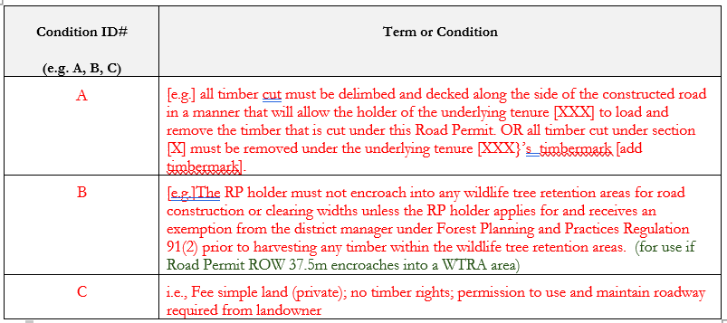
The Road Permit: Schedule A Table 2.01
Notes:
Road Permit
Content FA s 118
Main Body (the entire road length)
Extracted much of the content from the licence agreement
1.0 Grant of Rights, Road Permit Area and Term
3.0 Other Terms and Conditions
Standard limits on the constructions, use, maintenance and deactivation within the described area
4.0 Timber Mark
5.0 Waste Assessment
6.0 Roadway Timber Charges to a Specified Licence
Roadway Timber
Encumbered Roadway Timber
Mandatory Agreement Content (formerly part of a licence agreement)
7.0 Reporting – harvest performance
8.0 Liabilities and Indemnity – specifies the government is not held responsible for any issues associated with the permit
9.0 Court Determined Aboriginal Rights and Title – describes the responsibility of the CP holder in the event of a court determination or a discover of an Aboriginal issue/resource/value
10.0 Expiry, Surrender, (Suspension) (or) Cancellation – describes what is permitted in the event of a licence expiration, surrender or suspenson
11.0 Waiver limited scope and use of a waiver as it relates to the CP
12.0 Notice requirements for notice must be in writing and the rules on the purpose and application of a notice
13.0 Miscellaneous – additional rules on the permit and its limitations to both the holder and the SDM
14.0 Definition
Signature and Seal
Includes the following
RP #, Associated Licence # (for cut control purposes),
timber mark
Schedule A Road Permit Section (issued with each new RP application)
additional terms and conditions specific to RP sections
Expiration date, timber mark, timber rights, status, conditions by section,
Exhibit A
map of RP (sections)

Slide 17
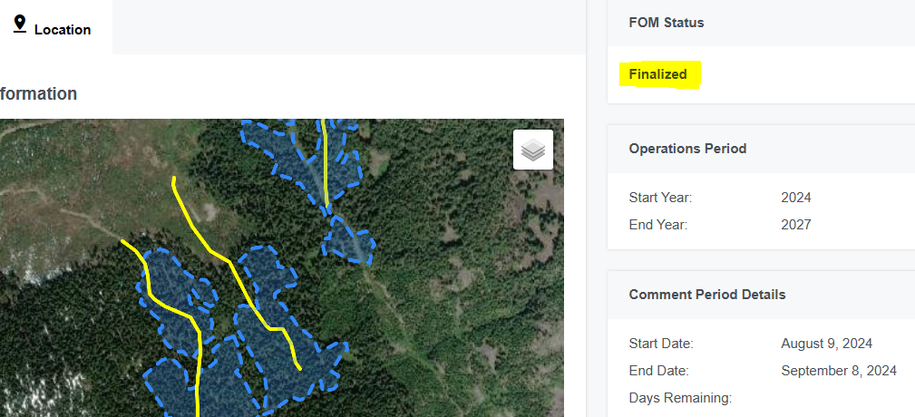
Forest Operations Map Scenario 1
FOM submitted to district but not all cutblock or road spatial finalized.
FPPR s. 34.4 requires a report:
Copy of the public notices
Copy of the FOM
Description of the changes made to the map as a result of comments received
Notes:
FOM Scenario 1: What happens when a FOM report is submitted to government via the government FOM portal, but not all cutblock or road spatial has been finalized?
FRPA s. 15.1 (2) (c)requires the FSP holder to submit to government a report on the public review and comments on the FOM in accordance with the regulations (FPPR s. 34.4)
When using the FOM portal, hitting the "finalize" button is what triggers the system to submit the "report" to government. This includes the uploaded newspaper notice, the web notice (if using the FOM portal, otherwise you can upload as a supporting document), the copy of the forest operations map (initial which was advertised), and a copy of the final FOM (final cutblock and road shapes) which acts as the description of changes made to the map as a result of comments received.
At the district, it's the "final FOM shapes" which are used for the "consistency test" in Forest Act s. 52.05 (1) (b) (ii) (b) and s. 117 (3) (a) (ii) (B) to compare against the CP or RP exhibit A shapes. The consistency test requires that the cutting permit or road permit area be consistent with the approximate locations of cutblocks or roads shown in the FOM.
So, what are some options to consider when it might be difficult to finalize all road or cutblock spatial prior to finalizing? Options:
Before finalizing: Ensure the FOM is the correct size configuration so that all blocks and roads can have final spatial uploaded prior to finalizing the FOM.
Finalize the FOM with all final spatial uploaded, but contact the district ahead of finalizing to let them know there may be minor inconsistencies between final shapes and CP/RP Exhibit A shapes, and discuss whether this will meet the DM's expectations for the "consistency test".
After finalizing: Post a new FOM in the future that includes any roads or cutblocks with spatial that was not finalized on the original FOM.
If you have this scenario where you’ve finalized the FOM but haven’t uploaded all final spatial: Speak to district staff on possible alternative options for the "report to government".

Slide 18
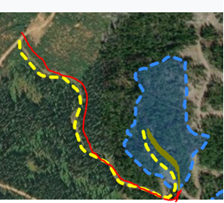
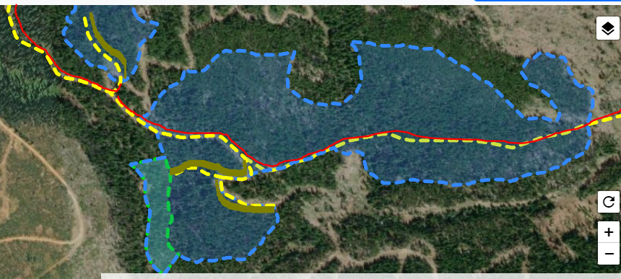
Forest Operations Map Scenario 2
Do in-block roads or non-status roads need to be advertised on the FOM?
FRPA s. 15.1 (2):
Before applying for a road permit to construct a road, the holder of an FSP must prepare a FOM.
New construction must be shown on a FOM. In-block road may be shown on the FOM.
In-block roads that connect to an RP at both ends becomes an RP, so must be shown on a FOM.
Notes:
FOM scenario 2: Do in-block roads or non-status roads need to be advertised on the FOM?
FRPA requires that the holder of an FSP must prepare a FOM before applying for a road permit to construct a road. This is for any road to be included in a road permit application, including new construction, in-block roads or non-status roads.
Left picture: Red line indicates a non-status road: must be shown on the FOM as it will be included in a RP application. The in-block road segment (green) may be shown on the FOM as road linework, or not included as it will be authorized under the cutting permit area.
Right picture: Red road segments must be shown on the FOM as it is a continuous RP outside of the block. Green road segments are all in-block and may be advertised on the FOM as proposed road (otherwise it is just shown within the polygon as cutblock and is authorized under the CP). For situations where the FSP holder knows that in-block roads will become RPs in the future (for example it will connect to road permit outside of the cutblock), it is recommended to advertise on the FOM. If it isn’t advertised on the FOM, when the CP expires and the licensee wishes to continue to use that road section, then they must meet the FOM requirements prior to applying for the road permit.

Slide 19
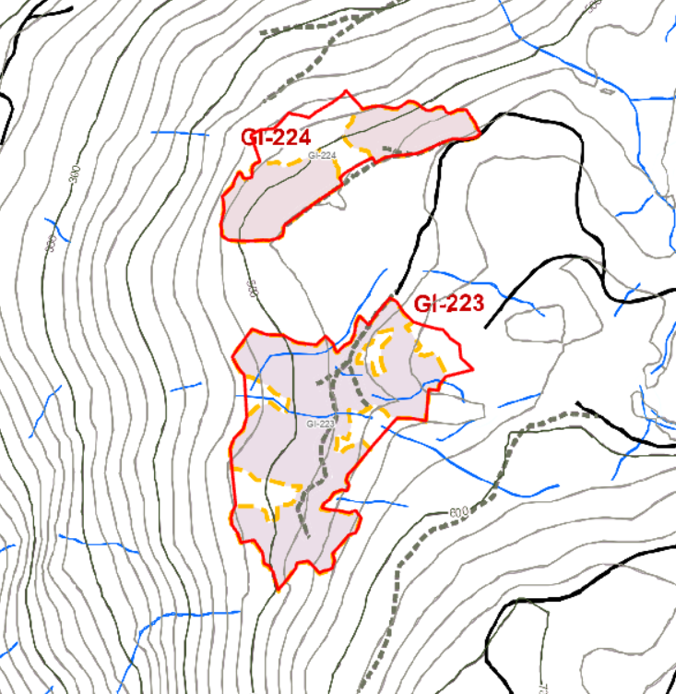
Forest Operations Map Scenario 3
FOM submitted to district outside of the government FOM portal
FRPA and the FPPR requires:
FOM must be submitted prior to CP/RP application
No mandatory requirement to use government FOM portal
Nuances may be addressed via a District Manager Letter of Expectations (paper FOMs, FOMs on licensee's website, etc.)
DDM to refuse to issue a cutting permit/road permit if the area is inconsistent with the approximate locations of cutblocks or roads shown in the FOM.
No definition in the Forest Act for "inconsistent", up to DDM discretion.
Notes:
FOM scenario 3: A FOM submitted to the district outside of the government FOM portal. FRPA and FPPR require: that a FOM be submitted prior to CP/RP application; there's no mandatory requirement to use the government FOM portal; but paper FOMs or FOMs advertised on an FSP holder's website might trigger a more detailed review at the district as using the government FOM portal helps with processing efficiency and ensures the majority of FRPA and FPPR requirements are met. I'll discuss some nuances of FOMs submitted outside of the portal, but some have been addressed by District Managers around the province by a DM Letter of Expectations. Please connect with natural resource district staff to discuss these expectations.
Nuances of FOMs submitted outside of FOM portal:
The FOM area is smaller than the CP Exhibit A area. This is addressed in DM Expectations letter if issued, some have considerations for if the Exhibit A area is larger than the FOM area. Best option is to communicate any known discrepancies between the shapes to the district prior to submitting a CP or RP application. Explaining the circumstances and providing a rationale ahead of time will allow the district and FSP holder to assess if any changes are required. In the example on screen, the FOM advertised net block areas while the CP Exhibit A had gross block areas. In this case, the District Manager found the CP application to be inconsistent with the FOM cutblocks so did not issue the CP, and a new FOM was required.
District received paper FOM and does not have shape files to compare final FOM area against CP submitted area. Addressed in DM Expectations letter, noting that if no shapefiles are provided then CP/RP processing may take longer.
Additional questions:
District does not have access to the comment history for review (licensee stated there were no comments in this situation, but how can the district confirm this?) FSP holder must submit a report to government on all comments received. It is the report that the district reviews. FRPA s. 110.1 applies, requiring persons to submit information that is complete and accurate.
If a member of the public misses the 30 day comment period, they have no notion that it was ever advertised. An individual can request info on the FSP holder's site, but must quote a FOM# that is not being displayed. The FOM holder is required to maintain a record of the FOM for 5 years. Interested parties could go to the FOM holder’s office to view the map.
If a licensee makes changes due to public comments, do they then need to publicly readvertise the new final FOM shapes? A: No, unless the shapes are completely different than the original advertisement (such as the considerations in the DM Expectations letter).
I would assume that no further comment period would be initiated? Would another notification be required? A: No further comment period nor notification is required, since no new FOM is required.
The new final FOM shapes would at least need to be displayed post comment period for the public to have any idea if comments were addressed or ignored. A: This is not a requirement in FRPA or FPPR. The FOM holder must submit the final map to government for review. The shapes on the map will be compared to the Exhibit A shapes during the consistency test, so the FOM holder would have to put the final FOM shapes on the submitted map for the report to government.

Slide 20
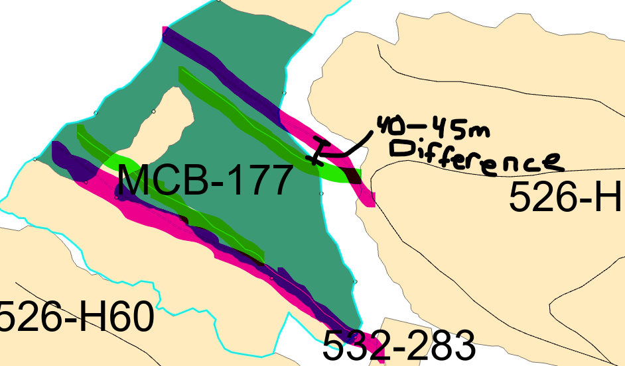
Forest Operations Map Scenario 4
FOMS and road permit amendments
Forest Act s. 52.05 and s. 117 require:
DDM to refuse to issue a cutting permit or road permit if the applicant was required to prepare and make publicly available a FOM before applying for the permit, and the applicant has not complied with section 15.1 of FRPA, or if the locations on the application are inconsistent with approximate locations on the FOM.
Notes:
Scenario 4: FOMs and road permit amendments. The Forest Act requires the DM to refuse to issue a permit if the application did not comply with the FOM provisions in FRPA or FPPR, or the approximate locations are deemed inconsistent with the FOM.
In this example, the pink road sections were issued prior to the FOM provisions taking effect, so were not advertised on a FOM. But, since the time of approval the field crew made some road adjustments, with the green road sections being the adjusted locations. In this case, a new road permit was required, and the new RP application needed to undergo FOM requirements.
Question: If the original pink road permit had undergone FOM requirements, would the green road permit application need a new FOM? In this case, the DM would need to apply the consistency test to see if the location of the proposed road is consistent with the approximate locations of roads shown in the original FOM. If deemed inconsistent, a new FOM would be required, but if deemed consistent, no new FOM would be required.
-For RP amendment scenarios like this, it is best to get in contact with district staff early to discuss the scenario ahead of RP applications, especially how the DM will be applying the consistency test.

Slide 21
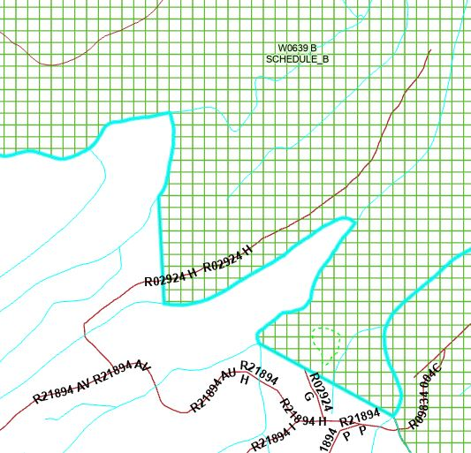

Woodlot applies for RP outside licence area – Scenario 5
Must be included in an approved FSP
  Options:
    Agreement with adjacent FSP holder
      to include in their FSP
    Agreement with adjacent FSP holder
      to apply and build road access for Woodlot
    WL has an FSP for outside their licence
      Area
FOM requirements apply to the RP
Woodlot
FNWL
Notes:
DPG example
Woodlot A R02924 Section H
Any right-of-way timber cut to construct the road for the road section outside of the woodlot becomes encumbered (had underlying timber rights) and a timbermark is not provided to the woodlot holder for the road section. In this RP example, there is no timber to remove for the road section as it goes through a previously harvested block. If there was any timber harvested to construct the road, it would need to be decked in accordance with the RP requirements and an overlapping permit (CP, FLTC) would be required to remove the decked timber.
For the DM to issue the RP to the woodlot holder, the woodlot licensee needs to be an agreement holder to an existing FSP in which the road section is within the FSP’s FDU. Plus, this road section must be FOM’d as per FRPA/FPPR requirements.
-------------------------------------------------------------------------------------------------------------------
Authorization
One CP
Is not a legal authority under the Forest Act
Issuance is at the discretion of the District Manager
Forest Act Part 3.1 applies to the decision to issue the CP
Applicant must complete an application form
Applicant requires a licence agreement in good standing, and an approved WLP
May be issued to holders of Woodlot Licences and Community Forest Agreements
Applies tabular rates, a cruise or appraisal is not required
DM may request information, which may apply to the entire licence areas
RP
Not required within the licence area (WL/CFA) under a One CP as all roads are considered in block roads
RP outside of the WL requires an approved FSP and to meet the requirements for a FOM
Forest Act Part 8.0 applies to the decision to issue the RP
Applicant must complete an application form
Applicant requires a licence agreement in good standing

Slide 22
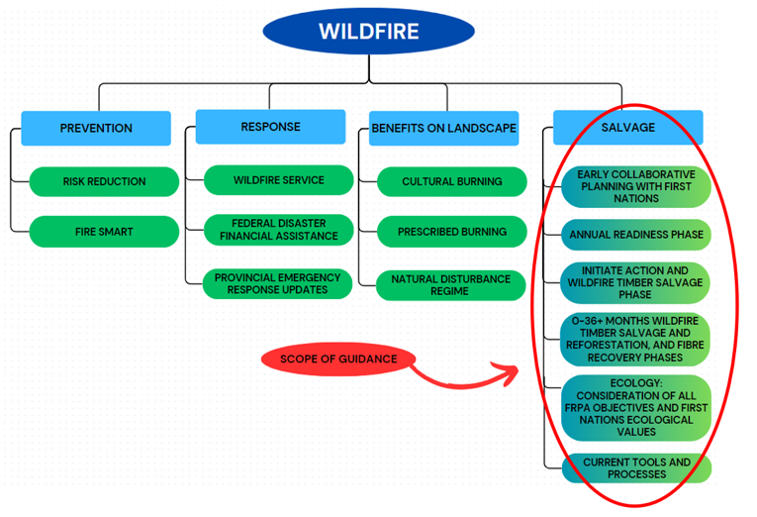
Wildfire Timber Salvage Scenario 6
Wildfire Timber Salvage Planning and Administration Guidance 2025 release
  Prioritizes moderate to high burn severity timber
  Includes:
    Post Wildfire Fibre Recovery Guidance
    Ribbonless Boundary Tool
    Wildfire Salvage Opportunity Agreement
Phase Planning and Development
  5 Phases
Current Tools:
  Tenures and Agreements
  Authorizations
Training in near future
Pricing
  Fully appraised
  Comparative Cruise
Notes:
Wildfire Timber Salvage Planning and Administration Guidance 2025 release
Emphasizes early planning and phase development and ongoing collaboration and relationship building
Clearly outlines the existing permits and processes
Tenures/Agreements
All replaceable and non-replaceable agreements, and
Wildfire Salvage Opportunity Agreements (WSOAs)
Authorizations:
Cutting Permit
Blanket Salvage Cutting Permit – District BSCP policy rescinded and replaced?
Forestry Licence to Cut (<2000 m3, <5000m3, Remove only)
Forestry Licence to Cut with Cutting Permit (associated with WSOA)
Training in April

Slide 23
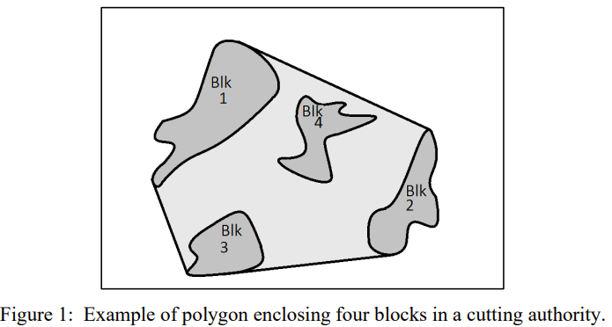
Wildfire Timber Salvage Scenario 6
Pricing Interior Appraisal Manual (IAM)
  Fully Appraised Cutting Authority Area (section 1.4 - IAM)
  Two options:
    Less than 7850 rule, or
    For salvage of wildfire damaged timber, all blocks must:
      Be fully within a mapped wildfire boundary
      consist of at least 40% fire damaged timber
      be within same management unit​ (TSA)
      be appraised to the same Point Of Appraisal (POA)​
Notes:
Maximum Area requirement (under 7850 ha) does not apply if all blocks are:
(Fred) - working on future policy for the Coast

Slide 24
Interior Wildfire Timber Salvage Scenario 6
Pricing Interior Appraisal Manual (IAM)
  Comparative Cruise Data (section 1.5.1.1)
    If there is time to perform a full cruise, timber is to be cruised (ss 1).
    Approval requirement – determination that cruising will delay expeditious harvesting and will result in further damage (ss 2).
      Under 5000m3 District Manager
      Over 5000m3 Regional Manager or BCTS ED
    May not be used if Licensee's history does not harvest in timely manner (ss 3)
  Interior Comparative Cruise Policy is posted on TPB website.
    Procedure to request comparative cruise approval.
    Outlines requirements.
Notes:
Comparative Cruise: for fully appraised permits

Slide 25
COAST Wildfire Timber Salvage Scenario 5
Stumpage Rates - Coast Appraisal Manual (CAM)
  Fully Appraised (No Reduction in Quality)
  District Average Sawlog Rates (under 2,500m3)
  Damaged Timber Salvage Rates
    40-60% Reduction
    Take the District Average Sawlog Rate (by species) and multiply by 40% - HemBal
    Take the District Average Sawlog Rate (by species) and multiply by 60% - Cedar,Cypress,Spruce,Fir
    Restricted to individual clearcut openings less than three hectares.
Notes:
Coast – no reduction in quality for full appraisals

Slide 26
Questions/Takeaways
CP and RP are a type of agreement under s12 of the Forest Act
Provision for the discretionary issuance of CP and RP are provided in Part 3.1 and 8.0 of the Forest Act
CP is the cutting authority for all tenures that require an FSP
  BSCP is CP for a salvage of small areas/volumes of damaged timber
RP is the authority to construct, use, maintain and deactivate a road
FOM is a non-approvable document, it is a valuable resource for public awareness and comment
Do not alter templates

Slide 27
Resources: Tenures and Authorizations
Forest Tenures Branch websites for
Manuals, Bulletins and Application Form (External):
  Cutting Permit & Road Tenure Administration Manuals - Province of British Columbia
  Timber Tenure Bulletins, Policies and Procedures - Province of British Columbia
Forest Tenures Branch contact
  Forest Tenures Branch FOR:EX ForestTenuresBranch@gov.bc.ca
  Kevin Kilpatrick: Kevin.Kilpatrick@gov.bc.ca
  Erin Lindberg: Erin.Lindberg@gov.bc.ca
  Shelley Zupp: Shelley.Zupp@gov.bc.ca
FRPA websites for Forest Operations Map:
  Forest Operations Map - Province of British Columbia
  Forest Operations Map – Admin training modules
  FOM contact: FOM.Admin@gov.bc.ca
  FRPA support contact: FRPA.Support@gov.bc.ca

