Slide 1
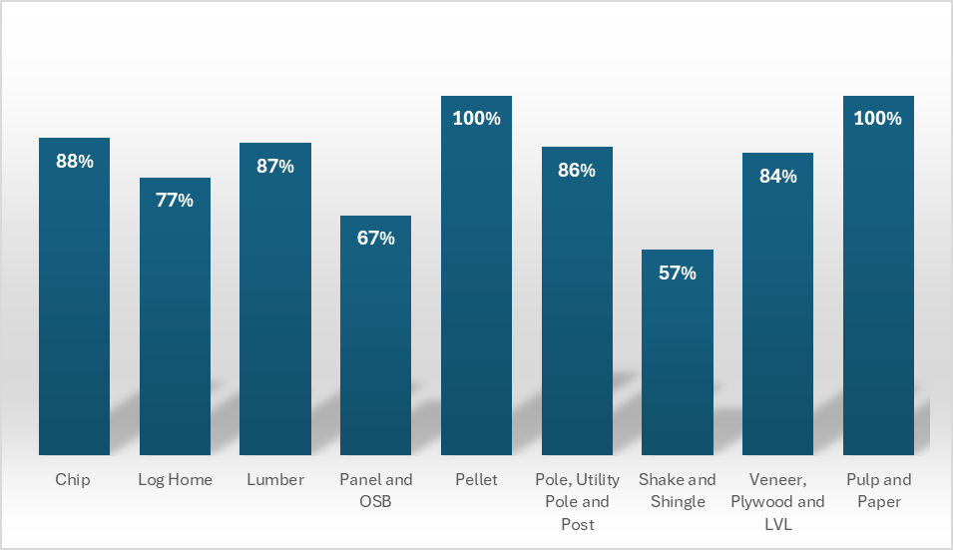
2022 Mill List Survey Response Rates by Products
Source: 2022 BC Mill List Database as of January 30, 2025
Notes: Responded mills are those that were in operation and provided survey responses. Non-responded mills are those that were presumed to be in operation but did not provide survey responses. Permanently closed mills and mills that were not in operation during the survey year were excluded from this calculation.

Slide 2
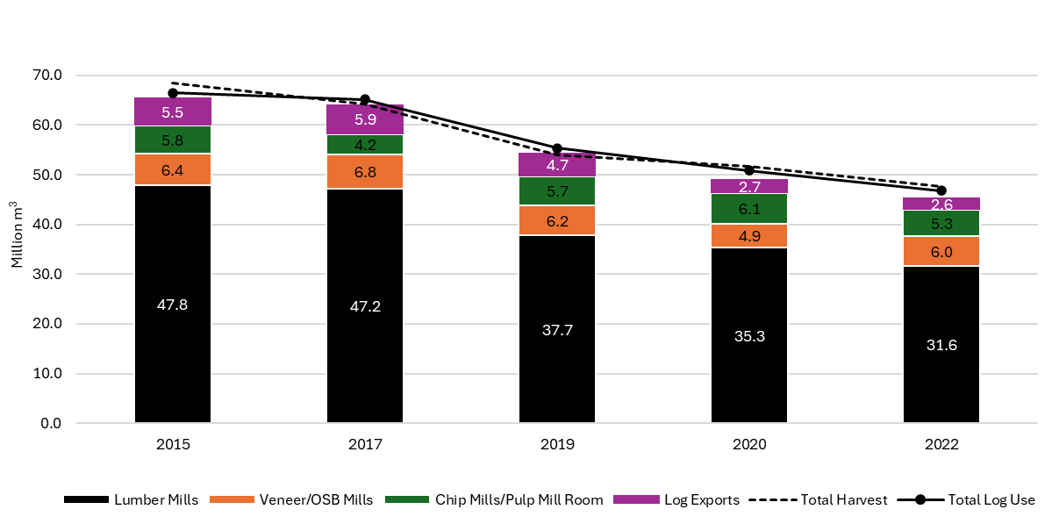
BC Primary Log Use and Supply for Selected Years
Source: 2022 BC Mill List Database as of January 30, 2025

