Slide 1

BC Timber Sales Fuel Handling
A pictorial of key requirements of the BCTS FUEL HANDLING ENVIRONMENTAL FIELD PROCEDURE 06

Slide 2
Fuel Handling
Purpose
The purpose of this pictorial is to support the BCTS EMS Fuel Handling Environmental Field Procedure #06, (EFP 06) by displaying requirements of commonly utilized tanks by BCTS Licensees, Permittees and Contractors (LPC’s) to help prevent and minimize impacts of fuel on the environment.
EFP 06 brings together legislative requirements, forest industry standards and best management practices as it relates to fuel handling, storage and transportation.
EFP 06 applies to all BCTS LPC’s and their workers involved in fuel handling within the scope of the EMS Program.

Slide 3
Key Sections of EFP-06
Truck Box (Slip Tanks) and other large portable tanks--230 to 3000 liters (EFP-06 Table #2 and #3)
-non-specification tanks can only be used for diesel in the 230L to 450L volume range and;
-tanks for diesel and gasoline in the >450L to 3000L volume range must be specification containers and tested by a Transport Canada Registered Facility every 5 years;
Large (double walled) Stationary Skid Tanks
-EFP-06 Table #5
Spill Kits
-EFP-06 Table #7

Slide 4
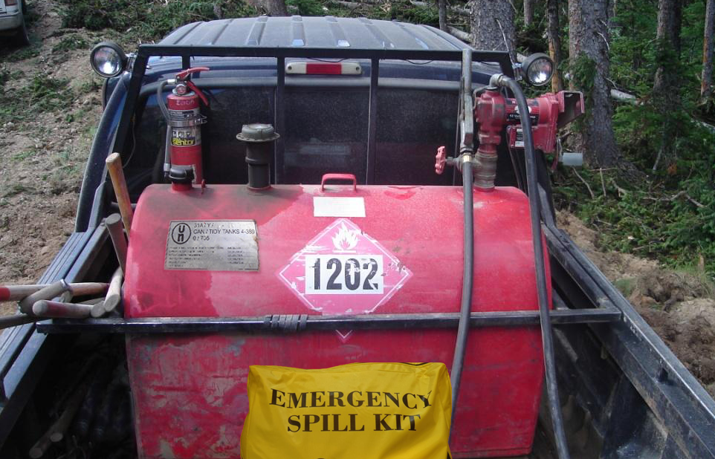
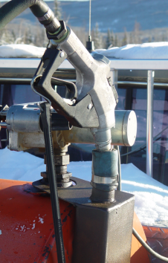
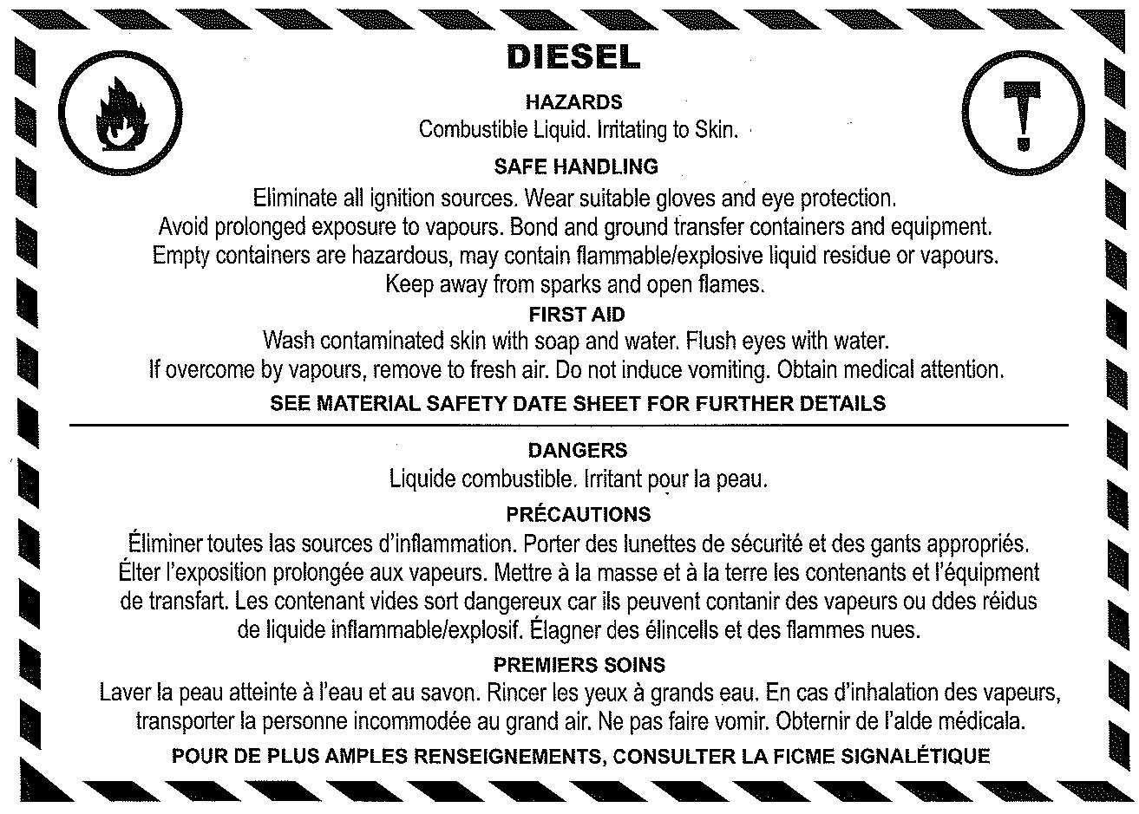
Truck Box Slip Tanks
Drip Containment
Options
Fire Extinguisher
WHMIS Label
Spec. Plate
Proper fuel dispensing
pump
TDG Label
Spill Kit
Tank secured to
prevent movement
 All tanks >450L must be tested by a Transport Canada Registered Facility every 5 years.

Slide 5
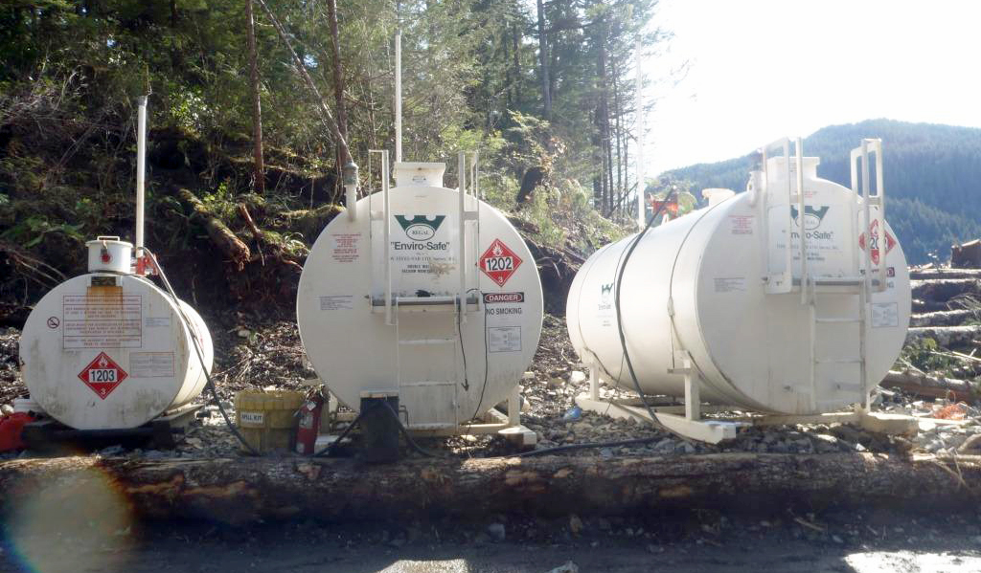
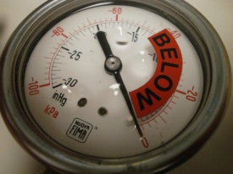
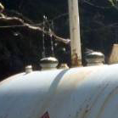
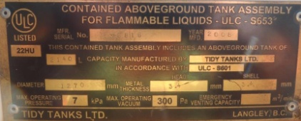
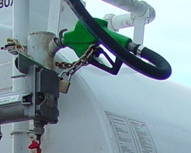
Large Double Walled Stationary Skid Tanks
Positive Containment Check
ULC-S601 Spec Plate
Vacuum Gauge
Dip Stick Port
TDG, WHMIS and
Safety Labels
Drip Containment Options
Spill Kit
Fire Extinguisher(s)
Guard Log

Slide 6
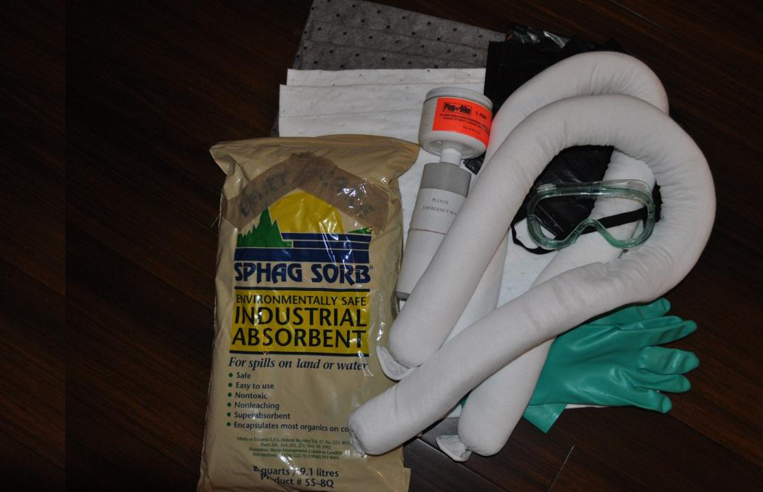
Spill Kits
Spill kits must be present in all equipment, vehicles transporting and dispensing fuel, near stationary tanks and mobile fuel storage and dispensing areas.
Spill kits must include a minimum of:
  heavy duty plastic bags or suitable container(s),
  absorbent pads (or equivalent absorbent material) appropriate for the type of spill,
  absorbent booms/ socks,
  bioremediation product,
  a shovel
  a container of emergency tank sealant (i.e. Plug-N-Dike, Seal-it or equivalent)
personal protective safety gear as required for the type of spill
See Fuel Handling Environmental Field Procedure 06, (Table #7) for details regarding spill kit requirements.
Bioremediation
Product

Slide 7
Fuel Handling
Conclusion
Conformance to this EFP pictorial will assist LPC’s to achieve a balance between their operational needs and requirements of the BCTS EMS-EFP 06 to help reduce significant risk to the environment.
For a copy of this fuel management pictorial please contact your local BCTS Certification Standards Officer.

