Slide 1
Presentation Instructions
Prepare a group of the Focus List Field Cards to review on slide 12.
Deliver this presentation and on slide 12, bring up the group of Focus List Field Cards separately and review them.
Field Cards should be chosen:
  To focus on specific species (eg to deliver a block specific species list to a TSL holder), or
  as examples (ie if the purpose of the training is to deliver the entire catalogue of Field Cards eg to a multiphase contractor).
Ensure you record attendance so the training record can be updated.

Slide 2
TKA SOMC
Species of Management Concern
Awareness Training

Slide 3
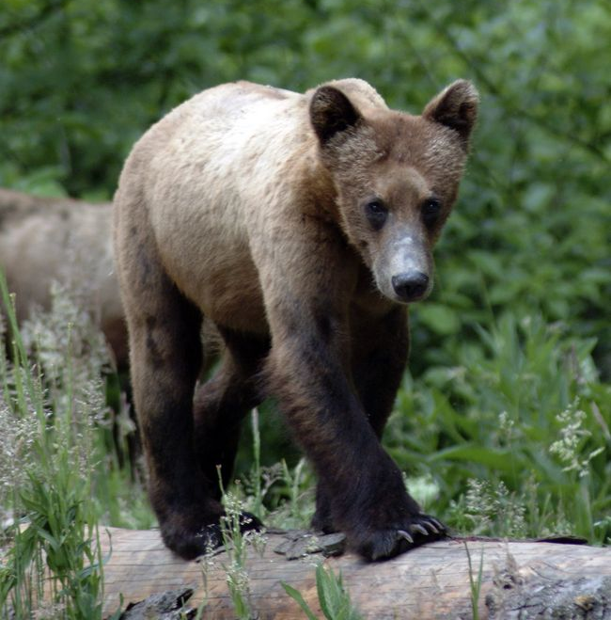
SOMC Awareness Training Overview
Introduction
  What are Species of Management Concern?
  Why protect them?
Legislation – Federal and Provincial
SFI Certification
Business Area SOMC Focus Species
Reporting SOMC
Identification Resources

Slide 4
What are Species of Management Concern?
BCTS has both legal and stewardship obligations to manage and conserve specific species, ecosystems and habitats that might occur within BCTS operating areas and be adversely affected by forestry activities. These species and ecosystems of management concern (SOMC) are identified by a variety of sources, including provincial and federal legislation and policy; independent bodies such as the BC Conservation Data Centre (CDC) or the Committee on Status of Endangered Wildlife in Canada (COSEWIC); local resource management plans; and forest certification programs. Some of these species and ecosystems are considered at risk; others are not at risk but require special management for social and/or economic reasons.

Slide 5
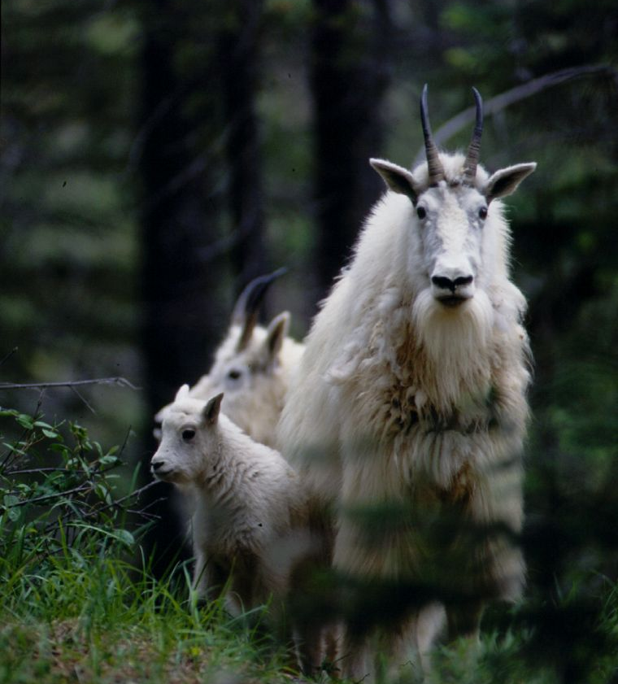
What are Species of Management Concern?
SOMC include the following:
Species and ecological communities that are designated as being at risk by federal or provincial agencies
  Federal – included on Schedule 1 of the Species at Risk Act (only species)
  Provincial – included on the red or blue list (species and ecological communities)
Species listed in specific regulations
  BC Wildlife Act
  FRPA – IWMS, GAR species (WHAs or UWR)
SFI Certification – includes species or communities (FECV) listed by NatureServe (Global) to be critically imperiled or imperiled
Some SOMC are not at risk but require special management for social and/or economic reasons
Notes:
Wildlife Act – Section 13 endangered or threatened species Burrowing Owl, sea otter, VI Marmot, American White Pelican, Section 34 - Bald Eagles, osprey, heron
FRPA – Section 7 notices – NOGO, MAMU, for TBA = Grizzly Bear, Caribou and MAMU
GAR species – species at risk - and ungulates to establish UWR for deer, elk, mountain goat, caribou, sheep and moose
IWMS – Identified Wildlife Management Strategy -

Slide 6
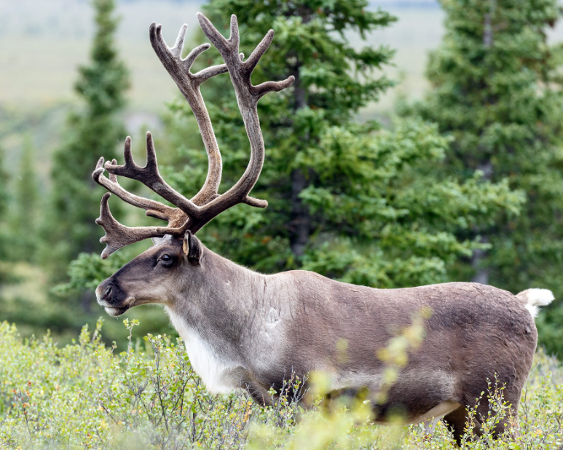
Why Protect SOMC ?
The conservation of SOMC is a fundamental component of sustainable forest management, an overarching BCTS principle
To maintain biological diversity
To comply with federal legislation - Species at Risk Act, Fisheries Act and the Migratory Birds Convention Act
To comply with provincial legislation - Wildlife Act and the Forest and Range Practices Act
To maintain Sustainable Forestry Initiative certification – BCTS is required to have a program to protect threatened and endangered species and ecosystems

Slide 7
Federal Legislation
Federal Legislation | Protection | What does it apply to? | Where does it apply?
Species at Risk Act | The legislation that legally assigns the national biological conservation status of species based on advice of COSEWIC Provides legal protection of species listed in Schedule 1, their residences and critical habitat if located on federal land. Critical habitat is designated for species listed as Endangered or Threatened | Applies to species listed in Schedule 1 as Endangered, Threatened and Special Concern Currently SARA only includes species and does not include ecological communities | Aquatic species and migratory birds – everywhere All other species – federal lands only
Migratory Birds Convention Act | Designates the migratory birds that the act applies to Protects migratory birds and their nests when they contain a live bird or a viable egg The new Migratory Birds Regulations (2022) includes a list of 18 species whose nests are reused and are protected year-round, unless they have been shown to be abandoned | Applies to migratory birds identified under the Act Some examples of groups it does not apply to are owls, jays, crows, ravens, hawks and eagles The nests of the 18 species identified in Schedule 1 of the MBR are protected year-round | Applies on all lands and all tenures in Canada
Notes:
There are other federal regulations, but they aren’t specific to SOMC, such as the fisheries Act.

Slide 8
Provincial Legislation
Provincial Legislation | Protection | What does it apply to? | Where does it apply?
Wildlife Act | Prohibits the hunting, trapping, wounding of endangered or threatened species and all native wildlife species (S.26) Protects a bird or its egg, the nest of an eagle, peregrine falcon, gyrfalcon, osprey, heron or burrowing owl or the nest of a bird not referred to when the nest it occupied by a bird or its egg (S.34) | All native species. Designated endangered or threatened species (S.13) include Burrowing Owl, Sea Otter, Vancouver Island Marmot, American White Pelican Nests of eagles, peregrine falcons, osprey, herons or burrowing owls Active nests of all bird species | Everywhere in BC
Forest and Range Practices Act | Section 7 Notices are objectives set by government for consideration during forestry planning (result of strategy in FSP) | Provincially designated species at risk Regionally important wildlife (none currently identified) Winter survival of specified ungulate species (GAR S.12) | Provincial Crown Land
Identified Wildlife Management Strategy supported by the Government Actions Regulation | IWMS (2004) is policy used to establish Wildlife Habitat Areas (GAR S.10) and the implementation of general wildlife measures (GAR S.9) for species designated as identified wildlife that are affected by forest or range operations | Identified Wildlife = Species at Risk and Regionally Important Wildlife Includes plant communities | Provincial Crown Land
Government Actions Regulation | Identify wildlife habitat features (GAR S.11) such as a fisheries sensitive feature, a marine sensitive feature, as significant mineral lick or wallow, the nest of a bald eagle, osprey, great blue heron or a category of species at risk that is limited to birds, any other localized feature. | Various species Specifically named species in GAR S.11(d) include bald eagle, osprey, great blue heron Currently only designated in the Kootenay Boundary region | Provincial Crown Land
Notes:
Species at Risk and Regionally Important Wildlife are designated by the Minister responsible for the Wildlife Act.

Slide 9
SOMC Ranking
Provincial Rankings (BC CDC) | Federal Rankings (COSEWIC) | Global Rankings Global (G), Provincial (S) (NatureServe)
Red Facing imminent extirpation or extinction (endangered). Likely to become endangered if limiting factors are not reversed (threatened). | Extirpated | GH, SH Possibly extinct
 | Endangered Facing imminent extirpation or extinction | G1, S1 Critically imperiled
 | Threatened Likely to become endangered if limiting factors are not reversed | G2, S2 Imperiled
Blue Characteristics that make them particularly sensitive or vulnerable to human activities or natural events. | Special Concern Characteristics that make it particularly sensitive to human activities or natural events | G3, S3 Vulnerable to extirpation or extinction
Yellow Secure and not at risk of extinction | Not at Risk | G4, G5, S4, S5 Widespread, abundant, secure

Slide 10
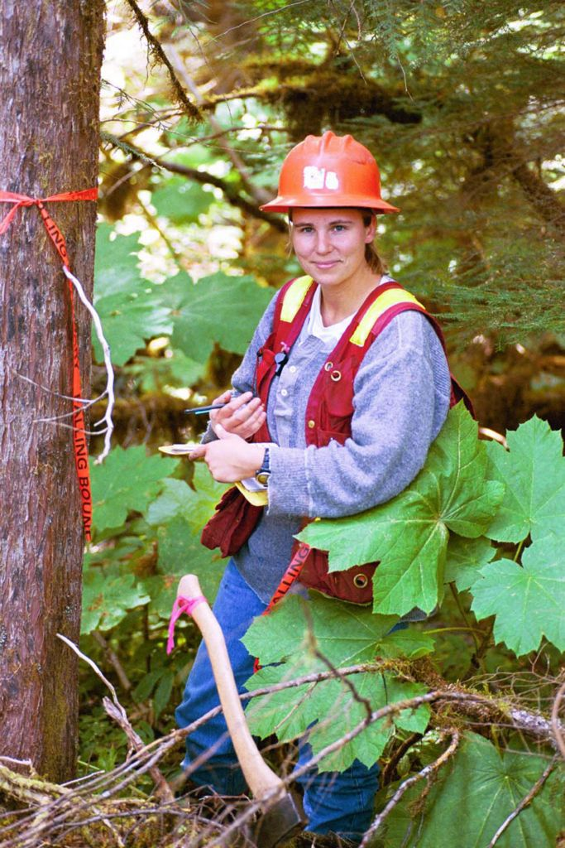
Sustainable Forestry Initiative
BC Timber Sales is certified under the Sustainable Forestry Initiative (SFI) Forest Management Standard (2022)
Objective 4 . Conservation of Biological Diversity
  Performance Measure 4.2: Certified Organizations shall protect threatened and endangered species, critically imperiled and imperiled species (Forests with Exceptional Conservation Values), and natural communities and old-growth forests.
  Indicator 4.2.1: Program to protect threatened and endangered species.
  Indicator 4.2.2: Program to locate and protect known sites of flora and fauna associated with viable occurrences of critically imperiled and imperiled species and ecological communities, defined as Forests with Exceptional Conservation Value.
Notes:
SFI defines a Program as an organized system, process or set of activities to achieve an objective or performance measure.
Conformance with these indicators is being achieved through the development of Species of Management Concern (SOMC) guidance and implementation programs. This includes the identification of SOMC, development of training materials and delivery of SOMC awareness training for staff, and guidance on the management of SOMC.

Slide 11
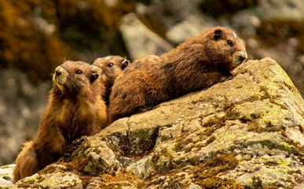
What are the SOMC for your Business Area?
The BCTS corporate resources include a Business Area SOMC Focus List of plants and animals. Suggest sharing the table and the location of the list for future reference.
The Focus List is updated when the Conservation Data Centre updates their list. Changes typically include:
Changes to species classification.
Changes to the provincial rankings (red, blue, yellow)
  * An At Risk Ecological Community Focus List will be developed and available in 2023

Slide 12
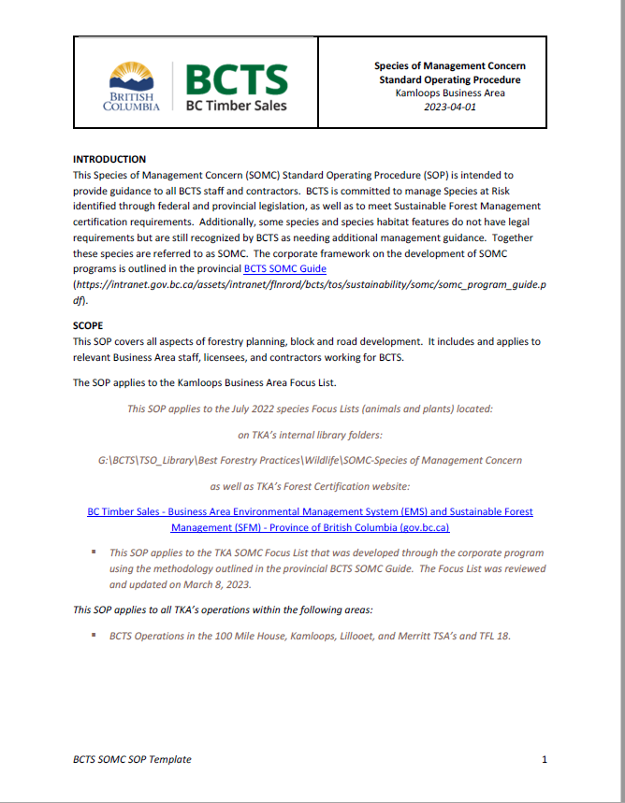
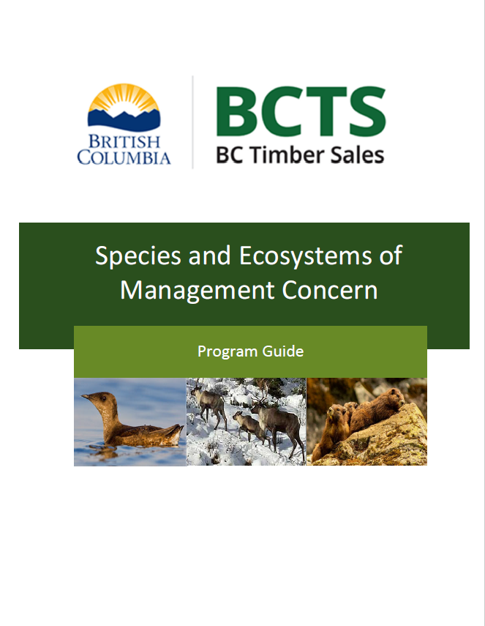
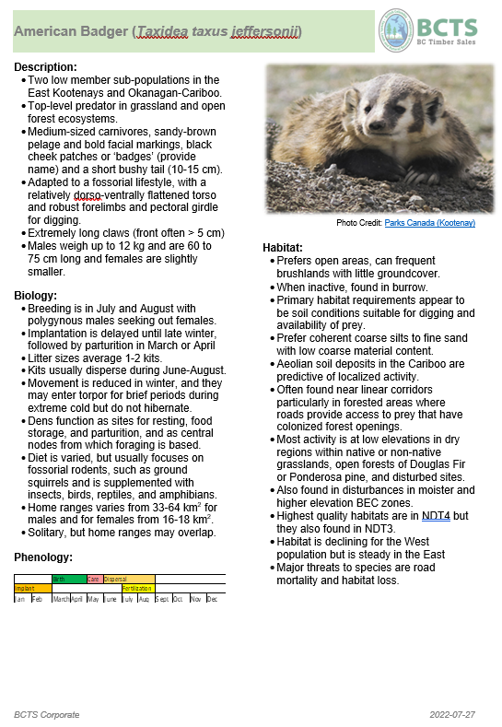
Key Documents & Field Card Examples
Standard Operating Procedure (SOP)
SOMC
Program Guide
Focus List
Field Cards

Slide 13
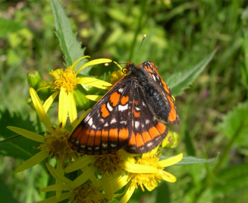
SOMC Reporting
If you find a species of management concern or a feature used by SOMC record the following:
Record the location on a map, GPS or iPad
Take photos and video if possible
General description of the habitat, including stand age and structure
Note any special features such as amount of coarse woody debris and wildlife trees
Record the elevation and slope of the site
Gillette’s Checkerspot
Observations of SOMC or wildlife habitat features should be submitted to the BCTS Planning Team for documentation and tracking. Observations can be submitted to the BC Conservation Data Centre as Incidental Observations at: Submit Wildlife / Plant Data and Information - Province of British Columbia (gov.bc.ca)
Notes:
Species to be reported to the BC CDC include all Red or Blue-listed species and their nests or dens, species included on Schedule 1 of the Species at Risk Act and their nests or dens.

Slide 14



Resources
For additional information, consult the BCTS Sustainability Intranet page where you will find the BCTS corporate SOMC resources.
Species ID Resources
Regional Amphibian ID Keys – ID keys for frogs, toads and salamanders
BC Species and Ecosystems Explorer – data about species and ecosystems in BC
iNaturalist – identification tool for plants and animals
Seek – developed by iNaturalist, will work without internet connection
Merlin Bird ID – bird identification by sight and sound

