Slide 1
TBA - Species of Management Concern
Awareness Training

Slide 2
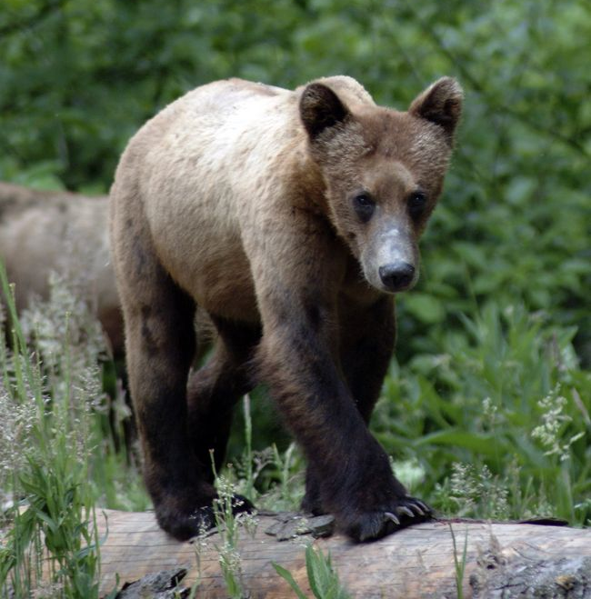

SOMC Awareness Training Overview
Introduction
  What are Species of Management Concern?
  Why protect them?
Legislation – Federal and Provincial
SFI Certification
Business Area SOMC Focus Species
Reporting SOMC
Identification Resources
Notes:
Hopefully you enjoy this session, which is primarily designed to provide awareness of our program and how it fits into our EMS system.
We’ll cover topics like “what is a SOMC, and why protect them”, the relevant legislation, and how this fits into our SFI certification.
Then we’ll get you acquainted with some of the local species for Babine that you need to be aware of
and we’ll make sure you know what to do if you come across one of these species or habitat features in the field
And finally link you up with some resources for more information

Slide 3
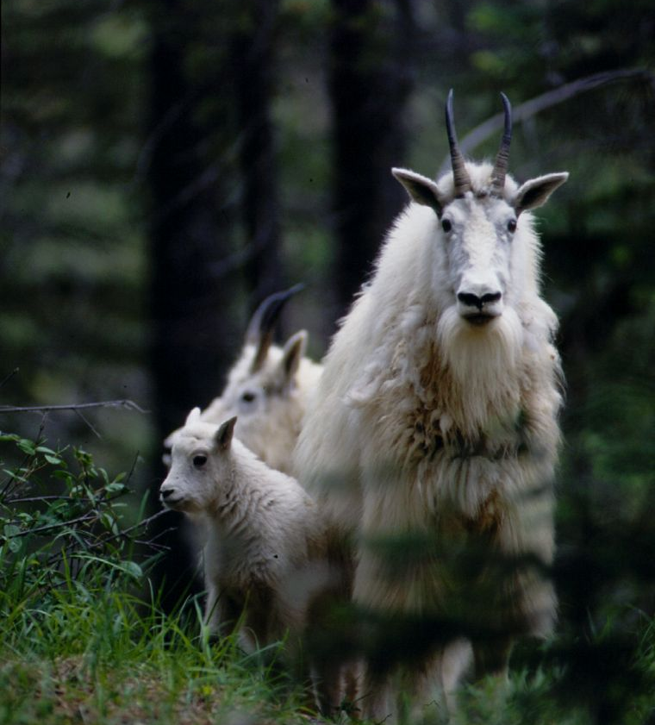
What are Species of Management Concern?
Species, ecosystems, habitats, or wildlife feature that occurs within BCTS operating areas and can be adversely affected by forestry.
Notes:
Species of Management Concern may be a new term for some of us, because this used be called our “Species at Risk” program
Our base definition of an SOMC is a species, ecosystem, habitat, or wildlife feature that occurs in our operating area and could be adversely affected by forestry operations.
BCTS has both legal and stewardship obligations to manage and conserve these

Slide 4
What are Species of Management Concern?
Species, ecosystems, habitats, or wildlife feature that occurs within BCTS operating areas and can be adversely affected by forestry.
  Legislation
  SFI requirements
  Not at-risk, but locally identified for social/economic reasons
Notes:
These species and ecosystems of management concern (SOMC) are identified by a variety of sources:
Legislation! including provincial and federal legislation and policy that spell out legal requirements for ‘at-risk’ species
SFI! Has specific requirements based on conservation status from independent bodies such as the BC Conservation Data Centre (CDC) or the Committee on Status of Endangered Wildlife in Canada (COSEWIC)
Not at-risk by established conservation definitions, but maybe a species has been locally identified for social/economic reasons. These may come from local resource management plans

Slide 5
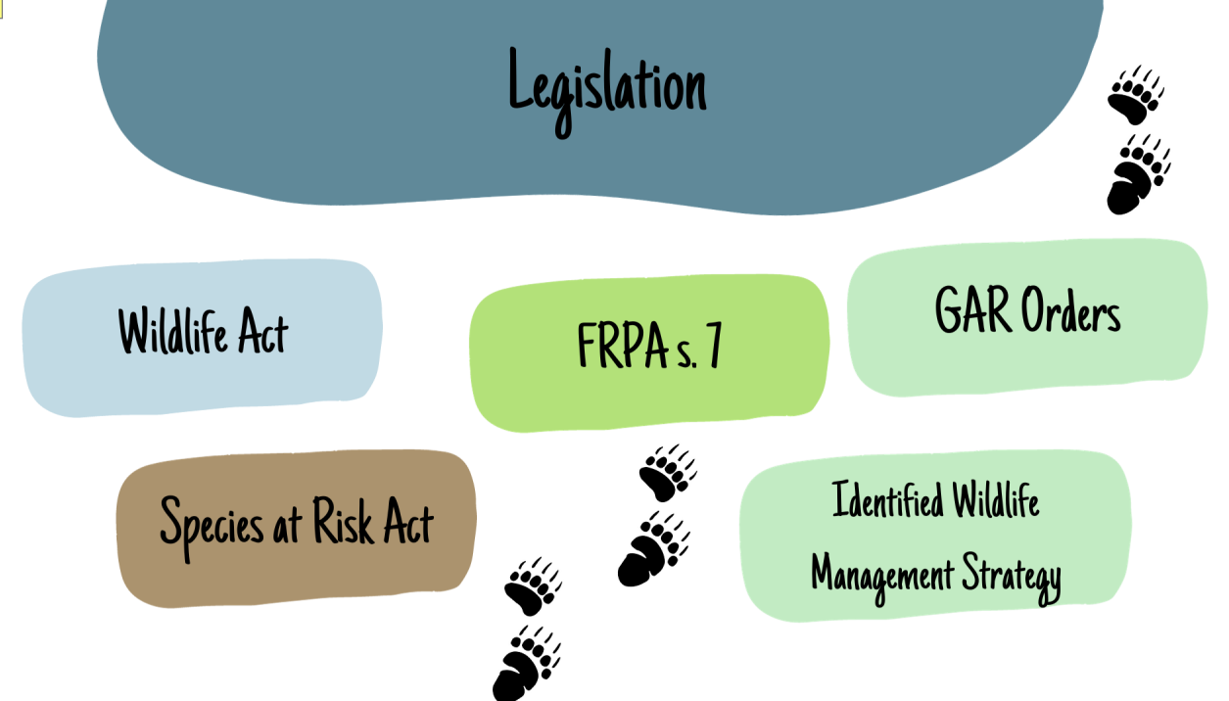
Notes:
As you can see, we have many examples of legislation that relate to our management of SOMC.

Slide 6
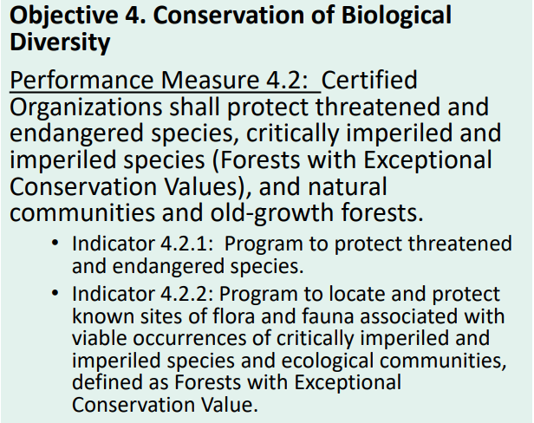
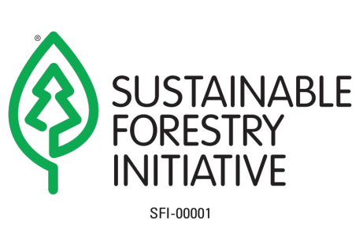
Sustainable Forestry Initiative
Notes:
Let’s talk certifications now.
As you all know, BC Timber Sales is certified under the Sustainable Forestry Initiative (SFI)
And you don’t need to memorize this, but just be aware that the SOMC program mainly falls under SFI Objective four.
Conformance with Objective 4’s indicators is being achieved through this SOMC program,
Which is why it’s so important we are all aware of this program and how to implement it!

Slide 7
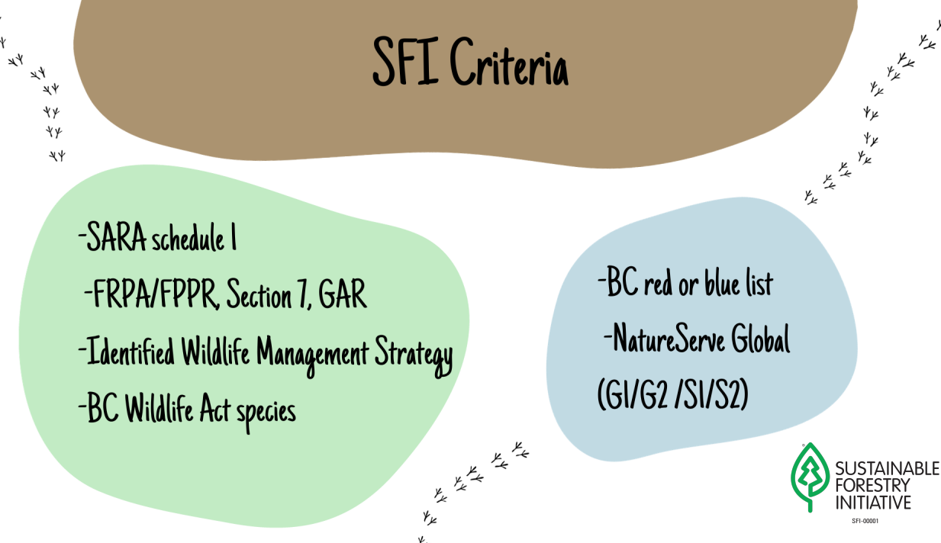
Notes:
SFI requires our SOMC program to cover ecosystems and species that are again a) covered by our legislation (listed here in green)
and b) covered by any of the conservation rankings shown here in blue
SFI also requires coverage for anything not at risk, but identified locally for social and/or economic reasons

Slide 8
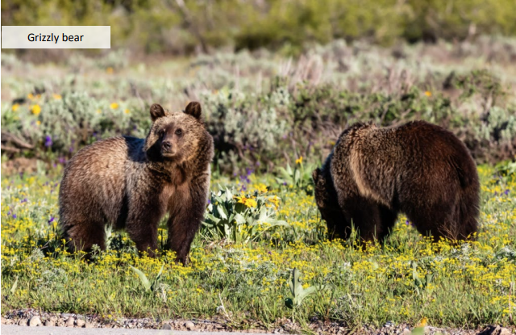
Why protect SOMC?
• Achieve sustainable forest management goals
• To maintain biological diversity
• To comply with federal legislation
• To comply with provincial legislation
• To maintain Sustainable Forestry Initiative (SFI) certification
Notes:
To summarize:
The conservation of SOMC is a fundamental component of sustainable forest management, and sustainability is an overarching BCTS principle. We genuinely want to maintain biological diversity
Next in line of importance of course, is to comply with federal and provincial legislation
And finally, we need to do this to maintain our SFI certification

Slide 9
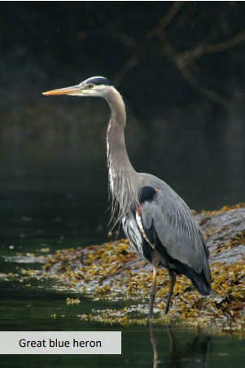
The Babine SOMC Program
Standard Operating Procedure
Focus List
Operator Awareness Sheet
Field Procedure package
Notes:
SFI has specific requirements not only for what defines an SOMC, but also what needs to be included in a program to be looking for, identifying, and managing these species
We are also required to deliver this awareness training for staff and contractors.
So, in conformance with those requirements, our program at Babine includes four main documents you need to be aware of:
Standard Operating Procedure
Focus Lists that identify the exact species covered under this program
Operator Awareness Sheet
Field Procedure package for the field

Slide 10
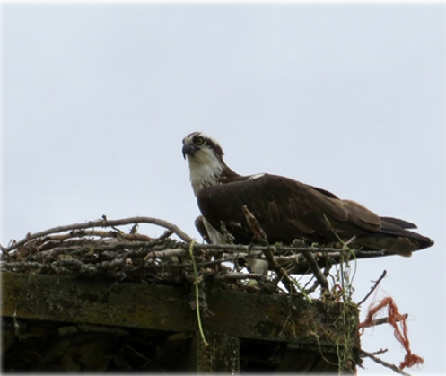
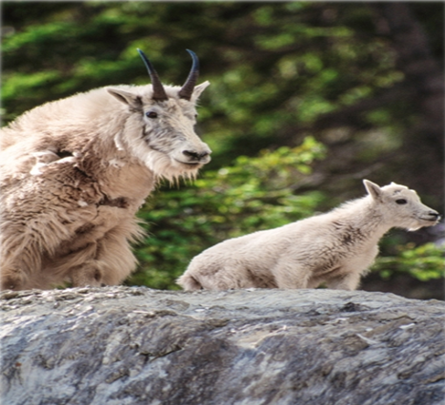
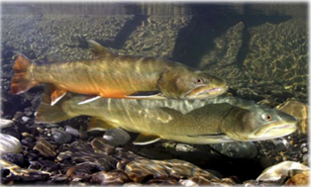
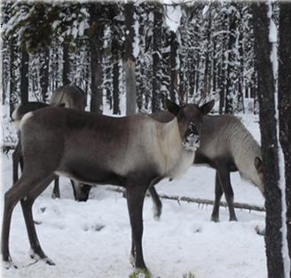
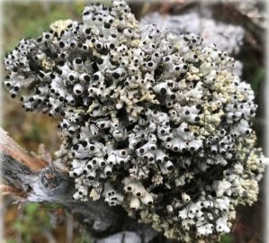
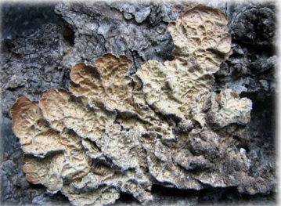
A Peek into the Focus Lists…

Slide 11
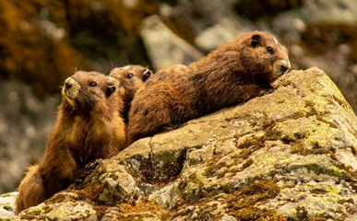
What are the SOMC for your Business Area?
The BCTS corporate resources include a Business Area SOMC Focus List of plants and animals. TBA’s Focus List can be found at this Link.
The TBA Focus List includes 23 total species:
  2 lichen
  1 vascular plant
  2 amphibians
  9 birds
  9 mammals
  1 fish species
  81 At-Risk Ecological Communities
Notes:
Here is a breakdown of the SOMC found in Babine business area, and a link to the focus list that we should all be familiar with.

Slide 12
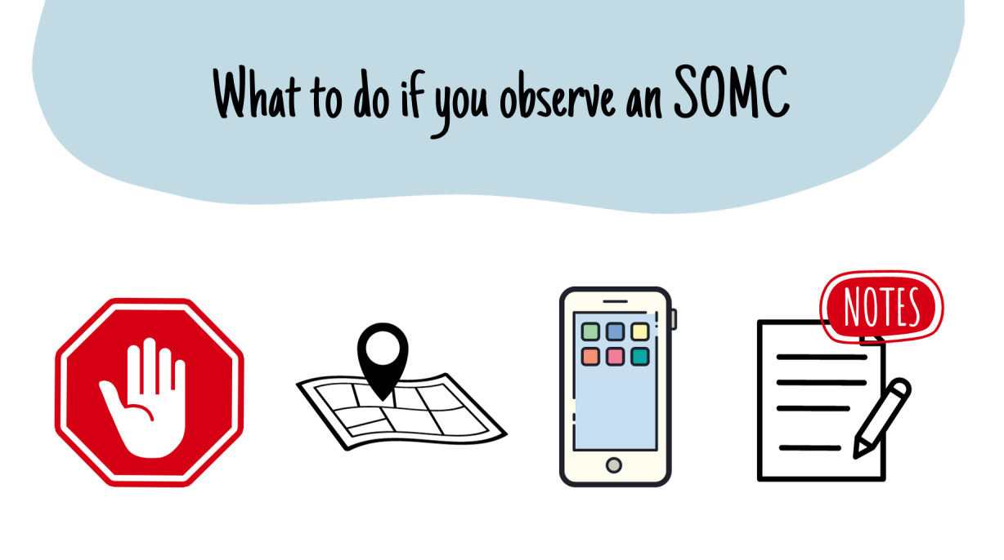
Observations of SOMC or wildlife habitat features should be submitted to the BCTS Planning Team for documentation and tracking. Observations can be submitted to the BC Conservation Data Centre as Incidental Observations at: Submit Wildlife / Plant Data and Information - Province of British Columbia (gov.bc.ca)
Notes:
There are specific procedures and details in the SOP outlining how we are systematically checking for SOMC during all aspects of our operations
But for today’s purposes, say you're out and about doing anything and come across an SOMC, this is what we generally need everyone to do!
First, Stop what you’re doing, and document
Proper documentation includes:
Record the location on a map, GPS, or iPad (lat/long are preferred)
Take photos and video if possible
Notes: General description of the habitat, maybe stand age and structure, elevation, slope
You’ll want to report all these details to BCTS as soon as possible, and follow any management direction given
Species to be reported to the BC CDC include all Red or Blue-listed species and their nests or dens, species included on Schedule 1 of the Species at Risk Act and their nests or dens.

Slide 13



Resources
For additional information, consult the BCTS Sustainability Intranet page where you will find the BCTS corporate SOMC resources.
Species ID Resources
Regional Amphibian ID Keys – ID keys for frogs, toads and salamanders
BC Species and Ecosystems Explorer – data about species and ecosystems in BC
iNaturalist – identification tool for plants and animals
Seek – developed by iNaturalist, will work without internet connection
Merlin Bird ID – bird identification by sight and sound
Notes:
Here are some popular species ID resources that may help you in the field.

Slide 14


Training Checklist
Watch the training presentation
Review the EMS documents
Make sure your training tracker has been updated
Notes:
Now that’s you’ve watched this presentation
You just need to go to the EMS website to review the SOP, field procedures package and focus list to complete your training
Reminder to update your training tracker once you are done, and remember we are suggesting this presentation be reviewed every two years

Slide 15
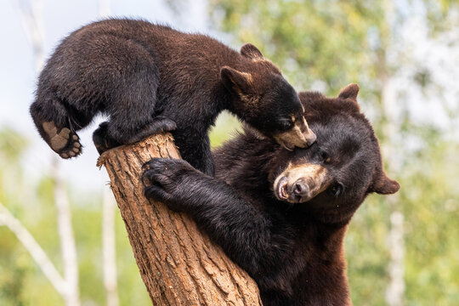
Thank you!

