Slide 1

TSK and TBA Business Areas
Migratory Birds and Breeding Birds
Awareness Training 2026
Regulations
  Federal
  Provincial
Nests
Nest Flow Chart
Highlight Species – Pileated Woodpecker
Interior Protocols

Slide 2
Federal Legislation – MBCA and MBR
The Migratory Birds Convention Act (MBCA) and the Migratory Birds Regulations (MBR) protect migratory birds, their nests and eggs on all land tenures anywhere in Canada and in ocean waters.
They apply to native migratory birds named in the convention such as ducks, geese, shorebirds, swallows, flycatchers, woodpeckers, hummingbirds and more.
They do not apply to hawks, eagles, falcons, owls, Corvidae (jays, crows, ravens) and grouse.

Slide 3
Federal Legislation – MBCA and MBR
All migratory bird nests are protected when they contain a live bird or viable egg.
The nests of 18 species listed in Schedule 1 of the MBR are protected at all times.
These nests may only be removed following registration of the nest and confirmation that the nest has been abandoned for the species specific designated waiting period outlined in the schedule.
Schedule 1 of MBR – species on the list with the potential for interaction with BCTS operations in the TSK and TBA Business Areas
Species | Wait Time (months) | Forestry Activities
Pigeon Guillemot | 12 | Shoreline sites only
Rhinoceros Auklet | 12 | Shoreline sites only
Great Blue Heron | 24 | All forestry activities
Fork-tailed Storm Petrel | 12 | Shoreline sites only
Pileated Woodpecker | 36 | All forestry activities

Slide 4
Federal Legislation - SARA
Migratory bird species that are listed as Endangered, Threatened or Extirpated on Schedule 1 of the Species at Risk Act (list) may also have year round nest protection if a nest is included in the definition of their residence habitat (SARA s33).
A permit under s73 would be required to remove a nest of these species.
In the TSK and TBA Business Areas the only species that meet these criteria are:
  Barn Swallow
  Bank Swallow
  Marbled Murrelet (TSK only)
The active and inactive nests of these species are protected.

Slide 5
Provincial Legislation
Section 34 of the Wildlife Act outlines provisions related to birds and their nests.
s34 - A person commits an offence if the person, except as provided by regulation, possesses, takes, injures, molests or destroys:
  A bird or its egg,
  The nest of an eagle, peregrine falcon, gyrfalcon, osprey, heron or burrowing owl, or
  The nest of a bird not referred to in paragraph (b) when the nest is occupied by a bird or its egg
Bold species could breed in the TSK and TBA Business Areas and their nests would be protected regardless of the activity status.

Slide 6
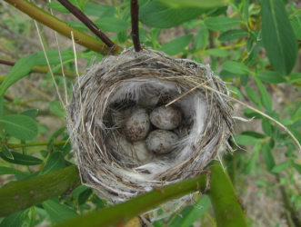
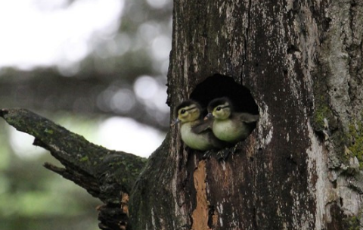
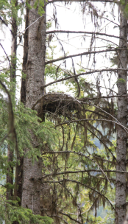
Bird Nests
!!!ALL ACTIVE BIRD NESTS ARE PROTECTED!!!
Locations: nests can be located in banks or on cliffs, on the ground, in vegetation or trees, within tree cavities and on structures such as buildings or bridges.
Nest types: nests can be built of sticks, moss, grass, hair and other fibers, they can be a scrape or shallow depression on the ground or they can be in a cavity, crevice or burrow into trees, cliffs or banks.
Active nests: evidence of an active nest include an adult perched in the nest, adult birds performing distraction displays, persistent alarm calls, birds carrying food or nesting materials to a location, accumulated droppings or whitewash below a nest. All active nests are protected.
Do not disturb, remove or relocate an active nest.

Slide 7
Inactive Nests
Inactive Nests of the following species that could be found in the TSK and TBA Business Areas* have regulatory protection.
Great Blue Heron Wildlife Act Schedule 1 Migratory Birds Regulations 2022 | Pileated Woodpecker Schedule 1 Migratory Birds Regulations 2022 | Barn Swallow and Bank Swallow Schedule 1 of Species at Risk Act | Marbled Murrelet (TSK only) Schedule 1 of Species at Risk Act
Bald Eagle and Golden Eagle Wildlife Act | Gyrfalcon (TSK only) Wildlife Act | Peregrine Falcon Wildlife Act | Osprey Wildlife Act
*Species on Schedule 1 of the Migratory Birds Regulations that nest at shoreline sites only have not been included as potential impacts are limited to specific development activities such as log dumps and barge ramps, not general forestry activities.

Slide 8
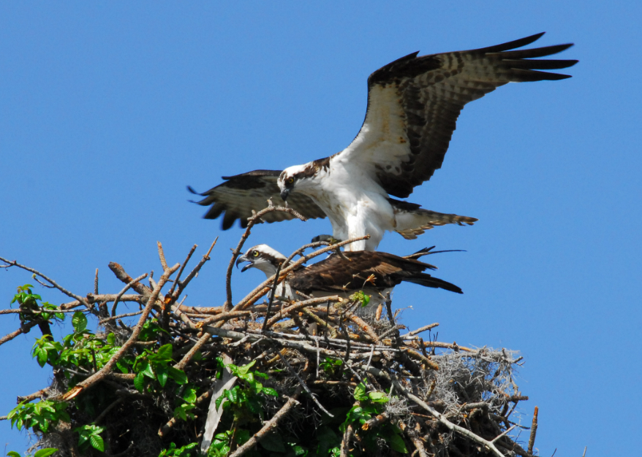
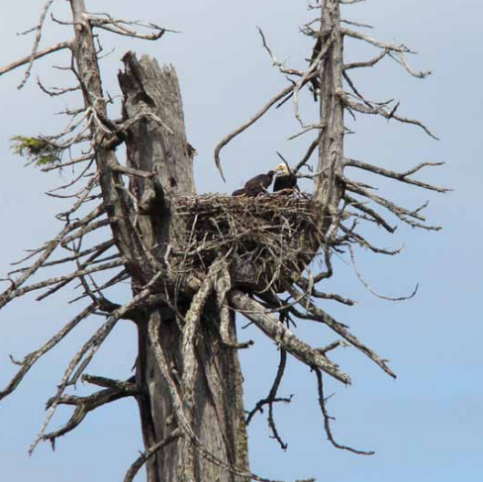
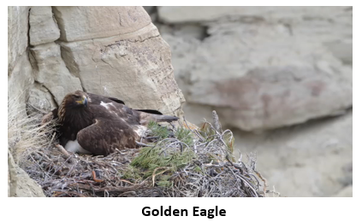
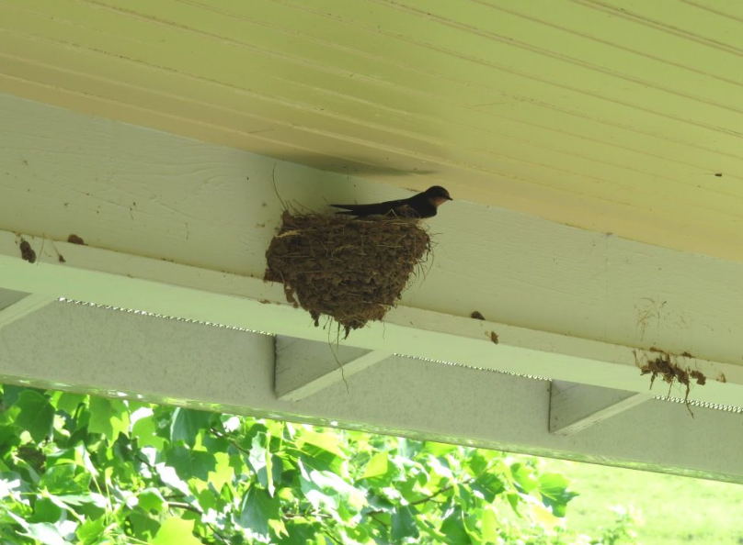
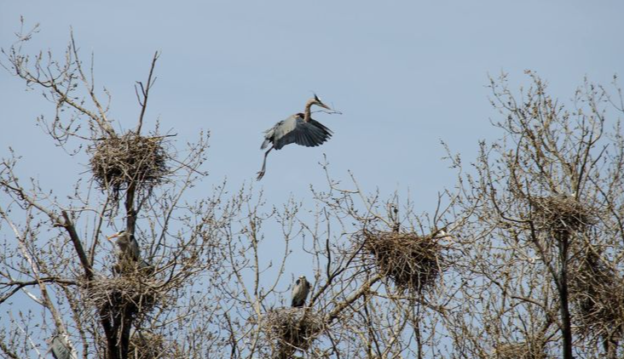
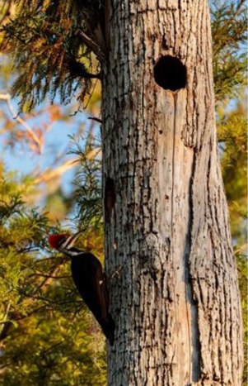
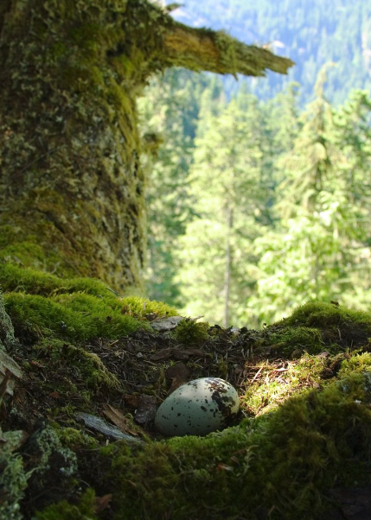
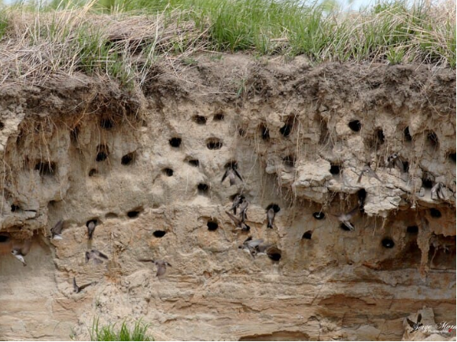
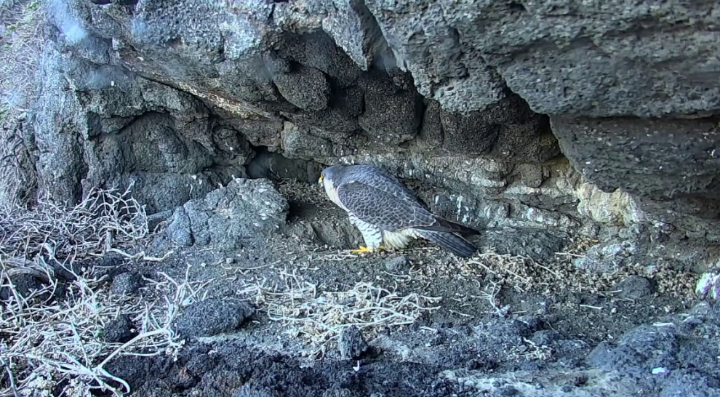
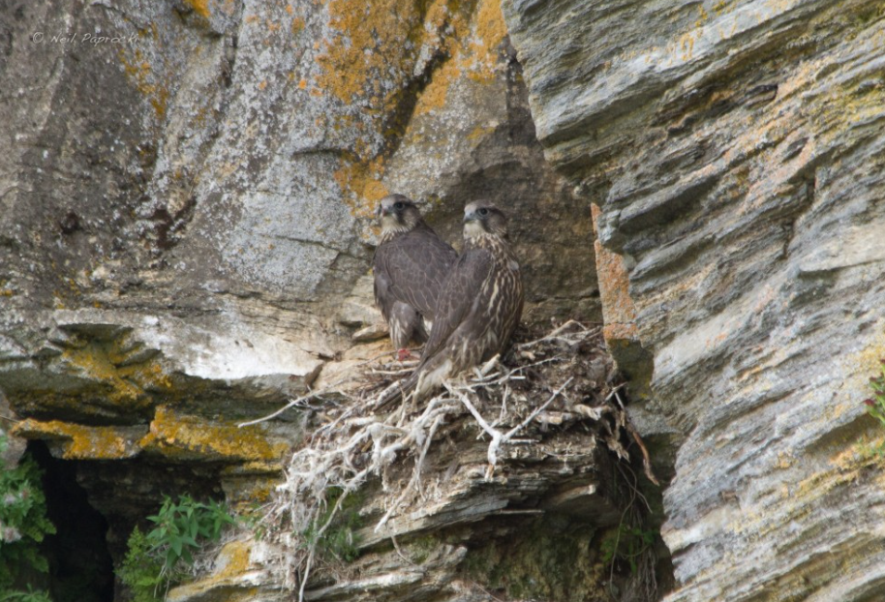
Osprey
Barn Swallow
Bald Eagle
Great Blue Heron
Peregrine Falcon
Bank Swallow
Gyrfalcon (TSK)
Marbled Murrelet (TSK)
Pileated Woodpecker

Slide 9
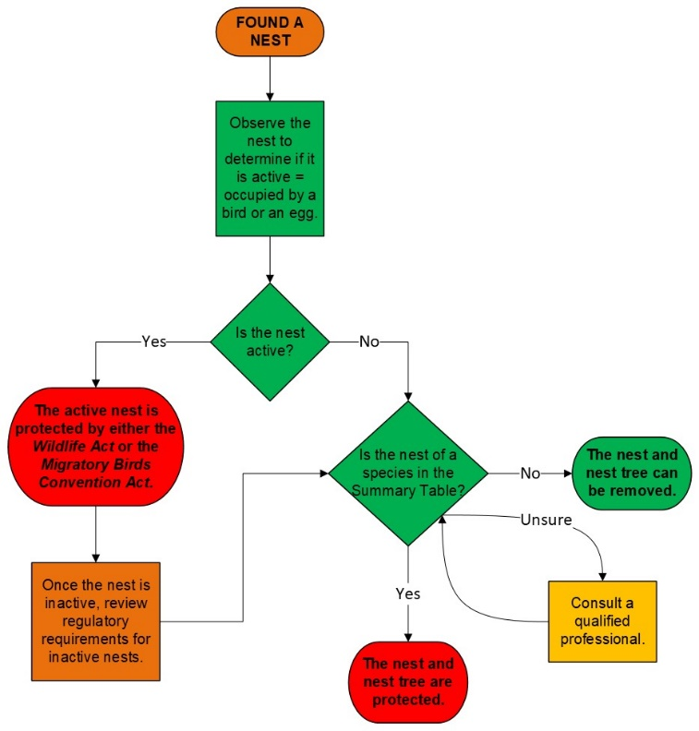

Nest Flow Chart
Signs that a nest is active:
Adult bird perched in the nest
Adult birds performing distraction displays
Persistent alarm calls
Birds carrying food or nesting materials to a location
Cheeping sounds coming from young birds in a nest or tree cavity
Accumulated droppings or whitewash below a nest
Species in the TSK and TBA summary table:
Great Blue Heron
Pileated Woodpecker
Marbled Murrelet (TSK only)
Barn Swallow
Bank Swallow
Bald Eagle
Golden Eagle
Peregrine Falcon
Osprey
Gyrfalcon (TSK only)

Slide 10
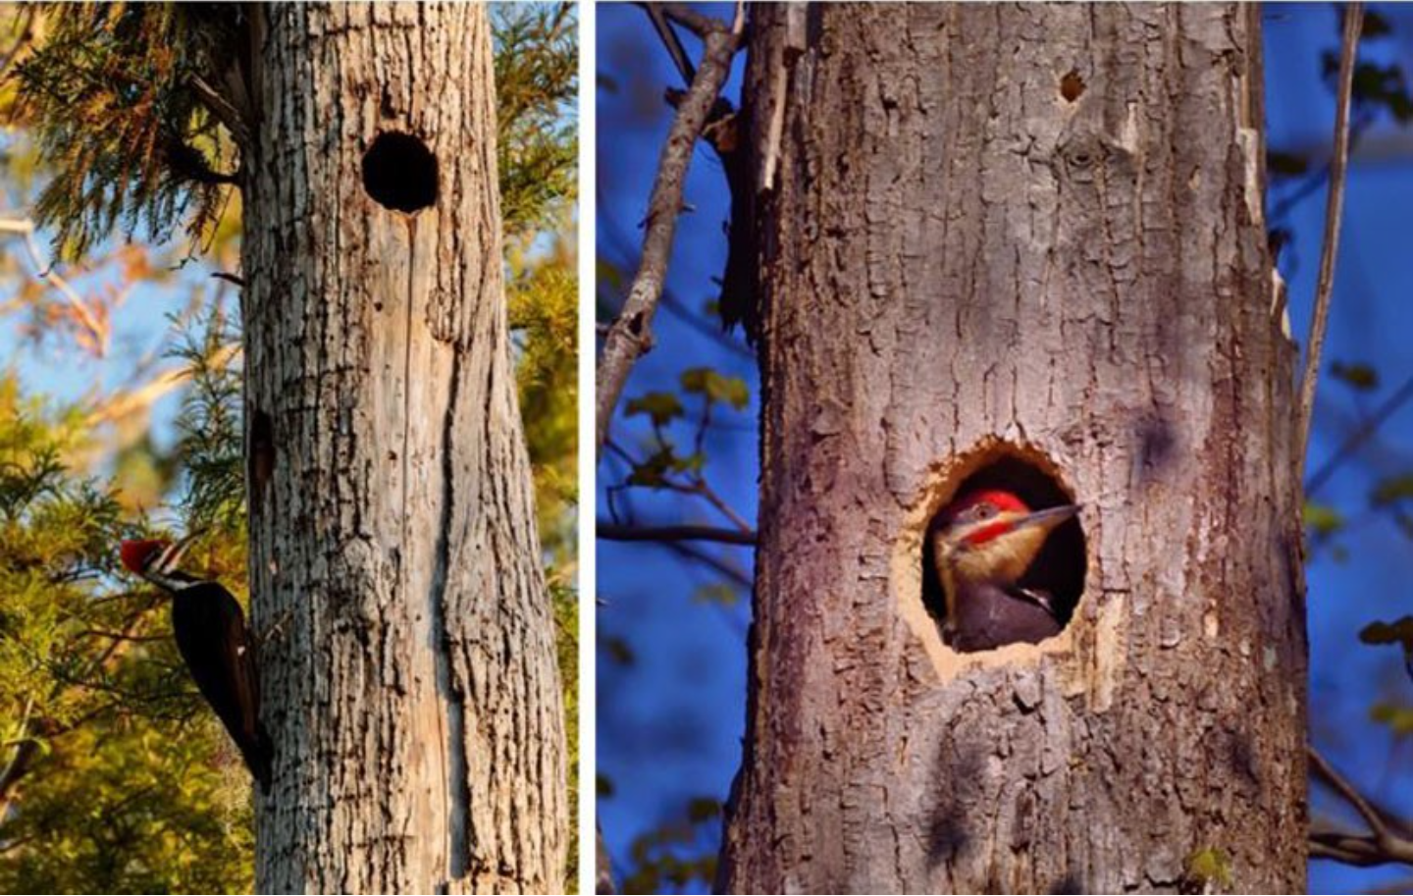
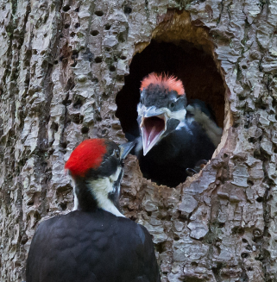
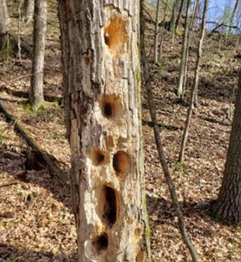
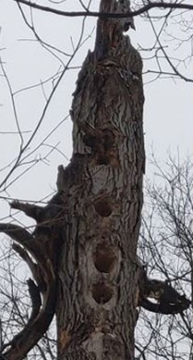
Pileated Woodpecker
BCTS Pileated Woodpecker
Field Card
Nesting Info:
nesting cavities have smooth edges
oval shaped 9X12cm in size
>40cm dbh trees
Often deciduous species
At elevations <1200m
Nesting cavities as shown above are protected.
Feeding and roosting cavities as shown below are not.

Slide 11
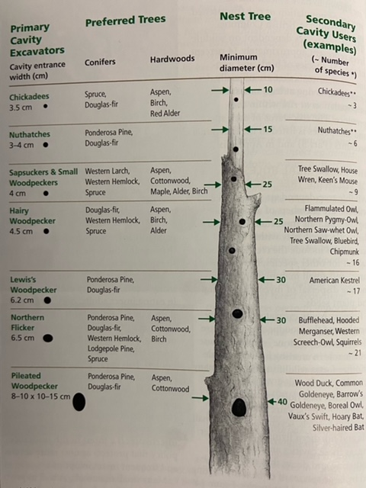
Pileated Woodpecker
If you find a potential Pileated Woodpecker nesting cavity record the location, take photos and report it to BCTS.

Slide 12
Pileated Woodpecker
Potential management options:
  Retain the tree within a reserve area or through modified block design to exclude the feature. If the feature can be retained the nest does not need to be registered with Environment and Climate Change Canada.
  If the potential PIWO nesting cavity is located at a critical control point for road design, cannot be accommodated in a reserve area or is located near a road and is a safety concern the following steps are suggested:
    Engage a professional to determine:
      if the cavity is a Pileated Woodpecker nesting cavity,
      the status of the cavity, e.g. active/occupied, and
      management recommendations.

Slide 13
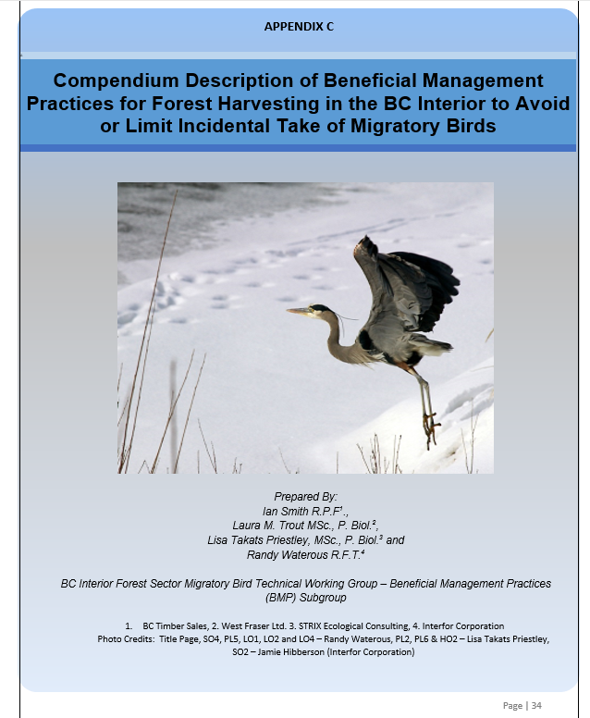
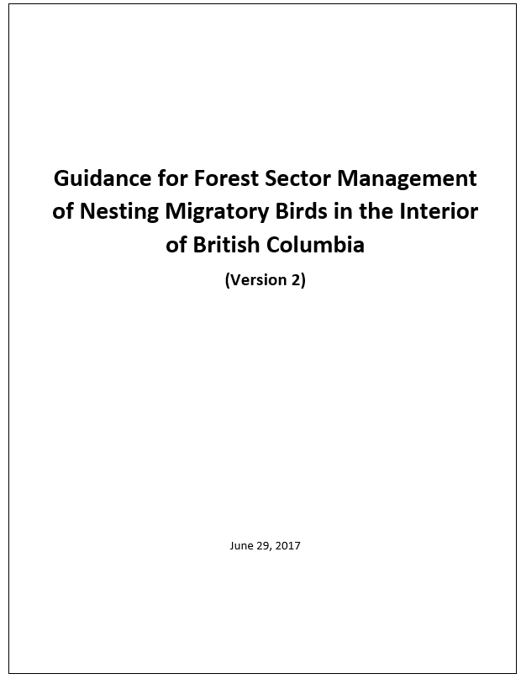
Interior Management Protocols
Based on expert opinion and ecological principles.
Risk management/due diligence tool, NOT a complete forest management plan for migratory birds or Species at Risk.
Components—Nesting Density Matrix; web map tool and Beneficial Management Practices.

Slide 14
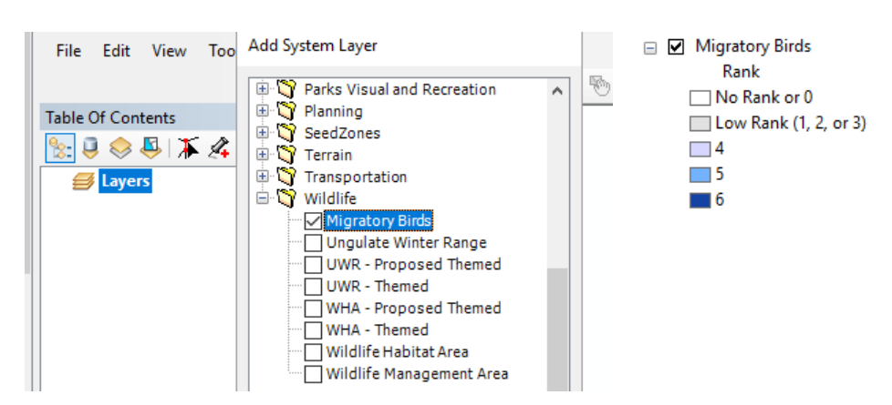
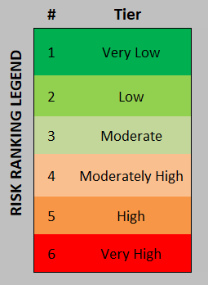
Nesting Density Matrix - Ranking
How to access the mapping of nesting density matrix in LRM - In map view, click on 'File' > Add System Data. In the Add System Layer pop-up, under Wildlife > toggle 'Migratory Birds’. This data will be updated annually by BCTS Provincial Operations GIS staff.
Risk rank = nest density

Slide 15
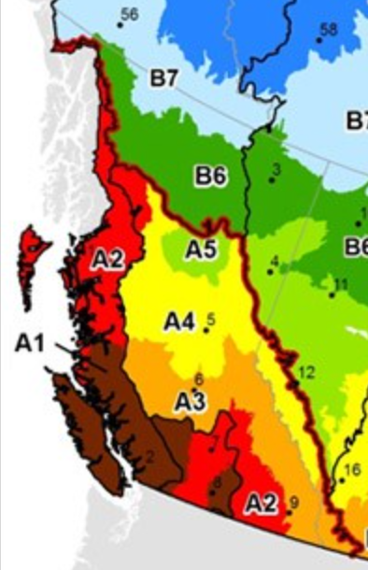
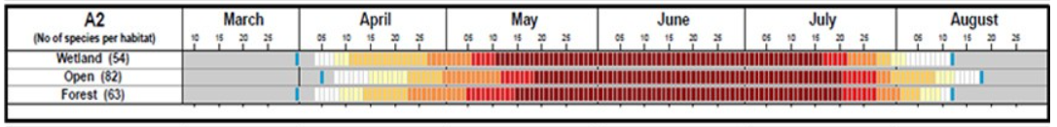
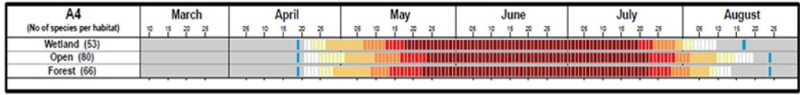
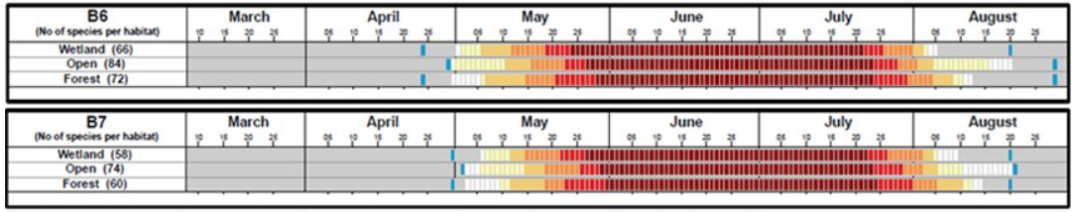
Nesting Calendars
Business Area boundaries overlap several nesting zones: TSK = A2, B6, B7; TBA = A4
Legend for nesting calendars: Number of species predicted to be nesting as a percentage of the total number of species known to nest in the habitat type (Blue markers show extreme dates predicted for some atypical parts of the nesting zone where nesting could be earlier or later)
There is a spatial layer to determine which zone a block is in.

Slide 16
Nesting Periods
Appendix C of the BCTS SOP
NP 1 – for most situations – covers 80-90% of the species
NP2 – when NP1 is not practicable – covers about 60% of the species
* ESSF – add 7 days to each date to account for later nesting due to higher elevation
NP1 NP2 NP2 NP1

Slide 17
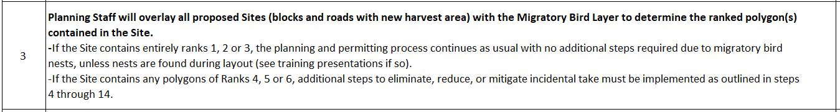
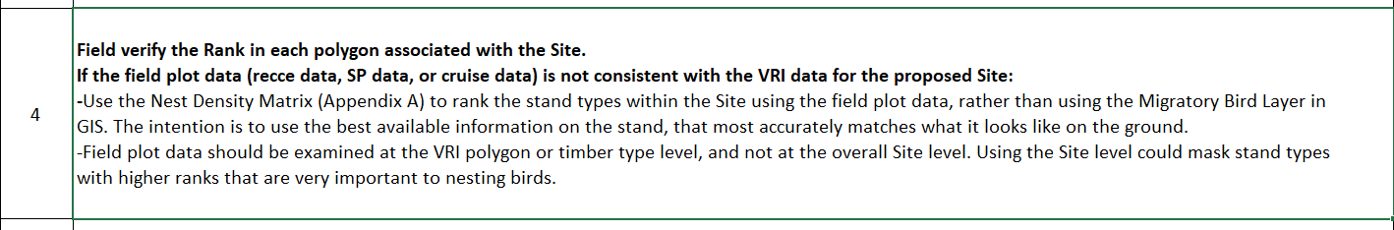
BCTS SOP - Procedure
Planning Process
Field verification
Based on the rank of the polygon (Rank 1-6), move through the SOP (Procedures sheet) steps 4-14 to verify the rank (Appendix A – Nest Density Matrix sheet), and determine the additional steps required to eliminate, reduce, or mitigate incidental take (Appendix D – BMPs sheet).
Document with supporting information why any rank adjustments were made → defensible rationale

Slide 18
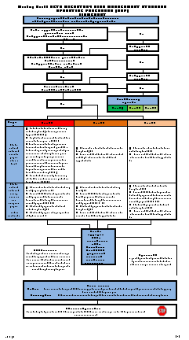
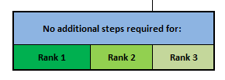
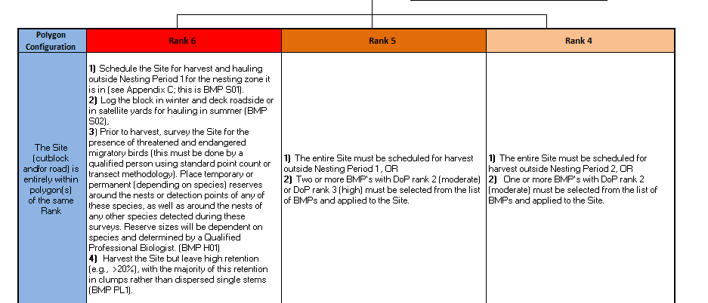

BCTS SOP - Flowchart

Slide 19
SUMMARY – Specific to TSK and TBA
ALL ACTIVE bird nests are protected during all activities on all land tenures in BC.
ALL INACTIVE bird nests that meet the following criteria are protected during all activities on all land tenures in BC:
  species listed in Schedule 1 of the Migratory Birds Regulations - Great Blue Heron and Pileated Woodpecker
  migratory birds listed as endangered, threatened, or extirpated on Schedule 1 of the Species at Risk Act, if nests are included in the definition of the residence for the species – Barn Swallow, Bank Swallow, and Marbled Murrelet (TSK only)
  species named in Section 34 of the Wildlife Act – Great Blue Heron, Bald Eagle, Golden Eagle, Peregrine Falcon, Gyrfalcon (TSK only) and Osprey
If nest removal is required, review all applicable provincial and federal regulations to determine if a permit or other conditions are required prior to nest removal.
Implement the Interior Migratory Bird Management Protocols and SOP.

Slide 20

RESOURCES
Merlin Bird App (free) - bird ID by sight or sound
Refer to BCTS Sustainability Intranet Site on Migratory and Breeding Birds: Migratory and breeding birds protections - Ministry of Forests
  The site has details on regulations and links to additional resources including a presentation from the Canadian Wildlife Service to the FPBC: Migratory Birds Convention Act and Regulations 2022
  Field card that summarizes all of the regulatory requirements: Migratory and breeding birds field card and summary - Ministry of Forests
  Details on the Interior Forest Sector Guidance: BCTS migratory birds regional management protocols - Ministry of Forests

Slide 21

Questions?

