Slide 1
At Risk Ecological Communities Awareness Training 2026

Slide 2

AREC Awareness Training Overview
Introduction
What are At Risk Ecological Communities?
Why protect them?
SFI Certification
AREC Program
SOP
Focus List
AREC Field Confirmation Procedures
Resources

Slide 3

Ecological Community Definition
The BC Conservation Data Centre defines Ecological Community as plant associations from the Vegetation Classification of the Biogeoclimatic Ecosystem Classification, and other natural plant communities including both forested and non-forested ecosystems.
FRPA defines an Ecological Community as a group of different species occupying a particular area.
Note: Great Bear Rainforest Order and the Identified Wildlife Management Strategy use the term Plant Communities

Slide 4
What are At Risk Ecological Communities?
BCTS has both legal and stewardship obligations to manage and conserve specific species, ecosystems and habitats that might occur within BCTS operating areas and be adversely affected by forestry activities.
For BCTS, an At Risk Ecological Community (AREC) is an ecological community that meets one or more of the following attributes:
Red or Blue listed (BC Conservation Data Centre)
Critically imperiled or imperiled (NatureServe)
Listed on a schedule of legislated Orders, i.e. GBRO
included on the list of plant communities under the Identified Wildlife Management Strategy.

Slide 5

Why Protect AREC?
To maintain biological diversity
To comply with provincial legislation - Forest and Range Practices Act and any applicable land use orders
Aligns with the Province’s commitment to establish Ecosystem Health as an overarching priority (OGSR Recommendation 2)
Required to maintain Sustainable Forestry Initiative certification
Professional due diligence and Code of Ethics

Slide 6
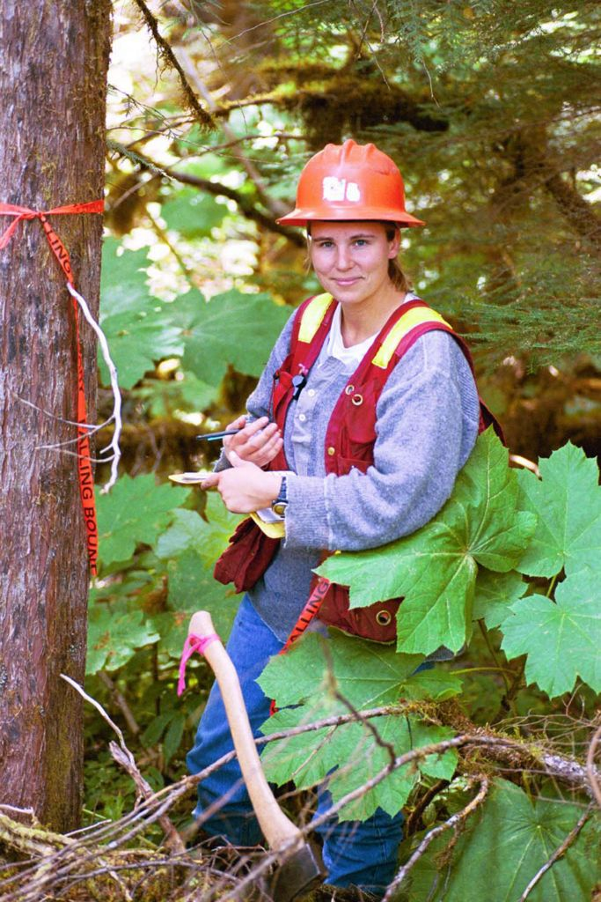
Sustainable Forestry Initiative
BC Timber Sales is certified under the Sustainable Forestry Initiative (SFI) Forest Management Standard (2022)
Objective 4 . Conservation of Biological Diversity
Performance Measure 4.2: Certified Organizations shall protect threatened and endangered species, critically imperiled and imperiled species (Forests with Exceptional Conservation Values), and natural communities and old-growth forests.
Indicator 4.2.1: Program to protect threatened and endangered species.
Indicator 4.2.2: Program to locate and protect known sites of flora and fauna associated with viable occurrences of critically imperiled and imperiled species and ecological communities, defined as Forests with Exceptional Conservation Value.
Notes:
SFI defines a Program as an organized system, process or set of activities to achieve an objective or performance measure.
Conformance with these indicators is being achieved through the development of Species of Management Concern (SOMC) guidance and implementation programs. This includes the identification of SOMC, development of training materials and delivery of SOMC awareness training for staff, and guidance on the management of SOMC.

Slide 7
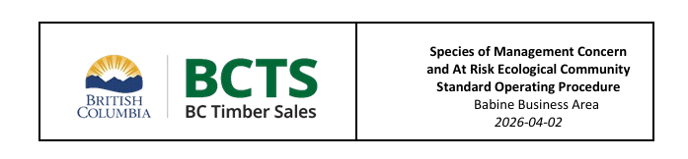
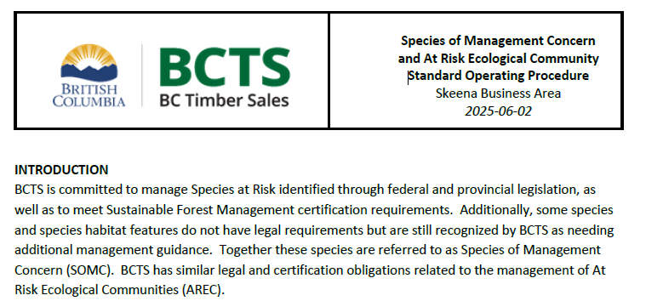
AREC Program Components
AREC program components are posted on the BCTS EMS/SFM external website: ​
BC Timber Sales - Business Area Environmental Management System (EMS) and Sustainable Forest Management (SFM) - Province of British Columbia
Standard Operating Procedures
Babine Business Area SOMC and AREC SOP: 2026-04-02
Skeena Business Area SOMC and AREC SOP 2025-06-02
AREC Focus List
TBA – 2024-08-30
TSK – 2022-12-17
The excel version of the AREC Focus List is available on the BCTS intranet site: AREC focus lists - Ministry of Forests

Slide 8
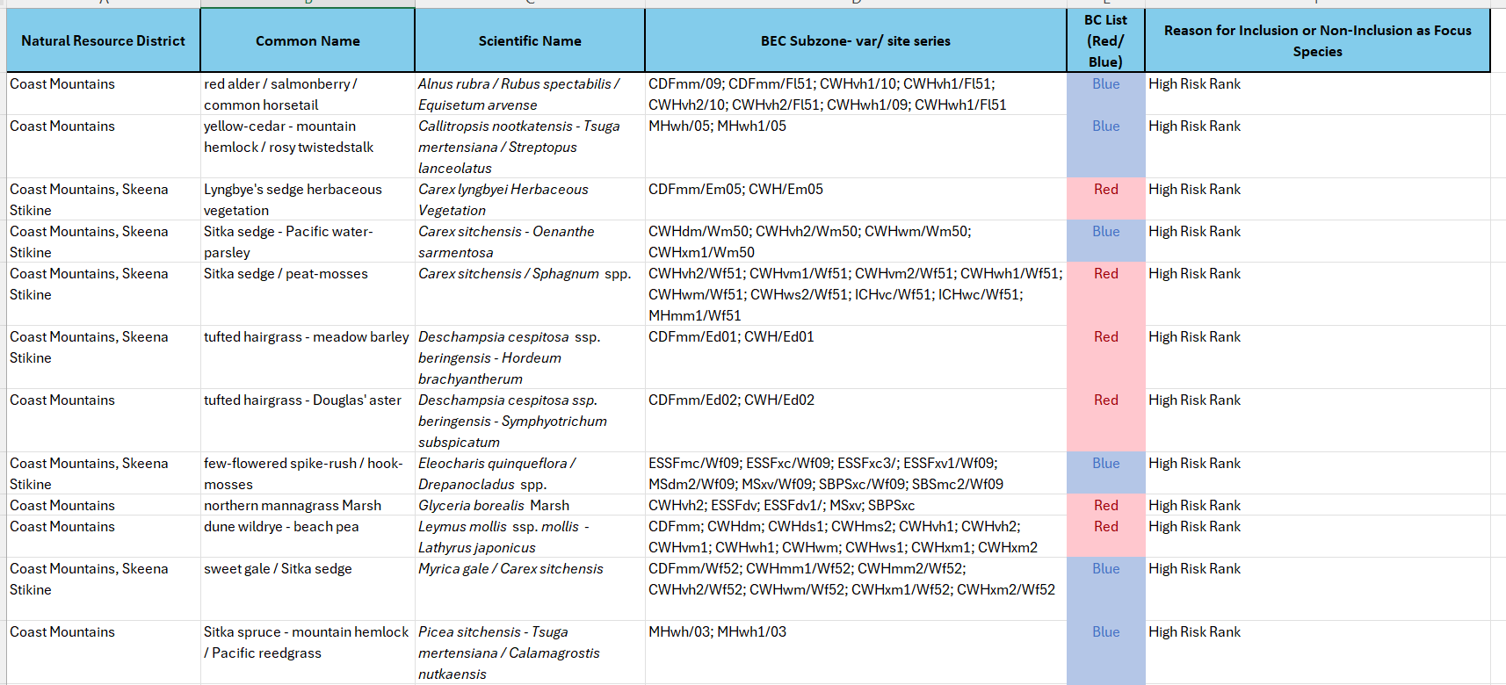
AREC Focus List
The AREC Focus Lists are large:
TSK = 49 AREC
TBA = 26 AREC.
During your pre-work you can sort and filter the list based on the BEC units mapped within your area of interest.
Excel demo – CWHws1

Slide 9
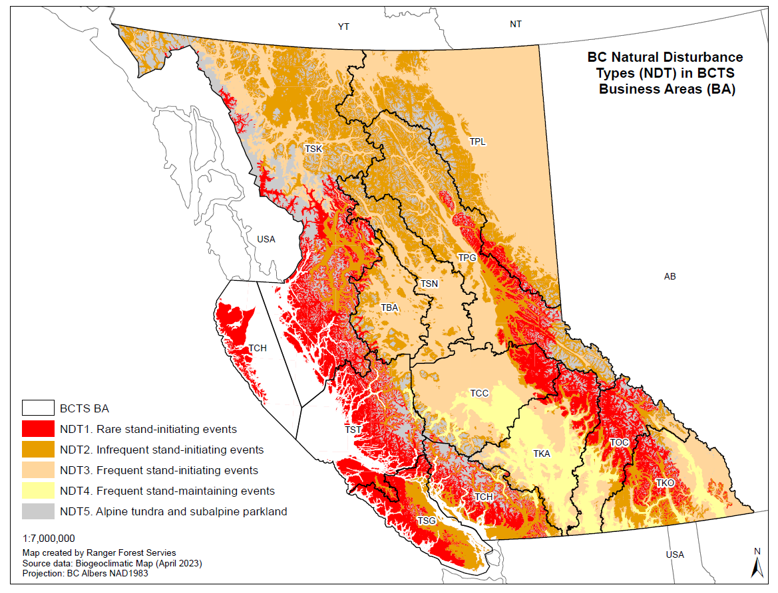
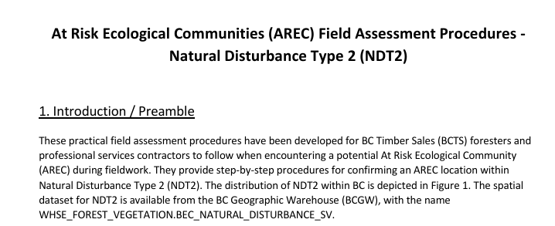
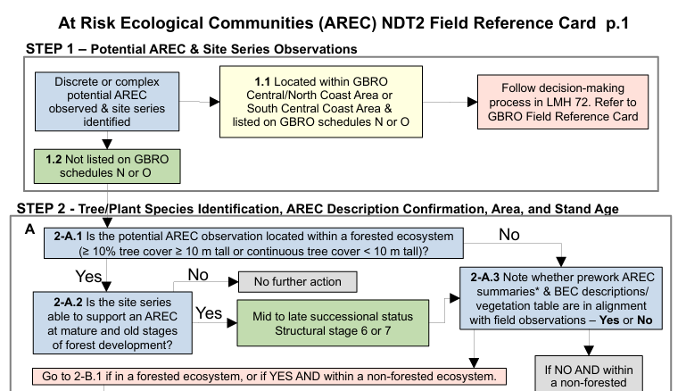
AREC Program Implementation
Field Assessment Procedures
Practical field assessment procedures were developed as a tool to confirm the presence of a potential AREC during fieldwork.
Derived for Natural Disturbance Types (Biodiversity Guidebook 1995).
TSK is in NDT 1, 2 and 3
TBA is in NDT 2 and 3
(minor amount of NDT 1)
Procedures include step-by-step directions to follow and data to collect with additional details beyond site series
A field reference card is available including visual flowcharts with supporting figures

Slide 10
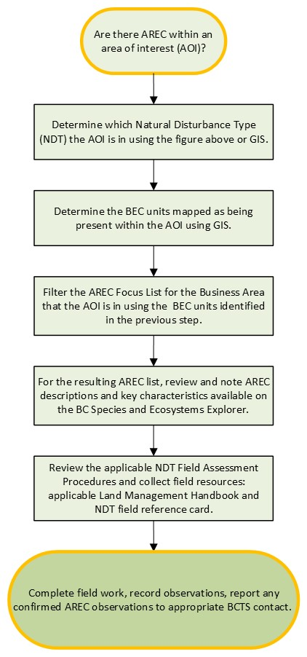
AREC Process
This flowchart outlines a process to determine which field procedure to use and the suggested pre-field planning steps. Additional details on office prework are outlined in section 4.1 of each AREC Field Assessment Procedure.
Essential Resources:
BCTS SOMC and AREC SOP and AREC Focus List
Land Management Handbook for the BEC unit
NDT 1,2 or 3 AREC Field Assessment Procedure and Field Reference Card
Completed prework – focussed AREC list for AOI, descriptions of potential AREC for the BEC unit, stand age
Field equipment, including increment borer for aging
Notes:
Species to be reported to the BC CDC include all Red or Blue-listed species and their nests or dens, species included on Schedule 1 of the Species at Risk Act and their nests or dens.

Slide 11
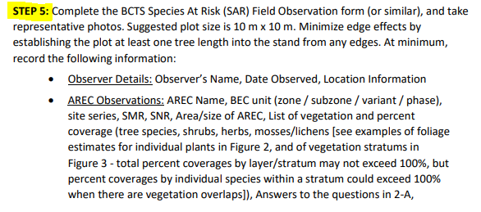
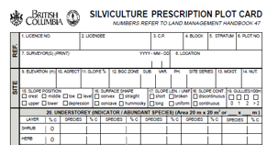
AREC Data Collection and Reporting
If an AREC is confirmed in the field record the data outlined in Section 4.6 (Step 5) of the assessment procedures and the field reference cards.
Data can be recorded on an SP plot card – FS 39A
Observations of AREC should be communicated to BCTS as outlined in Section 7. Reporting of the SOP or BCTS Contract Coordinator for documentation and tracking.
Observations can be submitted to the BC Conservation Data Centre as Incidental Observations: Submit Wildlife / Plant Data and Information - Province of British Columbia (gov.bc.ca)
Notes:
Species to be reported to the BC CDC include all Red or Blue-listed species and their nests or dens, species included on Schedule 1 of the Species at Risk Act and their nests or dens.

Slide 12

AREC Management
Draft management guidance has been prepared as a resource: AREC program implementation - Ministry of Forests
Outlines stand-level management recommendations for confirmed AREC
Retention guidelines
Red vs blue listed AREC – different objectives / recommendations
Recommendations for retention area sizes and design
Additional protection options
Notes:
Species to be reported to the BC CDC include all Red or Blue-listed species and their nests or dens, species included on Schedule 1 of the Species at Risk Act and their nests or dens.

Slide 13
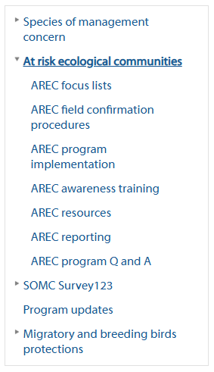
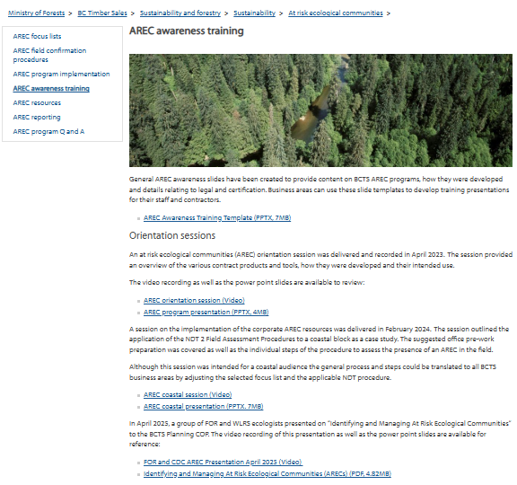
Corporate Resources
BCTS Intranet Site – AREC Program:
At risk ecological communities - Ministry of Forests

Slide 14
Resources
BC Conservation Data Centre Species and Ecosystems Explorer: BC Species & Ecosystems Explorer - Province of British Columbia (gov.bc.ca)
Biodiversity Guidebook (1995): Biodiversity Guidebook (Forest Practices Code of British Columbia, September 1995)
Field Manual for Describing Terrestrial Ecosystems 2nd edition (2010) – Reprinted in 2015 – Land Management Handbook 25: Deif0 Web Frnt Cvr-2010.indd
Guidelines to support implementation of the Great Bear Rainforest Order with respect to Old Forest and Listed Plant Communities (2019) – Land Management Handbook 72: LMH72.pdf
Field Verification of Priority Old Forest Deferral Areas: Technical Guidance (2022): Field Verification of Priority Old Forest Deferral Areas: Technical Guidance - Version 3.1 (Corrected: November 3, 2022)
NEW - Land Management Handbook 78 A Guide to Provincial Information on Ecosystems and Ecological Communities in Coastal BC 2025 - A Guide to Provincial Information on Ecosystems and Ecological Communities in Coastal British Columbia

