Slide 1

Engagement on the Public Interest Bonding Strategy
Discussion paper

Slide 2
Public Engagement Sessions
April 20, 9:00 – 11:00
April 21, 9:00 – 11:00
April 28, 10:00 – 12:00

Slide 3
Outline
Project Overview
What is Financial Assurance
Discussion Paper Overview
How to Provide Feedback
Next Steps

Slide 4
Project Overview
Minister’s mandate commitment 2020 & 2022
  “With support from the Minister of Energy, Mines and Low Carbon Innovation, take steps to ensure owners of large industrial projects are bonded moving forward so that they – not British Columbians – pay the full costs of environmental cleanup if their projects are abandoned.”

Slide 5
What is the Public Interest Bonding Strategy?
Created to address the mandate commitment
Two-phased comprehensive review of financial assurance requirements across the natural resource ministries

Slide 6
What is Financial Assurance?
The purpose of financial assurance is:
to promote forward-looking planning of environmental clean-up and reclamation, and to encourage the progressive implementation of those activities; and
to ensure timely clean-up and reclamation without additional costs to the Province should an owner of an industrial project be unable or unwilling to perform the required actions themselves.

Slide 7
Discussion Paper
Purpose
    Promote dialogue and gain feedback
    Inform effective and efficient solutions to deliver on the mandate commitment
Link to webpage
  https://engage.gov.bc.ca/govtogetherbc/consultation/public-interest-bonding/

Slide 8
Guiding Principles
The ‘polluter pays’ is the overarching principle
A subset of principles include:
Consistent with the Declaration Act
Risk-based approach
Maintain industry competitiveness and financial viability
Reduce and mitigate environmental risk
Transparent and accountable decisions
Consistent, compatible, and fair decision-making

Slide 9
Overview of Discussion Paper
Purpose
  Overview of preliminary ideas on how to strengthen BC’s approach to financial assurance
  Promote dialogue and gain feedback to help inform solutions
Categories
  Legal Framework
  Statutory Liability Tools
  Financial Assurance Mechanisms

Slide 10
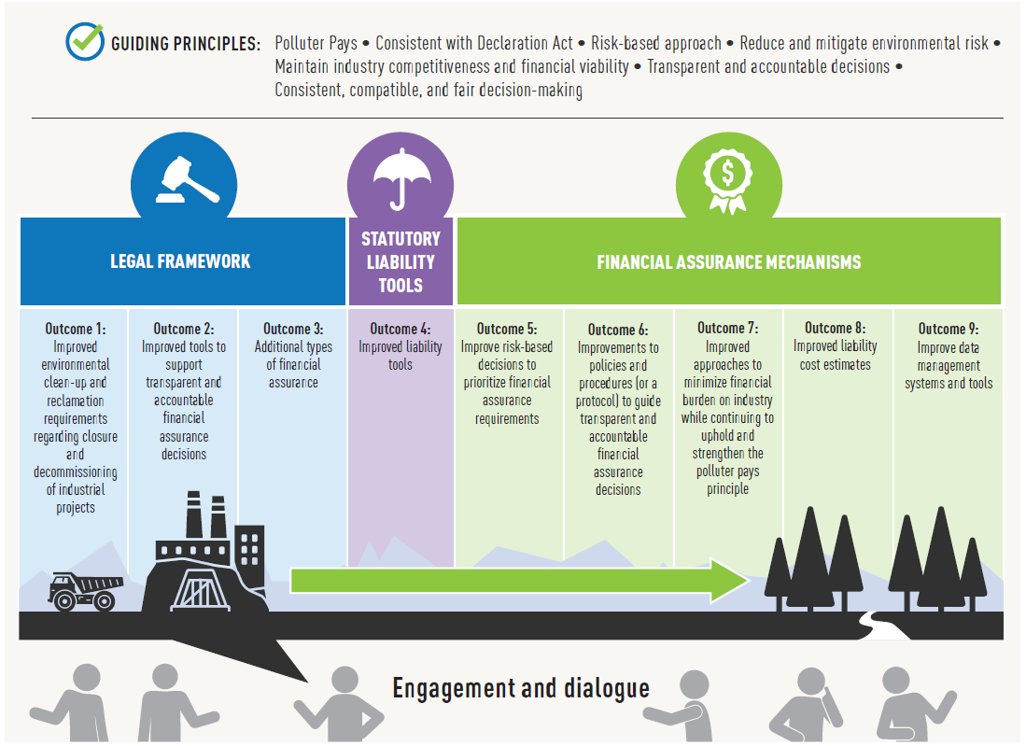

Slide 11
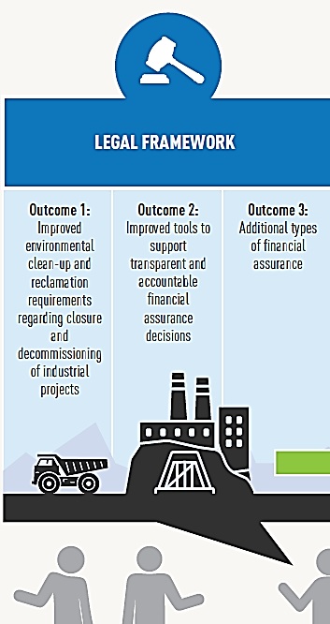
Category A. Legal Framework
Explores desired outcomes and potential opportunities to strengthen the overarching legal framework for financial assurance requirements in British Columbia

Slide 12
Outcome One
Better environmental clean-up and reclamation requirements regarding closure and decommissioning of industrial projects.
Opportunities:
Clarify and define “environmental clean-up and reclamation”
Improve plans for site decommissioning and reclamation

Slide 13
Outcome Two
Better tools to support transparent and accountable financial assurance decisions.
Opportunities:
Require financial assurance for specific types of industrial projects
Set the appropriate amount and form of financial assurance to require
Confirm the amount of liability against which financial assurance is collected

Slide 14
Outcome Three
Additional types of financial assurance.
Opportunities:
Allow the use of pooled funds to support:
More efficient use of fees and interest
Additional payment options
More affordable payment options

Slide 15

Category B.
Statutory Liability Tools
Hold companies legally responsible for the costs of cleaning up environmental damage that has happened or is imminent
Complement the use of financial assurance

Slide 16
Outcome Four
Improved liability tools.
Opportunities:
Create clear obligations for environmental clean-up and reclamation
Develop consistent financial assurance requirements
Obtain, review, update, and spend financial assurance at appropriate times
Strengthen the Province’s ability to
  collect financial assurance that is required but has not been received
  collect funds when the responsible parties are insolvent
  collect monies owing
Create or expand the liability of directors, officers, and related corporations

Slide 17
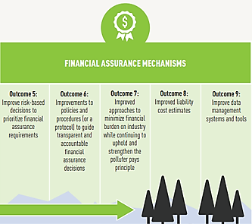
Category C. Financial Assurance Mechanisms
Financial assurance mechanisms support liability rules. If the owner of an industrial project is unwilling or unable to fulfill their environmental clean-up and reclamation obligations, the Province can draw upon financial assurance to fund necessary mitigations

Slide 18
Outcome Five
Better risk-based decisions to prioritize financial assurance requirements.
Opportunities:
Identify and prioritize industries and/or projects with the highest potential risk

Slide 19
Outcome Six
Improvements to policies and procedures (or a protocol) to guide transparent and accountable financial assurance decisions.
Opportunities:
Support fair and consistent financial assurance requirements

Slide 20
Outcome Seven
Better approaches to minimize financial burden on industry while continuing to uphold and strengthen the polluter pays principle.
Opportunities:
Flexible financial assurance options
Transition periods
Risk-based approach to determining financial assurance amounts

Slide 21
Outcome Eight
Improved liability cost estimates.
Opportunities:
Revise and update environmental clean-up and reclamation liability cost estimate information requirements
Improve methods and tools for estimating environmental clean-up and reclamation costs

Slide 22
Outcome Nine
Better data management systems and tools.
Opportunities:
Improve transparency with respect to how environmental cleanup and reclamation liabilities are determined
Improve how the Province manages environmental cleanup and reclamation liabilities and the required financial assurance to back these liabilities

Slide 23
Next Steps
Attend engagement sessions
View the discussion paper online at https://engage.gov.bc.ca/govtogetherbc/consultation/public-interest-bonding
Provide feedback online by May 28, 2022
Feedback will inform a What We Heard report

Slide 24
Discussion Paper Questions
Examples:
In defining environmental clean-up and reclamation, what key elements are most important to you, your industry or your organization?
What do you think are the most important considerations when determining which industrial projects should require a closure plan?
What is your feedback on how to support transparent and accountable financial assurance decisions?
How could pooled funds be used as a tool to support the Guiding Principles of the Public Interest Bonding Strategy?

Slide 26
Questions?
Comments?

