Slide 1
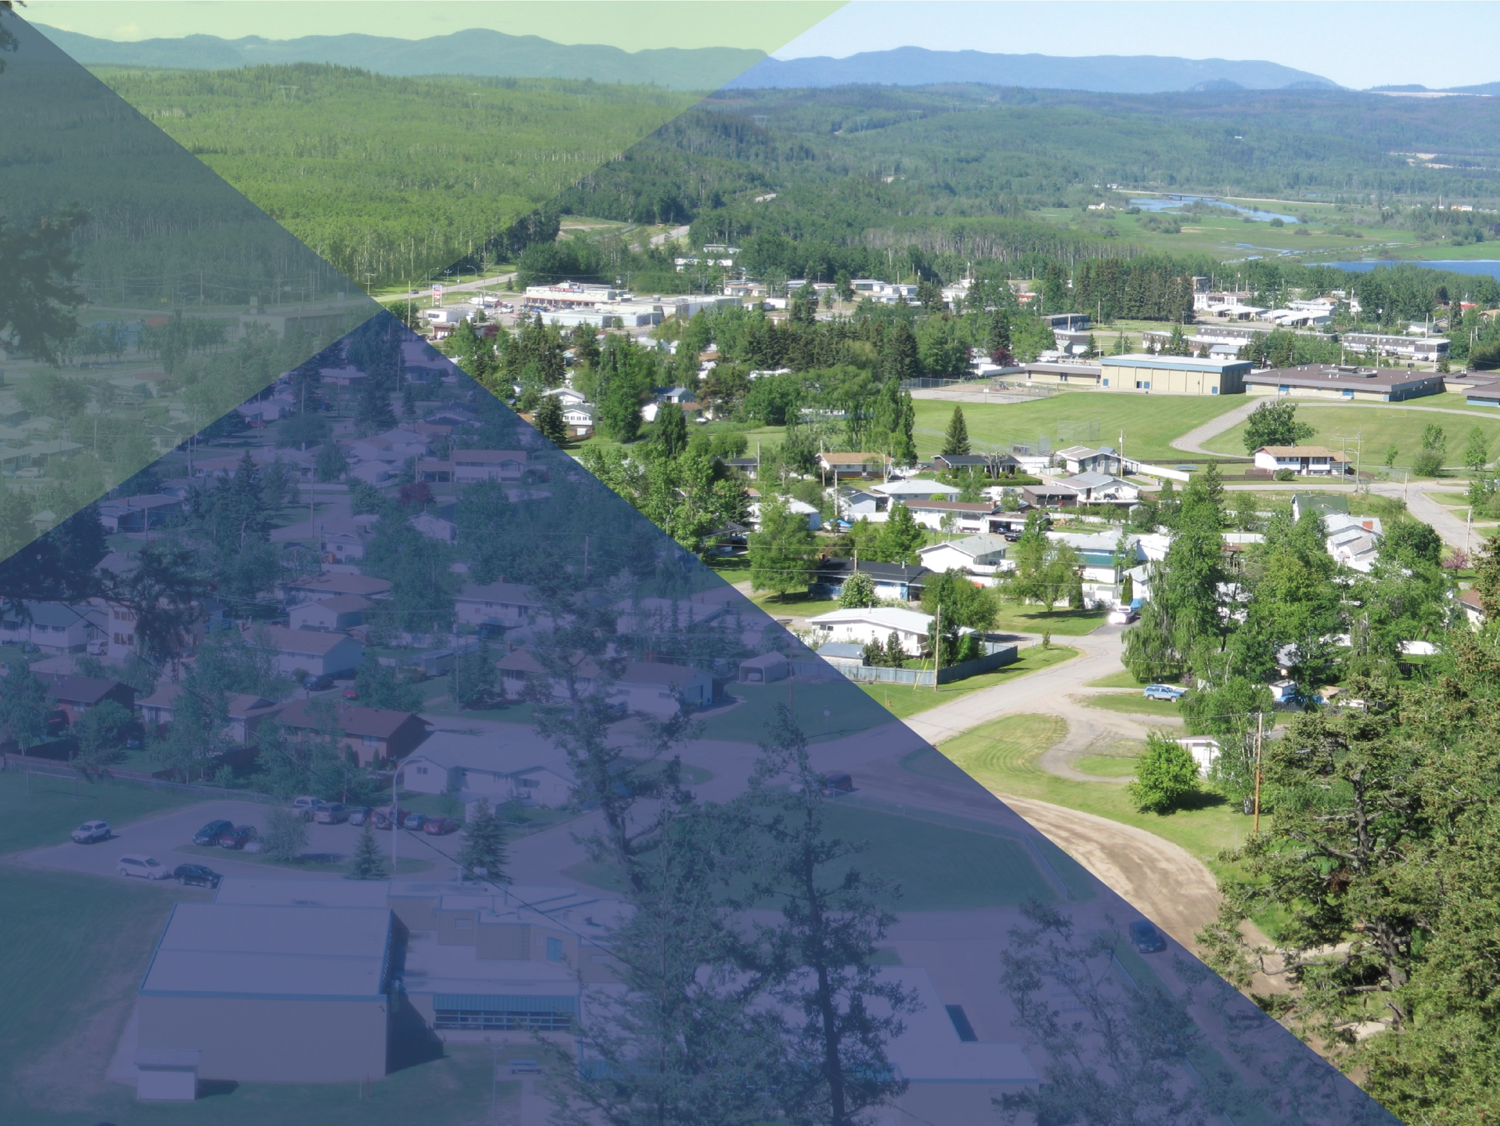
Rural Dividend –
6th Intake Application
Tips
Presented by: Rural Policy and Programs Branch
Economic Development Webinar Series
July 15, 2019
Notes:
Introductions.
This is the second of two webinars.
Our first webinar was on June 13th, and the recording has been posted to both the Rural Dividend and Economic Development Webinar Series website. The first webinar focused on an overview of the Rural Dividend Program and the updates that have been implemented for the sixth intake period. A reminder that that sixth intake will close at midnight PDT on August 15th.

Slide 2

Presentation Overview
Advice for Strong Applications
Tips for Application Questions
Additional Criteria
  Partnerships applications
  Budget form
  Mandatory supporting documents
Notes:
The webinar today will include some general advice to help support the development of a strong application, some tips to help you in developing you answers to the application questions, and then some additional criteria for applications, including partnerships projects, the Rural Dividend budget form, and mandatory supporting documents.
Where applicable we have incorporated examples for additional clarity.

Slide 3

Application and Technical Support
Applications will be accepted from Saturday, June 15, 2019 until midnight PST on Thursday, August 15, 2019
Documents for support can be found on the Rural Dividend Website
For technical support on the application form see the previous webinar – starting at timestamp 18:35
Notes:
The Rural Dividend online application form and all supporting documents can be accessed through the program website (gov.bc.ca/ruraldividend). We have added two eligibility checklists to the website to help support potential applicants in determining if their organization or community is eligible to apply and if their proposed project is eligible under the program criteria. Additionally, fillable PDF documents have been added that mirror the online application form.
As mentioned in our previous webinar, we strongly encourage all applicants to download the fillable PDF application form document, which can be used to prepare your application answers outside of the online system, so that you can see all questions related to the funding stream that you are applying under, and so that you can backup your application content.
To see a more in-depth review of technical support for the Rural Dividend application form please see our previous webinar on the Economic Development series, and begin at the timestamp of 18:35.

Slide 4
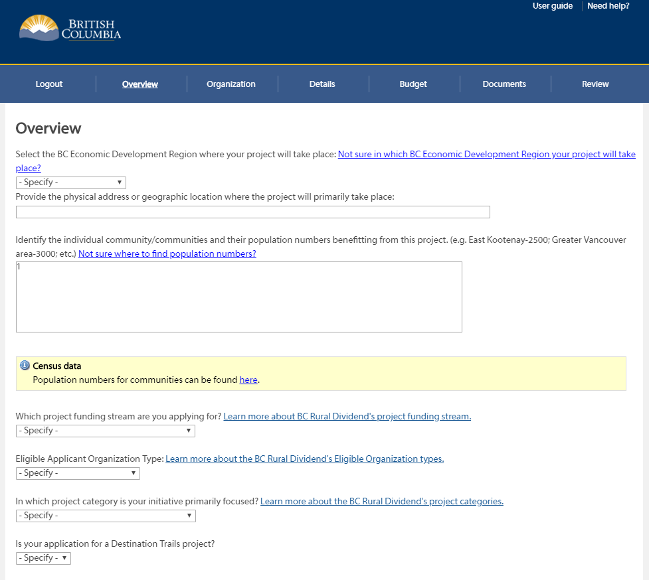
Advice for Strong Applications
Demonstrate strong project links to economic development and diversification
Be clear and concise
Use project-specific details and examples
Notes:
The review and assessment process for Rural Dividend applications is increasingly competitive and past intakes have been oversubscribed. Therefore, consider the program focus on economic development and diversification when developing all aspects of your project.
We bolded the first bullet for a reason: The most important thing that all applications should demonstrate is strong project links to economic development and diversification, such as job creation, business attraction and retention, investment attraction, economic development planning and implementation of projects, and skills training. When filling out your application ensure that all aspects of your project clearly connect to the program focus.
Strong applications usually include simple and concise language. It is not necessary to use “grand rhetoric” or buzz words in order to develop a strong application.
Responses that reference project activities as examples usually result in a stronger application.

Slide 5

Advice for Strong Applications
Ensure components can be easily identified and are consistent
Develop reasonable timelines and achievable outcomes and deliverables
Provide extra supporting documents where available
Ensure the application is relevant to the project phase
Notes:
If your project contains multiple components, make sure each component is fully described in your application and ensure that all components can be easily identified and are consistent throughout your application, from your project description, to your components and deliverables, to your project timelines, and in your mandatory supporting documents, including the project budget.
Develop reasonable timelines. Avoid being over-ambitious, consider the potential for delays and account for them in the timelines/milestones. Associate the timelines/milestones to specific project activities and components. Describe how the project or funding will be sustained long-term (if it is ongoing after the end date); for example, if the project involves the creation of an ongoing salary position, describe how funding for the position will be sustained following the project. If the request is for a specific phase of a larger project, keep the information specific to the phase that is being requested for funding.
Where possible, include additional documents and information to support your application and your project link to economic development. If you have completed previous phases of the project include any deliverables from those successful phases, include letters from organizations or communities that are in support of your project.
Finally, ensure that all information in your application is relevant to the project phase that you are requesting support for. You can identify that the phase is part of a larger initiative, but be specific as to what you plan to accomplish for the purposes of this application.

Slide 6
Tips – Project Overview
Direct Activities
Where project actions, steps, or events will take place
Direct Benefits
Positive changes that a specific community or group of communities experience as a direct result of project activities
Project Category
Pick the best fit
Notes:
The Overview tab on the application form includes the direct activities, direct benefits, and project category..
For direct activities, think about the actions, steps, or events that must be undertaken in order to complete your project. Determine where those direct activities will occur and identify the specific location. If your direct activities take place in more than one community, identify the region where the majority of activities will take place and then list the specific communities or municipalities. For example, if your direct activities are providing training workshops for community members in Fort St John, Vanderhoof, and Burns Lake, then you would select the Nechako economic development region, the Bulkley-Nechako Regional District, then you would list Fort St John, Vanderhoof, and Burns Lake in the subsequent section on the application.
For direct benefits, think about the geographic area that will directly benefit from your project activities. Describe these direct benefits. For example, the estimated number of training workshops provided in Fort St John, Vanderhoof, and Burns Lake, and number of community members who receive the training in each community.
The Rural Dividend Program is focused on economic development and diversification and to offer flexibility to develop a range of solutions, we have four categories that cover a wide variety of potential projects:
Project Categories:
Community Capacity Building
Workforce Development
Community and Economic Development, and
Business Sector Development
However, projects do not necessarily have to fit neatly within one specific category – it is permissible for projects to touch on multiple categories. Pick the category that best fits your project.

Slide 7

Tips – Project Details
Project Description
Short Description – elevator pitch
Long Description – full description
Notes:
Once you complete the Overview tab you will progress to the Organization tab where you enter information about your organization (contact details etc).
Then you will get to the Details tab.
The Details tab is where you provide the specific information about your project, including your description.
The updated application form now asks for a short and a long project description. The short project description should explain what the project is and what it will accomplish in 2-3 sentences. Essentially it is the “elevator pitch” or “executive summary” for your project. The long project description should fully detail your project and should include: - What direct actions you are taking; - Why (the rationale for the proposed project); and - What you hope to accomplish (the anticipated outcomes).
The Rural Dividend website includes a funded projects tab that has quick summaries for projects that have been funded in past intakes. These summaries are great examples for what a short project description could look like. For example, “this project will complete a tourism marketing initiative in ___ community. Components of the initiative include a feasibility study for a community tourism business , a tourism asset study, and a design and marketing campaign for a community brand.”

Slide 8
Tips – Updated Program Objectives
    Increase community resilience and support economic development and diversification through enabling rural communities to implement their vision for long-term vibrancy, as well as prepare and respond to economic disruptions.
    Support Indigenous communities and organizations to develop and lead traditional and/or emerging economic opportunities, including in the natural resource sector.
    Strengthen the capacity of small and remote communities to address unique challenges in realizing their economic potential.
    Assist rural communities to pursue innovative economic opportunities that support climate mitigation and/or adaptation for a cleaner future for BC.
Notes:
Program Objectives:
As mentioned in our first webinar. The program’s objectives have been refined to continue to be responsive to the needs of rural communities. The application form was updated and under the Details tab you will be asked to demonstrate how your project links to one or more of the program objectives, within the overall scope of economic development.
It is not necessary for your project to link to every objective. A strong application may detail a very strong link to only one of the program objectives.

Slide 9
Tips – Employment
  Direct Employment
  Full Time, Part Time, and Temporary/Seasonal Jobs directly created during the project
  Should be supported by information in the application and budget
  Directly relate to the project and support the project delivery
  Indirect employment
  Realistic and timely estimates of indirect employment that links to and is created by the project
Notes:
Identifying any direct and indirect employment created as a result of the project may help to further demonstrate the project link to economic development.
For direct employment, think about the jobs that will be created or impacted in order to deliver your project. For example, if you are hiring a project manager to work 100% on the project, then you may identify the creation of one full time position. Make sure the information that you detail about the direct employment is reflected throughout other sections of your application such as in timelines or components and deliverables, as well as in your project budget.
Indirect employment is an estimate of any jobs that may be indirectly created or impacted as a result of the project. For example, if your project includes components that will bring visitors or workers to the community, then the indirect employment created could be additional jobs for hotel staff to support the visitors. Make sure the information you provide can be linked to your project.

Slide 10
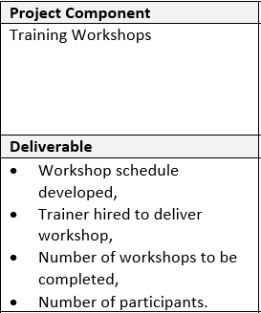
Tips – Components and Deliverables
Project Components
Specific project activities, steps or phases that will be completed
Project Deliverables
Specific outputs that will result from the completion of the project components
Components and deliverables define what you are doing in the project and what you plan to accomplish
Notes:
The components and deliverables section of the application asks you to define the specific things you hope to accomplish during your project. In previous intakes this portion of the application was called outcomes and indicators and sometimes the information received was broad or difficult to link to the project activities, such as “this project will increase the happiness of all community members”. Therefore, the application was updated to ask for components and deliverables because we want applicants to think specifically about the project activities or steps that will be completed during the project and the particular outputs that will result from those activities and steps.
Project components are specific project activities, steps or phases that will be completed as part of the implementation of your project, such as: Training workshops.
Project Deliverables are the specific outputs that will result from the completion of the proposed project components, such as: workshop schedule developed, trainer hired to deliver workshop, number of workshops to be completed, number of participants.
Make sure that your project components and related deliverables can be successfully completed within the two year time limit. Additionally, other documents and sections of your application should demonstrate linkages to your project components and deliverables, such as your project timelines and the information in your budget form.

Slide 11
Tips – Community Plans
Community/Economic Development Plans
Projects should directly reflect or support sections or goals within a community or economic development plan
Show that the project is consistent with and supports the plans and goals of the communities that will directly benefit
Notes:
Your application should demonstrate that the project is consistent with community or economic development planning.
Tell why the project is important for economic development in the communities that will directly benefit by referencing specific sections or goals in the community’s plans.
In addition to community or economic development plans, if your project has a link to regional plans (ex. destination development, trail strategies, etc…), then you should also highlight the links.

Slide 12

Tips – Community Support
Existing Community Support
Describe or show that the project is supported by the communities impacted, both Indigenous and non-Indigenous
Include any Letters of Support that are recent and specific to the project
Describe any community consultation that took place during project preparation
Notes:
ANNA
In addition to projects being consistent with community planning, your application should also demonstrate the existing support for project.
Indicate how support for your project has been demonstrated within the community or communities that will benefit or where project activities will take place. Where applicable, outcomes from formal or informal discussions with indigenous communities should be detailed.
Additionally, include any letters of support that are relevant and specific to your project and Rural Dividend application, as attachments. You can also reference these letters when describing the project’s support.
Any community consultation (ex. town halls, surveys) that relates to the project can also be detailed and supporting documents like meeting minutes or survey results can be included with the application.
If consultation and support gathering is part of your project activities, explain how that support will be obtained and when.

Slide 13
Tips – Timelines
Project Start and End Dates
Funding decisions – 6 months
Maximum duration – 24 months or two years
Project Timeline
Ensure each of your deliverables is addressed in the timeline
Budget alignment
Consider the potential for delays and account for them
Notes:
ANNA
After providing details about your project, you will be prompted to identify the project timelines including the start and end dates.
When determining your start date we encourage all applicants to remember that funding decisions are expected about six months after the intake close. As such, you may wish to account for the review and assessment period and plan to start your project at least six months following the intake close or August 15th.
Your project dates must align with the 24 month or two year criteria of the Program and the online application form will not let you exceed this duration.
The information about your project timelines should be consistent with your budget and the rest of your application. As such, when detailing your timelines, think back to your components and deliverables and reference them as milestones. For example, if your project component is training workshops, your project milestones could include : development of workshop content – January 1 2020 – April 1, 2020, Recruitment of workshop participants April 1 2020 – July 1, 2020, Delivery of workshops: August 1, 2020 – November 1, 2020, etc.
The dates listed in your project timelines should also align with the overall start and end dates for the project.
As there is a maximum duration of 2 years for projects, it is important to consider the potential for project delays. Try to provide yourself with a timeline that is realistic and that will allow you to successfully complete the project without having to alter your estimated dates. Some factors that could delay a project include weather, a lack of qualified candidates to deliver the project or staff turnover.

Slide 14

Tips – On-Going Activities
  On-Going Activities
  Demonstrate sustainability
  Give as much detail as possible about continuity of activities or staff positions following Rural Dividend funding
Notes:
ANNA
Some projects may create staff positions or include activities that continue once the project components and deliverables funded by the Rural Dividend are complete.
If your project establishes a staff position or ongoing activities, then you should explain how you plan to sustain the positions or activities following Rural Dividend funding. For examples, will the activity established by the original project, generate revenue to support it’s continuation?
Give as much detail as possible in this section, as applications that do not provide information on how continuing work or staff positions will be supported may be penalized in the review and assessment process.
.

Slide 15
Tips – Resources, Skills, and Risks
Applicant Resources and Skills
Demonstrate the project management skills or expertise that will be directed to your project
Project Risks
There is some risk inherent in every project
Explain how you have planned for and will mitigate project risks
Notes:
ANNA
The skills and resources section is for you to demonstrate the expertise, knowledge, and skills base that will be used to deliver your project. Depending on where you are in the project planning stage, you can include examples of your organization’s experience in delivering similar projects as well as the qualifications of any contractors attached to the project.
You can also include information about previous successful projects or project phases funded by the Rural Dividend in this section
Any project involves some level of risk. Demonstrate that you have considered any risks or potential roadblocks that your project could encounter and explain what you have done to plan for and mitigate those risks. For example, risks could be related to weather, or even securing space for training workshops.
Thinking about the potential risks to your project can also help you develop timelines for the activities you will undertake by considering where to add additional time as a contingency.

Slide 16
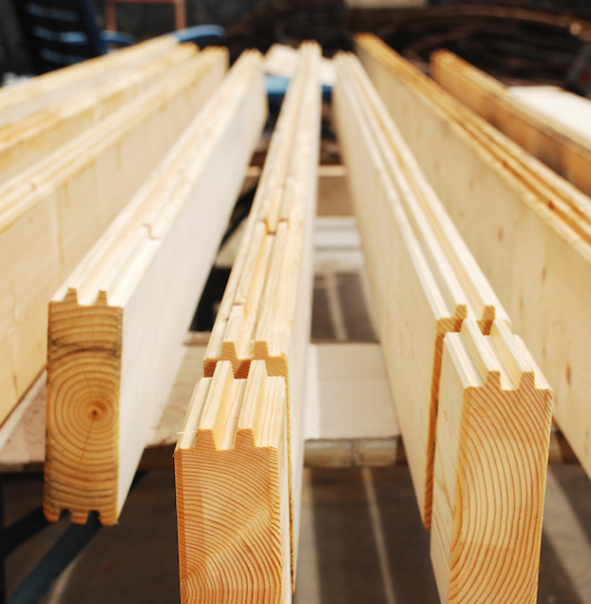
Tips – Infrastructure
Infrastructure
Outline how the infrastructure is key to the implementation of the project being applied for
Strong link to economic development
Infrastructure Ownership and On-Going Responsibility
Identify the organization that will be taking ownership of the infrastructure, and the long term plan on how to sustain the infrastructure
Notes:
ANNA
As we hope you are all aware, the Rural Dividend program has strict limits when it comes to project costs related to infrastructure. For the 6th intake, infrastructure-related costs can account for 35% of the total project cost.
If there are infrastructure-related costs, activities, or components for your project, demonstrate how and why the infrastructure is integral to the project and how it links to or supports economic development (e.g job creation, business development or business retention/attraction, revenue generation, etc.).
You will also need to provide information identifying who will own the infrastructure created as a result of the project and who will be responsible for its ongoing maintenance. Please note that this does not need to be the same entity or person. This is also a good area to identify if an organization has signed an agreement for ongoing maintenance with the owner of the infrastructure.

Slide 17
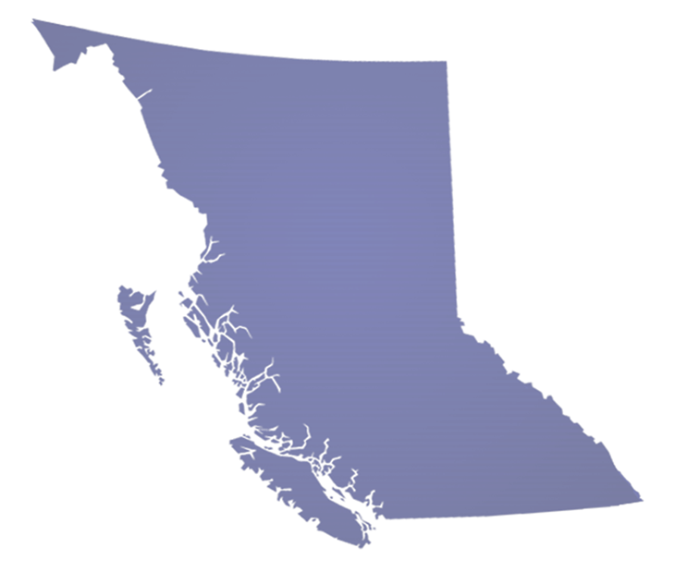
Additional Criteria –Partnerships Projects
Eligible Partners
Active role
Consistency between the application and letters
Informal partners such as other funders can be identified in the application but are not formal partners
Notes:
ANNA
Partnership applications require that you provide specific information about your formal project partner or partners including the organization name, a contact person and their phone and email.
All project partners listed in the application must submit a letter that demonstrates their commitment to the project and details the role they will play in delivering the project.
Ensure that when describing the active role that your project partner or partners will take in the application that the information aligns with that in the partnership letter(s). Inconsistencies or a lack of detail will have a negative impact on the assessment of the project.
A reminder that an eligible project partners must have an active role in the project. If other organizations are supportive of or are only providing funding to your project, then they should be identified elsewhere in your application – not as formal partners.
If you are submitting a project under the project development or single applicant streams, you can list project partners, however you are not required to submit partnership letters nor are you required to detail the role the partners will play in the project. However, providing this information can help provide important context and clarity to your application. If you have no project partners, you can enter N/A in the question about partners roles and you will not be penalized.

Slide 18
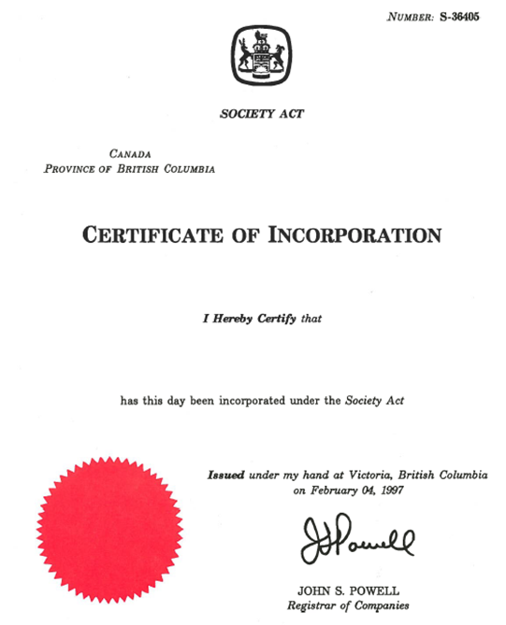
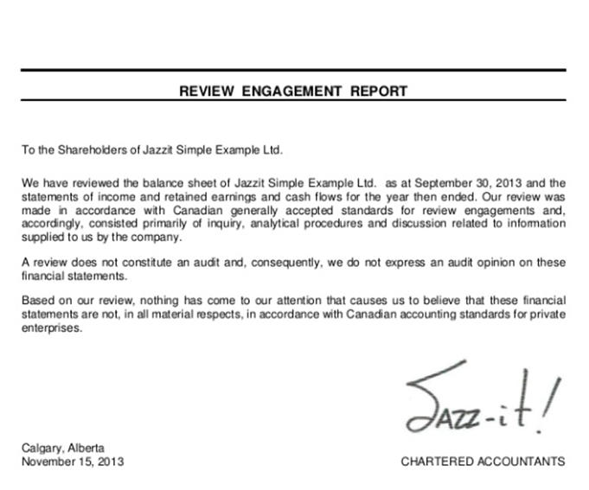
Additional Criteria – Mandatory Documents
Notes:
ANNA
There are certain key documents that the Program requires all applicants submit through the online application form in order to be eligible for funding.
Specifically, all applicants must submit:
Financial statements for the applicant organization, An update for the sixth intake is that internally prepared or Notice to reader statements can now be used for funding requests up to $50K
A budget for their project using the Rural Dividend budget form, available for download on our website, and
A resolution from the applicant organization showing support for the proposed project. The resolution must be submitted with the application. It can be passed via electronic/email.
In addition to the core documents that all applicants must submit – Indigenous and non-Indigenous not-for-profit organizations and First Nations development corporations are also required to submit articles of incorporation for their organizations.
All organizations submitting applications under the partnership funding stream must submit a partnership letter from each organization listed as a partner on their application.

Slide 19
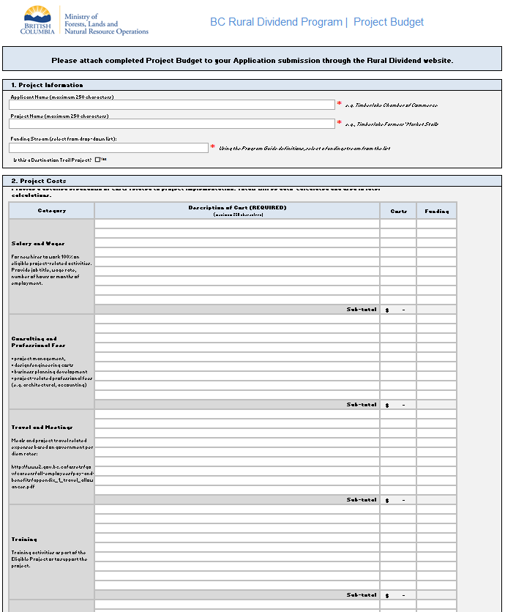
Additional Criteria – Mandatory Documents
Budget Form
Detailed descriptions of costs
Consistency between the application and budget
Ensure applicant contribution, if applicable, is met
Notes:
ANNA
Your budget form should be consistent with your application. Activities, project components and deliverables not referenced in the application, should not be listed in the budget.
Include as much detail as possible to explain what each cost entails (such as staff position, number of hours, term). Detailed descriptions of costs should also be accurate estimates, although we do understand that most costs listed are only estimates until the project is underway. Supporting documentation such as quotes from contractors can also be included to support the project budget.
For each cost listed in the budget, you must select if the it will be paid for by Rural Dividend funds, through in-kind contributions, or by other sources (examples of other funding sources include, funding from your organization, other grant funds or other government funds). The costs that have been identified as in-kind will form a maximum of 10% of your applicant contribution, however you can include additional in-kind contributions if you wish.
The budget must also demonstrate that the applicant financial contribution, if applicable, has been met.
In addition to meeting the applicant contribution, we will assess the project budget for the following components:
Costs that are direct and essential to project implementation and are clearly linked to project activities described in the application.
Indicates clearly that costs assigned to Rural Dividend funding meet the program’s eligibility criteria.
The inclusion of ineligible costs, including exceeding the Program’s limits on infrastructure and capital costs, will impact the assessment of the application and may result in ineligibility.

Slide 20
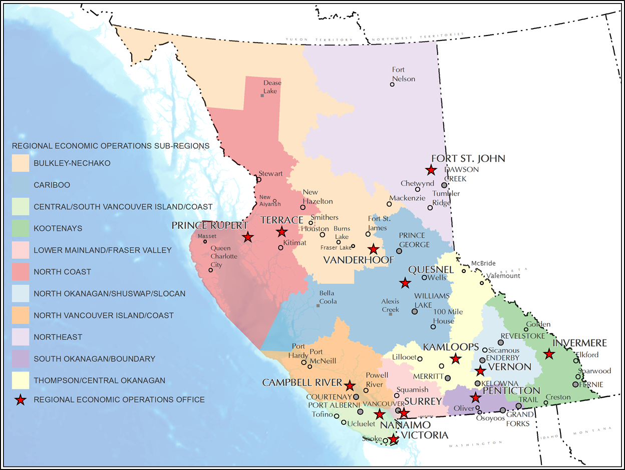
Support for Applicants –
Regional Economic Operations
On-the-ground economic development advisory support
Notes:
ANNA
Regional Managers within the Regional Economic Operations Branch are available to support communities in pursuing economic development opportunities.
They provide on-the-ground economic development advisory services and are an excellent resource for applicants who are looking for feedback on potential projects for the Rural Dividend Program.

Slide 21
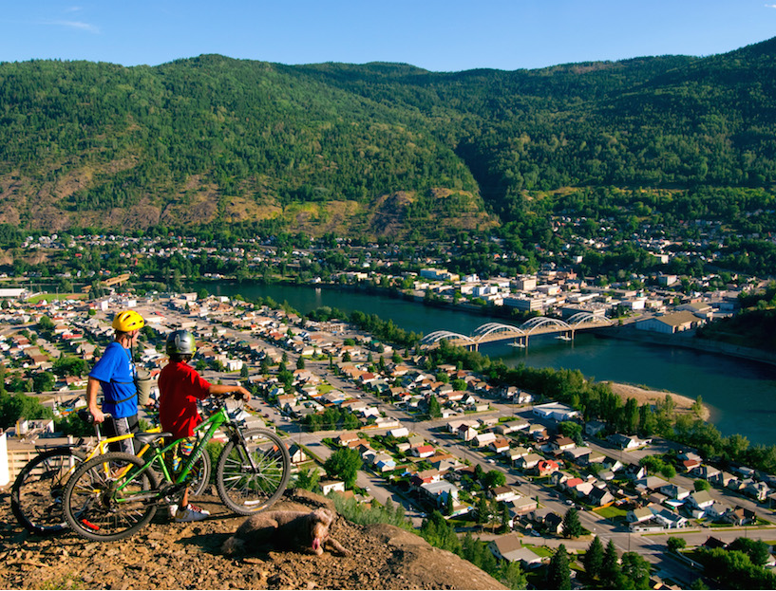
Support for Applicants – Program Office
Staff are available to answer questions about all aspects of the Rural Dividend Program:
  Phone: 250-356-7950
  Email: ruraldividend@gov.bc.ca
Notes:
ANNA
Rural Dividend Program Office:
We also have a great team of staff at the Rural Dividend Program office who are available by phone or email any time to answer questions regarding the Program or the application process.
If you are wondering about whether a project is a good fit for the Program, or you would like clarity regarding a question on the application form – please feel free to contact the staff at the Program office.

Slide 22
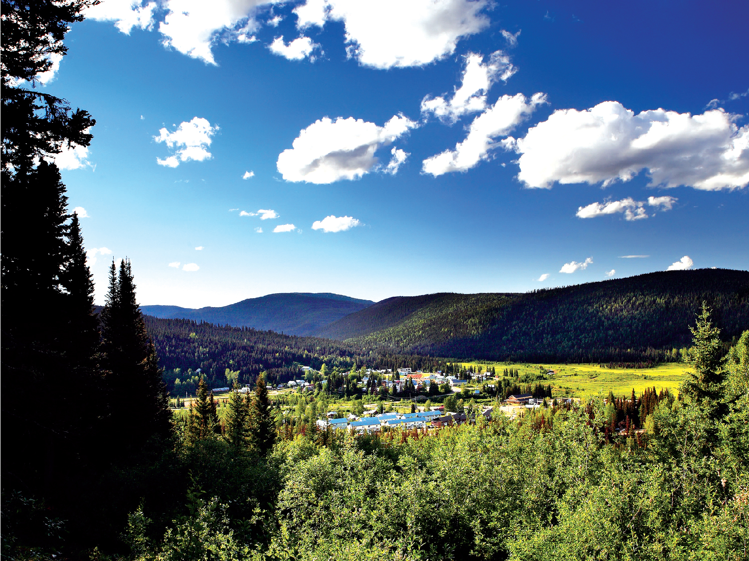
Questions?

