Slide 1


StudentTranscripts Service
Transcript and XML Previews
November 22, 2023

Slide 2
StudentTranscripts Service Overview
View Provincial Graduation Assessment results
View Provincial Scholarships Program awards
Preview transcript
Order copies of official transcripts
  Direct selection of Post Secondary Institution (up to 25 free for current students)
  By mail to any address entered by user (1 free order for current students)
  PDF order to any email address entered by user ($10 fee for all users)

Slide 3
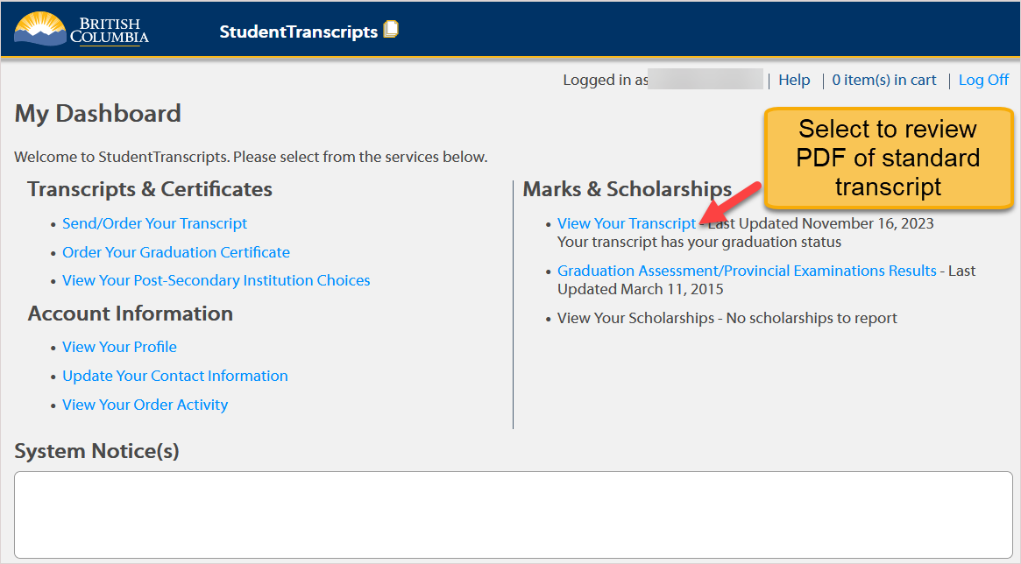
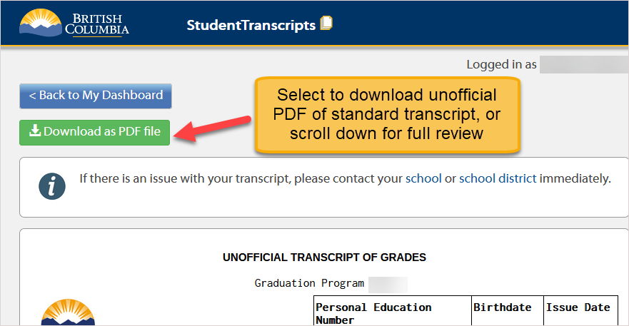
Transcripts – STS Dashboard Preview/Unofficial

Slide 4
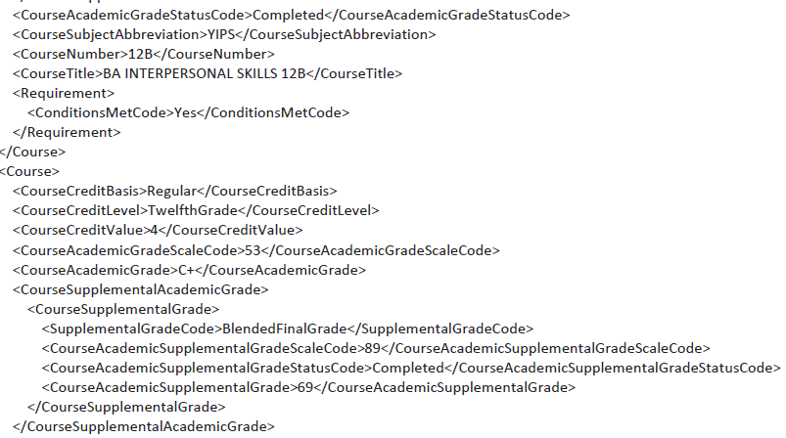
XML (Extensible Markup Language)
Standardized data format (PESC)
Secure data transfer
Eliminates need for schools to provide interim marks to select PSIs
Students benefit from PSIs’ early admission and program acceptance

Slide 5
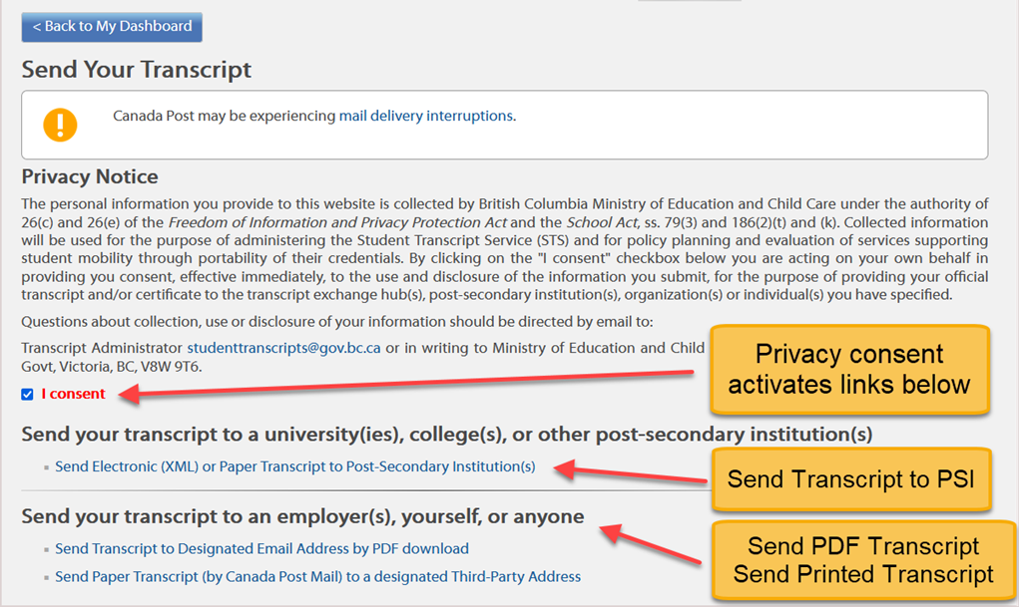
Transcript Order Types

Slide 6
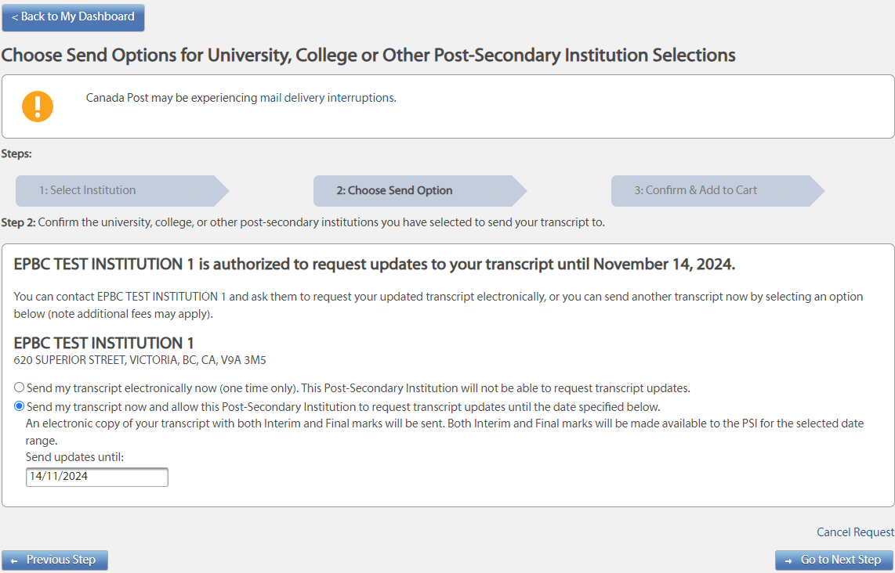
Student XML Preview in STS (PSI Selection Pre-Order)

Slide 7
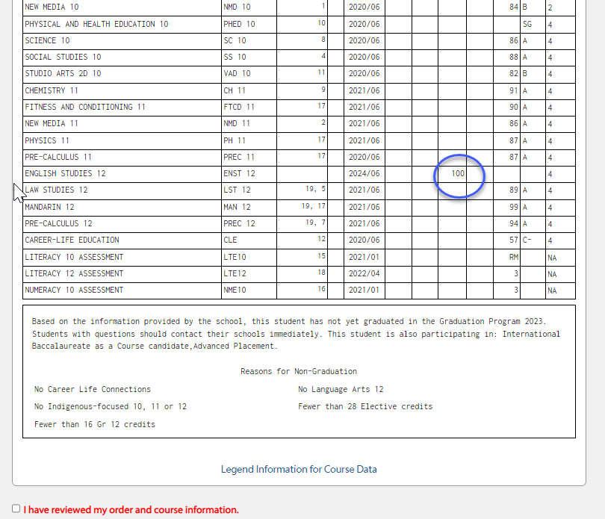
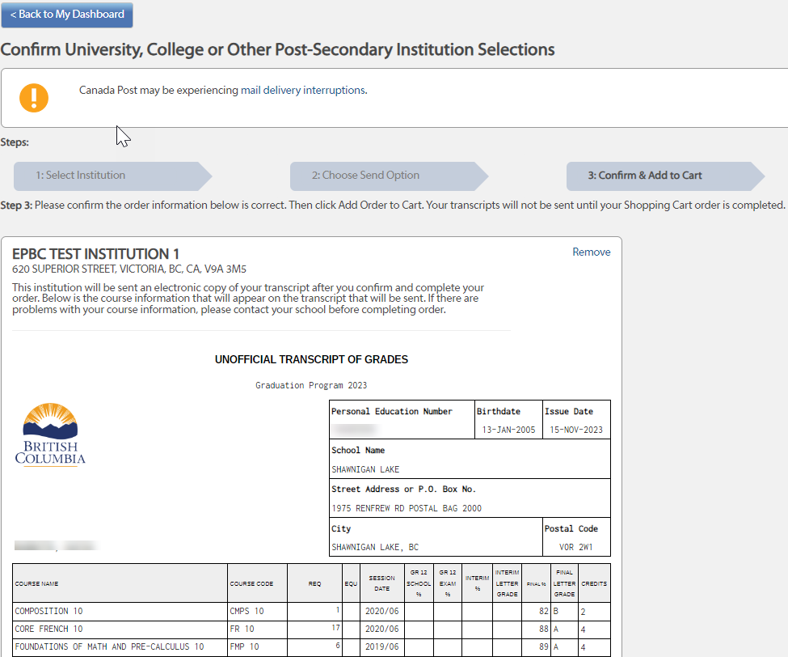
Student XML Preview in STS (PSI Selection Pre-Order)

Slide 8
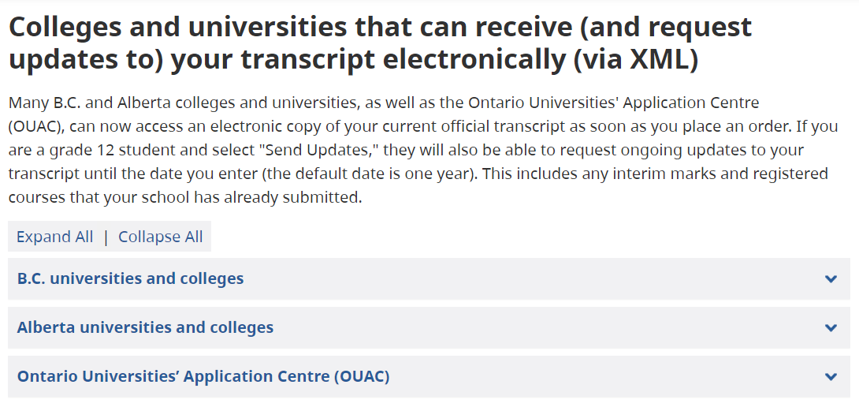
Which PSIs receive XML transcript data?
https://www2.gov.bc.ca/gov/content/education-training/k-12/support/transcripts-and-certificates/post-secondary-selection#electronically
B.C.
Alberta
Ontario
https://www2.gov.bc.ca/gov/content/education-training/k-12/support/transcripts-and-certificates/post-secondary-selection

Slide 9
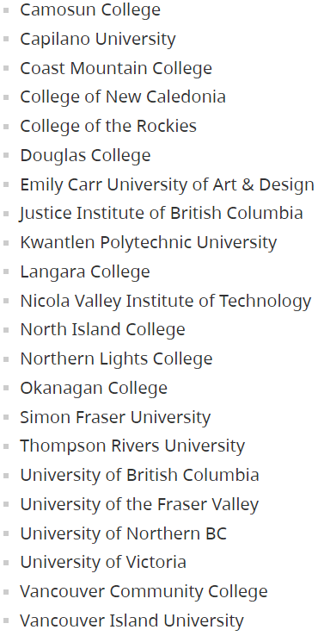
B.C.
Alberta
Ontario

Slide 10
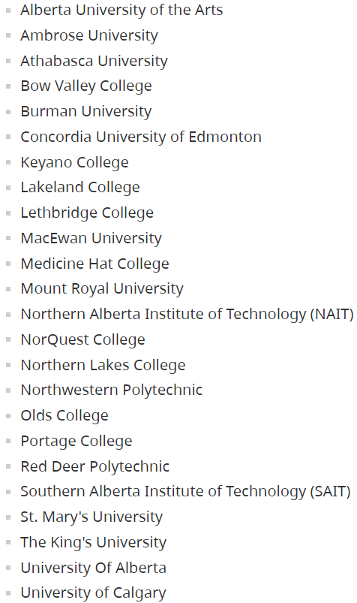
B.C.
Alberta
B.C.
Ontario

Slide 11
Ononnnn
B.C.
Alberta
Ontario
B.C.
Ontario Universities’ Application Centre (OUAC)
Manages applications and accepts
student transcript orders on behalf of
~23 Ontario Universities

Slide 12
Transcript
XML Data
Final Marks only
Successfully Completed
(> 49%; RM; AEG; XMT)
If Duplicate:
select best result if on current graduation program
Display original result and higher mark if GA on closed program
Registrations if
no final or interim mark duplicate exists
Course session date > current month
Interim marks if
no final duplicate exists OR if interim mark is higher than final mark
Course session date > current month
r
Rule
Comparison

Slide 13
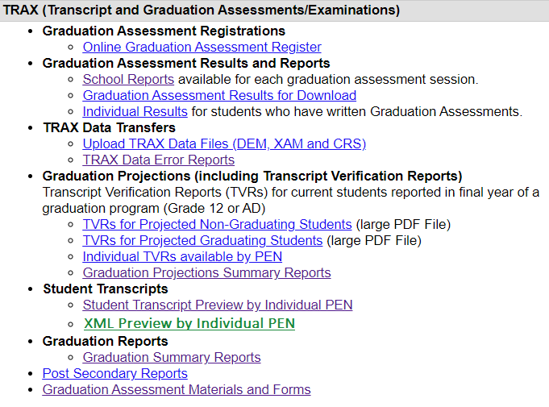

Student reports on School Secure Web (SSW)
TVR
Verify everything Ministry has on record for the student
Grad status (projections)
SDFSD
Transcript Preview
What currently appears on the student’s standard transcript
XML Preview
User-friendly view of what is currently available to send via XML data transfer

Slide 14
Thank you!
Students can contact StudentTranscripts@gov.bc.ca
Schools can contact:
Student.Certification@gov.bc.ca

