Slide 1




Indigenous-Focused
Graduation Requirement
OVERVIEW
2022/23
2022/23

Slide 2


What is the Requirement?
Involves secondary students completing 4 credits of Indigenous-focused coursework to graduate.
Provides opportunity for students to develop deeper understandings of the cultures, histories, contemporary contexts and perspectives of Indigenous peoples of BC.
Important part of the K-12 sector’s mandate to develop the Educated Citizen, which can in turn help to promote diversity, equity, and inclusion in our schools and communities.
Will come into effect for the 2023/24 school year. Students graduating in 2023/24 will need to complete 4 credits of eligible courses to graduate.
2

Slide 3
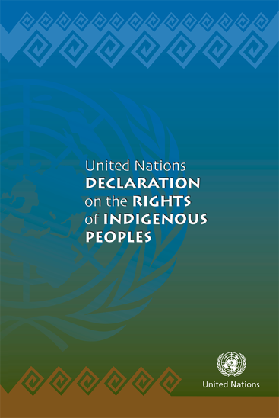
Background – Declaration Act
The Declaration on the Rights of Indigenous Peoples Act establishes the UN Declaration on the Rights of Indigenous Peoples as the framework for reconciliation
in British Columbia.
The Act commits the Government to develop and implement an action plan in consultation and cooperation with Indigenous peoples – to achieve objectives of the UN Declaration in B.C.
The Action Plan includes a commitment to:
“Implement a mandatory course or bundle of credits related to First Peoples as part of graduation requirements in B.C.”

Slide 4




Background – Truth,
Reconciliation, & Anti-Racism
10 Draft
Principles
Minister of Education and Child Care Mandate Letter
Indigenous-Focused Grad Requirement
Reconciliation is an ongoing process that occurs in the context of evolving Crown-Indigenous relationships.
Includes expectations to support lasting and meaningful reconciliation, equity and
anti-racism.
Part of a broader anti-racism and discrimination strategy in development for K-12.
Notes:
Draft Principles that Guide the Province of British Columbia’s Relationship with Indigenous Peoples

Slide 5
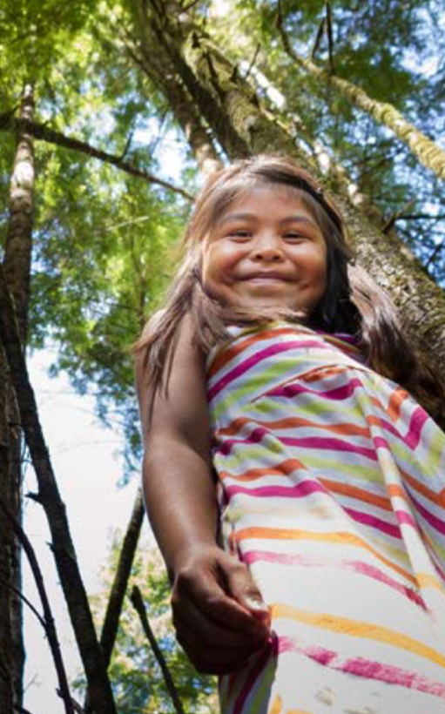

Indigenous Curriculum Content
Introduction of an Indigenous-focused grad requirement is
an important next step towards Truth and Reconciliation, & supports our commitment to develop the “Educated Citizen”
B.C. has been a leader in ensuring Indigenous worldviews, perspectives histories and cultures are represented across the provincial curriculum.
Formally supported by numerous partners, including BC Teachers’ Federation, BC School Trustees Association and BC
Association of Institutes & Universities
Several academically rigorous, Indigenous-focused courses already exist as part of the curriculum and will satisfy this grad requirement
5

Slide 6


How to Meet the Requirement
Successful completion of 4 credits from:
No increase to total
number of credits
required for graduation
Some existing provincial courses could meet multiple graduation requirements (e.g., BC First Peoples 12
could meet Social Studies 11/12 requirement, and
the new requirement)
  One or more of a variety of provincially-developed courses – AND/OR
  A First Nations Language course at the 10-12 level – AND/OR
  A locally-developed, Indigenous focused course (BAA) that meets specific criteria
6

Slide 7
Current Courses Meeting Requirement
BC First Peoples 12
  Peuples autochtones de la Colombie-Britannique 12
Contemporary Indigenous Studies 12
  Études autochtones contemporaines 12
English First Peoples Writing 10*
English First Peoples Literary Studies 10*
English First Peoples New Media 10*
English First Peoples Spoken Language 10*
English First Peoples Literary Studies & Writing 11
English First Peoples Literary Studies
& New Media 11
English First Peoples Literary Studies
& Spoken Language 11
English First Peoples 12
Any First Nations language course in grades 10-12 (where offered)
Locally-developed, Indigenous-focused BAA course in grades 10-12**
* 2 CREDIT COURSE – WOULD MEET HALF THE REQUIREMENT
** DEVELOPED ACCORDING TO SPECIFIC CRITERIA

Slide 8


Provincial Course Options
Explore the diversity of Indigenous peoples (First Nations, Métis and Inuit), cultures, histories, contemporary contexts and worldviews with a primary focus within B.C.
Equivalent to English Language Arts and Social Studies curricula in terms of competency development and meeting post-secondary admission requirements
Collaboratively developed by Indigenous and non-Indigenous B.C. educators
FNESC teacher resource guides available for English First Peoples 10, 11 & 12, and BC First Peoples 12
8

Slide 9


Graduation Planning
If I’m currently in Grade 9
In 2022/23 (Grade 9) - Cannot complete an eligible course – only Gr. 10-12 courses eligible
In 2023/24 (Grade 10) - May complete an eligible course(s) before entering Grade 11
In 2024/25 (Grade 11) - May complete an eligible course(s) before entering Grade 12
In 2025/26 (Grade 12) - Must satisfy the requirement to graduate
If I’m currently in Grade 10
In 2022/23 (Grade 10) - May complete an eligible course(s) before entering Grade 11
In 2023/24 (Grade 11) - May complete an eligible course(s) before entering Grade 12
In 2024/25 (Grade 12) - Must satisfy the requirement to graduate
If I’m currently in Grade 11
In 2022/23 (Grade 11) - May complete an eligible course(s) before entering Grade 12
In 2023/24 (Grade 12) - Must satisfy the requirement to graduate
If I’m currently in Grade 12
In 2022/23 (Grade 12) - Encouraged, but no requirement (if all other grad requirements met)
9

Slide 10


For additional information
Please contact (local school)
at (contact info) or visit:
BC Ministry of Education
and Child Care Website

