Slide 1
2025 Learning Series
Day 1 Nominal Roll Policy

Slide 2



2025 LEARNING SERIES - OVERVIEW
WEBINARS
IN-PERSON WORKSHOP
Nominal Roll Policy
Focuses on policy items related to the Nominal Roll process for First Nations
Expanded Nominal Roll Policy & Joint Verification Process Content from Webinars
Opportunity to meet with ISC Education and Funding Services staff
Network with other First Nations
Open to First Nations & Tribal Council representatives who support Nominal Roll and/or Joint Verification Process
Travel/hotel reimbursable for up to 2 representatives per First Nation/Tribal Council
Join us on September 12 in Vancouver. Register by September 5 here: https://www.fnesc.ca/nr-jvpworkshop/
DAY
Joint Verification Process
Provide both First Nations and school districts an opportunity to learn about information that can impact the process and ensure both have a clear understanding of roles and responsibilities
DAY
DAY
Education Information System
Live demonstration for First Nations on how to complete a Nominal Roll submission to ISC

Slide 3





2025 LEARNING SERIES - TOOLKIT
Nominal Roll Policy Presentation Slides
Nominal Roll Policy Presentation Slides
2024-2025 ISC Program Guide (Chapter 5, Education)
2024-2025 ISC Program Guide (Chapter 5, Education)
3
2024-2025 ISC Nominal Roll Instructions
2024-2025 ISC Nominal Roll Instructions
MS Teams Guide
MS Teams Guide
List of Commonly Used Acronyms
5
List of Commonly Used Acronyms
Notes:
A few days prior to this session, a toolkit was sent out to registrants. It included the:
presentation slides that will be shared at the session today;
ISC 2024/2025 Program Guide – Education (Chapter 5)
2024-2025 Nominal Roll Instructions (please note the 2025-2026 Nominal Roll Instructions will be shared with First Nations in September);
Teams guide for reference;
List of Commonly Used Acronyms.
If you did not receive these materials, please send an email to BC Education at BCEducation@sac-isc.gc.ca.

Slide 4
HOUSEKEEPING REMINDERS
Attendees will have an opportunity to ask questions at the end of each topic
If you have a question, use the ‘chat’ function
If you want to ask a question verbally, use the ‘raise hand’ function
Your audio is muted
Webinar will last approximately 3 hours
Have an IT-technical related question? Send us a message using the ‘chat function’
Following the webinar, a feedback form will be sent to all attendees
Notes:
At the end of each topic area, we will open the floor to questions. There is also a portion of the presentation dedicated to Q/A.
To ask a question, please use the chat function. If you want to ask a question verbally, please use “raise hand”. If you are experiencing any technical related questions, or need the speakers to speak up, please use the chat function. One of our hosts will gladly assist you. You can also reference the FAQ section of the Teams guide that was provided to troubleshoot problems as they occur.

Slide 5
TOPICS
01 ……………………………
04 ……………………………
Reporting Students on the Nominal Roll (slide 39)
Overview and Key Dates (slide 6)
02 ……………………………
Eligibility Requirements (slide 11)
05 ……………………………
Accommodation Supports (slide 46)
03 ……………………………
Elementary and Secondary Funding (slide 19)
06 ……………………………
Additions to Grades & Adult Education Programs (Slide 58)
Changing a School Name
(slide 61)

Slide 6

01
Overview of Nominal Roll
Key Dates and Planning
………………………………
Nominal Roll due date for 2025-2026: October 15, 2025
Contact ISC BC Education at BCEducation@sac-isc.gc.ca

Slide 7
What is the Nominal Roll?
The Nominal Roll is the registry of all eligible elementary and secondary students federally funded to attend a First Nations, public, or Independent (private) school as of the count date (September 29, 2025)
It serves as an annual student census which is used to calculate education funding for students ordinarily residing in your community
A term & condition of a First Nation’s funding agreement with ISC
Notes:
Please note there is only one Nominal Roll count date in the school year.

Slide 8
KEY DATES
AUGUST 14, 2025
EIS Opens for Nominal Roll Submissions
SEPTEMBER 29, 2025
Nominal Roll and 1701 Count Date
OCTOBER 10, 2025
School districts submit 1701 to BC Joint Verification Process due date
OCTOBER 15, 2025
First Nations submit Nominal Roll to ISC with signed Joint Verification Form
JANUARY 23, 2026
Nominal Roll Appeal Period: Deadline for Revisions/Corrections
FEBRUARY 1, 2026
Nominal Roll Finalized
Notes:
For exceptional circumstances, such as a student’s temporary relocation due to an emergency event for reasons outside of a family/community’s control, ISC would generally consider the student to be ordinarily resident on reserve and eligible for the Nominal Roll. For questions and/or if you would like to discuss further, please reach out to ISC BC Education at BCEducation@sac-isc.gc.ca

Slide 9
PLANNING FOR NOMINAL ROLL
May
June
July
Aug
Oct 10
Jan 23
Oct 15
Feb 1
Sept 29
Aug 14
Nominal Roll Student Count Date
Joint Verification Process (JVP) / 1701 Due Date
Nominal
Roll due to ISC with signed JVP
Advise ISC if you require EIS access
New Student Accommodation Requests
EIS
Opens for Nominal Roll entry
Nominal Roll Appeal Period ends
Nominal Roll Finalized
We are here
Joint Verification Process conversations (September or earlier)
First Nations & school district(s) complete Joint Verification of the Nominal Roll & 1701 student data to resolve discrepancies and attain agreement (signatures) on the completed Joint Verification Process form
Notes:
It is important to keep in mind key dates around Nominal Roll, so that you can plan accordingly. The next slide shows an overview of the Nominal Roll process, including friendly reminders, so that you can prepare going into the new school year.
Aug 14, 2025 – Education Information System (EIS) opens for data entry
September 29, 2025 – Nominal Roll Count Date
By this date, First Nations should have an idea of where students are attending to prepare for Nominal Roll submission.
October 10, 2025 – Joint Verification Due Date
The goal of the Joint Verification Process is for First Nations and school districts to discuss and agree on which students will be included on the Nominal Roll. Both will adjust their lists accordingly. As First Nations are likely most knowledgeable about where their students are attending school, First Nations should initiate contact with all relevant school districts, including those that are out of their geographic area if they have students ordinarily resident on reserve attending school in that district. However, school districts are encouraged to reach out to their local First Nation as well. A scanned copy of a signed document confirming joint verification of Nominal Roll must be included with Nominal Roll submission under the “Supporting Documentation” section of the report.
Joint Verification Process (JVP)
If you have students attending public school(s), the Joint Verification Process (JVP) is an opportunity for First Nations and school districts to meet and confirm that information on the Nominal Roll is consistent with school districts’ information
Nominal Roll data for elementary and secondary students residing on-reserve and attending public schools should be jointly reviewed by First Nations and their local school districts through the Joint Verification Process (JVP).
Verifying student records with your school district(s) ensures that student information and enrollment is captured accurately between both Federal and Provincial enrollment reports. Data collected from a First Nation’s Nominal Roll directly impacts federal funding from ISC.
For suggestions on how to complete the Joint Verification Process, you are invited to attend the JVP webinars and/or In-Person Workshop (September 12, 2025).
More information can be found in the BC Tripartite Education Agreement (BCTEA), available on FNESC’s website at: https://www.fnesc.ca/wp/wp-content/uploads/2018/08/AGREEMENT-BCTEA-2018-FINAL-Signed-with-Schedules-WEB-VERSION-2018-08-1.pdf (refer to Schedule J, paragraph 9.4 and 9.5)
It is important for First Nations to plan for the Joint Verification Process in advance, as the process may involve reaching out to school districts and/or parent(s) to confirm student information. First Nations are invited to attend the upcoming In-person Nominal Roll and Joint Verification Process Workshop and JVP webinars in September for more information.
In ISC’s Nominal Roll Instructions,
See Appendix 1 for more information about the Joint Verification Process and a sample form.
See Appendix 2 for a complete contact list of school district representatives to initiate this process.
October 10, 2025 – Joint Verification Process Due Date.
October – December 2025 – Nominal Roll Validation Period. ISC may reach out to you for clarification regarding students on your Nominal Roll submission during this time.
January 23, 2026 – Nominal Roll Appeal Deadline for Revisions or Corrections to 2025-2026 Nominal Roll submission.
January 31, 2026 – Due date to advise ISC if you are considering Additions to Grades for the 2026-2027 school year (Note: This is also discussed in Topic 6).
February 1, 2026 - Nominal Roll Finalized.
For exceptional circumstances, such as a student’s temporary relocation due to an emergency event for reasons outside of a family/community’s control, ISC would generally consider the student to be ordinarily resident on reserve and eligible for the Nominal Roll. For questions and/or if you would like to discuss further, please reach out to ISC BC Education at BCEducation@sac-isc.gc.ca

Slide 10

PREPARING FOR THE NOMINAL ROLL
New to your role?
Email ISC BC Education at BCEducation@sac-isc.gc.ca for questions, training materials, job aids, and one-on-one support.
2
Do you have access to the EIS?
Returning Users: Forgot your password? Email ISC IT Services at sti-its@sac-isc.gc.ca
New Users: To request access, email ISC Agreement Services at
BCFundingservices-cbservicesdefinancement@sac-isc.gc.ca
Notes:
Other Tips/Suggestions for Preparing for Nominal Roll:
Check that your EIS access is up-to-date. You may need to reset your password and/or request access if you are new or returning to this role.
If your account has been inactive for one year, it will be disabled as part of GCIMS annual clean-up.
One way to ensure you have a smooth log-in process is to periodically sign-in so your EIS remains active. Some coordinators do so as well for other reporting, such as post-secondary education.
Consider having early conversations with parents/guardians regarding plans for student(s) for the upcoming school year
3. If you have students attending public school, reach out early to school district(s) to confirm that information on the Nominal Roll is consistent with the 1701
4. If possible, have a back-up or alternate
It may be helpful to have an alternate or back-up who is familiar with Nominal Roll policy/eligibility, has confirmed EIS access and can assist with Nominal Roll submission.
5. Reach out early, reach out often
If you have a question, ISC is here to support you!

Slide 11
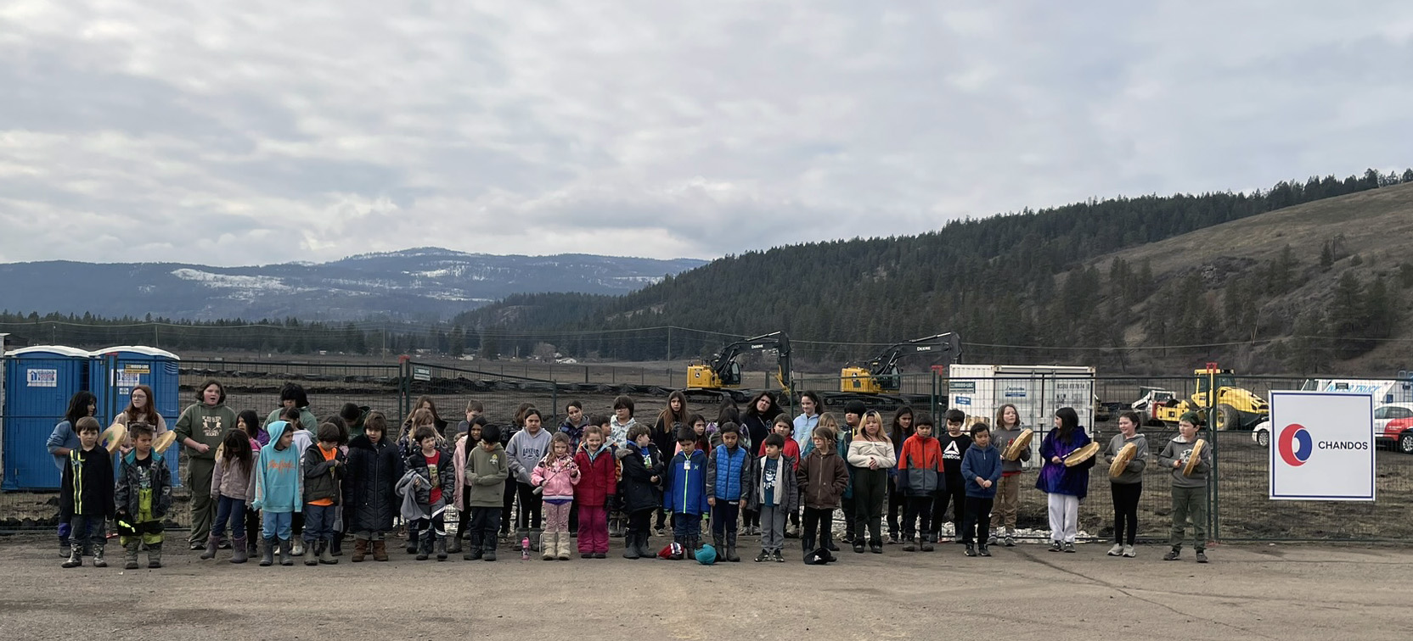
02
……………………………………
Nominal Roll Eligibility Requirements

Slide 12





NOMINAL ROLL ELIGIBILITY REQUIREMENTS
To be eligible for the Nominal Roll, a student must be
2
Enrolled in and attending a First Nation school, public school, or Independent (private) school recognized by the province
Aged 4 or older
(no age limit)
As of December 31 of the school year the student is enrolled in.
Ordinarily resident on reserve
Ordinarily resident on reserve
Source: ISC Program Guide
For more information, please refer to the notes included in this slide and ISC’s Nominal Roll Instructions
Notes:
A student living on reserve regardless of their Indigenous ancestry or band affiliation is eligible to be included on the Nominal Roll.
School Age students
Effective as of the 2023-2024 school year, Indigenous Services Canada revised the BC Region Nominal Roll report eligible age range for “school age students” to be ages 4 through 21 (previously, the range was ages 4 through 19) to align with the definition in BCTEA. Students aged 4 to 21 who are ordinarily resident on reserve and enrolled in a First Nation, public or Independent (private) school will be considered “school age students” for the purpose of adding students to the Nominal Roll and for funding purposes.
Prior to the 2023-2024 school year, ISC BC Region funded eligible school age students through the BCTEA funding formula using the Province of BC’s definition up to 19 years old.
Graduated/Non-Graduated Adult students
While ISC’s National Guidelines indicate that to be eligible for Nominal Roll, a student must be Aged 4-21, students over the age of 21 in British Columbia can be included on the Nominal Roll.
This includes Non-Graduated Adult students who are 18 years and older are eligible to enroll in the Adult Graduation Program towards the Adult Graduation diploma, and Graduated Adult students who are 18 years and older and who have graduated high school (received either a Dogwood or Adult Graduation diploma) and may enroll in certain eligible secondary school level courses for the purpose of upgrading, meeting post-secondary or trades school entrance requirements through First Nations Schools or Adult Learning Centres on reserve offering ISC approved adult education programs.
Please refer to ISC’s Nominal Roll instructions for more details.

Slide 13
DETERMINING ORDINARILY RESIDENT ON RESERVE
This is defined in the BC Tripartite Education Agreement (BCTEA) as:
“…the student usually lives at a civic address on reserve, is a child in joint custody who lives on reserve most of the time or is staying on reserve and has no usual home elsewhere. Students continue to be considered ordinarily resident on reserve if they return to live on reserve with their parents, guardians or maintainers during the year, even if they live elsewhere while attending school or working at a summer job.”
The First Nation determines whether a student is ordinarily resident on reserve.
It is recommended to keep supporting documentation on file (for examples, please refer to the Nominal Roll Instructions and slide notes)
Notes:
Note: A “reserve” is defined in BCTEA as “…all land set aside by the federal government for the use and occupancy of an Indian band, along with all other Crown lands which are recognized by Canada as settlement lands of the Indian band of which the student is a resident”.
What is the difference between Band of Residence and Reserve of Residence?
Band of Residence is where the student is ordinarily resident on reserve.
A Band or First Nation can be made up of various reserve lands. For example, a First Nation can have several reserves or settlement lands. Some reserves may have people living there year-round, while others may be only during certain times of the year or others where no one lives there but the land is considered part of the band or First Nation. The band of residence will be your First Nation. The reserve of residence would be the reserve (name or number) that the student is located. Information on the reserves under each Band or First Nation can be found on ISC’s website under First Nation Profiles (copy and paste link into your browser): https://fnp-ppn.aadnc-aandc.gc.ca/fnp/Main/Search/SearchFN.aspx?lang=eng#wb-cont
Considerations for Education Coordinators to Demonstrate “Ordinarily Resident on Reserve”
Provincial or federal government issued ID with current address (e.g. driver’s licence, BCID, passport, BC Services Card)
Utility bills confirming residential address (e.g. BC Hydro)
Canadian bank account statements or credit card statements
Rental /lease agreement or mortgage statement
ICBC vehicle registration paperwork
CRA income tax statements
Band administration documentation, such as a certificate of possession confirming residency on reserve (when documents stating physical address on reserve difficult to obtain)
Where relevant, documents confirming legal guardianship/ formal custody arrangements or Band Administration documentation confirming informal guardianship arrangements
When submitting the above mentioned documents to ISC, the only visible information required are the following:
1. Name
2. Residential address of the parent/guardian of the student
3. Type of document
All other personal and financial details should be blacked out before submitting. Parents or guardians are required to provide the information. If a student is 16 years of age or older, a BC Services card or other government issues ID (i.e. Driver’s license) can be used as documentation.
If demonstrating ordinarily resident on reserve is uncertain, additional documents may be requested.
Although the last bullet in the notes under Considerations for Education Coordinators to Demonstrate “Ordinarily Resident on Reserve” may not identify if a child is ordinarily resident on reserve, it is helpful to include these documents to support where the child is residing if not with biological parents.

Slide 14
Example 1
ELIGIBLE PROGRAMS
Students must be enrolled in one of the following as of the September count date
Public school;
First Nation school (including First Nation Independent Schools), Approved Adult Program, First Nations Early Childhood Education Program (for K4); or
Independent (private) school (Group 1 & 2) recognized by the province as an elementary/secondary institution
Public school;
First Nation school (including First Nation Independent Schools), Approved Adult Program, First Nations Early Childhood Education Program (for K4); or
Independent (private) school (Group 1 & 2) recognized by the province as an elementary/secondary institution
MY STUDENT IS…
ELIGIBLE AGES
Age 4 by December 31 of the current school year and enrolled in an ISC approved Kindergarten 4 (K4) program operated by a First Nations school or a First Nations operated early childhood program.
Age 5 to 21 (students are considered to be “school age” to the completion of the school year in which they turn 21).
Age 22 or older (born prior to July 1 of the current school year).
Age 4 by December 31 of the current school year and enrolled in an ISC approved Kindergarten 4 (K4) program operated by a First Nations school or a First Nations operated early childhood program.
Age 5 to 21 (students are considered to be “school age” to the completion of the school year in which they turn 21).
Age 22 or older (born prior to July 1 of the current school year).
Enrolled in a First Nations school
Age 4
Ordinarily resident on reserve
Is the student eligible for the Nominal Roll?
RESIDENCY REQUIREMENTS
Students identify as any of the following as of the September count date
Registered First Nations student (status) ordinarily resident on reserve or leased reserve lands
Non-registered First Nations student (non-status) or other Indigenous students ordinarily resident on reserve
Non-Indigenous student ordinarily resident on reserve
Yes! This student is eligible for inclusion on the Nominal Roll.
Registered First Nations student (status) ordinarily resident on reserve or leased reserve lands
Non-registered First Nations student (non-status) or other Indigenous students ordinarily resident on reserve
Non-Indigenous student ordinarily resident on reserve
Notes:
Answer: Yes, this student is eligible for inclusion on the Nominal Roll
Kindergarten 4 (K4) Student: The ISC Elementary and Secondary Education Programs terms and conditions allow for First Nations across Canada to provide full-time K4 as a part of the comprehensive K-12 curriculum that supports First Nation student progression towards a recognized secondary certification. Current ISC Elementary and Secondary Education Program National Guidelines allow for sites other than school facilities (i.e. sites offering early learning programs, such as Aboriginal Head Start On Reserve) to be eligible for K4 funding. For First Nations who are unsure if they are approved by ISC to offer K4 or who now wish to be approved, please contact the ISC BC Region Education Programs team at BCEducation@sac-isc.gc.ca .

Slide 15
Example 2
ELIGIBLE PROGRAMS
Students must be enrolled in one of the following as of the September count date
Public school;
First Nation school (including First Nation Independent Schools), Approved Adult Program, First Nations Early Childhood Education Program (for K4); or
Independent (private) school (Group 1 & 2) recognized by the province as an elementary/secondary institution
Public school;
First Nation school (including First Nation Independent Schools), Approved Adult Program, First Nations Early Childhood Education Program (for K4); or
Independent (private) school (Group 1 & 2) recognized by the province as an elementary/secondary institution.
MY STUDENT IS…
ELIGIBLE AGES
Age 4 by December 31 of the current school year and enrolled in an ISC approved Kindergarten 4 (K4) program operated by a First Nations school or a First Nations operated early childhood program.
Age 5 to 21 (students are considered to be “school age” to the completion of the school year in which they turn 21).
Age 22 or older (born prior to July 1 of the current school year).
Enrolled in a public school
School-aged
Non-registered (non-status)
Ordinarily resides on-reserve
Age 4 by December 31 of the current school year and enrolled in an ISC approved Kindergarten 4 (K4) program operated by a First Nations school or a First Nations operated early childhood program.
Age 5 to 21 (students are considered to be “school age” to the completion of the school year in which they turn 21).
Age 22 or older (born prior to July 1 of the current school year).
RESIDENCY REQUIREMENTS
Is the student eligible for the Nominal Roll?
Students identify as any of the following as of the September count date
Registered First Nations student (status) ordinarily resident on reserve or leased reserve lands; or
Non-registered First Nations student (non-status) or other Indigenous students ordinarily resident on reserve; or,
Non-Indigenous student ordinarily resident on reserve.
Registered First Nations student (status) ordinarily resident on reserve or leased reserve lands
Non-registered First Nations student (non-status) or other Indigenous students ordinarily resident on reserve
Non-Indigenous student ordinarily resident on reserve
Yes! This student is eligible for inclusion on the Nominal Roll.
Notes:
Answer: Yes, this student is eligible for inclusion on the Nominal Roll.
As long as students are ordinarily resident on reserve and enrolled in/attending school as of September 29, they are eligible for the Nominal Roll regardless of status or ancestry. This includes non-registered students (non-status) or non-Indigenous students and Other Indigenous students.
The Nation receives funding for student supports and tuition (if there is a Local Education Agreement in place with the school district).
Please Note:
- Other Indigenous and non-Indigenous students residing on leased reserve lands are not eligible for inclusion on the Nominal Roll. They should instead be reported by the school district on their 1701 report.
If you have questions about student eligibility, please reach out to BCEducation@sac-isc.gc.ca.

Slide 16
Example 3
ELIGIBLE PROGRAMS
Students must be enrolled in one of the following as of the September count date
Public school;
First Nation school (including First Nation Independent Schools), Approved Adult Program, First Nations Early Childhood Education Program (for K4); or,
Independent (private) school (Group 1 & 2) recognized by the province as an elementary/secondary institution.
MY STUDENT IS…
Public school;
First Nation school (including First Nation Independent Schools), Approved Adult Program, First Nations Early Childhood Education Program (for K4); or
Independent (private) school (Group 1 & 2) recognized by the province as an elementary/secondary institution
ELIGIBLE AGES
Enrolled in a Public School
Non-Graduated Adult Student working towards a BC Adult Graduation Diploma
Ordinarily resident on reserve
Age 4 by December 31 of the current school year and enrolled in an ISC approved Kindergarten 4 (K4) program operated by a First Nations school or a First Nations operated early childhood program.
Age 5 to 21 (students are considered to be “school age” to the completion of the school year in which they turn 21).
Age 22 or older (born prior to July 1 of the current school year).
Age 4 by December 31 of the current school year and enrolled in an ISC approved Kindergarten 4 (K4) program operated by a First Nations school or a First Nations operated early childhood program.
Age 5 to 21 (students are considered to be “school age” to the completion of the school year in which they turn 21).
Age 19 or older (born prior to July 1 of the current school year).
RESIDENCY REQUIREMENTS
Is the student eligible for the Nominal Roll?
Students identify as any of the following as of the September count date:
Registered First Nations student (status) ordinarily resident on reserve or leased reserve lands
Non-registered First Nations student (non-status) or other Indigenous students ordinarily resident on reserve
Non-Indigenous student ordinarily resident on reserve.
Registered First Nations student (status) ordinarily resident on reserve or leased reserve lands
Non-registered First Nations student (non-status) or other Indigenous students ordinarily resident on reserve
Non-Indigenous student ordinarily resident on reserve
Yes! This student is eligible for inclusion on the Nominal Roll.
Notes:
Answer: Yes, this student is eligible for inclusion on the Nominal Roll
Adult Student: While ISC’s National Guidelines indicate that to be eligible for Nominal Roll, a student must be Aged 4-21, students over the age of 21 in British Columbia can be included on the Nominal Roll.
To be comparable with BC’s Ministry of Education and Child Care (ECC), ISC allows for all adult students to be eligible on Nominal Roll.
Non-Graduated Adult Student
Students who are 18 years and older are eligible to enroll in the Adult Graduation Program towards the Adult Graduation diploma. Such programs can be offered at Public schools, First Nations schools that offer an ISC approved Adult Program or ISC approved First Nation Adult Learning Centers.
If First Nations encounter students aged 16-17 years old wishing to enroll in adult education programs towards completion of their BC Certificate of Graduation or Dogwood Diploma, please contact the Education Program Advisor BCEducation@sac-isc.gc.ca before including them on the Nominal Roll report. ISC is currently amending policy to make this change. At this time, only being approved based on exceptional circumstance.

Slide 17
Example 4
Is the student eligible for the Nominal Roll?
MY STUDENT IS…
This student can be included on your Nominal Roll report based on the appropriate FTE (Full Time Equivalent) rate for how many courses they are taking.
A list of eligible secondary school level courses can be found in Appendix 4 of the Nominal Roll Instructions
This change took effect in September 2021.
18 years and older
Graduated Adult Student (received either a Dogwood or Adult Graduation diploma)
Enrolled in *certain eligible secondary school level courses through a First Nation School or Adult Learning Centre on reserve offering an ISC approved adult education program.
Notes:
Answer: Yes, this student is eligible for inclusion on the Nominal Roll
Implemented in the 2021-2022 school year: Students who are 18 years and older AND who have graduated high school (received either a Dogwood or Adult Graduation diploma) may enroll in certain eligible secondary school level courses for the purposes of upgrading, meeting post-secondary or trades school entrance requirements through First Nations Schools or Adult Learning Centres on reserve offering ISC approved adult education programs. See Appendix 4 of the 2025/26 Nominal Roll Instructions for a list of eligible secondary level courses. These students should be included on your Nominal Roll report based on the appropriate FTE rate for how many courses they are taking. These students will be funded the same way ungraduated adult students are supported through the BCTEA funding formula.

Slide 18
Q&A
If you have a question, use the ‘chat’ function
If you want to ask a question verbally, use the ‘raise hand’ function

Slide 19
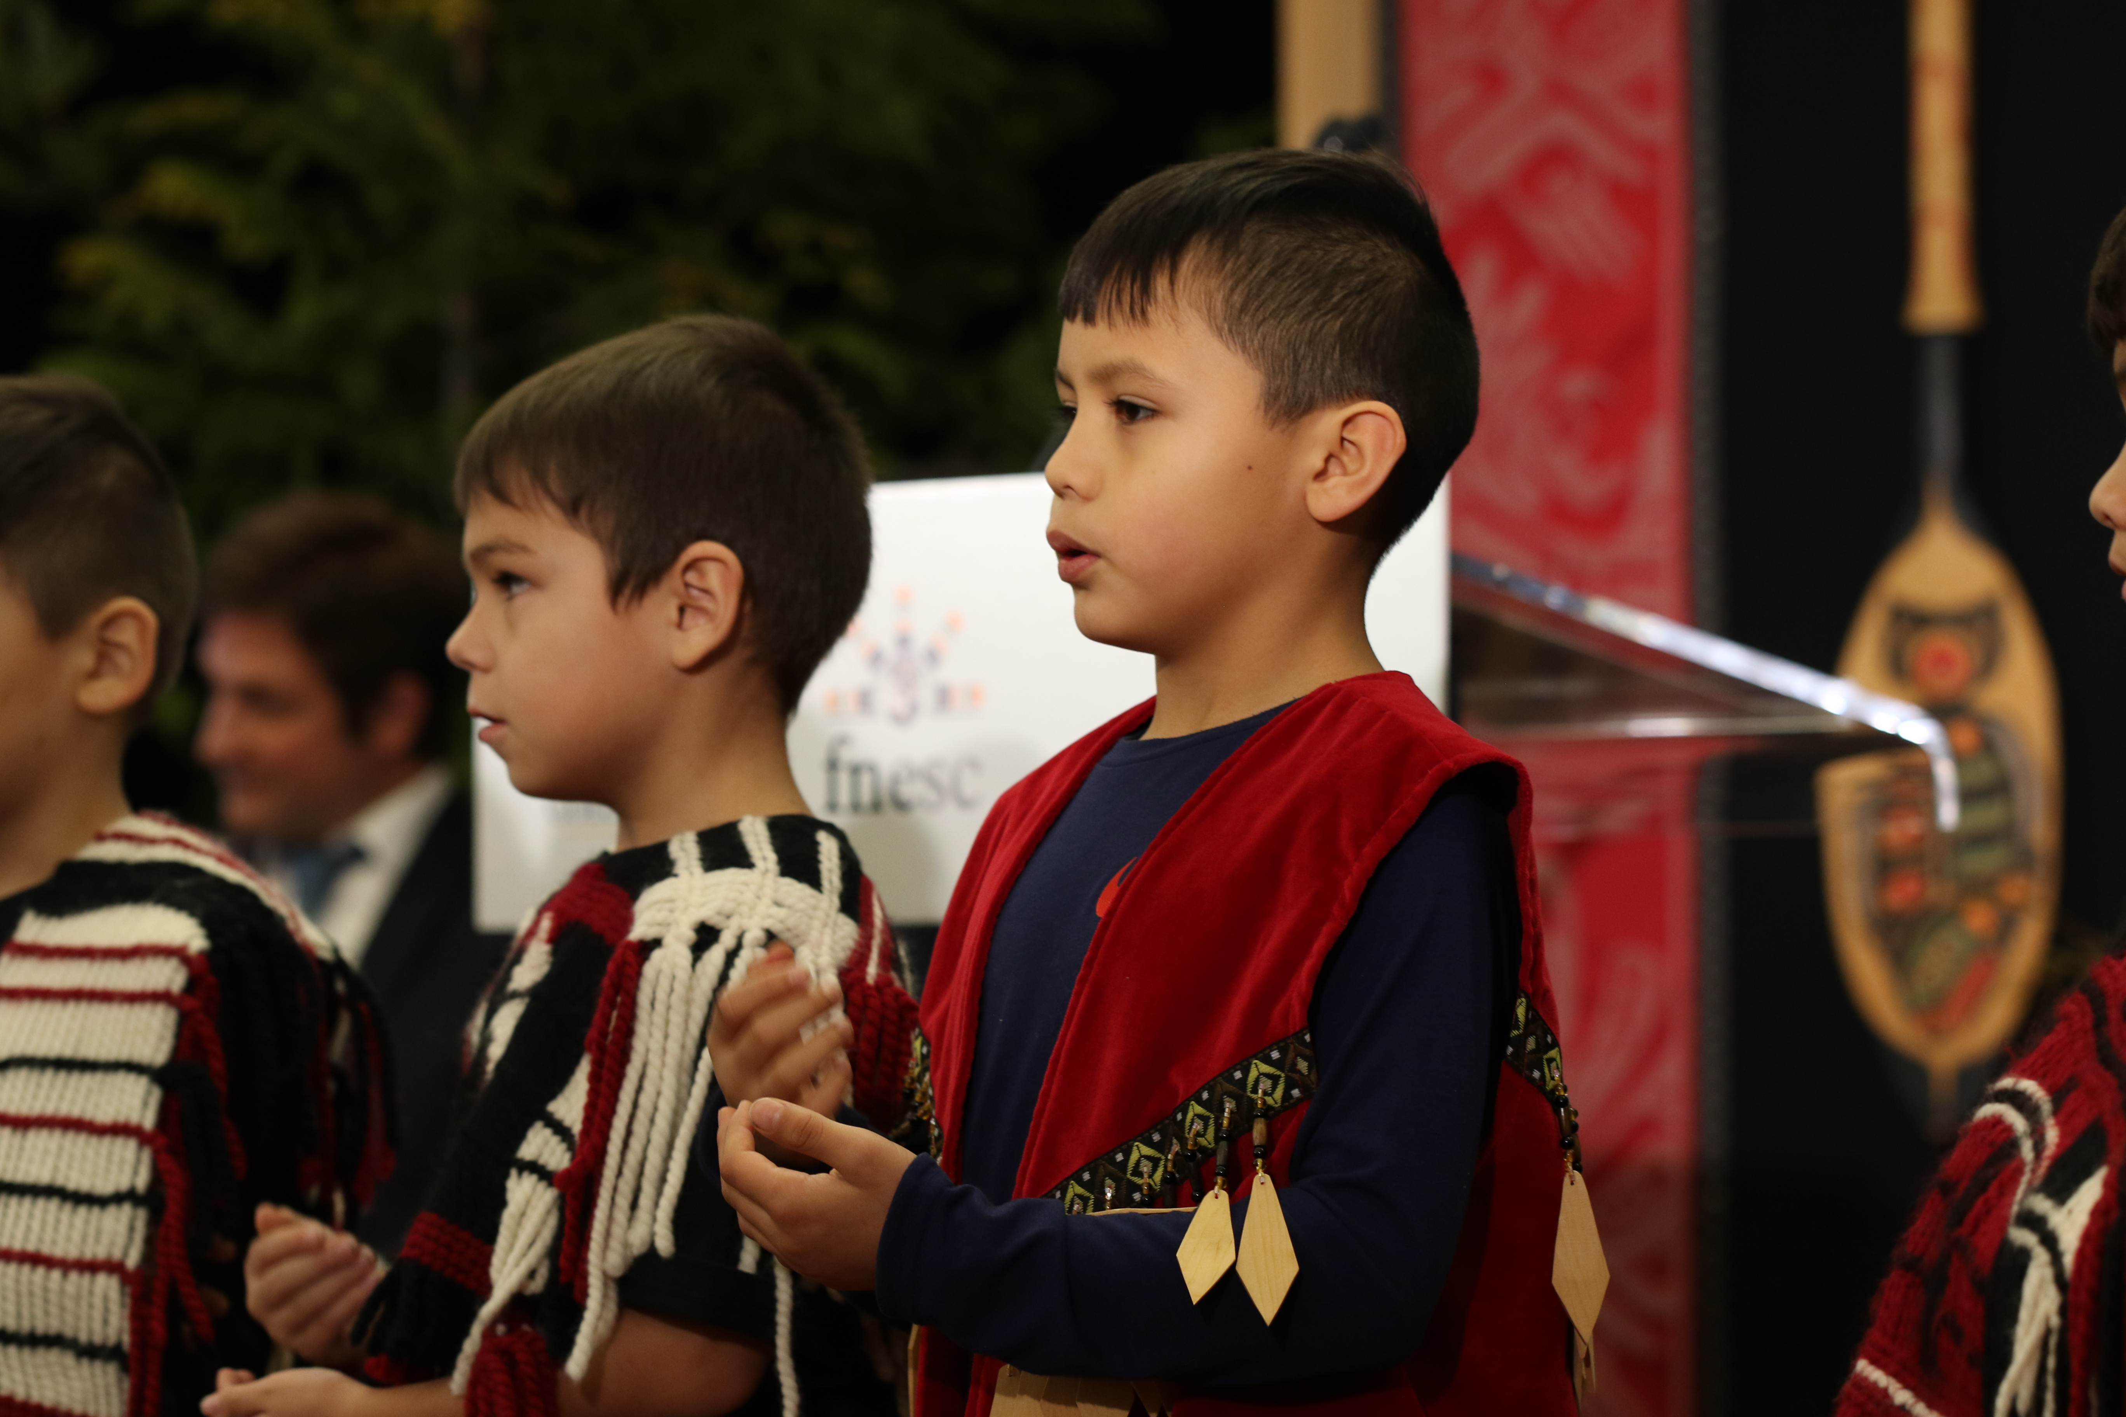
03
……………………………
Elementary
and Secondary
Funding
Funding Cycles and Arrangements
Tuition and Student Supports
Notes:
Contribution, Grant and Block First Nations all submit Nominal Roll on a yearly basis.

Slide 20
TYPES OF FUNDING ARRANGEMENTS
The flow of education funding is based on the type of funding arrangement your First Nation holds with ISC.
For questions on how funds flow within your organization, or how funding arrangements may impact funding, please contact your First Nation’s Finance Office.
Contribution
Block
New Fiscal Relationship Grant
Self-Governing / Treaty

Slide 21
2025-2026 FUNDING CYCLES
………………
CONTRIBUTION AGREEMENT
………………
BY FISCAL YEAR (APRIL 2025 – MARCH 2026)
BY SCHOOL YEAR (JULY 2025 – JUNE 2026)
Month of Payment | Percentage | Period Covered | Payments Based on Which Nominal Roll
April 2025 | 30% | April to June 2025 | School year starting September 2023
June 2025 | Adjustment | September 2024 to June 2025 | School year starting September 2024
September 2025 | 40% | September 2025 to December 2025 | School year starting September 2024
January 2026 | 30% | January to March 2026 | School year starting September 2024
Adjustment June 2026
Sept – June
40%
Sept 2025
Sept – Dec
30%
Jan 2026
Jan – March
30%
Apr. 2026
April – June
Based on Sept 2025 NR
Based on Sept 2024 NR
Based on Sept 2024 NR
Notes:
Please note:
The table in this slide shows the flow of funding by ISC based on fiscal year. The circular graph on the right shows the flow of funding based on the current school year for comparison.
For First Nations Financial Coordinators, the adjustment in June 2025 occurs in ISC’s 2025-26 fiscal year.

Slide 22
2025-26 FUNDING CYCLES
2024-25 FUNDING
………………
NEW FISCAL RELATIONSHIP GRANT (NFR) /
BLOCK AGREEMENT
………………
BY FISCAL YEAR (APR 2025 – MAR 2026)
BY SCHOOL YEAR (JUL 2025 – JUN 2026)
Month of Payment | Percentage | Period Covered | Payments Based on Which Nominal Roll
April 2025 | 30% | April to June 2025 | School year starting September 2023
June 2025 | Adjustment | September 2024 to June 2025 | School year starting September 2024
September 2025 | 70% | September 2025 to March 2026 | School year starting September 2024
30%
Adjustment
June 2026
April 2026
Sept 2025
70%
Sept – March
April – June
Sept – June
Based on Sept 2025 NR
Based on Sept 2024 NR
Based on Sept 2024 NR
Notes:
BLOCK AGREEMENT
As of the 2023-24 school year, funding for Block-funded First Nations is adjusted annually based on the previous year’s Nominal Roll. Please refer to the communique shared with affected First Nations in Aug 2022.
Block Protection Methodology: Gradual step-down of 1.5% stabilization approach - ISC will apply a 1.5% step-down to funding protection on Sept – Mar block amounts from 2022-2023 levels. Funding will not be less than 97% of what would have been received for the 2022-2023 fiscal year under the Block.
Recipients previously received their block allocation with block growth for elementary/secondary in April 2022 (cash flow is from April 2022 to January 2023)

Slide 23
Have a Funding Question?
For information on what funding has flowed to your First Nation, we encourage you to connect with your First Nation’s Financial Coordinator or Lead.
You can also refer to your 2025-2026 Budget Allocation Report for an overview of Elementary/Secondary funding flowed to your First Nation, which is shared with First Nations Finance and Education departments by ISC each year.
To request a copy of this report, please email: BCFundingservices-cbservicesdefinancement@sac-isc.gc.ca

Slide 24
Comprehensive Instructional
Financial Assistance
Guidance and Counselling
STUDENT SUPPORTS
FROM ISC
……………………………………
Ancillary
See ISC’s 2024/25 Program Guide for more details on Student Support Services funding.
Menstrual Products
Accommodation Services

Slide 25
STUDENT SUPPORTS FROM ISC
COMPREHENSIVE INSTRUCTIONAL
GUIDANCE AND COUNSELLING
$221 per eligible student per year
School Supplies
Accommodation
Transportation
Financial Assistance
Guidance and Counselling
$179 per eligible student per year + $1,094 per eligible student per year with approved student accommodation services on Nominal Roll
Base salary
Benefits
Travel
Telephone Service
ANCILLARY SERVICES
$287 per eligible student per year
Supplementary Services
School Supplies
Equipment
Specialized Educational Services
Fees for Specialized Classes
For eligible students living on reserve and attending public/independent (private) schools in BC
Notes:
Comprehensive Instructional Elementary/Secondary Support Services
All First Nation funding agreement Recipients receive additional funding for their students attending First Nation, public and independent (private) schools, to be used towards school supplies, accommodation, transportation, financial assistance, or guidance and counselling. All students on the Nominal Roll receive student support funding, regardless of the school they are attending.
For example, there are 44 students in the previous year’s September Nominal Roll. The funding agreement Recipient receives $221 X 44 = $9,724 for Comprehensive Instructional Support Services (CISS).
Guidance and Counselling
Funding is provided to assist in the provision of K-12 Guidance and Counselling administration services, including the Nominal Roll. Funds for Guidance and Counselling administration include base salary and associated costs such as benefits, travel, and telephone service.
Block and New Fiscal Relationship (10-Year Grant) funded Recipients have this program built into their core funding.
Funds for Guidance and Counselling administration include base salary and associated costs such as benefits, travel, and telephone service. The formula is $179 per student per year plus $1,094 per student per year with approved student accommodation services on the Nominal Roll. Adult students are eligible for the base formula but not the supplement for student accommodation services.
For example, a funding agreement Recipient with 44 students on the Nominal Roll and one of these students is eligible for accommodation. The funding agreement Recipient receives $179 X 44 students and $1,094 x 1 student or $8,970.
Ancillary Services
For eligible students living on reserve and attending public/independent (private) schools in British Columbia, funds are available for supplementary services such as school supplies, equipment, specialized educational services, and fees for specialized classes. Allocations are based on the rate per student (per year) listed on the Nominal Roll for public/private schools. Adult students are eligible for this funding. Block and New Fiscal Relationship (10-Year Grant) funded Recipients have this program built into their core funding.
For example, if a First Nation has 44 students on the Nominal Roll attending a public or private/independent (private) school. The funding agreement Recipient receives $287 X 44 students = $12,628 for Ancillary Services.

Slide 26

STUDENT SUPPORTS FROM ISC (cont’d)
FINANCIAL ASSISTANCE
ACCOMMODATION SERVICES (see Section 5: Accommodation Supports)
Ungraded Secondary Students - $144
Grade 8 to 10 - $144
Grade 11 - $287
Grade 12 - $431
These allowances may be provided to the students directly or used by the First Nation for education purposes such as:
1. the cost of purchase or rental of books and supplies
2. specialized clothing (including a graduation allowance)
3. equipment or specialized educational services; and additional fees for specialized classes
$8,671 to $15,048 per eligible student per year (based on type of accommodation and location)
Room and Board
Clothing
Monthly Allowance
Transportation while in room and board
Seasonal transportation
MENSTRUAL PRODUCTS
$159 per eligible student per year Students aged 8 and up (adults included) reported as female or another gender on the Nominal Roll
Notes:
Financial Assistance
To provide student allowances to eligible students in grades 8 to 12. These allowances may be provided to the students directly or used by the First Nation for education purposes such as:
1. the cost of purchase or rental of books and supplies;
2. specialized clothing (including a graduation allowance);
3. equipment or specialized educational services; and additional fees for specialized classes.
The allocation is based on the number of students in grades 8 to 12 including ungraded students that may be taking courses at two different grade levels) on the Nominal Roll.
Adult students are eligible for this funding.
Block and New Fiscal Relationship (10-Year Grant) funded Recipients have this program built into their core funding.
For example, based on the current year Nominal Roll, there are 34 students in grades 8 to 10 and ungraded secondary, 5 students in grade 11, and 5 students in grade 12. All students attend public/private or band-operated schools.
34 students X $144 = 4,896; 5 students X $287 = 1,435; 5 students X $431 = 2,155
Total 44 students = $8,486. The funding agreement Recipient is entitled to receive $8,486 for Student Allowance.
Student Accommodation Services
This funding is provided to assist eligible students ordinarily resident on reserve who must leave home to attend school.
Annual allocations for accommodation are made by the actual number of approved students who must attend school away from their home communities. The funding for these students is based on the type of accommodations (5-day or 7-day), and the distance (remote/non-remote) the student must travel. The funding may be used for items such as room and board; clothing; monthly allowance; transportation while in room and board, and seasonal transportation.
For example, a funding agreement Recipient has a band-operated school to grade 9, with 14 students in grades 10-12 who must leave the community for school, and another grade 6 student who must be near the BC Children’s Hospital for medical care (medical documentation submitted). The community is remote, and the students will require 7-day accommodation. The funding (which may vary based on location) is estimated at $15,048 per eligible student. A breakdown of funding can be found in the program guide under Student Accommodation Services.
This funding agreement Recipient is eligible for estimated accommodation funding for 15 students X $15,048 = $225,720 plus administration of 5% for a total of $237,006.
---
If the student is living on leased reserved lands, eligibility differs. See ISC’s 2024/25 Nominal Roll Instructions for more detail.

Slide 27
TUITION AND STUDENT SUPPORTS
STUDENTS ATTENDING PUBLIC SCHOOLS OR INDEPENDENT (PRIVATE) SCHOOLS OFF-RESERVE
Tuition
Based on the First Nations Student Rate (formerly First Nations Billing Rate and First Nations Block Rate), which includes Inclusive Education funding.
Student Supports
Comprehensive Instructional
Financial Assistance
Guidance and Counselling
Ancillary
Menstrual Products (age 8+ incl. adults, identifying as female/non-binary)
Potential for accommodation up to age 21 (age 22+ are not eligible)
See ISC’s Nominal Roll Instructions for more details.
Notes:
Definitions:
Public School funding provides education services for eligible, on-reserve students attending Public schools for grades Kindergarten - Age 5 to grade 12.
Independent (private) School (Off-Reserve) funding provides education services for eligible on-reserve students in grades Kindergarten - Age 5 to grade 12 attending schools in Group 1 or 2 categories.
How is Tuition Paid?
Payment of tuition is based on the First Nations Student Rate for the school district you are in.
For more information on the First Nation Student Rate, you can refer to the BC Ministry of Education and Child Care (ECC) websites:
First Nation Student Rate 101 https://www2.gov.bc.ca/assets/gov/education/administration/resource-management/bctea/fnsr_101_-_2025.pdf
Local Education Agreement (LEA) / Indigenous Services Canada (ISC) / Self-Government
https://www2.gov.bc.ca/gov/content/education-training/k-12/administration/financial-management/school-district-financial-reporting/lea-isc-self-government
How does tuition funding work?
Initial allocations are based on the September 2024 Nominal Roll and the 2024-2025 school district First Nation Student Rates. In June, allocations are adjusted for price and volume changes after the September 2025 Nominal Roll has been updated and confirmed by the Province using the 2025-2026 First Nation Student Rates.
---
If a student is attending a public school or independent (private) school off-reserve, they will receive student supports funding from ISC based on the Nominal Roll. However, if the student is not attending a public or independent (private) off-reserve school, this funding is included in the BCTEA funding formula.
---
If the student is living on leased reserved lands, eligibility differs. See ISC’s Nominal Roll Instructions for more details.

Slide 28
FLOW OF TUITION AND STUDENT SUPPORTS
FOR REGISTERED (STATUS) STUDENTS ATTENDING PUBLIC SCHOOLS
First Nations with a Local Education Agreement (LEA)
ISC sends tuition and student supports funding directly to the First Nation
Note: This applies for registered (status) students only
The First Nation may opt to have ISC send tuition to the Province. ISC will send student supports funding to the First Nation.
OR
ISC
First Nation
School District
ISC
First Nation
Province of BC
----------------------------------------
Student Supports
Tuition
Tuition
Student Supports
Tuition
Notes:
When an LEA is in place, ISC will flow tuition and student supports to the First Nation for registered (status) students
In the second option, the First Nation must submit a Band Council Resolution (BCR) if they don't want the tuition funding flowed to them.
Local Education Agreements (LEA)
An LEA is an agreement between a First Nation and a Board of Education (or a First Nation and an independent school authority) to purchase education programs and services from the board/authority for First Nation students living on reserve and attending schools off reserve.
LEAs are an integral part of the delivery of education services to First Nations students attending BC schools. More than a financial transaction, they serve as a mechanism for building relationships and accountability to support improved First Nations student outcomes.
If your First Nation has a new or revised LEA for the 2025/26 school year, please include it as a supporting document with your Nominal Roll submission by October 15. If you have an LEA signed after this date, please contact ISC BC Education at BCEducation@sac-isc.gc.ca.

Slide 29
FLOW OF TUITION AND STUDENT SUPPORTS
FOR STUDENTS ATTENDING PUBLIC SCHOOLS
First Nations without a Local Education Agreement (LEA)
ISC sends tuition to the Province and sends student supports funding to the First Nation.
ISC
First Nation
Province of BC
Student Supports
A new Model Local Education Agreement (Model LEA) is now available that was collaboratively developed by FNESC and ECC.
First Nations can apply the Model LEA and/or use it as an available precedent to negotiate their own customized version with a school district.
-----------------------------------------------
Tuition

Slide 30
FLOW OF TUITION AND STUDENT SUPPORTS
FOR NON-STATUS STUDENTS ATTENDING PUBLIC SCHOOLS
ISC
First Nation
Province of BC
The following students are eligible for the Nominal Roll:
Non-registered (non-status) Students
Other Indigenous Students (Métis, Inuit)
Non-Indigenous Students
For these students:
Tuition flows directly to the Province, even if a Local Education Agreement (LEA) is in place with school district(s)
Student supports flow to the First Nation where the student ordinarily resides
Student Supports
---------------------------------------------------
Tuition
Notes:
For the students shown on this slide, please be aware that ISC pays provincial/public tuition directly to the Ministry of Education and Child Care (ECC), even when a Local Education Agreement (LEA) is in place with school district(s). This practice has been in place since the inception of BCTEA in 2018/2019.
Student supports services funding flows to the First Nation (band of residence) reporting the student on Nominal Roll. By including these students on the Nominal Roll, the First Nation receives student supports funding that may be used to support expenses such as school supplies, books, clothing, equipment and guidance and counselling. The First Nation can choose to flow this funding according to how it best meets student needs.
Ultimately, the First Nation holds the authority as to which eligible students to include on their Nominal Roll report.
For more information, please refer to the Frequently Asked Questions (Appendix 5) in ISC’s Nominal Roll Instructions. For questions, please contact ISC BC Education at bceducation@sac-isc.gc.ca

Slide 31
TUITION AND STUDENT SUPPORTS
STUDENTS ATTENDING FIRST NATION SCHOOLS OR FIRST NATION INDEPENDENT SCHOOLS
Tuition
Based on the BCTEA Funding Formula
First Nation schools can apply for Special Education Funding through the FNESC/FNSA Special Education Team
Student Supports
Comprehensive Instructional
Financial Assistance
Guidance and Counselling
Menstrual Products (age 8+ incl. adults, identifying as female/non-binary)
Potential for Accommodation up to age 21 (age 22+ are not eligible)
See ISC’s Nominal Roll Instructions for more details.
Notes:
Definition
BCTEA formula is based on the provincial funding formula, with additions and adaptations to reflect the needs of First Nations operated schools. Over the years, there have been some adaptions to this formula based on varying circumstances.
Recipients that administer First Nations Band-operated schools on reserve receive BCTEA funding for all attending students regardless of the reserve of residence.
---
The BCTEA funding model for First Nations operated schools is formula-based funding calculated using the annual Nominal Roll count. The BCTEA funding model is based on the provincial funding formula, with additions and adaptations to reflect the needs of First Nations operated schools.
The BCTEA funding formula is flexible and allows for First Nations to determine how to best invest the funds to support the needs of learners. Further information can be found in ISC’s 2024-2025 Program Guide on page 79. For further breakdown of funding, please reach out to your assigned Funding Services Officer.
BCTEA funding is allocated to First Nation operated schools for costs associated with education for eligible on-reserve students (K4 to Grade 12). These include instructional costs such as school staff, recruitment, salaries, books, supplies, low-cost special education services and language and curriculum development. School Operations and Maintenance (O&M) are factored into the formula, as well as transportation.
Ancillary Services is built into the BCTEA formula.
Student Supports Services funding for students attending a First Nations School or First Nations Independent School is included in the BCTEA funding formula.

Slide 32
FLOW OF BCTEA FUNDING
FOR STUDENTS ATTENDING FIRST NATION SCHOOLS (OR FIRST NATION INDEPENDENT SCHOOLS)
Tuition and student supports funding flows to the First Nation who operates the school for students who live on that reserve and are included on the Nominal Roll
Tuition and student supports funding flows to the First Nation who operates the school for students who live on that reserve and are included on the Nominal Roll
What if a student is attending a First Nation school on a different reserve? Let’s look at a scenario…

Slide 33
Scenario 1
WHO REPORTS THE STUDENT?
I have a student who is…
The First Nation where the student is ordinarily resident (or “Band of Residence”) should report the student on the Nominal Roll
WHO RECEIVES TUITION AND STUDENT SUPPORTS?
Ordinarily residing in my community
Attending a First Nation School on a different reserve
Student supports flow to where the student ordinarily resides
Tuition flows to the First Nation who operates the school

Slide 34
OFF-RESERVE STUDENTS
Students living off-reserve are not eligible for inclusion on the Nominal Roll
Instead, First Nations with students living off-reserve attending a First Nation school may apply for Reciprocal Tuition through the Ministry of Education and Child Care (ECC)
Funding is based on the First Nation Student Rate (K5-12 students only)
First Nation schools are required to have FNSA certification or BC Independent School status (Group 1 or 2) to be eligible to apply for reciprocal tuition
For more information:
See ECC’s website for information on how to apply and key dates
Refer to FNESC’s Reciprocal Tuition Handbook
See ISC’s Nominal Roll Instructions for more details.
Notes:
**Reciprocal Tuition Application Process and Key Dates: https://www2.gov.bc.ca/gov/content/education-training/k-12/administration/program-management/indigenous-education/reciprocal-tuition
The Ministry of Education and Child Care (ECC) will pay reciprocal tuition for the education of off-reserve students attending First Nations schools; schools that have FNSA certification or BC Independent School status (Group 1 or 2) may receive reciprocal tuition funding from the Province for students who are not eligible for federal funding on the Nominal Roll. Calculations are based on the First Nations Student Rate. Applications for funding must be made to the ECC Indigenous Education Branch.
For information on the reciprocal tuition application process, visit: https://www2.gov.bc.ca/gov/content/education-training/k-12/administration/program-management/indigenous-education/reciprocal-tuition
Note: Adult students are not eligible for reciprocal tuition.
Resource:
FNESC/FNSA – Reciprocal Tuition Handbook (for Non-Independent First Nations Schools)
http://www.fnesc.ca/wp/wp-content/uploads/2020/10/Reciprocal-Tuition-Handbook-2020.pdf

Slide 35


FIRST NATIONS SCHOOLS ASSOCIATION (FNSA)
FIRST NATIONS EDUCATION STEERING COMMITTEE (FNESC)
“The First Nation Schools Association will collaborate with First Nation schools to create nurturing environments that will develop learners’ pride and competence in their First Nations language and heritage and will equip them to realize their full potential, within self governing First Nations communities.”
“To facilitate discussion about education matters affecting First Nations in BC by disseminating information and soliciting input from First Nations.”
Notes:
The First Nation’s Education Steering Committee was founded in 1992 by communities who wanted a collective, unified voice around education. Since then, FNESC has been working on behalf of First Nations to achieve quality First Nations education for all First Nations learners in BC, both on and off-reserve. The Board members represent 141 or 70% of BC First Nations. Only 1 percent of the funding received by Canada goes to administration.
The First Nations Schools Association (FNSA) of BC was formally established in 1996 and is governed by a Board of Directors that includes regional representatives that are selected. Today, almost all of the 131 Frist Nation schools in BC are members of the Association. FNSA leads in research projects, networking and communication services, and raises awareness about what makes First Nations schools unique. FNSA works with First Nations schools to develop and implement new tools for gathering data on schools and students.

Slide 36
EDUCATION SUPPORTS FROM FNESC/FNSA
……………………
……………………
Under BCTEA, FNESC and FNSA provide Second Level Services to First Nations and First Nations schools in BC. In addition, FNESC provides Third Level Services.
For more information on available supports, please visit www.fnesc.ca
Examples of Second Level Services:
Curriculum supports
Student assessments
School assessments
Professional Growth Process
School capacity development activities
First Nations Parents Club
Connected Classrooms Initiative
Data management assistance

Slide 37
Q&A
If you have a question, use the ‘chat’ function
If you want to ask a question verbally, use the ‘raise hand’ function

Slide 38
BREAK
Please return in 10 minutes

Slide 39
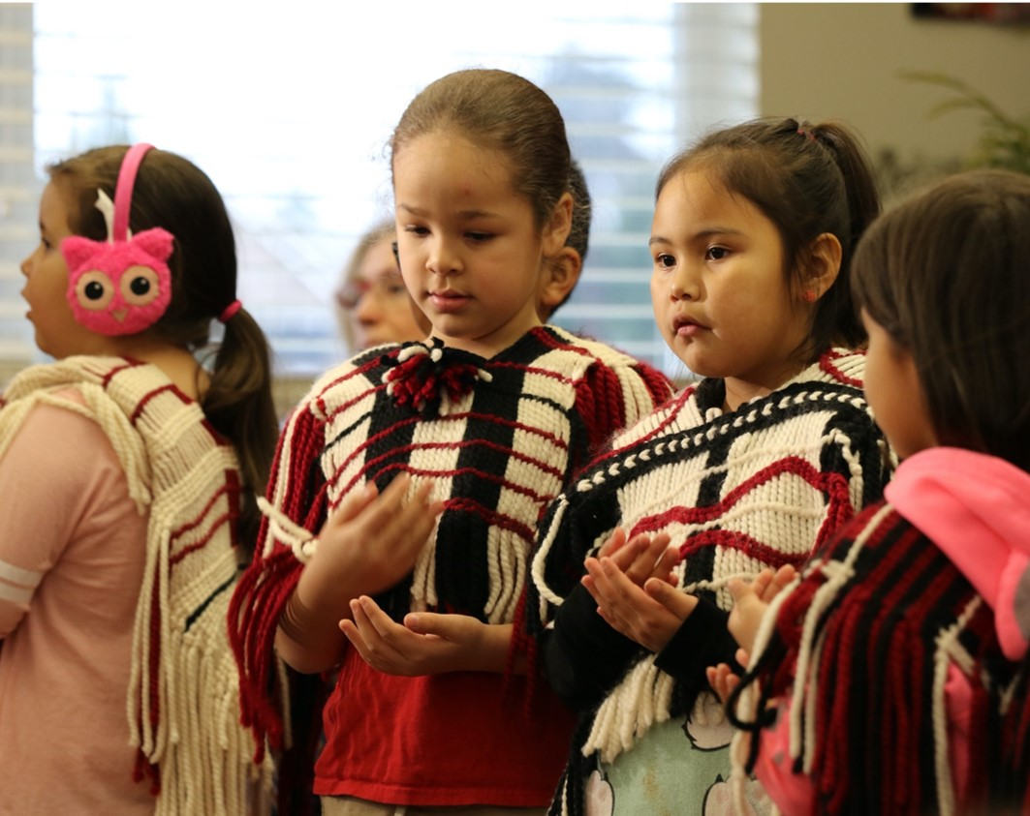
04
………………………………
Reporting Students on the Nominal Roll

Slide 40
STUDENTS WITH GREATER THAN 1.0 FTE
REMINDER: Starting in the 2023-2024 school year, all students who were previously reported as greater than 1.0 FTE will be automatically reset to 1.0 FTE in EIS.
!
Please ensure that you review these student records and update their FTE values accordingly to ensure students are funded accurately.
For one-on-one assistance, please contact ISC BC Agreement Services: bcfundingservices-cbservicesdefinancement@sac-isc.gc.ca
Notes:
For information on how to calculate student’s Full Time Equivalent, please refer to the 2025/26 Nominal Roll instructions.
Elementary students who are accessing these learning opportunities are eligible for a full FTE. Secondary and adult student FTEs are based on the number of courses a student is enrolled in, with eight courses considered a full FTE.
Other Reminders
Learning opportunities can be carried out online, through hardcopy packages, or a combination of both. The student does not need to be physically in school full-time to claim a full FTE.
In EIS, Education Coordinators are encouraged to select the “method of delivery” that best reflects the students’ circumstance as of September 29.
For example, selecting “virtual internet”, “blended – classroom and virtual” or “blended – classroom and distance education” instead of “in-class instruction”.

Slide 41
ONLINE LEARNING VS. HOMESCHOOLING
ISC encourages First Nations to connect with their respective school districts to develop a plan for where students will carry out their learning to ensure students are fully supported.
Online Learning
Homeschooling
A method of instruction that relies primarily on communication between students & teachers through the internet
Delivery of BC curriculum is overseen by a BC certified teacher or letter of permission holder
Programming delivered by a Provincial Online Learning School or District Online Learning School
First Nation Schools may offer online/blended learning to their students
An alternative education program outside the BC K-12 education system
Parent/guardian is responsible for providing the educational program (not supervised by BC-certified teacher or inspected by the Ministry)
Parents are required to register their homeschooled children with a public, Independent (private), or First Nation school (registering is not the same as enrolling)
Students are eligible for 0.0625 FTE funding and reported as “Home Schooled” under “Method of Delivery” in EIS (should be “enrolled” under their registering school)
Notes:
When determining learning alternatives for students and how to record them on the Nominal Roll, it is important to make the distinction between online learning and homeschooling.
Online Learning (formerly Distributed Learning):
Online Learning (previously Distributed Learning), is programming delivered by a Provincial Online Learning School or District Online Learning School.
Online Learning Schools are led by BC certified teachers or letter of permission holders.
District Online Learning Schools serve students who are resident in the district and Provincial Online Learning Schools serve students across the province.
Homeschooling
Homeschooling is an alternative education program that is outside the B.C. K-12 education system.
The Parent/Guardian is responsible for providing the educational program to their homeschooled child, including planning, delivery and assessment of the program.
Homeschool educational programs are not supervised by BC-certified teachers or inspected by the Ministry of Education and Child Care. Students who are homeschooled will be claimed at .0625 of an FTE.
Under B.C.’s Homeschooling Policy, the Parent/Guardian must register a homeschooled child with a B.C. school (public, independent or online) by September 30 each year.
When reporting homeschooled students on the Nominal Roll, it is important to select the correct school where the student is registered to ensure the accuracy of funding.
For more information on homeschooling see Homeschooling Procedures & Guidelines Manual: https://www2.gov.bc.ca/assets/gov/education/kindergarten-to-grade-12/support/homeschooling/homeschooling-procedures-and-guidelines.pdf
For homeschooled students on the Nominal Roll:
Select 0.0625 FTE
Choose “Home Schooled” under Method of Delivery
Ensure the school of registration is listed correctly in EIS for accurate funding
Tuition funding goes to the school of registration, not to the parents.
For more information about homeschooling, visit ECC’s website: https://www2.gov.bc.ca/gov/content/education-training/k-12/support/classroom-alternatives/homeschooling

Slide 42
Scenario 2
I have a student who is…
WHICH FIRST NATION SHOULD BE CLAIMING THE STUDENT?
The First Nation where the student is ordinarily resident (or “Band of Residence”) should report the student on the Nominal Roll.
The Band of Residence will administer the tuition funds (based on the First Nations Student Rate) if there is a Local Education Agreement (LEA) in place.
Ordinarily resident on reserve, different from their Band of Origin
Attending a public or non-First Nation Independent School off-reserve

Slide 43
Scenario 3
I have a student who is…
WHICH FIRST NATION SHOULD BE CLAIMING THE STUDENT?
The First Nation where they were residing prior to going into care should report the student on their Nominal Roll even if they have been relocated to another First Nation.
This will allow for student supports services funding to be available to these students.
A Child or Youth in Care (through Child & Family Services or Indigenous Child and Family Service Agencies)
Notes:
For Children and Youth in Care (through Child & Family Services or an Indigenous Child and Family Service Agency) in a formal or informal care arrangement, the First Nation where they were residing prior to going into care should report the student on their Nominal Roll even if they have been relocated to another First Nation. This will allow for student supports service funding to be available to these students.
While some students may not be living on reserve, it may not be appropriate to include on them on the Ministry of Education and Child Care’s 1701 report due to placement. This should be discussed between the First Nation and local School District.
First Nations may provide student support services funding to Children in Care ordinarily resident on reserve.
ISC recognizes that there may be informal arrangements, not through BC’s Ministry of Education and Child Care or an Indigenous Child and Family Services Agency, where a student lives with a grandparent or aunt/uncle who is not living on-reserve but may still be considered ordinarily resident on reserve. Each situation is reviewed on a case-by-case basis. Reach out to BCEducation@sac-isc.gc.ca for further discussion.

Slide 44
Scenario 4
I have a student who is…
WHICH FIRST NATION SHOULD BE CLAIMING THE STUDENT?
Contact ISC BC Education Programs staff (bceducation@sac-isc.gc.ca) for support to determine which First Nation should include the student on their Nominal Roll.
A child in a 50/50 joint custody arrangement
Residing 50% of the time with a parent on a different First Nation reserve
Notes:
For children in a 50/50 joint custody arrangement where they are residing 50% of the time with a parent on a different First Nation reserve, please contact the Education Programs Team BCEducation@sac-isc.gc.ca as to which First Nation should include the student on their Nominal Roll.
There may be circumstances where a student is not ordinarily resident on reserve with parents, but ordinarily resident on reserve with another community member. For example, a child does not always live with their parent(s) and there is an informal arrangement living with other family member(s). There is a section in the Nominal Roll Instructions that speaks to guardianship, which could make this arrangement possible for the purposes of submitting the student on Nominal Roll. The Band Administrator could say they are OK with this student at address Y instead of X.

Slide 45
Q&A
If you have a question, use the ‘chat’ function
If you want to ask a question verbally, use the ‘raise hand’ function

Slide 46

05
…………………………………………
Accommodation Supports

Slide 47

ACCOMMODATION SERVICES
Accommodation services may be available for students who are:
school-aged, up to the age of 21
enrolled in and attending K4 to Grade 12 programs
ordinarily resident on reserve but must attend school away from their home communities.
For new requests or changes to previously approved requests, First Nations must contact ISC at bceducation@sac-isc.gc.ca before the school year begins.
Students who fall under pre-approval do not require an application.
Notes:
Accommodation Services for School-Aged Students
Accommodation services may be available, upon application, for school-aged students who meet the following criteria:
Have not graduated;
Are enrolled in and attending Kindergarten (K4) through Grade 12;
Ordinarily reside on-reserve; and
Must attend school away from their home community.
These supports are intended for students whose primary residence remains on-reserve throughout the school year, even if they board elsewhere to attend school. Students should return to their home community during holidays and summer breaks.
Please note: This support is not available to students who live permanently off-reserve with their families, even if they are members.
Eligible Expenses
Funding may be used to cover a range of costs, including: Room and board, clothing, monthly allowance, local transportation while in room and board, ancillary expenses, transition support, travel chaperone, criminal record checks, seasonal transportation
Application Process
If your student does not fall under pre-approval, First Nations must contact bceducation@sac-isc.gc.ca to initiate an accommodation support request. Requests should be submitted before the school year begins or no later than October 15.
During the application process, ISC Education Programs will review submissions and determine eligibility. Supporting documentation will be required—such as proof of enrolment or a letter of support. The specific documentation needed may vary depending on the nature of the request.
Important Note
Students who leave their home community to attend school and are approved for accommodation—or who fall under pre-approval—are still considered ordinarily resident on-reserve. These students may be included on the Nominal Roll.

Slide 48



CIRCUMSTANCES FOR ACCOMMODATION SUPPORTS
There is no school within reasonable travelling distance of the community that offers the appropriate grade levels or programs.
Unique circumstances
The student requires placement in order to be near a medical facility or services.
Ordinarily resident on reserve
Provide supporting documents/explanation of the student’s circumstances
Reviewed on a case-by-case basis
Source: ISC 2024/25 Program Guide
More details can be referenced in ISC’s Nominal Roll Instructions
Notes:
#1 is generally captured through ISC BC Region’s Pre-Approved Accommodation List.
#2 and #3 are generally considered unique circumstances.
As noted in the previous slide, for new requests or a change in circumstance to a previously approved request, First Nations should contact the BC Education team by Oct 15th and we will review on a case-by-case basis.

Slide 49
TYPES OF ACCOMMODATION
Boarding School
An Independent (private) school where students live on the school campus
Boarding School
Group Home
Group Home
A group of students reside in a home with adult supervision
Residence
Where a student attends school and lives in a residence
Residence
Temporary: freeze up and break up (when a student lives across a body of water and during these times needs to stay on the reserve land where the school is located – not used in BC
Room and Board 3 Types
Room and Board 3 Types
5 day: student resides in a home to attend school during the week and returns home for the weekend
7 day: student resides in a home for 7 days a week and returns to home community for holidays
Notes:
During the application process, or if the student falls under pre-approval, it is up to the education coordinator to determine the best type of Accommodation to select for the student. For questions about the most appropriate accommodation type, consult during the application process or contact bceducation@sac-isc.gc.ca.
Important: The type of accommodation and location (remote/non-remote) determines the amount of funding generated for a student. The amount of funding generated for 7-day is the same as Boarding school, group home, and residence (dependent on remoteness).
Important: If a student does not return home every weekend during the school year, or if it is uncertain how often they will return home, it is advisable to choose 7-day accommodation instead of 5-day accommodation.

Slide 50
For students who are ordinarily resident on reserve who
FUNDING METHODOLOGY FOR ACCOMMODATION SUPPORTS |  | For students who are ordinarily resident on reserve who must leave home to attend school
 |  | 7-DAY ACCOMMODATION (Remote/Isolated) | 7-DAY ACCOMMODATION (Non-remote) | 5-DAY ACCOMMODATION (Non-remote)
 | ROOM AND BOARD | $6,480 | $6,480 | $4,629
 | ANCILLARY | $280 | $280 | $280
 | TRAVEL SUPPORT | $1,436 | $1,436 | $1,436
 | CRIMINAL RECORD CHECK | $28 | $28 | $28
 | BUS PASS | $600 | $600 | $600
 | TRAVEL CHAPERONE | $516 | $155 | N/A
 | SEASONAL TRAVEL | $4,725 Avg* | $1,238 | $1,238
 | TOTALS | $14,065 | $10,217 | $8,211
must leave home to attend school
7-DAY ACCOMMODATION
(Non-Remote)
5-DAY ACCOMMODATION (Non-Remote)
7-DAY ACCOMMODATION
(Remote/Isolated)
Room and Board
$6,480
$6,480
$4,629
Ancillary
$323
$323
$323
Transition Support
$1,660
$1,660
$1,660
Criminal Record Check
$28
$28
$28
Bus Pass
$600
$600
$600
Travel Chaperone
$596
$179
N/A
Seasonal Travel
$5,361 Avg*
$1,431
$1,431
TOTALS
$15,048
$10,701
$8,671
* The amount for remote communities may vary based on location
Note: Administration of 5% is added to the total to support the coordination of accommodation services.
See ISC’s Nominal Roll Instructions for more details.
Notes:
Example
A funding agreement Recipient in a Remote location has a First Nations school to grade 8, with 12 students in grades 9-12 who must leave the community for school. This funding agreement Recipient is eligible for 7-day accommodation funding for 12 students X $15,048 = $180,576 plus administration of 5% = $189,604.80.
A funding agreement Recipient in a Non-remote location has a First Nations school to grade 9, with 14 students in grades 10-12 who must leave the community for school, and another grade 6 student who must be near the BC Children’s Hospital for medical care. This funding agreement Recipient is eligible for 7-day accommodation funding for 15 students X $10,701 = $160,515 plus administration of 5% = $168,540.75.
A funding agreement Recipient in a Non-remote location has a First Nations school to grade 10, with 18 students in grades 11-12 who must leave the community for school. This funding agreement Recipient is eligible for 5-day accommodation funding for 18 students X $8,671 = $156,078 plus administration of 5% = $163,882.
Note Regarding Seasonal Travel Rate for Remote/Isolated Communities:
This rate is based on the Vacation Travel Assistance rates for federally-posted employees in isolated communities as published twice annually by the National Joint Council based on data collected from Federal Departments https://www.njc-cnm.gc.ca/s3/d831/en
Note: This is a funding sample only. It is up to the Nation how they wish to administer accommodation supports.

Slide 51
PRE-APPROVED ACCOMMODATION LIST
Students may already be eligible for accommodation services if their First Nation, reserve and grade appear on the ISC Pre-Approved Accommodation List (Appendix 3).
The List generally includes communities who do not have a school within reasonable travelling distance of the community or do not offer appropriate grade levels or programs.
The list will reflect grades not offered in/near the community.
It is not necessary to apply to ISC for accommodation supports if the student would be included on the List.
Notes:
Pre-Approved Accommodation Supports
Students whose First Nation, grade level, and reserve of ordinary residence are listed on the ISC Pre-Approved Accommodation List do not need to contact ISC BC Education to initiate a request. These students are automatically eligible for inclusion on the Nominal Roll as requiring accommodation supports.
However, these students must be clearly identified as requiring accommodation supports in the Nominal Roll Report (EIS) at the time of submission.
Purpose of the Pre-Approved List
The Pre-Approved List is designed to reduce administrative burden. It identifies situations where a First Nation does not have a school or specific grade levels available to on-reserve students within a reasonable travelling distance.
For questions about the pre-approved List, please contact bceducation@sac-isc.gc.ca.

Slide 52
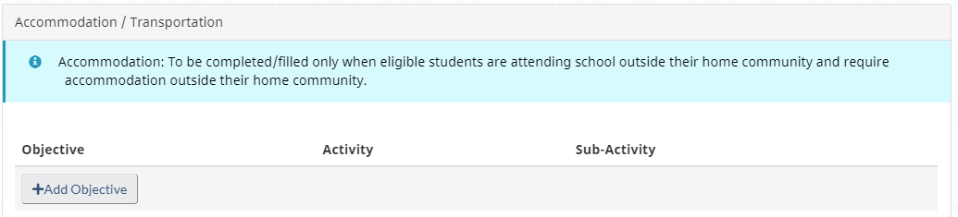
ACCOMMODATION in EIS
In the Education Information System, accommodation is an objective located at bottom of each student record.
To receive funding for eligible students approved (or pre-approved) for accommodation supports, click on the Add Objective button to add it to their record
Notes:
Guidance on Selecting Accommodation Types for the Nominal Roll
These slides are intended to assist in selecting the appropriate accommodation types for students listed on the Nominal Roll.
Key Requirement
Students who are either:
Approved by ISC for accommodation supports, or
Included under the ISC Pre-Approved Accommodation List
must have “Accommodation” added as an objective and clearly indicated on the Nominal Roll Report. Failure to include this objective will result in no funding being provided for the student.
Reminder on Data Roll-Over
If you choose to roll over Nominal Roll data from the previous year, any previously selected accommodation objectives will also carry forward.
It is strongly recommended that you review all students with an accommodation type from the prior year and update objectives as needed to reflect the current year’s circumstances—either by adding or removing objectives as appropriate.

Slide 53
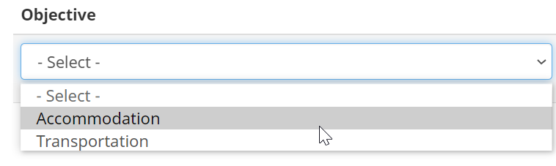
ACCOMMODATION in EIS
Select Accommodation from drop-down list
Select Type Of Accommodation From The Activity Drop-down Lists Of The Types Of Accommodations

Slide 54
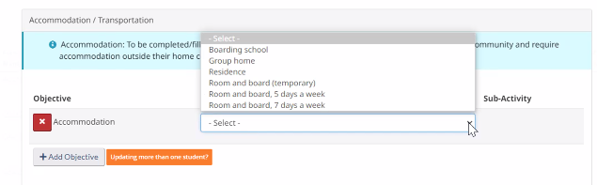
ACCOMMODATION in EIS
Select Type of Accommodation from drop-down list

Slide 55

Example 1
ELIGIBLE PROGRAMS
MY STUDENT IS…
Students must be enrolled in one of the following
Public school;
First Nations school (including First Nations Independent Schools), Approved Adult Program, First Nations Early Childhood Education Program (for K4); or
Independent (private) school (Group 1 & 2) recognized by the province as an elementary/secondary institution
Enrolled in a public school in Vancouver, BC
Temporarily attending school in the city due to medical reasons - they need to live with family near BC Children’s Hospital for treatment. They will be returning home on-reserve (4+ hours away) some weekends during the school year, and holidays.
Age 12, Grade 7
Ordinarily resident on reserve or leased reserve lands
Not eligible for pre-approval according to the pre-approved List
ELIGIBLE AGES
Age 4 by December 31 of the current school year and enrolled in an ISC approved Kindergarten 4 (K4) program operated by a First Nations school or a First Nations operated early childhood program.
Age 5 to 21 (students are considered to be “school age” to the completion of the school year in which they turn 21).
Age 22 or older (born prior to July 1 of the current school year).
RESIDENCY REQUIREMENTS
Students must be one of the following
Registered First Nations student (status) ordinarily resident on reserve or leased reserve lands
Non-registered First Nations student (non-status) or other Indigenous students ordinarily resident on reserve
Non-Indigenous student ordinarily resident on reserve
Could this student be a candidate for Accommodation? If so - what type of Accommodation is applicable for them?
TYPES OF ACCOMMODATION
Boarding School
Group Home
Residence
Temporary
Room & Board – 7 Day
Room & Board – 5 Day
Yes – this student could be a candidate for Accommodation
Notes:
Answer: Yes, this student could be a candidate for Accommodation. As the student does not fall under pre-approval, and this would be considered unique circumstances, a request for accommodation must be submitted to bceducation@sac-isc.gc.ca for this student before October 15th or ideally, before the start of the school year. As the student is not returning home every weekend, it is recommended to choose Residence or Room & Board – 7 Day.
Note: This student fits the residency requirement of ‘ordinarily resident on reserve’ as they are only temporarily leaving community for the school year, and their usual home is on-reserve.

Slide 56

Example 2
ELIGIBLE PROGRAMS
Students must be enrolled in one of the following
MY STUDENT IS…
Public school;
First Nations school (including First Nations Independent Schools), Approved Adult Program, First Nations Early Childhood Education Program (for K4); or
Independent (private) school (Group 1 & 2) recognized by the province as an elementary/secondary institution
Enrolled in a public school in Williams Lake, BC
Attending school in the city (away from their community/reserve) because their parents/guardians and family live in the city year-round
Age 16, Grade 11
Registered First Nations student (status)
Eligible for pre-approval according to the pre-approved List
ELIGIBLE AGES
Age 4 by December 31 of the current school year and enrolled in an ISC approved Kindergarten 4 (K4) program operated by a First Nations school or a First Nations operated early childhood program.
Age 5 to 21 (students are considered to be “school age” to the completion of the school year in which they turn 21).
Age 22 or older (born prior to July 1 of the current school year).
RESIDENCY REQUIREMENTS
Students must be one of the following
Registered First Nations student (status) ordinarily resident on reserve or leased reserve lands
Non-registered First Nations student (non-status) or other Indigenous students ordinarily resident on reserve
Non-Indigenous student ordinarily resident on reserve
Could this student be a candidate for Accommodation? If so - what type of Accommodation is applicable for them?
TYPES OF ACCOMMODATION
No – this student would not be a candidate for Accommodation
Boarding School
Group Home
Residence
Temporary
Room & Board – 7 Day
Room & Board – 5 Day
Notes:
Answer: No, this student would not be a candidate for Accommodation, despite falling under pre-approval. This is because they and their parents live permanently in the city (‘their parents guardians and family live in the city’), so the student does not fall under the category of ‘ordinarily resident on-reserve’.
Reminder: To be eligible for accommodation supports, the student must be ordinarily resident on-reserve and their usual home needs to be located on-reserve. Accommodation can only be utilized when students board temporarily during the school year and return to their usual home on-reserve during the summer/holidays and after leaving. Accommodation is not eligible for students who permanently live off-reserve year-round. Per BCTEA, the definition of ordinarily resident on reserve is “…the student usually lives at a civic address on reserve, is a child in joint custody who lives on reserve most of the time or is staying on reserve and has no usual home elsewhere. Students continue to be considered ordinarily resident on reserve if they return to live on reserve with their parents, guardians or maintainers during the year, even if they live elsewhere while attending school or working at a summer job.”

Slide 57
Q&A
If you have a question, use the ‘chat’ function
If you want to ask a question verbally, use the ‘raise hand’ function

Slide 58
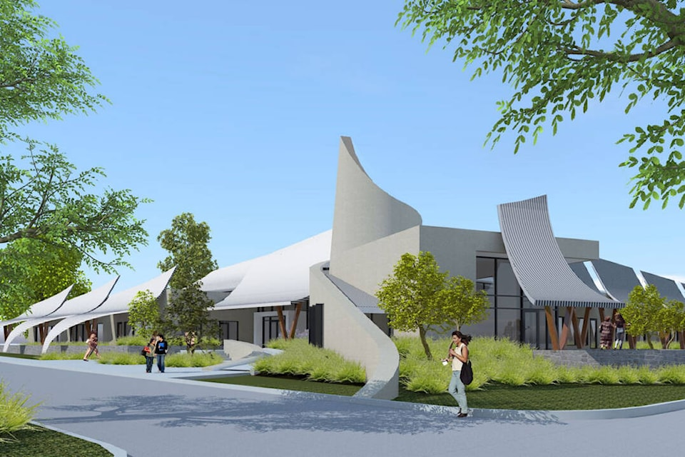
06
……………………………
Addition to Grades/Programs*
On-Reserve Adult Education Programs
Changing a School Name
*Application deadline for 2026/2027: January 31, 2026
Contact ISC BC Education Programs to apply: BCEducation@sac-isc.gc.ca

Slide 59



ADDITIONS TO GRADES/PROGRAMS
When is approval required?
Application Timing
Reminder
Adding grades, changing facilities, or starting a new on-reserve K–12 or adult program
Before including in Nominal Roll as funding will not flow without ISC’s approval
Community Infrastructure may be involved for additions involving school-age students
Deadline to add or change grades/programs is January 31 preceding school year of implementation
Next intake: 2026–2027 school year
Deadline: January 31, 2026
Note: Late applications may not be approved in time for the upcoming school year
Contact ISC (bceducation@sac-isc.gc.ca) to apply prior to the January 31 deadline before including students enrolled in new grades or programs on the Nominal Roll report
Notes:
The Additions to Grades/Programs process is most relevant for First Nations currently operating, or planning to operate, their own K–12 school or adult education program/school on-reserve.
Application required when:
Adding a new grade to an existing First Nations school (including Independent First Nations Schools)
Changing the instructional facility used to offer on-reserve K-12 or adult programming
Launching a new on-reserve First Nations adult education program or school
Approval from ISC BC is necessary to:
Access BCTEA tuition funding for new on-reserve school grades/programs
Ensure the grade/program appears in EIS for Nominal Roll reporting
Note: Funding is not available until ISC approval is granted
For First Nations under Block agreements, approval may still be required for grades not previously authorized.
Timing matters:
The next application cycle is for the 2026–2027 school year
Applications are due by January 31, 2026
Applications for September 2025 should have already been submitted by January 31, 2025
While ISC accepts applications year-round, late submissions are not guaranteed to be approved in time for fall implementation
At this point, any new submissions will be reviewed for 2026–2027, not the current 2025–2026 school year
If you have not yet applied for a 2025–26 addition and plan to operate this fall, please contact ISC BC Education immediately.

Slide 60




ADULT EDUCATION PROGRAMS
Key reminders for First Nations who are approved by ISC to operate an Adult Education Program in community (on-reserve) and report those students on the Nominal Roll
Adult students can only be funded for certain courses, dependent on if they are graduated or ungraduated
Like all students, adult students must be enrolled by the Count Date to be included on the Nominal Roll
FTE values should reflect the number of eligible courses they are taking, their learning level, and if they are graduated or ungraduated
ISC-approved Adult Education Programs are intended for students aged 18 or older. Contact ISC staff before enrolling students under 18.
Notes:
This slide outlines key reminders for First Nations that are approved by ISC to operate an adult education program in community (on-reserve):
Course Eligibility Based on Graduation Status
Your adult students’ FTE value can only consist of eligible courses, dependent on the students’ graduation status.
Ungraduated Adults: For students who have not received a BC Graduation or Adult Graduation Certificate, they can be funded for any elementary or secondary courses that contribute credits toward their Graduation Certificate.
Graduated Adults: For students already hold a BC Graduation Certificate or Adult Dogwood. They can only be funded for specific secondary-level upgrading courses. The full list of courses is available in the Appendix of the Nominal Roll Instructions, and on the Province of British Columbia’s website here: https://www2.gov.bc.ca/gov/content/education-training/adult-education/adult-upgrading/already-graduated
FTE (Full-Time Equivalent) Considerations
Adult student FTE values in the Education Information System (EIS) must reflect the number of courses a student is taking, as with all students.
Graduation status and learning level both affect how FTE is calculated for adult students, which can make FTE values for adults trickier to determine.
For example, an adult student taking only 1–2 courses should not be entered as 1.0 FTE, unless they are at a K4- Grade 7 learning level and have not yet graduated.
For more information, see the ‘How are Students’ Full-Time Equivalent (FTE) Calculated?’ section of the 2025-2026 Nominal Roll Instructions. It would be advised to refer to this when entering in your adult students’ FTE values in EIS.
Enrollment Timing
All adult students must be enrolled by the Count Date to be included on the Nominal Roll.
As with all students, students who enroll after this date (e.g., in January) are not eligible for inclusion or funding.
Age Requirements
ISC-approved, on-reserve Adult Education Programs are intended for students aged 18 and older.
If you are considering enrolling students under 18 alongside adults, you must contact the ISC BC Education Programs team at BCEducation@sac-isc.gc.ca before enrollment.
The inclusion of younger students alongside adults requires additional safety and programming considerations, and at a minimum, students must be at least 15 years of age.
If you are considering enrolling multiple younger students or starting a separate Alternative Education Program for your high school students, this may require an Addition to Grades application.
Contact for Support
For questions or to discuss specific cases, reach out to: 📧 BCEducation@sac-isc.gc.ca

Slide 61
CHANGING A SCHOOL OR FIRST NATION NAME
To update your First Nation school’s name, provide the information below and send it to ISC BC Education Programs (BCEducation@sac-isc.gc.ca)
 | PREVIOUS/ CURRENT | NEW
Grades/Programs Offered
“School” Name
Address (physical location as well as mailing address)
Contact Information (phone number/website)
To change a First Nation’s name, send a Band Council Resolution (BCR) requesting a legal name change to your ISC Governance Officer
Notes:
Requesting a First Nation school name change
If you have a First Nations operated school or Adult Program and are looking to change your school's name, please fill out the table that is provided on the slide and send it to BCEducation@sac-isc.gc.ca
Requesting a First Nations name change
If your First Nation is looking to have your name changed within our databases, send a Band Council Resolution (BCR) requesting a legal name change to your ISC Governance Officer. Once it has been processed, a formal letter will be sent from ISC to your First Nation confirming the name change and it will be in effect on the day your BCR was signed.
As this information is also shared with FNESC, please ensure any changes or issues are flagged to your ISC Governance Officer.
Note:
Any changes to the building being used to offer instruction for K-12 students must be discussed with ISC BC Education and Community Infrastructure before making the change. Buildings used to offer Elementary/Secondary programming are very tightly regulated for building safety, and utilizing non-instructional facilities for classes could risk student safety.

Slide 62
Q&A
If you have a question, use the ‘chat’ function
If you want to ask a question verbally, use the ‘raise hand’ function

Slide 63
2025 LEARNING SERIES - UPCOMING WEBINARS
*Webinars for Day 1, 2 and 3 will cover the same material, so it is not necessary for participants to attend multiple sessions
DAY 1
...............................
Nominal Roll Policy
Tuesday, August 12
Tuesday, August 19
Tuesday, August 26
from 9:00 a.m. – 12 p.m.
DAY 2
...............................
Joint Verification Process
Wednesday, August 13
Wednesday, August 20
Wednesday, August 27
from 9:00 a.m. – 11 a.m.
DAY 3
...............................
Education Information System (EIS)
Thursday, August 14
Thursday, August 21
Thursday, August 28
from 9:00 a.m. – 11 a.m.
To register, please email: BCEducation@sac-isc.gc.ca

Slide 64
ISC BC EDUCATION PROGRAMS KEY CONTACTS
ALEXIS FELLS
Manager, Education Programs
604-561-8468, alexis.fells@sac-isc.gc.ca
MARIE URDIGA
Program Advisor
236-335-1674, delainn.urdiga@sac-isc.gc.ca
Nominal Roll Policy and Eligibility
DEBRA KINEQUON
Program Officer
604-655-2816, debra.kinequon@sac-isc.gc.ca
NICOLE LUI
Program Advisor
236-330-7064, nicole.lui@sac-isc.gc.ca
ISC BC Education Inbox BCEducation@sac-isc.gc.ca
LAURA LANGS
Program Advisor
778-846-5132, laura.langs@sac-isc.gc.ca
PHILIP WONG
Program Advisor
604-368-7069, philip.wong4@sac-isc.gc.ca

Slide 65
ISC BC AGREEMENT SERVICES KEY CONTACTS
PHIL CAPPELLINI
Funding Services Manager, Transfer Payment & Agreement Services
604-368-4421, phil.cappellini2@sac-isc.gc.ca
Access to EIS / Log-in assistance
Support with Nominal Roll Report Entry and Verification
RYAN BURNS
Business Analyst
236-334-0495, ryan.burns@sac.isc.gc.ca
ISC BC Agreement Services BCFundingservices-cbservicesdefinancement@sac-isc.gc.ca
BAHAR FARAHBAKHSH
Agreement Officer
604-499-4563, bahar.farahbakhsh@sac-isc.gc.ca

Slide 66
Thanks for joining us today!
Please share any feedback or suggestions
We would love to hear from you

