Slide 1



2026 Learning Series
Day 2
Joint Verification Process
Presented by
Indigenous Services Canada (ISC) First Nations Education Steering Committee (FNESC) British Columbia Ministry of Education and Child Care (ECC)

Slide 2
2026 LEARNING SERIES - OVERVIEW
WEBINARS
IN-PERSON WORKSHOP
Nominal Roll Policy
Focuses on policy items related to the Nominal Roll process for First Nations
Expanded Nominal Roll Policy & Joint Verification Process Content from Webinars
Opportunity to meet with ISC Education and Funding Services staff
Network with other First Nations
Open to First Nations & Tribal Council representatives who support Nominal Roll and/or Joint Verification Process
Travel/hotel reimbursable for up to 2 representatives per First Nation/Tribal Council
Join us on September 11 in Vancouver. Register by September 7 here: https://www.fnesc.ca/nr-jvpworkshop/
DAY
Joint Verification Process
Provide both First Nations and school districts an opportunity to learn about information that can impact the process and ensure both have a clear understanding of roles and responsibilities
DAY
Education Information System
Live demonstration for First Nations on how to complete a Nominal Roll submission to ISC
DAY

Slide 3
2026 LEARNING SERIES - TOOLKIT
Joint Verification Process Presentation Slides
Appendix 1: Joint Verification Process from Draft 2026-2027 ISC BC Region Nominal Roll Instructions
MS Teams Guide
List of Commonly Used Acronyms
If you did not receive these materials, please email
the ISC BC Education Programs team at: BCEducation@sac-isc.gc.ca

Slide 4
HOUSEKEEPING REMINDERS
Attendees will have an opportunity to ask questions at the end of each topic
If you have a question, use the ‘chat’ function
If you want to ask a question verbally, use the ‘raise hand’ function
Your audio is muted
Webinar will last approximately 3 hours
Have an IT-technical related question? Send us a message using the ‘chat function’
Following the webinar, attendees will be invited to share feedback through polls
Notes:
At the end of each topic area, we will open the floor to questions. There is also a portion of the presentation dedicated to Q/A.
To ask a question, please use the chat function. If you want to ask a question verbally, please use “raise hand”. If you are experiencing any technical related questions, or need the speakers to speak up, please use the chat function. One of our hosts will gladly assist you. You can also reference the FAQ section of the Teams guide that was provided to troubleshoot problems as they occur.

Slide 5


#1:
The Joint Verification Process (JVP)
#2:
Tips for Completing the JVP
TOPICS
#3:
Scenarios: Navigating the JVP

Slide 6



#1:
The Joint Verification Process (JVP)

Slide 7
THE JOINT VERIFICATION PROCESS (JVP)
The JVP was introduced in the 2018-2019 school year as a commitment under the BC Tripartite Education Agreement (BCTEA).
To support accurate student reporting and federal/provincial funding, First Nations and school districts meet each September to confirm the enrollment data for students that are ordinarily resident on reserve and attending in BC public schools.
These joint conversations can help to reduce potential billing differences, support mutual accountability, and set the stage for future conversations around student needs.
First Nations have the authority to decide whether to include a student on their Nominal Roll report or not.
Notes:
As part of the BC Tripartite Education Agreement (BCTEA), Nominal Roll data for elementary and secondary students residing on-reserve and attending public schools should be jointly reviewed by First Nations and their local school districts through the Joint Verification Process (JVP). This can be referenced in Schedule J, paragraph 9.4 and 9.5 of the BCTEA agreement.
It is critical that student information and enrollment is captured accurately between both Federal and Provincial enrollment reports as the data collected from a First Nation’s Nominal Roll directly impacts their Federal funding from ISC.
Ensuring accurate student information and enrollment between federal and provincial enrollment reports helps ensure students are funded accurately and avoids payment issues.

Slide 8
KEY STEPS
JOINT VERIFICATION PROCESS
…………
…………
…………
2
…………
…………
3
…………
First Nations and school districts jointly review Nominal Roll and 1701 enrollment of on-reserve students attending public schools to ensure that all students are accounted for accurately
Both parties sign the Joint Verification form confirming student data accuracy by key dates and First Nations attach the form to the Nominal Roll report
First Nations receive accurate allocations of federal funding based on the Nominal Roll, and school districts are paid accurately for provincial tuition
Notes:
JVP is set up at the discretion of the First Nation and the school district to develop a joint verification process that will work best for them.
This process helps ensure that First Nations receive accurate allocations of Federal funding based on Nominal Roll and for school districts to be paid appropriately.
For First Nations, a scanned copy of a signed document confirming the jointly verified Nominal Roll should be included with your Nominal Roll submission to ISC (under the “Supporting Documentation” section). If you are having issues in uploading the supporting document, please email the signed document to ISC at bceducation@sac-isc.gc.ca. ISC can assist in uploading the document for you.
JVP is intended to provide First Nations and school districts an opportunity to meet and confirm that the student information on the Nominal Roll is consistent with school district’s information prior to the submission deadlines. This process would result in the signed document confirming joint verification between both parties. This process is important as this helps ensure that First Nations receive accurate allocations of Federal funding based on Nominal Roll and for school districts to be paid appropriately.
LEAs are an important mechanism for building relationships between First Nation communities and boards of education and schools to support improved First Nation student outcomes. JVP provides an added opportunity for First Nations and school districts to clearly identify students included under the provisions of their LEA.

Slide 9
RESPONSIBILITIES
First Nations
School Districts
Connect with representatives for all school districts where your students attend public schools
Ensure accuracy of student data
Include signed JVP Form(s) with their Nominal Roll Report submission to ISC by October 15, 2026
First Nations have the authority to decide which students to include on their Nominal Roll report
Connect with First Nations in a timely manner
Ensure accuracy of student data
Ensure First Nations have the information needed to complete the Nominal Roll accurately
Both First Nations and school districts sign off on the Joint Verification Form
Notes:
Both First Nations and school districts are responsible for meeting the annual requirement of JVP. It is important to note that First Nations and school districts with or without an LEA are still required to submit a Joint Verification Form.
First Nations and school districts will connect to jointly review the enrollment data for students who are ordinarily resident on reserve and enrolled in BC public schools. Where a First Nation has students who are ordinarily resident on reserve attending public schools outside of school districts in their geographic area, the First Nation will reach out to the relevant school district(s). For example, if you have students ordinarily resident on reserve who are currently attending schools in another district.
To support this process, please see the links below:
First Nation & Tribal Council contacts: https://fnp-ppn.aadnc-aandc.gc.ca/fnp/
School district contacts: https://bcschoolcontacts.gov.bc.ca/contacts
It is equally important that school districts support First Nations and are open to conversation to ensure that students registered with the school district are on the Nominal Roll, as this will impact the accuracy of funding.
The Joint Verification Process helps both parties verify that an accurate amount of funding flows to First Nations or a school district(s).

Slide 10
BENEFITS OF VERIFYING STUDENT DATA
Ensures a smoother payment process
  Minimizes discrepancies in tuition invoicing and payments between First Nations and school districts
  Avoids under funding by ISC and billing discrepancies with school districts
Ensures students are enrolled in the correct school district and that students are accurately identified
  If Joint Verification is not completed, students may be funded based on a First Nation Student Rate from a different school district
Notes:
ISC funds First Nation based on the FTE value(s) provided on the Nominal Roll
School district invoices the First Nations based on the FTE value shown on the 1701
When the two do not align, there is the potential for a billing difference
Ensuring students are enrolled in the correct school district and that students are accurately identified would promote clarity around student enrollment for all parties, regardless of whether an LEA is in place.

Slide 11
EXAMPLE: TUITION FUNDING/BILLING
 | Nominal Roll | 1701
Number of FTEs Reported | 1.0 | 1.25
Funding | $13,179 | $16,474
Difference/Billing Discrepancy: -$3,295
When FTE values are not matched through JVP, the school district will invoice the First Nation based on Full Time Equivalent (FTE) values on the 1701, which means the First Nation may be invoiced for more than it is funded by ISC
Notes:
This example uses the 2025-2026 First Nation Student Rate for SD39 Vancouver, which is $13,179.
The First Nation reports the student as 1.0 FTE on the Nominal Roll submitted to ISC, whereas the school district has reported the student as taking 1.25 FTE, or the equivalent of two additional courses, on the 1701.
If the school district invoices the First Nation for 1.25 FTE, this results in a difference of 0.25 FTE or $3,295.
To avoid a potential billing difference, it is important to review FTE values during the Joint Verification discussion.

Slide 12
STUDENT DATA COMPARISON: NOMINAL ROLL & 1701
Below are the total number of public school students reported as greater than 1.0 Full Time Equivalent (FTE) between the Nominal Roll and 1701 for the 2024-2025 school year:
Nominal Roll | 1701
293 students | 777 students
Difference:
484
To minimize funding and billing discrepancies, as part of the JVP it’s important to ensure that the number of FTEs match exactly between the Nominal Roll and the 1701 for the school district(s) where First Nation students are attending BC public schools.
Notes:
This means that
- the NR identified 293 students with 1.0 FTE
- The 1701 identified 777 students with greater than 1.0 FTE

Slide 13
WHAT IS THE 1701?
The school district’s version of the Nominal Roll which is submitted to the Ministry of Education and Child Care
The registry of all students enrolled in BC public schools
Determines Full Time Equivalents (FTEs) for funding purposes
Funding Code 20 is applied to the Student’s record on the 1701 if eligible to be on the Nominal Roll (confirmed through the Joint Verification Process)
Notes:
Link to 1701 Instructions:
https://www2.gov.bc.ca/assets/gov/education/administration/kindergarten-to-grade-12/data-collection/september/pi1701.pdf
What’s important?
Legal Name, usual name, date of birth, school attending
What is documented?
Language program enrolment
Indigenous Education program enrolment
Inclusive Education category enrolment
Number of courses for all students in the secondary grades, including adults
Funding Code 20 – detailed process. Students can be assigned the code 20 pre-JVP (at the time of school registration – the student self identifies and lets the SD know that they are living on Reserve) – this helps for the JVP as the SD can run a report (the Echo report) for all of the code 20’s
Information like the status number does not need to be shared with the school district.
------------------------
It is not appropriate for school districts to request and maintain a student’s Indian Registration or Status number just like it would not be appropriate to collect or maintain students’ Social Insurance Numbers. Instead, it is recommended for First Nations and school districts to use other ways to identify a student, such as student name, legal name or alias, or date of birth.
ISC does not require the First Nation nor the School District to provide information to ISC if there is a discrepancy. This should be addressed between the First Nation and School District before submitting the Joint Verification Form.
It is currently not a requirement for First Nations or School Districts to submit the consolidated student list (which was agreed to by both parties) to ISC, as ISC recognizes that some First Nations may not want to submit their list of their students. However, the school list may be required by ISC’s Compliance unit during the program review process.

Slide 14

WHAT IS THE FIRST NATION
STUDENT RATE (FNSR)?
The FNSR is based on the average funding amount provided for a student attending a BC public school within a specific school district.
Annual changes in either funding amounts or student FTE will affect the rate.
    Examples: Classroom Enhancement Fund; Feeding Futures Fund and Supplement for Unique Geographic Factors
60 different school district First Nation Student Rates are generated.
Includes factors and funding agreed to by the Ministry of Education and Child Care, FNESC and Canada (starts in November, finalized in January).
Notes:
The FNSR is the funding amount provided:
• By Canada to First Nations (with an LEA) or the Ministry of Education and Child Care (if there is no LEA or non-administered LEA) for students who are normally resident on reserve and attending a public school.
• By Canada to First Nations for students who are normally resident on reserve and attending a non-First Nation independent school.
• By BC to First Nations for students who are normally resident off reserve and attending a First Nations independent school (Reciprocal Tuition Agreement).
For more information on the First Nation Student Rate, please refer to the BC Ministry of Education and Child Care (ECC) website below:
First Nation Student Rate 101
https://www2.gov.bc.ca/assets/gov/education/administration/resource-management/bctea/fnsr_101_-_2026.pdf
2025-2026 First Nation Student Rates:
https://www2.gov.bc.ca/assets/gov/education/administration/resource-management/school-district-financial-reporting/lea-isc-sg/2025-26_first_nation_student_rates.pdf
For more information:
https://www2.gov.bc.ca/gov/content/education-training/k-12/administration/financial-management/bctea

Slide 15
Q&A
If you have a question, use the ‘chat’ function
If you want to ask a question verbally, use the ‘raise hand’ function

Slide 16
#2:
Tips for Completing the JVP

Slide 17
UPCOMING KEY DATES FOR JOINT VERIFICATION PROCESS
September 29, 2026
September 29, 2025
Student count date (Nominal Roll & 1701)
October 9, 2026
Joint Verification due date
School districts submit 1701 to BC’s Ministry of Education and Child Care
October 10, 2025
October 15, 2026
Nominal Roll report due to ISC with all signed Joint Verification form(s) for each school district where First Nations have students attending BC public schools
October 15, 2025
Notes:
Please have details finalized by September 29, 2026.
September 29, 2026: The Nominal Roll only has one count and submission date, so it is important to ensure accuracy of data based on the count date. First Nations do not have a subsequent count date to adjust enrollment. If FTEs are inaccurate in the October submission, First Nations may not have sufficient funding.
October 9, 2026: Is the date the JVP discussion is expected to be completed by First Nations and School Districts.
1701 is the School District’s version of the Nominal Roll.
1701 is due October 10 from the SD’s to the Ministry.
Nominal Roll is due October 15 from the FN’s to ISC.
Do First Nations schools file a 1701 form for students? No. The 1701 form is what school districts submit to the BC Ministry of Education and Child Care. First Nations submit a Nominal Roll report to ISC. Unless First Nations schools are seeking reciprocal tuition payments, First Nations do not have to be concerned about submitting information to the Ministry of Education and Child Care.
What happens when this deadline is missed? It is both the responsibility of the First Nation and school district to ensure that timely communication methods are used to meet required deadlines from both BC’s Ministry of Education and Child Care, and ISC. The Joint Verification Process is important as this helps ensure that First Nations receive accurate allocations of Federal funding based on Nominal Roll and for school districts to be paid appropriately.
A strategy may be to go through your local Indigenous Education Council representative to connect within the school district for sign off. Should you have trouble making contact with your school district, ISC, BC’s Ministry of Education and Child Care, and FNESC can try to assist.

Slide 18
PLANNING FOR JOINT VERIFICATION
Sept
Aug
Oct 9
Feb
Oct 15
Sep 29
First Nations and
school district(s)
connect
Joint Verification Process/
1701 Due Date
Nominal Roll/1701 Count Date
Nominal Roll
Due Date to ISC
Nominal Roll Finalized by ISC
Joint Verification Process conversations
(September or earlier)
First Nations and school district(s) meet to: complete Joint Verification of NR/1701 data, resolve discrepancies and attain agreement (signatures) via completed Joint Verification form(s) before October 9
Notes:
September 29, 2026 – Nominal Roll Count Date
By this date, First Nations should have an idea of where students are attending to prepare for Nominal Roll submission.
October 9, 2026 – Joint Verification Due Date
The goal of the Joint Verification Process is for First Nations and school districts to discuss and agree on which students will be included on the Nominal Roll. Both will adjust their lists accordingly. As First Nations are likely most knowledgeable about where their students are attending school, First Nations should initiate contact with all relevant school districts, including those that are out of their geographic area if they have students ordinarily resident on reserve attending school in that district. However, school districts are encouraged to reach out to their local First Nation as well. A scanned copy of a signed document confirming joint verification of Nominal Roll must be included with Nominal Roll submission under the “Supporting Documentation” section of the report.
It is important for First Nations to plan for the Joint Verification Process in September, prior to the count date, as the process may involve reaching out to School Districts and/or parent(s) to confirm student information. First Nations are invited to attend the upcoming In-person Nominal Roll and Joint Verification Process Workshop and JVP webinars in September for more information.
October 15, 2026 – Nominal Roll Due Date
Nominal Roll submission with signed document confirming Joint Verification is due to Indigenous Services Canada.
Key Resources:
For a copy of the Joint Verification Process form, please visit FNESC’s website at: https://www.fnesc.ca/nominal-roll-and-joint-verification-process/
For a complete contact list of school district representatives to initiate this process, please visit ECC’s searchable website at: https://bcschoolcontacts.gov.bc.ca/contacts
First Nations can also refer to ISC’s Nominal Roll Instructions, Appendix 1 – Joint Verification Process.

Slide 19
BEST PRACTICES
Before the school year starts, both parties should determine who should be involved in the process (e.g., Director of Indigenous Education, Secretary-Treasurer, First Nation Education Coordinator, etc.); when you can meet, and how you’ll meet (virtually/in-person, etc.).
First Nations can refer to ISC BC Region’s Nominal Roll Instructions (Appendix 5: K-12 Nominal Roll Support Tool On/Off Reserve Tool) for assistance in determining student eligibility.
First Nations may wish to establish best practices to identify/include non-registered (non-status) students who ordinarily reside in your community on your Nominal Roll report so they can generate ISC funding for tuition/student supports.
  ISC funding for student supports can be used for school supplies, clothing and equipment, guidance and counselling, school food, menstrual products, and more.
Notes:
First Nations can refer to K-12 – Nominal Roll Support Tool On/off Reserve (Appendix 5) in ISC’s Nominal Roll Instructions for assistance in determining the student eligibility for the Nominal Roll.
For questions about the Nominal Roll report, including student eligibility, school districts should reach out to First Nations Education Representatives.

Slide 20
REMINDERS
The First Nation and school district can develop a process that works best for them to complete the joint verification of Nominal Roll and 1701 data
School district representatives should direct their questions about the Nominal Roll report (including student eligibility) to First Nations representatives
  If First Nations representatives have questions about the Nominal Roll report/policy, they can contact the ISC BC Education Programs team at BCEducation@sac-isc.gc.ca.
The JVP should be completed for each school district (not school) where students are ordinarily resident on reserve in BC and enrolled in public schools
Both parties sign the Joint Verification Form
Notes:
The school district will support your First Nation to ensure on-reserve students attending public schools are on Nominal Roll.
Once respective parties’ lists are verified and the joint verification form is signed between both parties, the First Nation will submit the signed joint verification form on or before October 15 with their Nominal Roll submission to ISC.
Note: For Nominal Roll purposes, if the First Nation has a student who attends multiple schools, the First Nation would select the school where the student attends the majority of the time.

Slide 21
JVP MEETING: WHAT TO BRING
A list of students enrolled in the current school year, including the following key data for both First Nations and school districts, to share with each other to help verify students:
  legal first/last name (and commonly used names, if appropriate)
  date of birth
  enrolled school/school district
  Full Time Equivalent (FTE) values *school districts to flag students with an FTE greater than 1.0 to the First Nation
    For help determining appropriate FTE values, refer to the 1701 instructions and ISC BC Region’s Nominal Roll Instructions
First Nations representatives are NOT expected to share student’s Status numbers as part of the JVP.
Notes:
First Nations can refer to the K-12 – Nominal Roll Support Tool On/off Reserve (Appendix 5) in ISC’s Nominal Roll Instructions for assistance with eligibility of students.
Tips:
It is a best practice to use a list of enrolled students for comparison. As students may use an alias opposed to their legal name, in addition to the list of enrolled students, it may be helpful to have another identifying piece of information available when both parties have a conversation to ensure the same student is being discussed.
Each party is encouraged to provide a printed list of students for comparison:
As a starting point, the First Nation can generate the Operational report 004 from EIS containing their Nominal Roll data using last year’s student data and ensure it is updated with student enrollment information for the current school year prior the meeting for students in the particular school district. Note: First Nations will need to update this data to ensure it reflects student enrollment in the current school year prior to meeting with school district(s).
School districts may bring an extract from MyEdBC from the school district that includes students they believe to be ordinarily resident on reserve with the particular First Nation. For example, a student list including students’ First and Last Name/Date of Birth/Grade/School Name, etc. The amount of information provided to each party could vary depending on what is needed to verify the same student is being discussed or to confirm a student is ordinarily resident on reserve.
The school district will support your First Nation to ensure on-reserve students attending public schools are on Nominal Roll.
Once respective parties’ lists are verified and the joint verification form is signed between both parties, the First Nation will submit the signed joint verification form on or before October 15 with their Nominal Roll submission to ISC.
Note: For Nominal Roll purposes, if the First Nation has a student who attends multiple schools, the First Nation would select the school where the student attends the majority of the time.

Slide 22
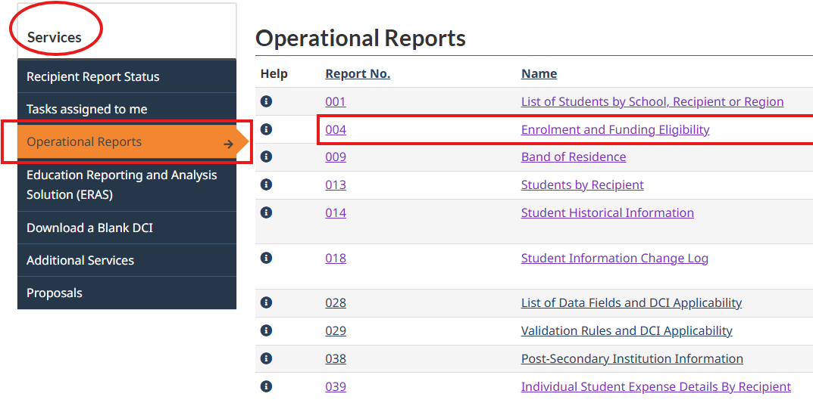
HOW TO GENERATE EDUCATION INFORMATION SYSTEM REPORT WITH PRIOR YEAR STUDENT DATA
  Log in to the Education Information System (EIS)
  Click on “Operational Reports” from the lefthand navigation menu under “Services”
  Under “Operational Reports”, click on “004 – Enrolment and Funding Eligibility”
  Directions continue on the next slide
  For assistance generating the report, contact ISC Transfer Payment Services at:
  BCFundingservices-cbservicesdefinancement@sac-isc.gc.ca
Notes:
To prepare for sharing student data with the school district(s), First Nations can generate the EIS operational report “004 Enrolment and Funding Eligibility” with Nominal Roll data for the previous school year (e.g. 2025-2026).
This report will contain student data that was submitted in the First Nation’s previous Nominal Roll submission to ISC, including FTE value, school and grade, which can be used as a starting point.
However, please note this data will need to be updated with student data for the current school year prior to meeting(s) with school district(s).

Slide 23
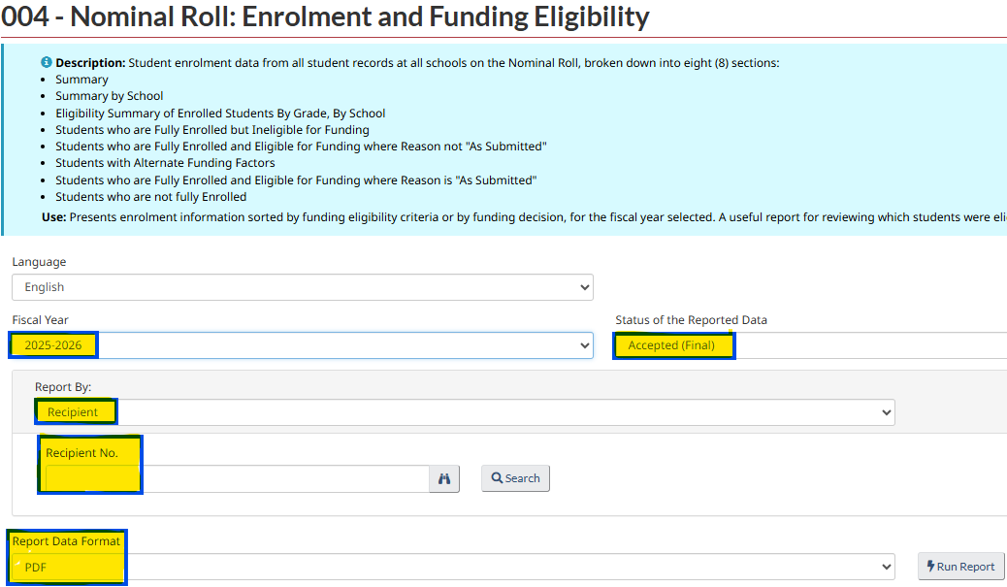
HOW TO GENERATE EDUCATION INFORMATION SYSTEM REPORT WITH PRIOR YEAR STUDENT DATA
  Continuation of previous slide…
  Under “Fiscal Year”, select “2025-2026”, and for “Status of the Reported Data”, select “Accepted (Final)”.
  Enter your First Nation’s name and recipient number in the appropriate fields.
  For the “Report Data Format”, select your report format preference of either “Excel – Formatted” or “PDF”.
  Click on “Run Report”.
  Important: First Nations will need to update the data in the prior school year report to reflect student enrollment for the current school year prior to meeting with school district(s).

Slide 24

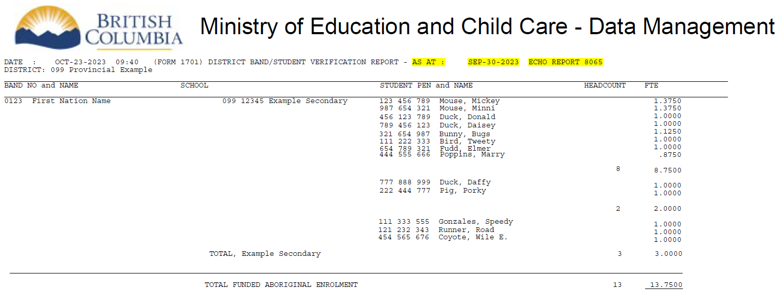
EXAMPLE: COMPARING STUDENT DATA
STUDENT PEN and NAME HEADCOUNT FTE
123 456 789 Mouse, Mickey 1.3750
987 654 321 Mouse, Minni 1.3750
456 123 789 Duck, Donald 1.0000
789 456 123 Duck, Daisey 1.0000
321 654 987 Bunny, Bugs 1.1250
111 222 333 Bird, Tweety 1.0000
654 789 321 Fudd, Elmer 1.0000
444 555 666 Poppins, Marry .8750
8
8.7500
Nominal Roll
STUDENT PEN and NAME HEADCOUNT FTE
123 456 789 Mouse, Mickey 1.3750
987 654 321 Mouse, Minni 1.3750
456 123 789 Duck, Donald 1.0000
789 456 123 Duck, Daisey 1.0000
321 654 987 Bunny, Bugs 1.1250
111 222 333 Bird, Tweety 1.0000
654 789 321 Fudd, Elmer 1.0000
444 555 666 Poppins, Marry .8750
8
8.7500
Nominal Roll
STUDENT PEN and NAME FTE
123 456 789 Mouse, Mickey 1.3750
456 123 789 Duck, Donald 1.0000
444 555 666 Poppins, Marry 0.8750
454 565 656 Coyote, Wile E. 1.0000
Student
FTE
Student
FTE
Mouse, Mickey
123 456 789 Mouse, Mickey 1.3750
Mouse, Mickey
1.3750
Mouse, Mickey
1.3750
1.3750
456 123 789 Duck, Donald 1.0000
Duck, Donald
0.5000
1.0000
Duck, Donald
0.5000
Duck, Donald
0.5000
0.5000
Poppins, Mary A.
1.2500
Poppins, Mary A.
1.2500
Mary A.
1.2500
Poppins, Mary A.
1.2500
444 555 666 Poppins, Marry 0.8750
Marry
0.8750
Coyote, Wile Y.
1.0000
Wile Y.
Coyote, Wile Y.
Coyote, Wile Y.
1.0000
1.0000
454 565 656 Coyote, Wile E. 1.0000
Wile E.
Do student names match?
Do FTE values match?
HEADCOUNT
8
FTE TOTAL
8.7500
Notes:
Let’s look at an example that demonstrates the importance of ensuring that student information matches exactly between the Nominal Roll and 1701 as part of the JVP.
A key area for careful joint review is all students with a FTE value greater than 1.0. For information on how the FTE value was determined, First Nations can connect with the school district for a detailed breakdown. Factors may include expanded courseload, funded credits, and type of credential.
If there is not a match between the Nominal Roll and the 1701, other funding may not be accurate, for example, extracurricular transportation.
Changes must be made prior to submission on either the Nominal Roll or the 1701.
If changes occur after the signed JVP form has been submitted:
Education is not impacted
If the school district changes, the funding informed by the JVP does not change for the whole year.
The Ministry does not make funding adjustments when a student transfers to a school out of a district after the count date.
Within ISC’s EIS system, for students identified as First Nation, the use of the Given Name and Surname as it is recorded in their status card or birth certificate is recommended. Use the field "Alias" to capture the student’s preferred name and have the school district update their records when possible.

Slide 25
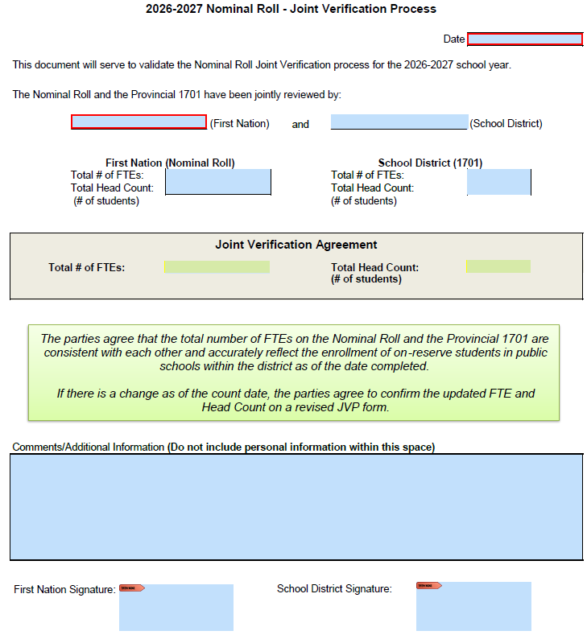
KEY FIELDS: JVP FORM
Date of JVP meeting where student data was verified and agreed to (prior to October 9, 2026).
Before meeting, each representative adds the # of FTE (course load) & student head count for public school students, per their records/shared student list.
During the meeting, the final/agreed to student FTE and # of students is recorded here.
Changes to FTE # after the form is signed will require the form to be updated and re-signed/submitted by both parties.
Once agreement is reached, both parties sign the form, noting any relevant comments in the field above. The First Nation attaches the signed JVP form(s) to their Nominal Roll Report for ISC.
To request a copy of the form, visit FNESC’s website or email ISC at: bceducation@sac-isc.gc.ca
Notes:
The joint verification sign-off template form is an example of wording you may like to use in your jointly signed document. To obtain a copy of the fillable PDF form, visit FNESC’s website at: https://www.fnesc.ca/nominal-roll-and-joint-verification-process/ or email ISC BC Education at bceducation@sac-isc.gc.ca.
Please note the signed form should be included with your First Nation’s Nominal Roll submission to ISC.
Who is required to sign for the school district?
In general, the Secretary Treasurer is required to sign the Joint Verification document, but may choose to delegate this responsibility.
Recognizing that school district education representatives and First Nation education coordinators work closely on the Nominal Roll verification, there is the option to have a school district education representative additionally sign to verify students included on the Nominal Roll.
Who is required to sign for FN? The person completing the Nominal Roll or an elected Council member or band manager? Or would any of the above mentioned signatures work?
ISC does not have any specific requirements. As the roles may differ between bands, it could be those delegated at the First Nations level who has authority to sign-off on an education-related matter. In some cases, this could be the Chief and Council.

Slide 26
FINAL STEPS
  First Nations
  Nominal Roll Report: Attach a copy of the signed JVP form(s) for all school districts where your students are attending public schools to your Nominal Roll submission to ISC by October 15, 2026
    The form can be uploaded as “Supporting Documentation” within the EIS
  Keep a copy of the signed JVP form to record your agreeance with the 2026-2027 student data
  School districts
  Keep a copy of the signed JVP to record your concurrence with the 2026-2027 student data
Notes:
Once both parties confirm all student data matches and sign the Joint Verification Form indicating agreement, each party has different final steps to follow.

Slide 27
Q&A
If you have a question, use the ‘chat’ function
If you want to ask a question verbally, use the ‘raise hand’ function

Slide 28
#3:
Scenarios: Navigating the JVP

Slide 29
Scenario 1
HOW IS THE STUDENT CLAIMED?
I have a student who…
Would it be….
A ) First Nation A claims the student on the Nominal Roll as the student is “ordinarily resident on reserve”
Is ordinarily resident on reserve at First Nation A
Attends public school in Vancouver during the 10 school months
Receives student accommodation supports to board in Vancouver
B ) The school district in Vancouver claims the student on the 1701 with Funding Code 20 where the student is attending school
C ) Both A and B
Answer:
C ) Both A and B
Notes:
Instead of the student going to the next school district over to attend school, this student attends school in Vancouver which is far from the student’s home community. From a Vancouver school district perspective, they would not expect this student to be ordinarily resident on reserve. This student has an address within the catchment area of the Vancouver school, but because ISC pays student supports, they are considered to be ordinarily resident on reserve and a First Nation would still include them on the Nominal Roll.

Slide 30
Scenario 1: Continued
…………
…………
RESPONSIBILITIES OF THE FIRST NATION
  The First Nation where the student is ordinarily resident on reserve claims the student on the Nominal Roll regardless of where they are attending school.
    Example: First Nation A would contact the school district in Greater Vancouver to inform them that the student is attending a school in their district.
…………
RESPONSIBILITIES OF THE DISTRICT WHERE THE STUDENT IS ATTENDING SCHOOL
…………
  The school district in Greater Vancouver would claim the child on the 1701 under “Funding Code 20”.
  The school district in Greater Vancouver would support the First Nation in the student’s inclusion on the Nominal Roll.
Notes:
If the student is on the public 1701 (under Funding Code 20), but not on the Nominal Roll, the First Nation may verify the student’s residence and add him/her to the Nominal Roll at the discretion of the First Nation.

Slide 31
Scenario 2
HOW CAN THIS BE RESOLVED?
The First Nation’s public school student records indicate…
The First Nation and school district will:
Go line by line through each of their student lists to confirm:
  The students ordinarily reside on the First Nation’s reserves
  The student’s legal name and date of birth match
  The FTE value for each student is based on their correct courseload
2) Confirm the correct head count # and FTE #
3) Enter the agreed to FTE/head count numbers in the JVP form and jointly sign-off at the end
A total student head count of 17 but an FTE # of 19.125
During the JVP meeting, it is determined that the school district’s records show a head count of 16 and an FTE # of 18.25
Notes:
If the Nominal Roll report is submitted with data that does not match the 1701, it is possible the First Nation may be invoiced by the school district for more than it is funded by ISC (if an LEA is in place with the school district).
The JVP form is signed by both parties (the school district and the First Nation) as it is intended to be a collaborative approach, rather than one party having the final say. Hopefully, any issues that arise in the process can be resolved by discussing each party’s concerns in support of finalizing the form in a way that both parties can agree on.

Slide 32
Scenario 3
HOW DO I COMPLETE THE JVP?
I have a student who is…
A JVP meeting will need to be completed with both school districts.
The First Nation and school districts will ensure FTE value, legal name, date of birth, and school/grade match.
Complete a JVP form for each school district.
Each school district will need to include all schools that the student is attending.
The First Nation attaches all signed JVP forms to the Nominal Roll submission to ISC.
Ordinarily resident on reserve
Registered to more than one school district
  The student attends a public school and additional courses at a Provincial Online Learning School (POL)

Slide 33
Scenario 4
WHO CLAIMS THE STUDENT AND WHAT IS THE IMPACT TO JVP?
I have a student who…
If First Nation A would like to continue claiming the student on their Nominal Roll, they would inform First Nation B or ISC who would communicate with First Nation B
Alternatively, First Nation B would add the student to their Nominal Roll and First Nation A would remove the student from the Nominal Roll as ISC pre-populates it with the previous year’s information
Communication between both First Nations is highly encouraged and it may result in a
mutually agreed upon decision-making process
Normally lives on First Nation A’s reserve
During the year, sometimes resides with a relative on First Nation B’s reserve
Notes:
Please note: Depending on the circumstances, however, First Nation A may come to an agreement with First Nation B and student may still be considered ordinarily resident of First Nation A (such as in Scenario 1) have the student reported on First Nation B’s Nominal Roll (as if the student is ordinarily resident in First Nation B).
If there is no agreement, ISC will usually advise that the student be reported by First Nation A.
For children in care (through BC Ministry of Children and Family Development or Indigenous Child and Family Services Agencies), the First Nation where the student was residing prior to going into care should report the student on their Nominal Roll even if they have been relocated to another First Nation. This will allow for student support services funding to be available to these students.

Slide 34
SUMMARY: WHY IS THE JVP IMPORTANT?
Matched student information between the Nominal Roll and 1701 reports ensures a more accurate funding process between First Nations and school districts
Supports mutual accountability between First Nations and school districts and promotes collaborative conversations around student needs

Slide 35
2026 LEARNING SERIES - UPCOMING WEBINARS
*Webinars for Day 1, 2 and 3 will cover the same material, so it is not necessary for participants to attend multiple sessions
DAY 1
...............................
Nominal Roll Policy
Tuesday, August 11
Tuesday, August 18
Tuesday, August 25
from 9:00 a.m. – 12 p.m.
DAY 2
...............................
Joint Verification Process
Wednesday, August 12
Wednesday, August 19
Wednesday, August 26
from 9:00 a.m. – 11 a.m.
DAY 3
...............................
Education Information System (EIS)
Thursday, August 13
Thursday, August 20
Thursday, August 27
from 9:00 a.m. – 11 a.m.
To register, please email: BCEducation@sac-isc.gc.ca

Slide 36
ISC BC EDUCATION PROGRAMS
KEY CONTACTS
ALEXIS FELLS
Manager, Education Programs
604-561-8468, alexis.fells@sac-isc.gc.ca
MARIE URDIGA
Program Advisor
778-783-2380, delainn.urdiga@sac-isc.gc.ca
Nominal Roll Policy
and Eligibility
DEBRA KINEQUON
Program Officer
604-403-8316, debra.kinequon@sac-isc.gc.ca
NICOLE LUI
Program Advisor
778-783-6113, nicole.lui@sac-isc.gc.ca
ISC BC Education Inbox
BCEducation@sac-isc.gc.ca
LAURA LANGS
Program Advisor
604-403-8317, laura.langs@sac-isc.gc.ca
PHILIP WONG
Program Advisor
778-783-6136, philip.wong4@sac-isc.gc.ca

Slide 37
BC MINISTRY OF EDUCATION AND CHILD CARE
KEY CONTACTS
CAROLINE PONSFORD
Executive Director, Funding and Financial Accountability Branch caroline.ponsford@gov.bc.ca
BECKI O’RAE
Senior Policy Analyst, Funding and Financial Accountability Branch
becki.orae@gov.bc.ca
KRISTINE HEANEY
Director, Strategic Planning
Strategy, Projects and Reporting
kristine.heaney@gov.bc.ca
RICHARD RALLOFF
Financial Reporting and Systems Officer, Funding and Financial Accountability Branch richard.ralloff@gov.bc.ca

Slide 38
Thanks for joining us today!
Please share any feedback or suggestions
We would love to hear from you

