Slide 1



BCSSA Summer
Leadership Academy
AUGUST 19, 2022

Slide 2

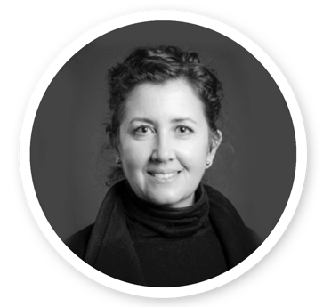

Walking
Side by Side
Christina Zacharuk
DEPUTY MINISTER
Ministry of Education & Child Care
Thank you for your strong leadership
and compassion in supporting the sector
Continued collaboration is key for the
year ahead
Navigating the “new normal” together

Slide 3
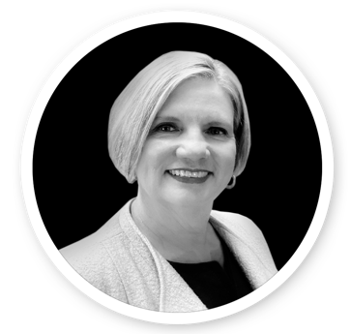

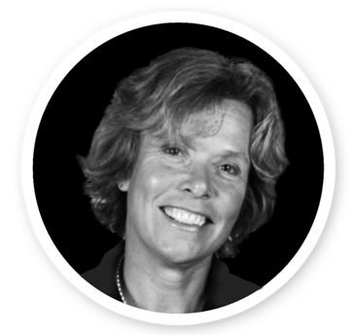

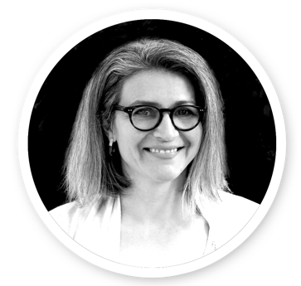


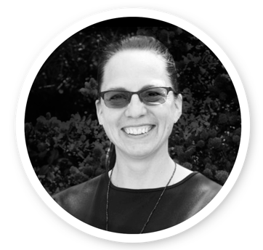
Ministry
Executive Team
Patricia Boyle
Assistant Deputy Minister,
Child Care Division
Melanie Stewart
Assistant Deputy Minister,
Education Programs Division
Eleanor Liddy
Assistant Deputy Minister,
Services & Technology Division
Jennifer McCrea
Assistant Deputy Minister,
Learning Division
Cloe Nicholls & Lucas Corwin
Acting Assistant Deputy Ministers,
Governance & Analytics Division
Chris Brown
Assistant Deputy Minister,
Resource Management Division
Denise Augustine
Superintendent
Indigenous Education

Slide 4

System and Ministry Snapshot
What’s Coming in the Fall 2022
Focus on Teaching and Learning
Major Government Priorities & Focus
Additional Things to Think About
Q & A
Agenda

Slide 5



System Snapshot
Completion Rates
Students
Workforce
2020/21
The six-year completion rate for public schools exceeded 90% for the first time
The Indigenous completion rate was 72.5%, for both Dogwood and Adult Dogwood, the highest recorded rate
The second year in a row in excess of 70%
2021/22
578,798
public school students
12% (68,281)
Indigenous
13% (72,739)
have a designation
12% (68,858)
English Language Learners (ELL)
2021/22
Approx. 88,000 people
in the public school system
46,000 teachers
37,000 unionized
support staff
3,000 administrators
2,000 non-unionized support staff

Slide 6
Ministry of Education + Child Care
 | 2021 | 2022
Ministry Name | Ministry of Education | Ministry of Education and Child Care
Ministry staff | 408 FTEs | 800 FTEs
Ministry buildings | 2 physical locations | 3 physical locations
Minister(s) | 1 Minister | 1 Minister 1 Minister of State
Responsibilities | 1,583 public schools 578,798 students | 1,583+ public schools 578,798+ students 136,900 childcare spaces ( 130,300 Child Care Operating Funding spaces, 6,600 $10 a Day ChildCareBC ) 39,000 spaces in 900 public schools
See Joint Ministers Letter to Education Partners here for additional details

Slide 7
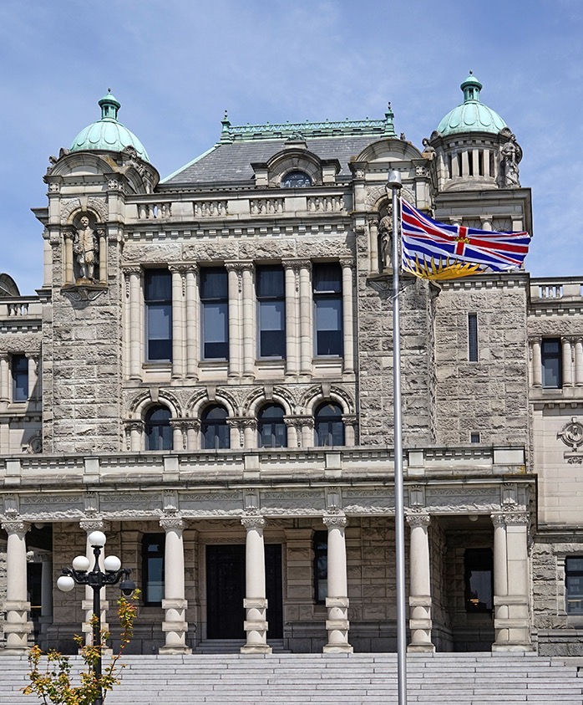

FALL 2022
What’s Coming
  Political Change
  Government Cycles

Slide 8





Government Cycle - What You Need to Know
LEGISLATION DEVELOPMENT
Policy/
Program/
Priority
Identified
Program
Development
of Request
Decision (RFD)
ADM
Committee
Review of
Draft RFD
DM
Committee
Review of
Draft RFD
Cabinet
Committee
Review &
Ratification
START
Cabinet
Committee
Review &
Ratification
DM
Committee
review of Draft
Request for Legislation
ADM
Committee
Review of
Draft RFL
Program
Development
of RFL
Treasury
Board
Review
Program
Development
of Treasury
Board
Drafting
of Legislation
by Legislative
Counsel
Legislative
Review
Committee
Introduction/
Debate
in House
Cabinet
Review of
Regulations
(if required)
Public
Service
Implementation
of new Policy

Slide 9
Budget 2023 Process
Treasury
Board
Submission
Process
Preliminary
Operating
Funding
( 2023/24 SY )
Budget Day
( 4th Week of
February )
New Fiscal
Year
( 2023/24 FY )
Sept-Dec 2022
February 2023
March 2023
April 2023

Slide 10
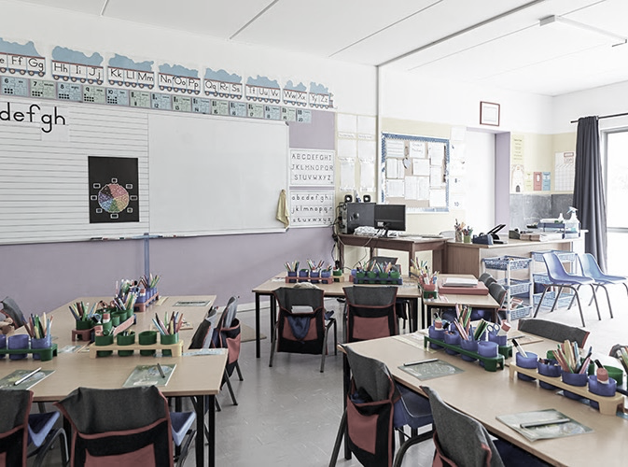


Focus on Teaching
and Learning
Indigenous-focused Graduation Requirement
Classroom Assessment and Reporting
Provincial Assessments
K-12 Learning Renewal: Curriculum Update

Slide 11



Indigenous-Focused
Graduation Requirement
Declaration Act Action Plan commitment
Part of broader K-12 Anti-Racism Strategy
Beginning 2023/24 school year
Pro-D workshops for teachers
Additional implementation resources to follow

Slide 12

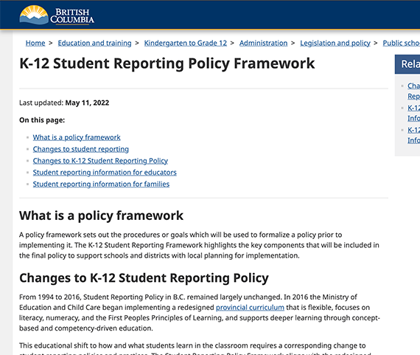
Classroom
Assessment and
Reporting
K-12 Student Reporting Policy Framework
released in May 2022
Interim policy support document for
school districts is available
Policy implementation support materials
being developed 2022/23
New Performance Standards
( available - fall 2022 )

Slide 13

Provincial Assessments
Grade 12 Literacy Assessments
New e-assessment service
Provincial Assessments administration
Advisory Group on Provincial Assessments
( AGPA ) III reconvened in May 2022

Slide 14




K-12 Learning Renewal:
Curriculum Update
Began sector engagement on curriculum update process - spring 2022
Alignment with
The Declaration of the Rights of Indigenous Peoples Act
Priorities for the update
include:
  Consent education
  Climate action
  Anti-racism

Slide 15


Focus on Teaching and Learning
Framework for Enhancing Student Learning
YEAR 1
YEAR 2
  Introduction
  of system-wide approach to
  strategic planning
  Participation expanded to district leaders
  ( Superintendents, Board Chairs and Secretary-Treasurers )

Slide 16
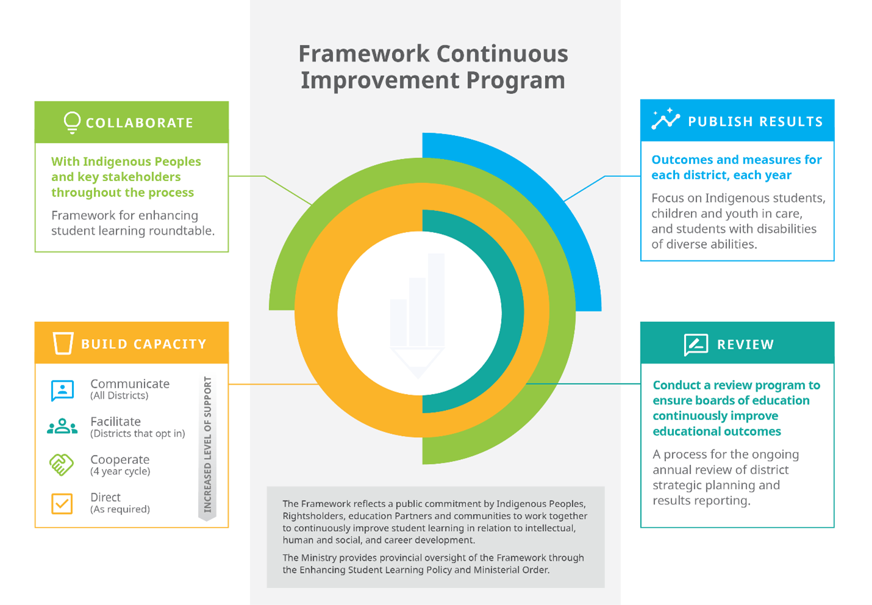
Ministry
Commitments
BCSSA SUMMER LEADERSHIP ACADEMY

Slide 17
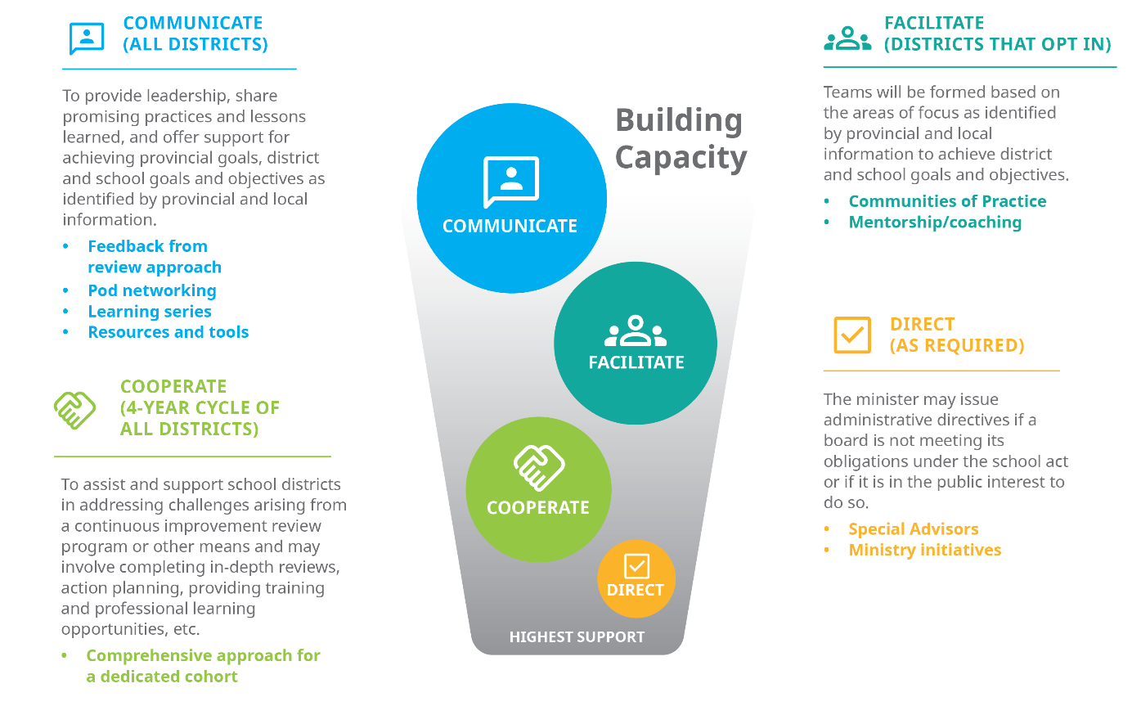
Capacity
Building
BCSSA SUMMER LEADERSHIP ACADEMY

Slide 18
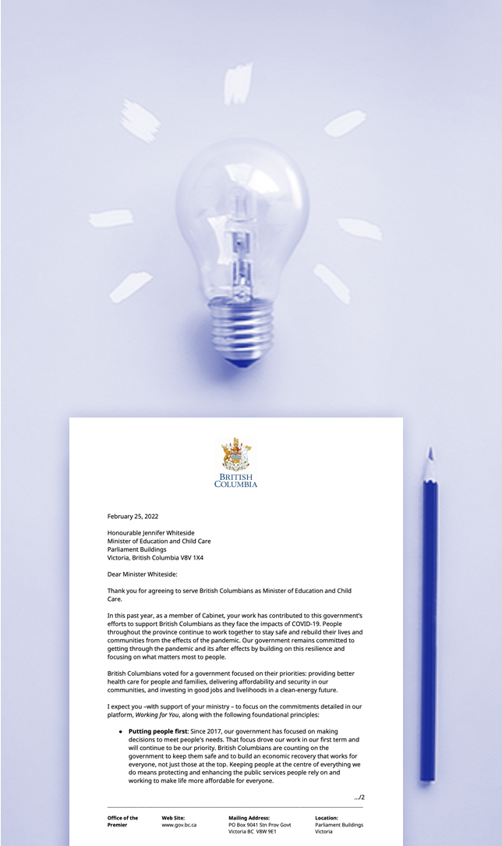



Major Government Priorities & Focus
01
Reconciliation
02
Child Care
Equity, Anti-Racism & Mental
Health in Schools
03

Slide 19


Reconciliation
Education Jurisdiction
  Four BC First Nations have
  law-making authority over their
  K–12 education
  Establishment of the First Nations Education Authority
BCTEA & DRIPA Commitments
  13 Actions
  Local Education Agreements (LEAs)
  Indigenous Education Councils (IECs)
  Mandatory course
Sts’ailes Sasquatch Dancers at the Education Jurisdiction Celebration

Slide 20

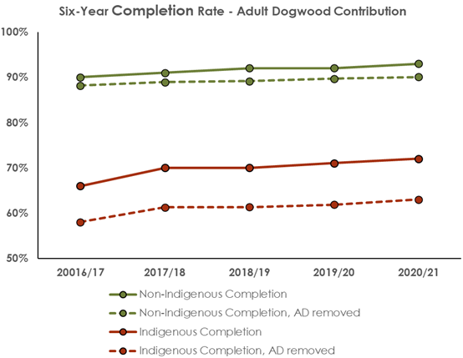

Reconciliation
- Why is this so
important
See most recent ‘How Are We Doing’ Report

Slide 21


Reconciliation Priority Commitment:
Local Education Agreements
BC Tripartite Education Agreement priority commitment
Gov’t to Gov’t relationship - Boards of Education and First Nations
  This includes actions related to LEAs, Indigenous Education Councils, & Indigenous student success
What this means for you and your team:
First Nations Education Steering Committee and the Ministry will continue to connect with you at future meetings
Continue to have conversations
with local First Nations
Next Steps:
First Nations Education Steering Committee and the Ministry will consult and engage with Indigenous Peoples and education partners

Slide 22


Child Care
Grow an integrated system of early learning and child care to improve equitable access to quality programs
Continue implementation of ChildCareBC Plan
Adjust implementation of initiatives based on input
$5.2 B
Invested
2018-2025
$3.5 B
2021-2025
PROVINCIAL DOLLARS
FEDERAL DOLLARS

Slide 23


Child Care – Responsibilities
 | Build district capacity to expand delivery of child care on school grounds through board-operated or third-party providers Build or strengthen relationships with local child care providers to support collaborative space creation planning
 | Administer the New Spaces Fund, Child Care Operating Funding, Child Care Fee Reduction Initiative, & additional ChildCareBC programs
 | Liaise with partners for Seamless Day Kindergarten and Just B4 in addition to existing early learning initiatives Work with Child Care Division to plan growth and integration of early learning
Districts
Child Care
Division
Learning
Division

Slide 24

Complete environmental scan of existing Early Learning and Child Care (ELCC) on school grounds
Engage across districts and with partners
Identify resources and opportunities for expanding ELCC
Lead, support, and coordinate new and existing projects and initiatives alongside early learning staff
Maintain a focus on high-quality early learning and child care experiences
Child Care –
Immediate focus
for 2022/23 District Capacity Funding

Slide 25




      MENTAL HEALTH IN SCHOOLS
      EQUITY
      ANTI-RACISM
      Grants
      New Resources
      Compassionate Systems
      Leadership Webpage
      Integrated Child & Youth Teams
      Meal programs
      Classroom supplies
      Draft K-12 Anti-Racism
      Action Plan

Slide 26







Additional Things to Think About…
Workforce Reality
COVID-19
Capital
Bargaining
National Day of Truth & Reconciliation

Slide 27
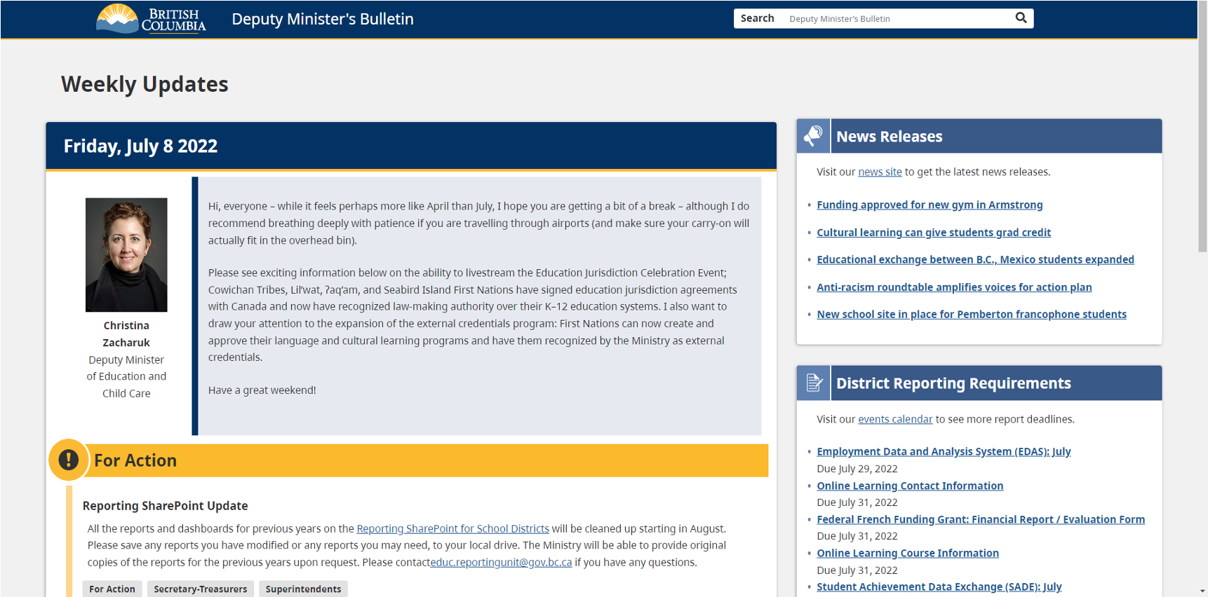
DM Bulletin Online - Fall 2022

Slide 28




Thank You.

Slide 29

Ministry Executive Team Information
DEPUTY MINISTER’S OFFICE
Christina Zacharuk | Deputy Minister
Christina.Zacharuk@gov.bc.ca
The Deputy Minister’s Office is the primary liaison between the Ministry and the
Minister’s Office, rightsholders and partner groups and central government. It is
also responsible for overseeing the strategic and operational business of the
Ministry of Education and Child Care.
LEARNING DIVISION
Jennifer McCrea | Assistant Deputy Minister
Jennifer.McCrea@gov.bc.ca
The Learning Division provides leadership and support to school districts and independent schools in the areas of Indigenous Education, Early Learning, French Education, Inclusive Education, Student Wellness and Safety and Mental Health.
SERVICES & TECHNOLOGY DIVISION
Eleanor Liddy | Assistant Deputy Minister
Eleanor.Liddy@gov.bc.ca
The Services and Technology Division provides information and technology services for
the K-12 sector. This includes the provision of a provincial high-speed internet network and Student Information system, online learning, results and transcripts, learning
supports and the BC Training and Education Savings Grant.
EDUCATIONS PROGRAMS DIVISION
Melanie Stewart | Assistant Deputy Minister
Melanie.J.Stewart@gov.bc.ca
The Education Programs Division is responsible for the development and
maintenance of the provincial K-12 curriculum as well as assessment development
and administration, student reporting, graduation policy, career programs and
student transcripts to post-secondary.
RESOURCE MANAGEMENT DIVISION
Chris Brown | Assistant Deputy Minister & Executive Financial Officer
Chris.Brown@gov.bc.ca
The Resource Management Division provides operational and capital funding for
school districts and monitors financial accountability and compliance. The division
also provides corporate functions for the Ministry including budgeting, strategic
human resources, workplace and facilities support, and risk management and
emergency preparedness.
GOVERNANCE & ANALYTICS DIVISION
Cloe Nicholls & Lucas Corwin | Acting Assistant Deputy Ministers
Cloe.Nicholls@gov.bc.ca & Lucas.Corwin@gov.bc.ca
The Governance and Analytics Division is responsible for legislation, workforce development, education analytics, continuous improvement, teacher certification and discipline, as well as independent schools and international education.
CHILD CARE DIVISION
Patricia Boyle | Assistant Deputy Minister
Patricia.Boyle@gov.bc.ca
The Child Care Division oversees the implementation and delivery of all government
programs associated with child care, as well as those for early years and inclusion.

