Slide 1
Social Media Guidelines for Personal Use
For BC Public Service Employees
<insert facilitator’s name>
<insert date>
Notes:
Notes
The title slide presents an opportunity for the facilitator to introduce themselves and welcome participants to the session.

Slide 2
Agenda
Policy framework
Social media and public service obligations
Conflicts of interest
Political expression, dialogue and impartiality
Use during work time
Cyber safety/bullying
Profile choices
Privacy and permanence
Consequences
Resources
Social Media Guidelines for Personal Use
Notes:
Notes
Once the facilitator finalizes the session agenda, it may be helpful for them to review it with participants at the start of the meeting. This will also provide participants with an idea of what to expect and encourage them to think about potential questions they may have about a subject.

Slide 3
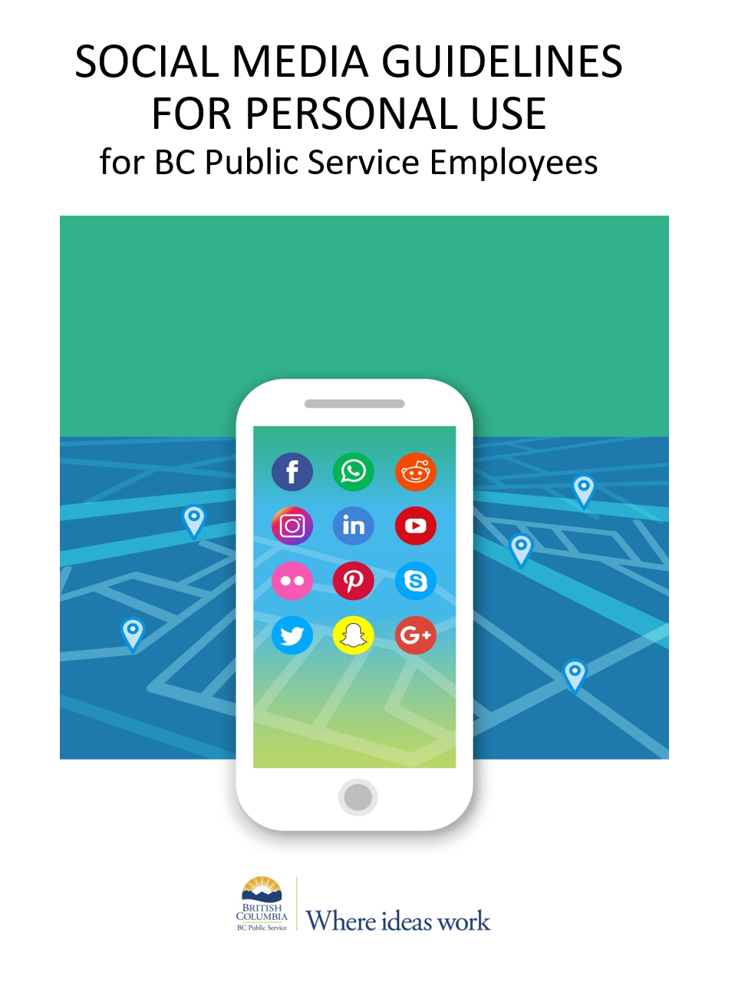
Optional: Opening activity/question
You may want to start the session by:
  Doing an icebreaker
  Who has read the Social Media Guidelines for Personal Use?
  What social media platforms do you use?
  How do you use them?
Social Media Guidelines for Personal Use
Notes:
Notes
The facilitator may choose to start the session with a quick activity, such as an icebreaker.

Slide 4
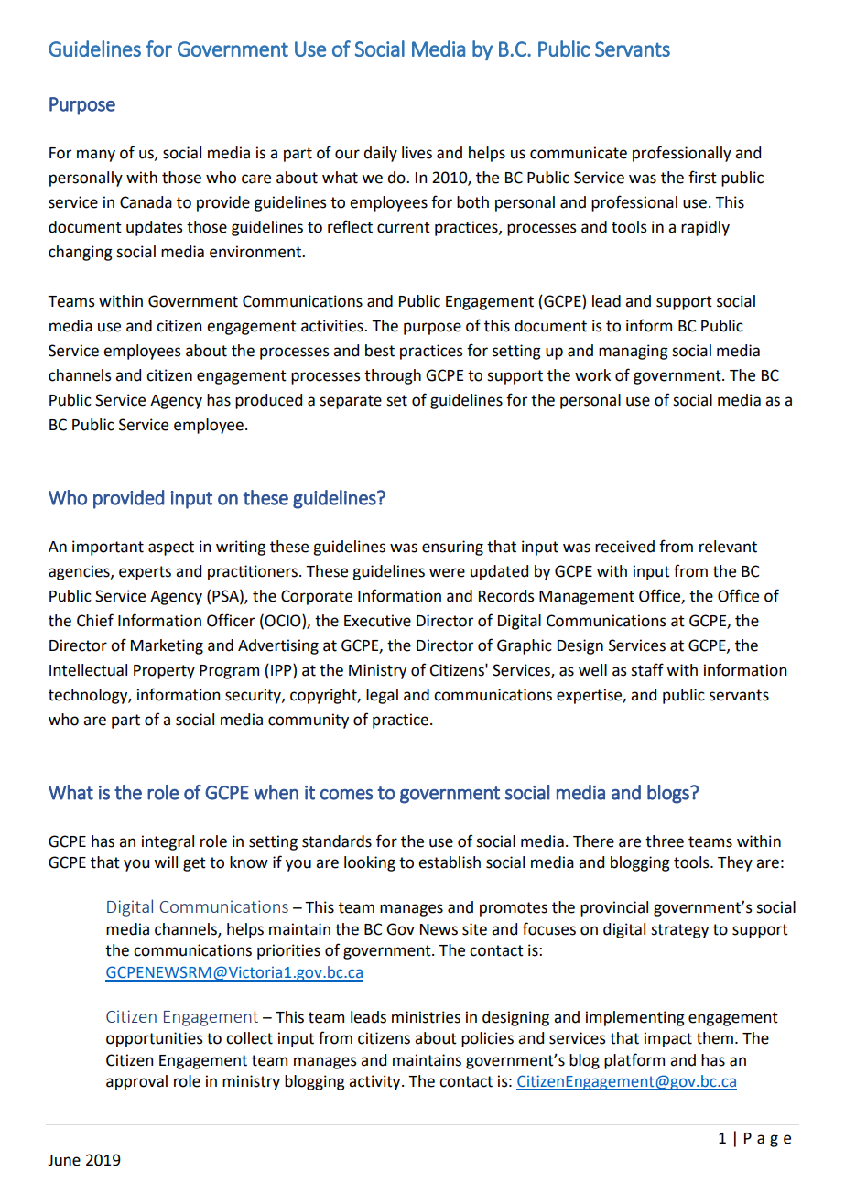
Two sets of guidelines
Social Media Guidelines for Personal Use focus on employees’ personal use of social media.
GCPE Guidelines for Government Use of Social Media by Public Service Employees.
Social Media Guidelines for Personal Use
Notes:
Notes
There are two sets of social media guidelines in the BC Public Service.
The Social Media Guidelines for Personal Use was released by the Public Service Agency in 2019 and have been updated in 2024.
The GCPE guidelines for government use are the updated version of the guidelines that GCPE released in 2011.
While the Social Media Guidelines for Personal Use focus on employees’ personal use of social media accounts unaffiliated with the workplace, the GCPE guidelines focus on social media for official government use including guidance on stakeholder engagement, record-keeping, collection of third-party information and copyright.

Slide 5
Policy framework
Oath of Employment
Standards of Conduct
Discrimination, Bullying and Harassment in the Workplace
Freedom of Information and Protection of Privacy Act
BC Human Rights Code
Occupational Health and Safety Regulation
Appropriate Use Policy
Ministry-specific Policies
Social Media Guidelines for Personal Use
Notes:
Notes
Remind employees about their roles and responsibilities:
All BC Public Service employees must comply with all employment-related obligations in both personal and professional activity.
These include standards for workplace behaviour, privacy, confidentiality, conflict of interest, serving impartially, public comments and political activity as outlined in the Standards of Conduct - Human Resources Policy 09, the Oath of Employment, and other HR Policies (e.g. Discrimination, Bullying and Harassment in the Workplace – Policy 11).
There are also standards for the appropriate use of government information and legislation to protect personal information.
The BC Public Service as the employer must comply with legislation that regulates workplace behaviour, such as the BC Human Rights Code and WorkSafeBC legislation.

Slide 6

Social media guidelines: Why?
Social media use is increasingly part of daily life
As employees, what’s important to remember about social media?
  How quickly and easily words/images can be circulated
  Long shelf life of online activity
  How fast social media platforms and habits evolve.
  Diversity in how people use and think about social media as a way of connecting with others
Social Media Guidelines for Personal Use
Notes:
Notes
How quickly and easily words and images can be circulated.
The long shelf life of online activity.
How fast social media platforms and how we use them evolve – e.g. privacy settings.
People may have a diverse understanding about social media as a way of connecting with others.

Slide 7
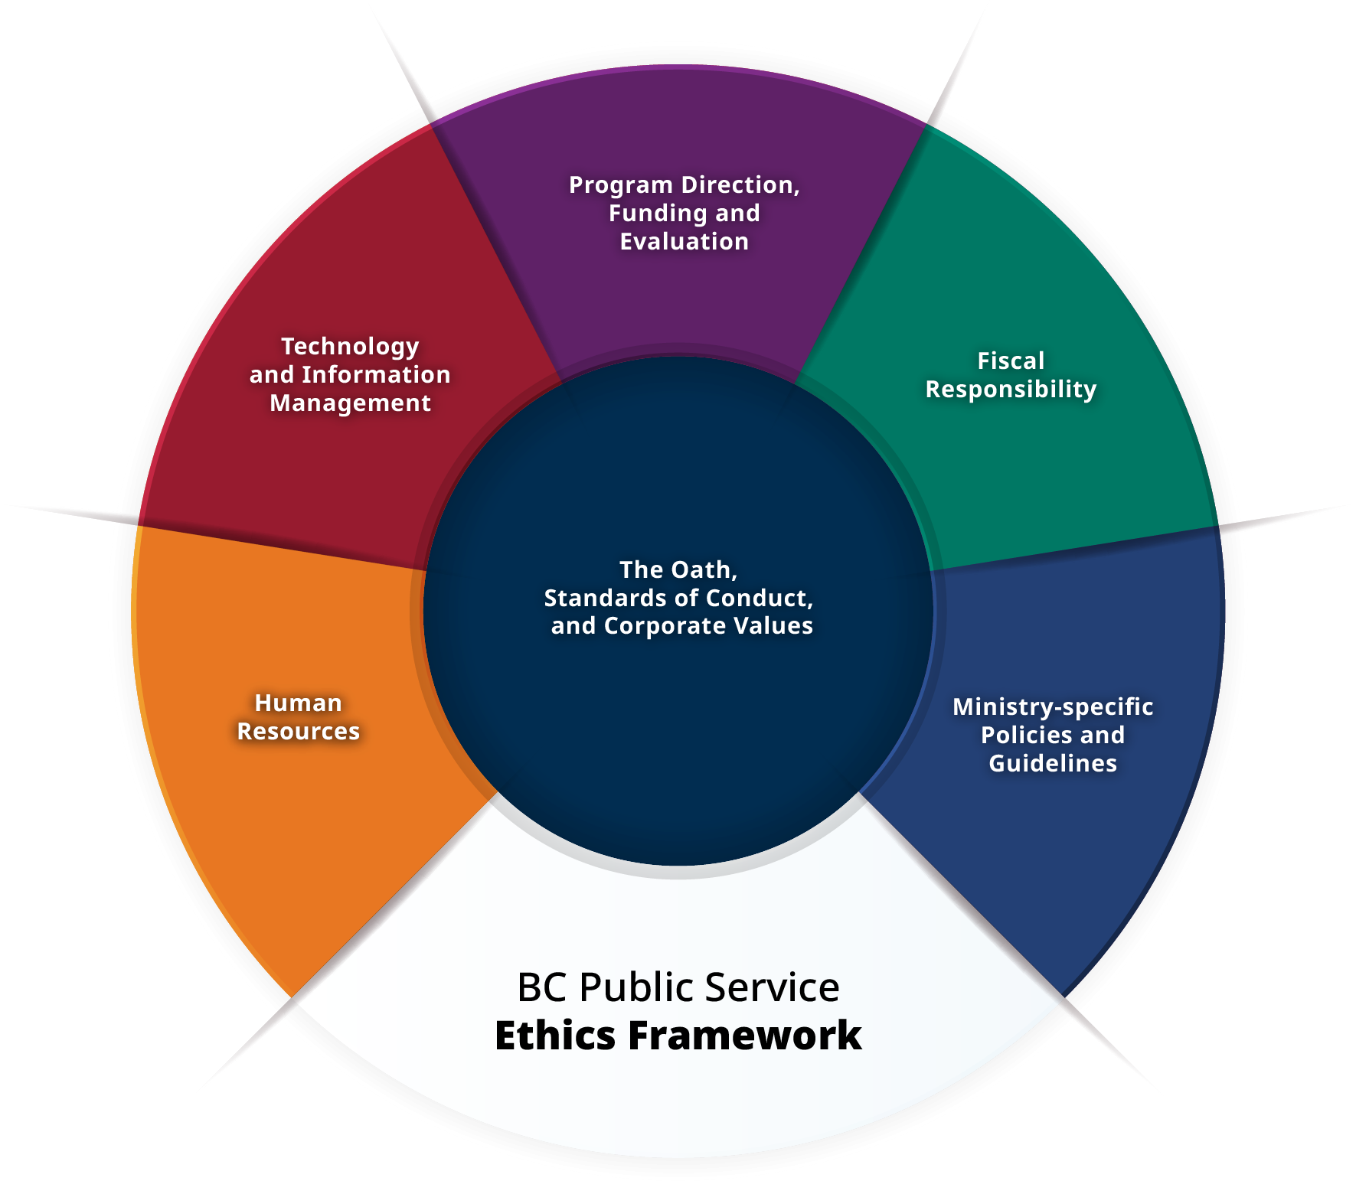
Ethics management framework
Office of the Chief Information Officer
Treasury Board
Office of the Comptroller General
Ministries
Public Service Agency
Records Management
Social Media Guidelines for Personal Use
Notes:
Notes
BC Public Service employees
are united by a shared commitment, not just to deliver services and programs, but to do so in ways that maintain and enhance the trust and confidence of British Columbians.
On the MyHR Ethics and Standards of Conduct page you can find the BC Public Service Ethics Management Framework <https://www2.gov.bc.ca/gov/content?id=AA7A692DF7E044F099662E7BAD7BFA82>. It shows that many parts of government are involved in supporting employees in making ethical choices.
Managers and supervisors are responsible for acting in a manner that is consistent with guiding documents for managing employees.
All BC Public Service employees are required to take the Oath of Employment, which reinforces the significance and special trust placed in public service employees by the citizens of British Columbia. It also highlights the importance of ethics, impartiality and integrity in all that we do as members of the BC Public Service.

Slide 8
Social media and public service obligations
BC Public Service obligations apply to personal social media accounts
Personal use in and outside of the workplace
You are responsible for making informed choices
Social Media Guidelines for Personal Use
Notes:
Notes
As BC Public Service employees, we are bound by the standards of conduct and oath of employment, as well as a suite of HR policies.
These policies and standards ensure we maintain the public’s trust and confidence.
BC Public Service policies apply not only to our conduct at work, but also, in some circumstances, to our conduct outside of the workplace.
Obligations in these policies apply to employee’s social media accounts unaffiliated with the workplace-when those accounts are used at work, or outside of work.
For example, employees shouldn’t speak out at protest rallies using their public service job to lend weight to their opinions – nor should they be doing this on Twitter or Reddit.
Just like in your non-internet interactions, you are responsible for making informed choices, if you would think twice before saying it to a colleague in the line up at Tim Hortons, think twice before posting it online.

Slide 9

Questions to ask yourself
It up to us to reflect on our choices
Ask yourself questions like:
  If I post this, would I be failing to treat other employees with respect and dignity?
  Does my post reveal confidential work information?
  Could my comments on social media be seen as bringing the public service into disrepute?
  Is my use of social media during working hours impacting my ability to provide service?
Notes:
Notes
Ask yourself questions like:
“If I post this, would I be failing to treat other employees with respect and dignity?” If so, you could be susceptible to a coworker complaint of discrimination, bullying and harassment.
“Does my post reveal confidential information?” Confidential information can only be disclosed to those who are authorized to receive it. If in doubt about what is confidential, speak with your supervisor.
“Could my comments on social media be seen as bringing the public service into disrepute?” In other words, are you making statements online that could hurt the reputation of the BC Public Service. An example would be clearly racist or discriminatory statements online.
“Is my use of social media during work hours impacting my ability to provide service to the public or to my colleagues, or creating that perception?”

Slide 10

Conflicts of interest
As employees, we must arrange our private affairs in a way that will prevent real, perceived or potential conflicts of interest.
Don’ts:
  Using Instagram during work time to market your side business
  Using your work phone or computer for your side business
  Campaigning for a political party on Facebook when you identify yourself as a public servant
Social Media Guidelines for Personal Use
Notes:
Notes
Conflict must not exist between employees’ private interests and the discharge of their BC Public Service duties.
The Standards of Conduct, the Oath of Employment, and the Conflict of Interest Guidelines provide explicit direction that public servants must avoid all conflicts of interest, whether real, potential or perceived, and disclose any within 30 days of becoming aware of them.
Employees may need to think about:
How their profiles are set up
Who their friends or contacts are
Whether they post about their work or their workplace

Slide 11
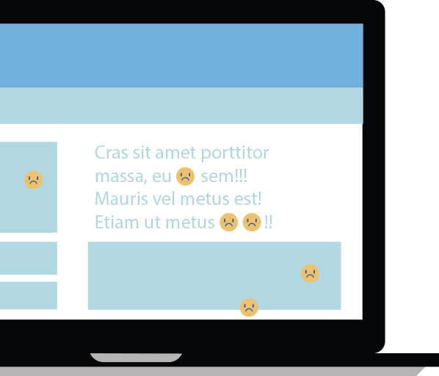
(1) Political expression, public dialogue and impartiality
BC Public Service employees have a right to political activity
How we engage in topics like political parties and government policy must take into account special considerations
Read the guidelines, Oath of Employment and Standards of Conduct to learn more
Social Media Guidelines for Personal Use

Slide 12
(2) Political expression, public dialogue and impartiality
1
2
3
Impartiality
Campaigning
Identification
Don’t make comments that would cause people to doubt your ability to do your job impartiality.
Don’t campaign for a political party using your government email or other BC Public Service identification.
Don’t identify as a public service employee if engaging in public dialogue.
4
Lend weight
Not using government position to lend weight to the public expression of your personal opinions.
Social Media Guidelines for Personal Use
Notes:
Notes
Employees need to think about all 7 of these factors in considering whether their public comments will be inappropriate or not:
Not making comments that would make a reasonable person doubt your ability to conduct your work responsibilities impartially.
Not campaigning for a political party or initiative using your government email address or any other self-identification as a public service employee (completely separate your political activities from your work).
Not identifying yourself as a public service employee through your profile, photos posted, etc. if you are going to be engaging in public dialogue about political topics.
Not using your position in government to lend weight to the public expression of your personal opinions.

Slide 13
(3) Political expression, public dialogue and impartiality
5
6
7
Role in Gov
Petitions
Official act
Not making public comments related to your ministry or role.
Don’t list your job when signing online petitions.
Not making comments that are perceived as an official act or representation.
Social Media Guidelines for Personal Use
Notes:
Notes
(continued from last slide)
5. Only making public comments when the topic or issue is not related to your government role or ministry.
6. Not listing your job when signing online petitions.
7. Not making comments that would be reasonably perceived as an official act or representation of government (unless authorized to do so).

Slide 14

Personal use during work time
Limited, reasonable use of social media is permitted
Employees should talk with their supervisor to understand what is appropriate
Social Media Guidelines for Personal Use
Notes:
Notes
Limited, reasonable use of social media during work hours is permitted as long as it’s in line with the Standards of Conduct, Appropriate Use Policy, and other policies and guidelines.
Employees should talk to their supervisors to understand what is appropriate.

Slide 15
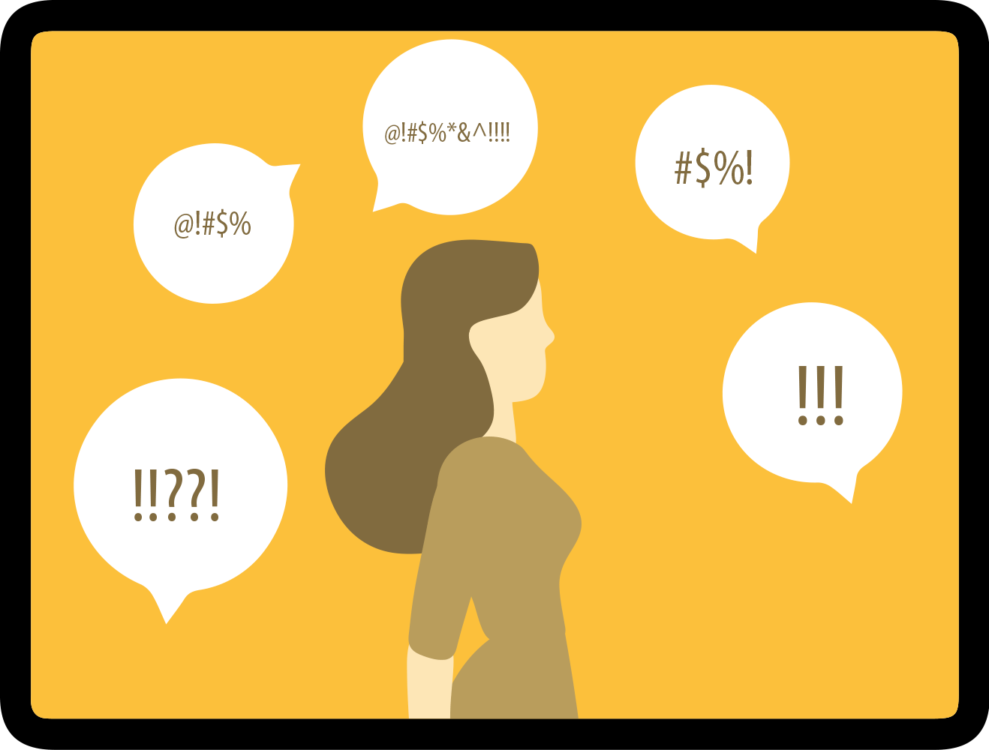
(1) Cyber safety/bullying
Under the Standards of Conduct, bullying or any other inappropriate conduct will not be tolerated
The BC Public Service takes discrimination, bullying, harassment and threats to employee safety seriously including those which occur over social media
Social Media Guidelines for Personal Use
Notes:
Notes
If an employee has concerns about their safety because of a comment on social media, they should talk to their supervisor right away.
If an employee believes they have been subject online bullying and harassment by another employee, and the conduct is relevant to their employment, they should take steps to address the behaviour and review the information on MyHR as well as HR Policy 11 – Discrimination, Bullying and Harassment.
If an employee is experiencing bullying by a client, customer, member of the public, or another employer, they should inform their supervisor right away. With the support of the BC Public Service Agency’s Workplace Health and Safety Branch, their supervisor will assess and investigate and take all necessary steps to resolve the issue.

Slide 16
(2) Cyber safety/bullying
For guidance, read the cyber safety section of the Social Media Guidelines
If you’re experiencing online bullying, visit Address discrimination, bullying and harassment on Careers & MyHR
Social Media Guidelines for Personal Use

Slide 17
Scenario: Passion and posting
Jeanine is a passionate anti-poverty advocate. On her personal Facebook page, she posts criticisms of what she sees as her ministry’s inaction. Her profile identifies her as a “sometimes reluctant employee of a certain large government ministry.” She also posts angry comments in response to BC Government ads and press releases.
Social Media Guidelines for Personal Use
Notes:
Notes
Questions to think about:
Why is this an issue?
Is it appropriate for Jeanine to use social media to comment about her work in the BC Public Service? Why or why not?
Who can help Jeanine make decisions about ethical choices?
For guidance, refer to the Social Media Guidelines Scenarios document.
Key messages:
Jeanine needs to understand the Standards of Conduct for Public Service Employees in relation to the current situation.
Under the Standards of Conduct, public service employees have a duty of loyalty to the government as their employer. They must act honestly and in good faith and place the interests of the employer ahead of their own private interests.
Employees must not jeopardize the perception of impartiality in the performance of their duties through making public comments or entering public debate regarding ministry policies – as it may create a perception of bias.
In this situation, by identifying herself as a “sometimes reluctant employee of a certain large government ministry”, a reasonable person could conclude that she is a public service employee in the ministry she is criticizing. This could result in people associating her personal opinions with her government role, and thus using her position in government to lend weight to her personal opinions. She may also be perceived as being unable to be impartial in doing her job because of her personal opinions and how they may conflict with the priorities of the elected government of the day.

Slide 18

Profile choices
When people see from your profile or photos that you’re a public service employee, they’ll think differently about what you post.
What could be an issue with using this as your profile photo?
Social Media Guidelines for Personal Use
Notes:
Notes
Your social media name, profile and photos influence how people associate your work identity with your social media activity.
If you list your job title or place of work or have photos of you that clearly identify you as a public service employee, people may draw a connection between your work duties and what you post that undermines their trust and confidence in government.
You may even be in a conflict of interest if the social media account is used to promote a side business. Carefully consider these choices when deciding what to post.
If your profile strongly associates you with the BC Public Service, people may also perceive that you’re speaking in an official capacity rather than as private individual. It may also mean that you are using your position in government to lend weight to your personal opinions.
Official government logos or other branding images can be used only for authorized and official government business, not for personal use.

Slide 19

Privacy and permanence
When you share something, you may only be thinking of a narrow or particular audience
However, your personal social media may reach a wider audience
Use common sense and err on the side of caution
Social Media Guidelines for Personal Use
Notes:
Notes
When work colleagues are added to your online social network (e.g. added as Facebook friends, Instagram followers or LinkedIn connections), your work colleagues are now part of the audience for your activities in that network. When you add colleagues to your social network, what you say online could be considered an extension of the workplace. If you do have work friends added to your network, think about what you say online and how it could negatively impact the work environment.
Because of the nature of social media as social and digital, what you intend to be private may become public.
Before posting, consider carefully what would happen if your words or images were visible to a wider audience.

Slide 20

Trust and consequences
Employees are trusted to make ethical choices
Supervisors who become aware of inappropriate use, should contact the BC Public Service Agency
Social Media Guidelines for Personal Use
Notes:
Notes
Sometimes violations of these policies and regulations in employee social media use do come to the attention of other employees, supervisors and the employer.
If other employees or members of the public see social media activities that constitute a conflict of interest or other violation of the Standards of Conduct, they may speak up and share that information with the employer.
In some cases, investigations and discipline may be necessary.
You’re responsible for using your best judgment and reaching out for help when unsure. Employees observing unethical conduct on social media can speak with their own supervisor or their ministry's ethics advisor for guidance.

Slide 21
Careers & MyHR Resources
Social Media Guidelines for Personal Use
Social Media Guidelines FAQ
Conflict of Interest Guidelines for Employees (PDF, 369KB)
Standards of Conduct
Appropriate Use Policy
Promote Respect in the Workplace
Address a respectful workplace issue
Violence in the Workplace
GCPE Guidelines for Government Use of Social Media (PDF, 229KB)
Social Media Guidelines for Personal Use
Notes:
Notes
If you are unsure about how to navigate a situation, consult the Social Media Guidelines for Personal Use and talk to your supervisor.
There is also information and resources on Careers & MyHR to help you along the way.

Slide 22

For more information, please contact:
Name
Title
Useful Links:
Social Media Guidelines for Personal Use

