Slide 1
Sample Presentation
Cybersecurity Review for Executive
<Organization>
Presenter's Name

Slide 2
Cybersecurity has never been more imperative
Data Aggregator Hacked!
  Dozens of corporations impacted …
CIAS Reports Bicare Breach
  Data of 3.9 million military clinic and hospital patients compromised. HHS fines and scrutiny assured. Next up, the class action lawsuits.
HHS HIPAA Enforcement
  HHS to renew and expand proactive audit program for security and privacy.
Notes:
NOTE: The examples on this slide are representative, they are not intended to be used in your board presentation. Security incidents are always changing, so organizations must replace these headlines with recent headlines that are applicable to their own industry, company, and organization.
Narrative: Every board member will be familiar with the most recent headlines. In many cases, these headlines are why you are being asked to speak to them. The headlines must be acknowledged, but only to briefly establish what, if any, relevance there is to recent headlines and attacks that may directly impact your organization. For example, retail companies being attacked for personally identifiable information (PII) and credit card numbers are not very relevant to a cement company with no credit cards or large customer data bases.

Slide 3
Global Context
global annual cybercrime will cost the world in excess of $6 trillion annually by 2021
  this is an increase from $400 billion in early 2015
global spending on cybersecurity defence is projected to exceed $1 trillion over the next 5 years
U.S. has declared a national emergency to deal with the cyber threat
global shortage of cybersecurity professionals is expected to reach 2 million by 2019
  now expected to be 3.5 million by 2021
  Canada’s share expected to be 62-65,000
* source: Herjavec 2016 Cybercrime Report

Slide 4
Security Threat Landscape
Cyber attacks are more:
Frequent
Effective
Targeted
Sophisticated
Profitable
Elusive
Global Security Incidents (millions)
61% compound annual growth since 2009
(based on reported incidents of sufficient size PWC 2016)

Slide 5

Threat Actors
juveniles
insiders
hacktivists
organized crime
nation-states
cyber terrorists

Slide 6
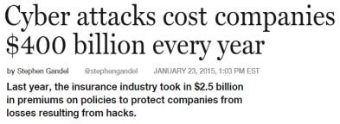
Business Impacts
direct impact to citizens
financial loss
litigation, regulatory
data breach and loss
brand and reputation
lost/stolen intellectual property
lost productivity
In the news

Slide 7
What Is Appropriate Risk?
There is no such thing as "perfect protection"
Less complex business,
less of a target
Growing business, more
customers and complexity
Larger, more complex
business, more of a target
Business Model
Lower Risk
Higher Cost
Higher Maturity
Higher Risk
Lower Cost
Lower Maturity
As our business grows, we have to continually reassess how much risk is appropriate.
Our goal is to build a sustainable program that balances the need to protect against the needs to run our business.
Notes:
The purpose of this slide is to very directly address that reality that there is no such thing as perfect protection.
KEY CONCEPT: Many boards will lead you to believe they understand this, but they do not. They still believe this is a technical problem, handled by technical people, buried in IT. They believe this problem can be SOLVED. All they need to do is higher the right people with the right technical knowledge and that will keep them out of the headlines with no attacks.
KEY CONCEPT: When this slide is delivered well, most boards will have a palpable sense of relief because they will finally understand why the headlines get worse and worse and no one seems to be able to stop this. It helps them understand their role in setting the goal for appropriate protection at the organization.
Narrative:
Build 1: Risk management is an explicit recognition that there is no such thing as perfect protection. The organization must make conscious decisions regarding what it will do, but more importantly, what it will not do to protect itself. The decision must be considered with the risk stakeholders in the non-IT parts of the business, and residual risk must be accepted.
Build 2: The risk stakeholders have choices. They can choose to accept more risk at lower cost, or lower risk at higher cost.
KEY CONCEPT: At no point are we ever perfectly protected, but it is a legitimate business decision to choose to exist anywhere on this continuum. We don’t have to be the most protected organization on the planet, but neither can we choose to push endlessly to the right side because there is a law of diminishing returns. Continuously pushing to the right will eventually have a negative impact on our business by harming efficiency, lowering customer satisfaction, or <pick a negative impact>. For anyone on the board who does not believe this, please hand in your smartphones and tablets because those are not safe.
Build 3: Although certain industries generally cluster around one end of this spectrum or another, it is not sufficient to benchmark against a general industry. Business model and complexity raise the overall risk profile, requiring a greater investment in security controls and programs.
Build 4: As our business grows, we have to continually reassess how much risk is appropriate.
Build 5: Our goal is to build a sustainable program that balances the need to protect against the needs to run our business. My intent here is to show you, very transparently, the state of our security program, and to start a discussion about our gaps and opportunities for improvement.

Slide 8
Cybersecurity Program Maturity
Level of Program Maturity
Initial
Developing
Defined
Managed
Optimizing
1
2
3
4
5
Conclude
Catch-Up
Projects
Continuous
Process
Improvement
Relative Program Maturity
Design
Architecture
Track Technology
and Business
Change
Develop New
Policy Set
Composite
Risk Position
Review Status Quo
Process
Formalization
Initiate Strategic
Program
(Re-)Establish Security Team
Time
Notes:
The purpose of this slide is to introduce the concept of program maturity and to show its relationship to our risk position.
KEY CONCEPT: Maturity is a great way to speak about the readiness of a security program while keeping the technology out of this discussion.
This figure illustrates a Security Program Maturity Curve. The lower left represents organizations that are technology-focused and reactive to security issues. The upper right represents organizations that are process-oriented and proactive that can take advantage of efficiencies to provide better protection at lower cost. The black arrows represent the milestones that an organization hits as its maturity improves. There is a relationship between maturity and risk posture. The more mature an organization becomes, the less risk it will experience. Maturity is essentially how good an organization is at accomplishing a particular process. Better execution leads to lower risk. For example, if an organization is good at disaster recovery, it will minimize its losses in the event of a natural disaster. If it is bad at disaster recovery, it will experience greater losses. Consider also that the organization does not control if it will be hit by a natural disaster, but it does control its readiness. Addressing maturity is a choice.

Slide 9
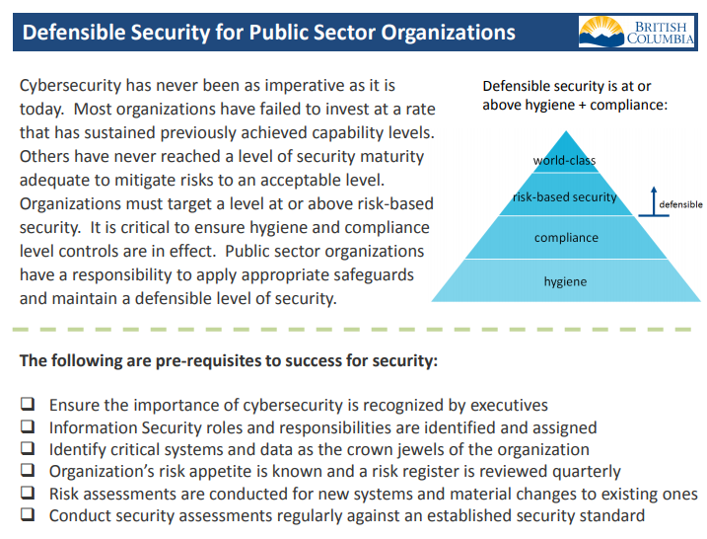
Defensible Security

Slide 10
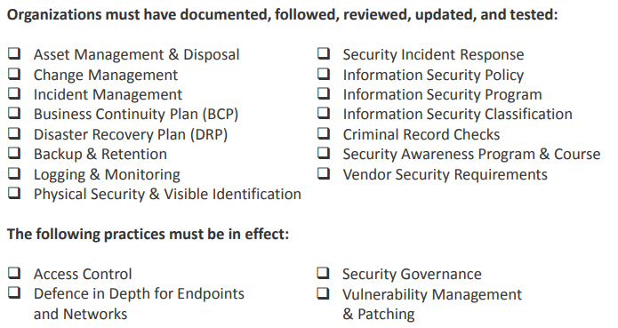
Defensible Security Controls

Slide 11

Defensible Security Posture
World Class
DefSec1
Risk-Based
DefSec2
Defensible
Compliance
DefSec3
Hygiene
DefSec4
Notes:
increase the security capability across our country to an acceptable level, raise the water level

Slide 12


Defensible Security Categories
Security Embedding (DNA) Controls
Security Prerequisites
DNA
Prerequisites
Executive Support
Roles & Responsibilities
Crown Jewels
Risk Appetite & Register
Risk Assessment
Security Assessment
Information Security Program
Information Security Classification
Security Awareness Program & Course
Security Governance
Defensible
Security
Security Respiratory Controls
Security Directives
Backup & Retention
Logging & Monitoring
Physical Security & Visible Identification
Personnel Security
Vendor Security Requirements
Logical Access
Defence in Depth for Endpoints and Networks
Vulnerability Management & Patching
Asset Management & Disposal
Change Management
Incident Management
Business Continuity Plan (BCP)
Disaster Recovery Plan (DRP)
Security Incident Response
Information Security Policy
Directives
Respiration
“Covering the organization from end to end”

Slide 13
Defensible Security Dashboard
1 |  | 2 |  | 3 |  |  |  |  |  | 4 |  | 5 |  | 6
Exec |  | Roles |  | Crown |  |  |  |  |  | Risk |  | Risk |  | Security
awareness |  | responsibilities |  | jewels |  |  |  |  |  | appetite |  | assessments |  | assessments
7 |  | 8 |  | 9 |  | 10 |  | 11 |  | 12 |  | 13 |  | 14
Asset |  | Change |  | Incid |  | BCP |  | DRP |  | Backup |  | Logging |  | Physical
management |  | management |  | management |  |  |  |  |  | & retention |  | & monitoring |  | & visible ID
15 |  | 16 |  | 17 |  | 18 |  |  |  | 19 |  | 20 |  | 21
Incid |  | Policy |  | Prog |  | Info |  |  |  | Crim |  | Aware |  | Vendor
response |  | (security) |  | (security) |  | classification |  |  |  | record checks |  | program/course |  | requirements
22 |  | 23 |  |  |  |  |  |  |  |  |  | 24 |  | 25
Access |  | DiD |  |  |  |  |  |  |  |  |  | Security |  | VM
control |  | for end-points |  |  |  |  |  |  |  |  |  | governance |  | & patching
 |  | & network
Sample
complete or substantially complete
partially complete or in progress
incomplete or substantially incomplete
Ensure the importance of cybersecurity is recognized by executives
• review security threat landscape and request executive support
• this can be accomplished with a 30-60 minute presentation, conversation, or briefing note with 5-10 hours of preparation time

Slide 14
<Company> Initiatives
Our partnering strategy
  Support the security of initiatives to enable partnering
Mergers and acquisitions
  Manage raised threats, and the required integration
Business productivity (through IT)
  For cloud, mobility and social media, determine whether to accelerate or brake
Compliance
  Ensure compliance with Defensible Security and other security assessment frameworks
Notes:
The purpose of this slide is to present three to five board level business initiatives and to describe the value of proactively address risk and security concerns in these initiatives.
NOTE: This slide must be modified to reflect business initiatives in your specific business. This sample narrative below uses a growing healthcare company with a business model that leverages partners.
Narrative:
Here are further examples of our business initiatives that are directly impacted by our investment and choices in technology risk and security.
Our partnering strategy was described on the previous slide.
Mergers and acquisitions. We are growing by 30% a year based on acquisitions alone. Our current due diligence processes do not have IT or security readiness reviews. This results in integration tossed to the IT and security teams after the deal closes with no visibility into challenges or risks. Proactively analyzing IT and security readiness as part of due diligence can impact time to integrate, amount of risk accepted, and even purchase price.
Business productivity: As the Internet of Things accelerates and everything is connected to our networks, a more proactive engagement in risk and security can give us knowledge about accelerating or braking our planes to use cloud, mobile devices and social media. This can have direct impact on customer experience and satisfaction.
Compliance is a significant requirement for us to stay in business. Although in many cases this is box-checking without value, we can choose to approach our compliance obligations integrated with our risk and security program to create business benefit.

Slide 15
Key messages
Incidents are increasing in frequency and are more sophisticated and targeted than ever
No organization globally is immune to attack
Doing the basics well will stop 80% of the problems
Organizations will be judged not only on their ability to prevent but detect and respond
Security is not just an IT problem, it’s business enterprise risk
Security is a top issue of concern for executives and Boards of Directors globally

Slide 16
Questions the CEO/Board are asking security teams:
Do you know what our critical systems and data are?
What are the security controls in place?
Are the controls sufficient to mitigate risk to an acceptable level?

Slide 17
Questions the CEO/Board should be able to answer:
What are the key cybersecurity risks affecting your industry/organization?
Is your organization aligned with an existing industry security standard (ie. ISO or NIST)
What is your current capability/maturity rating?
(0 – Not Implemented, 1 – Initial, 2 – Repeatable, 3 – Defined, 4 – Managed, 5 – Optimized)
What is your desired capability/maturity rating?
Do you have a plan to reach the desired level?
How frequently do you receive plan updates?
Is security a recurring item on the board agenda?

Slide 18
Next Steps
Recommend a third-party audit of risk and security program to identify gaps and opportunities for improvement.
Recommend continued monitoring and resolution of deficiencies to maintain the entire application portfolio at the current level of security controls.
Recommend an annual update on IT security to the audit committee.
Notes:
The purpose of this slide is to discuss next steps.
This slide should be populated with whatever your executives feel is appropriate for your board.

Slide 19
Asks
Ensure you and your team are familiar with the Defensible Security for Public Sector Organizations framework
Assess present state, future state, and high-level gap analysis
Identify any initiatives underway, priority areas or additional initiatives required
Leverage oversight authority and collaborate with others to ensure a defensible security level
Take advantage of the Defensible Security for Public Sector Organizations (DefSec) from the OCIO

