Slide 1
Fraud Awareness & Prevention
February 1, 2022

Slide 2
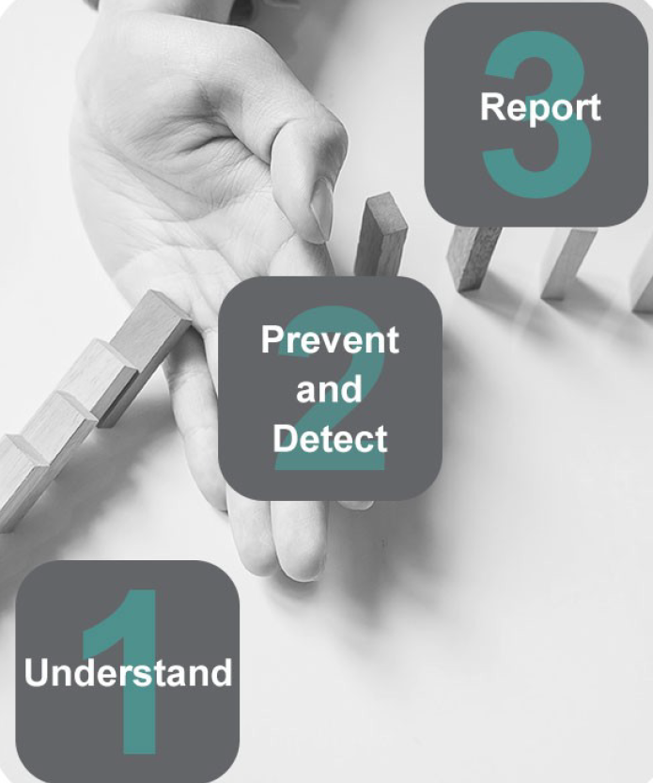
Introduction
Managing fraud risks is the responsibility of all employees
This presentation will help employees better understand what fraud is and how to prevent, detect, and report it

Slide 3
Learning Objectives
Recognize key risk areas where fraud can occur
1
Identify elements of preventative and detective controls
2
Report fraud through the proper reporting channels
3

Slide 4

Employee Responsibilities
Be aware of and comply with the organization’s standards of conduct and fraud prevention policies
Acknowledge and assume accountability for safeguarding the organization’s assets
Have a basic understanding of fraud and be aware of the red flags
Understand how your job procedures are designed to manage fraud risks and when non-compliance might create an opportunity for fraud
Report suspicions or incidents of fraud to your supervisor and/or designated contact as per the organization’s internal policies and procedures
Cooperate in investigations

Slide 5
Understanding Fraud
Fraud is defined as any intentional act to deceive others, resulting in the organization suffering a loss and/or the perpetrator achieving a gain.
The cost of fraud is not limited to financial losses. It can also cause detriment to an individual’s and/or an organization’s reputation.
Potential Impacts of Fraud
Financial Loss | The actual dollar value of the cash or other items stolen is the easiest cost to quantify.
Cost of Investigation | Every fraud should be investigated to determine the actual amount, method(s), and the individuals involved. Such costs depend on how complicated the fraud is.
Reputation | An organization that suffers a fraud will lose some of the public trust. At a minimum, people will assume the organization lacks proper management.
Negative Publicity | Fraud publicity not only damages the organization immediately, but also leaves doubts about the organization’s credibility for years to come.
Loss of Employees | Depending on the nature of the fraud — especially if committed by a senior staff member — other employees may begin looking for other employment.
Litigation | If an organization discovers a substantial fraud, it is possible to lead to legal proceedings.
Damaged Morale | A decline in morale as the employees may feel the organization has failed them and failed the mission.

Slide 6

Fraud Triangle Theory
The Fraud Triangle Theory is a useful framework to analyze an organization’s vulnerability to fraud and unethical behaviour. The Theory explains the reasoning for fraud. It also suggests that three factors generally apply to fraud perpetrators:
Pressure – Perpetrator feels that they have a financial problem that could be solved through theft of cash or other assets. This creates the motive of the offence.
Opportunity –Perpetrator feels that they can commit the offense without getting caught. This can be provided through weaknesses in internal controls.
Rationalization – Perpetrator rationalizes the offence before it takes place. For example, they may think “I’ll pay the money back” or “I need it more than the organization”.

Slide 7
Fraud Schemes & Examples
There are three major types of occupational fraud:
Asset Misappropriation – stealing property from the workplace or using it for personal gain, with the breach of trust.
Corruption – wrongful use of influence to get a benefit, contrary to the duty or the rights of others.
Financial Statement Fraud – the deliberate misrepresentation of the financial condition of an enterprise. This is done through the intentional misstatement or omission of amounts (or disclosures) to deceive statement users.
In this presentation, we will focus on the first two fraud schemes: asset misappropriation and corruption. Common examples of both types are included in the next section.

Slide 8
Asset Misappropriation Examples
Type | Examples
Skimming | Employee collects cash, but does not record the sale Employee collects payment, but does not credit the amount to the client’s account
Cash Larceny | Employee steals cash at the point of sale or register Employee steals cash for cheques from bank deposits
Theft of Inventory or Equipment | Employee misappropriates assets purchased by the organization for personal use Employee takes inventory from the organization’s premises
Theft of Proprietary Information | Employee accesses client records for purposes of committing identity theft Employee discloses confidential information for personal financial gain
Billings | Employee uses a corporate credit card for personal purchases Employee submits invoices for payment from a fictitious vendor controlled by the employee
Employee Reimbursement | Employee requests reimbursement for personal expense by claiming it as business related Employee submits a single expense for reimbursement multiple times
Cheque Tampering | Employee forges signature endorsement on a cheque intended for the organization Employee steals ongoing cheques to a vendor, changes the payee designation on the cheque and deposits the cheque into their personal bank account
Payroll | Employee takes vacations without recording their vacation hours to the payroll system Employee receives salary overpayment from the organization due to falsifying work hours or their pay rates on the payroll system
Wire Transfers | Employee wires funds from organization’s bank accounts to an account controlled by the employee or accomplice
Register Disbursement | Employee issues a refund for fictitious merchandise and keeps the money Employee retains a customer receipt, processes a fictitious voided sale, and keeps the money

Slide 9
Corruption Schemes Examples
Type | Examples
Conflict of Interest | Employee owns an undisclosed interest in a supplier and negotiates a contract between their employer and the supplier, purchasing materials at an inflated price.
Bribery | Employee offers, gives, receives, or solicits a thing of value to influence a business decision.
Kickback | Employee receives undisclosed payments from vendors resulting in the organization being overbilled. Employee receives undisclosed payments for directing excess business to a vendor.
Bid-Rigging | Employee fraudulently assists a vendor in winning a contract through the competitive bidding process.
Illegal Gratuities | Employee gives or receives something of value to reward a business decision.
Economic Extortion | Employee demands payment from a vendor for decisions made in the vendor’s favour. Refusal to pay the extorter results in harm to the vendor.

Slide 10
Internal Controls
Internal control activities take the shape of policies and procedures. They enforce management’s directives intended to mitigate risk.
Internal controls help:
Prevent and detect fraudulent activities Prevent, detect, and correct errors and irregularities Ensure integrity, relevance, and reliability of financial reporting Achieve corporate goals and objectives | Ensure the organization’s funds are used for their intended purpose Ensure compliance with laws and regulations Avoid cost of investigations and other related costs Avoid damage to reputation and loss of public confidence

Slide 11

Prevention
Policies and procedures that help prevent fraud are called preventative internal controls. Examples of these controls include:
Employee background and reference checks
Segregation of duties
Limiting physical access to cheques and cash
Requiring pre-approval of actions and transactions (e.g., purchase orders)
Mandatory use of computer passwords

Slide 12

Detection
Detective internal controls help detect fraud that has occurred. Examples of these controls include:
Physical inventory counts
Bank reconciliations
Data analysis to review large volumes of data for unusual transactions
Reviews and/or audits

Slide 13
Examples of Internal Controls
Control | Example
Segregation of Duties | Assign the various steps in a process to different people (e.g., ensure no single employee is responsible for handling cash, issuing cheques, and reconciling bank statements).
Authorization | Have two signing authorities for issuing cheques.
Safeguarding of Assets | Deposit cash receipts in a timely manner.
Safeguarding of Records | Sensitive items should be kept in a locked storage area.
Hiring Processes | Conduct reference and background checks for new hires.
IT Security | Store and manage data in compliance with records management and retention policies.
Monitoring | Evaluate whether internal controls are operating as intended through reviews and/or audits.

Slide 14
Reporting Fraud
All employees have a responsibility to report suspicions of fraud to their supervisor or their organization’s designated contact in accordance with the organization’s policies and procedures.
Reporting an incident to your supervisor and/or the organization’s designated contact is important because:
The designated contact is responsible, or reports to those who are responsible, for ensuring the quality and integrity of the organization’s financial management and control systems.
The designated contact must also ensure adherence to the organization’s policies and procedures when assessing fraud, which may include, the principles of administrative fairness which ensures processes are fair and unbiased when addressing fraud incidents. Reporting issues demonstrates the organization sought independent and objective advice and supports.

Slide 15

What not to do
It is important that you maintain confidentiality. Do not:
Contact law enforcement unless you believe it’s an emergency
  Reporting non-emergency incidents requires appropriate approval and legal advice in line with the organization’s policies and procedures
Launch your own investigation
Confront the accused or alert them discreetly
Disclose the matter to any unnecessary parties
Try to settle or resolve the matter yourself

Slide 16

Conclusion
Now that we have covered the basics of fraud awareness, prevention, and detection, let’s look at a case study.
The following case study is about Business Email Compromise (BEC) scams. BEC scams are a form of phishing scam that remain a prevalent threat in today’s business world.

Slide 17
Case Study: Business Email Compromise (BEC) Scam
An accounts payable clerk receives an urgent request from a supplier requesting to change their bank account information for a significant upcoming payment. The email is sent from a domain that appears to be the supplier’s legitimate account. As it is time sensitive, the employee decides to process the request without further inquiry and makes the payment to the new bank account.
The following week, the employee receives an email from the legitimate supplier inquiring when they will receive payment for the outstanding invoice. At this point, the accounts payable clerk reviews the previous communication and realizes that the email address was slightly altered from the legitimate supplier’s email.
What to do
If this incident were to occur:
Immediately notify your supervisor or other designated contact in line with your organization’s fraud management framework

Slide 18
Case Study: Business Email Compromise (BEC) Scam Continued
How to Prevent Repeat Incidents
To safeguard funds, employees must be able to identify potential email phishing scams. They must also know how to act to prevent potential fraud. BECs occur when email accounts are compromised. This gives the fraudster access to information to initiate a fraudulent transaction. In this case, the fraudulent transaction was redirecting payments to a fraudulent bank account.
Typical characteristics of a potentially fraudulent email:
The emails may not address anyone specific
The email typically implies a sense of urgency with words like ‘urgent’ in the subject line or body of the email
The email comes from a known email address appearing to be the company that the employee normally works with. It may also come from a slightly altered email address that appears to be from the supplier company
An email or forged letter from a supplier advising that their bank account numbers have changed and requesting payments be sent to the new account

Slide 19

Case Study: Business Email Compromise (BEC) Scam Continued
Tips to prevent fraud:
Use more than one authentication method (email) when there is a request to change payment information. Try calling the supplier using the number on file to confirm the request
Apply extra scrutiny to emails requesting:
  payment information
  outstanding invoices
  a change of payment arrangements
  contact information (email, phone number, etc.)
  other confidential/financial information

