Slide 1
The Pre-www2 Transition
SDSI Public Site

Slide 2
The Pre-www2 Transition
SDSI Public Site
In the last 30 days:
131,412 visitors
74% of visits within British Columbia
44,233 visits to Cheque Issue Dates page

Slide 3
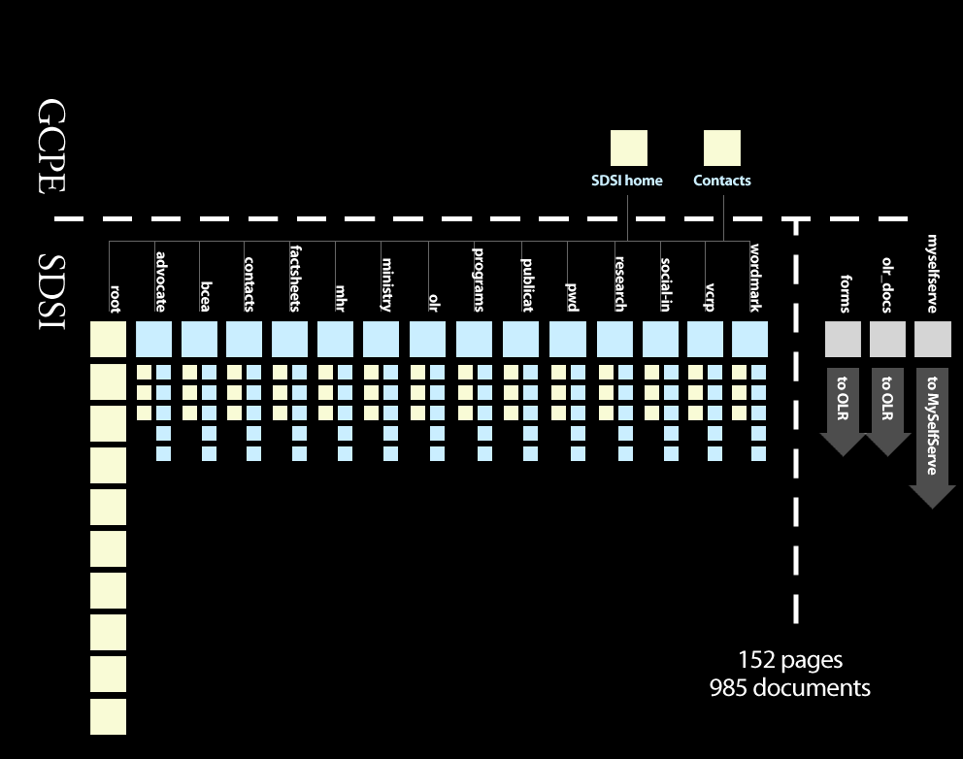

Slide 4
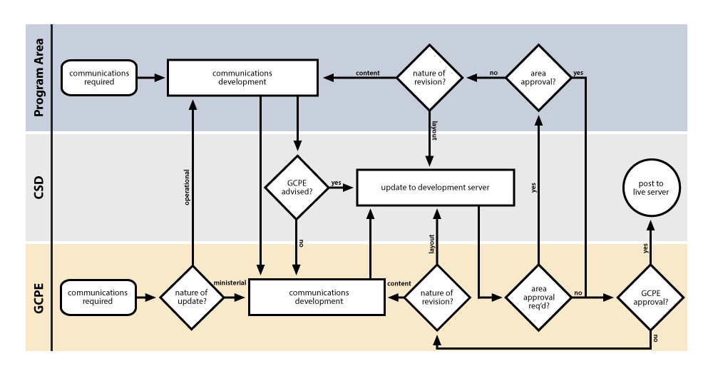
Ye Olde Update Process

Slide 5
Checks and Balances
Accuracy
Standards:
  Communications
    Grammar, spelling, tone, etc.
  Web
    Functional, valid markup
  Accessibility
    Communications: plain language, SMOG, etc.
    Web: Valid markup, access design, browser compatibility, etc.
    Structure: UX, architecture, navigation, duplication, etc.
GCPE/Minister concerns

