Slide 1

BC Knowledge
Development Fund
Investing in B.C.’s Research Infrastructure
Investing in B.C.’s Future
Webinar info session September 19, 2018

Slide 2
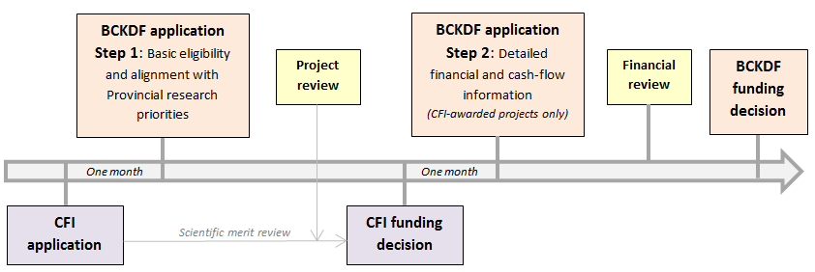
BCKDF application process
https://www2.gov.bc.ca/gov/content/governments/technology-innovation/bckdf
Note that CFI approval does NOT imply BCKDF approval
BCKDF Webinar
2

Slide 3
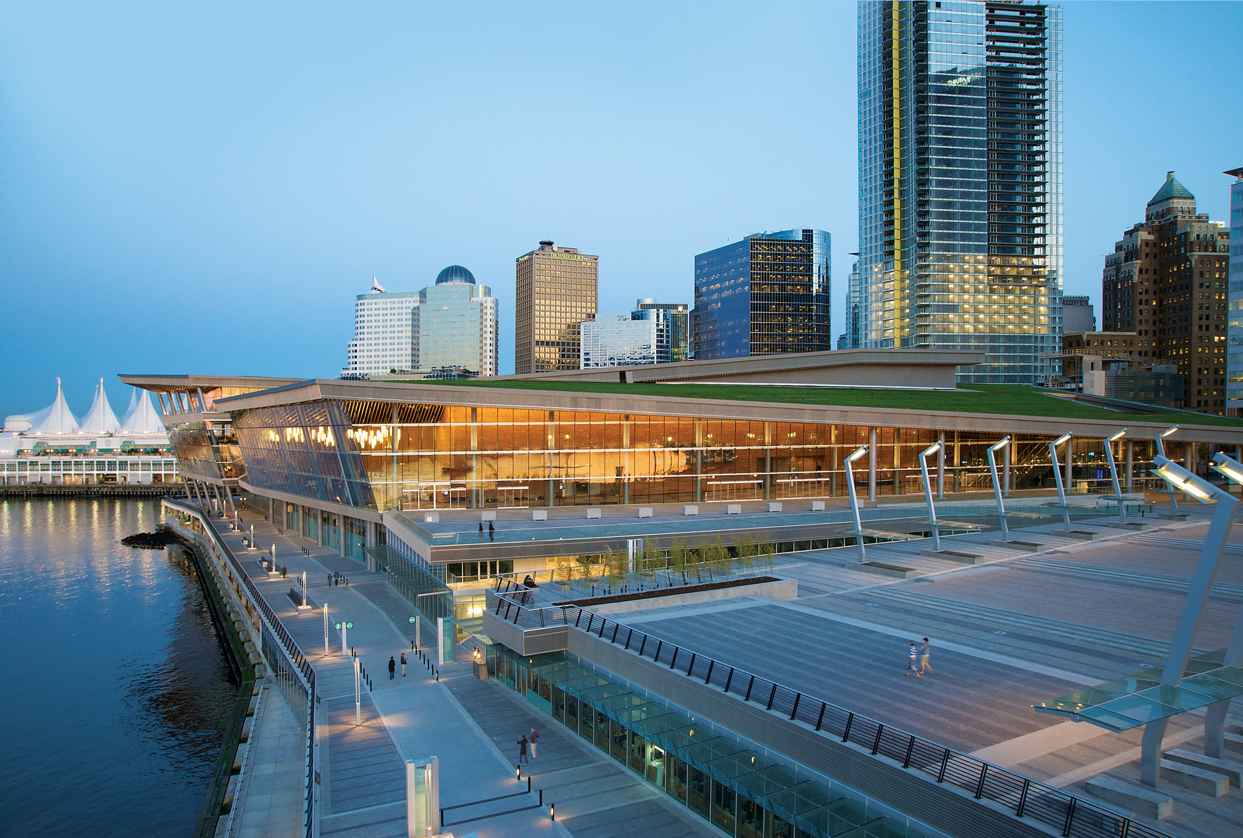

BCKDF: Research priorities
Societal, environmental, and economic benefits to B.C.
Research translation (plans to achieve expected benefits of research)
BCKDF Webinar
3

Slide 4

BCKDF: Societal benefits for B.C.
Examples:
Improvements to health and well-being of British Columbians
Benefits for equity-seeking groups or Indigenous peoples
Profound shift in the understanding of a given discipline
Improvement of services for British Columbians
Making B.C. more affordable
Reducing poverty in B.C.
BCKDF Webinar
4

Slide 5
BCKDF: Environmental benefits for B.C.
Examples:
Preservation of B.C.’s natural environment and wildlife
Enhancement of B.C.’s natural environment and wildlife
Reduction of greenhouse gas emissions in B.C.
Development of sustainable urban environments
BCKDF Webinar
5

Slide 6
BCKDF: Economic benefits for B.C.
Talent:
Expected number of students trained on infrastructure
Type of skills gained; demand for skills
Contribution of infrastructure to recruitment of researchers
Jobs:
Expected creation of direct and short-term jobs
Expected number of student jobs, indirect and long-term jobs
BCKDF Webinar
6

Slide 7
BCKDF: Economic benefits for B.C.
Examples:
Improvement to B.C.’s productivity or competitiveness
Development of specific economic sectors
Regional economic development
Promotion of trade
Potential for commercialization, spin-offs, patents, etc.
BCKDF Webinar
7

Slide 8
BCKDF: Research translation
(Plans to achieve expected benefits of research)
Examples:
Collaborations to engage with users (e.g. industry, non-profit, government)
Partnerships to share infrastructure, license technologies, create start-ups, etc.
Roles of research team in realizing research impacts
Previous knowledge transfer experience of research team
Collaborations with expert organizations (accelerators, liaison offices, non-profits)
BCKDF Webinar
8

Slide 9
Comments?
Questions?
BCKDF@gov.bc.ca

