Slide 1

Methadone Maintenance System Performance Measures – 2011/2012
Office of the Provincial Health Officer January 28, 2013
Dr. Eric Young, MD, MHSc, CCFP, FRCPC
Deputy Provincial Health Officer

Slide 2
Background
2002 Health Canada Best Practices – PMMT
2009 BCMA – Policy Paper on Addictions
2009 independent review of BC’s methadone maintenance system (CARBC & UBC’s CHEOS)
“Methadone Maintenance Treatment in British Columbia, 1996-2008: Analysis and Recommendations” (September 2010)
Government response
PHO follow-up monitoring of MMT key indicators (not including data on-reserve First Nations)

Slide 3


Slide 4
HMHP Key actions and outcomes related to
BC’s Methadone Maintenance System
  p. 33 - Enhance and improve BC’s methadone maintenance treatment system (including medical, pharmaceutical and psychosocial support components)
  p. 34 – By 2015:
    90 per cent of methadone prescribers will adhere to optimal dose guidelines
    60 per cent of people started MMT retained at 12 months
  p. 23 – Where appropriate, expand the reach and range of harm-reduction services that prevent and reduce the health, social and fiscal impacts of illegal drug use

Slide 5
Introduction
Effectiveness of the province’s MMS involves three key components:
  prescribing
  dispensing
  counselling and other adjunct services and supports
Regulatory Bodies
  College of Physicians and Surgeons of BC
  College of Pharmacists of BC

Slide 6
MMS Measures
The reach of BC’s MMS can be summarized by reporting on key professional participation indicators
  # of patients with methadone maintenance prescriptions (whose meds covered by PharmaCare)
  # of physician prescribers
  # of methadone-dispensing pharmacists and pharmacies

Slide 7
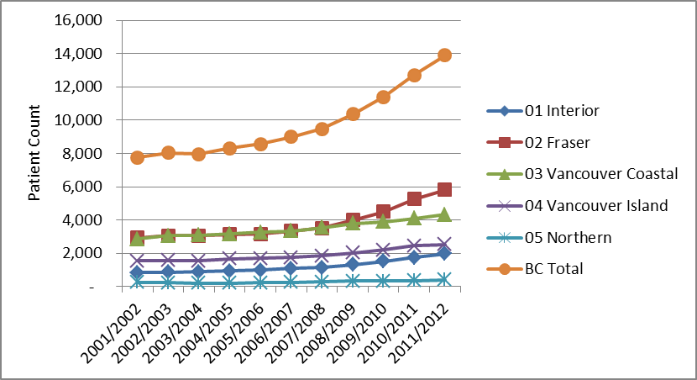
Methadone Maintenance Patients by Health Authority

Slide 8
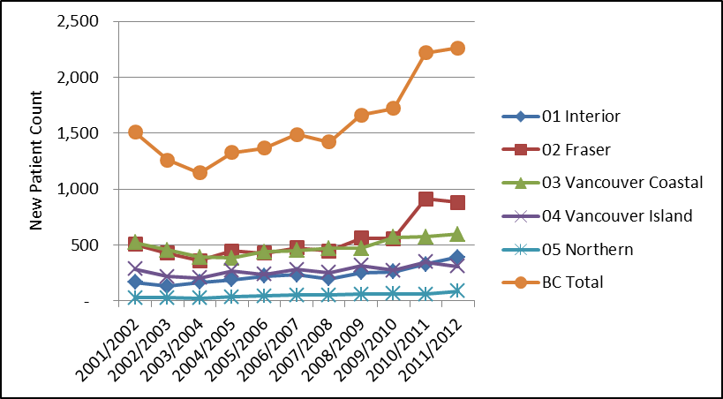
New Methadone Maintenance Patients by Health Authority

Slide 9
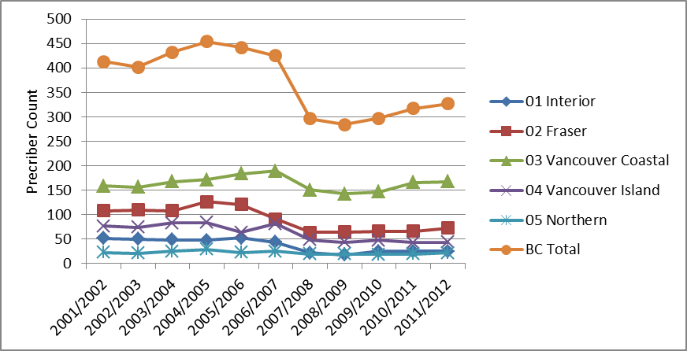
Methadone Maintenance Active Prescribers by Health Authority

Slide 10
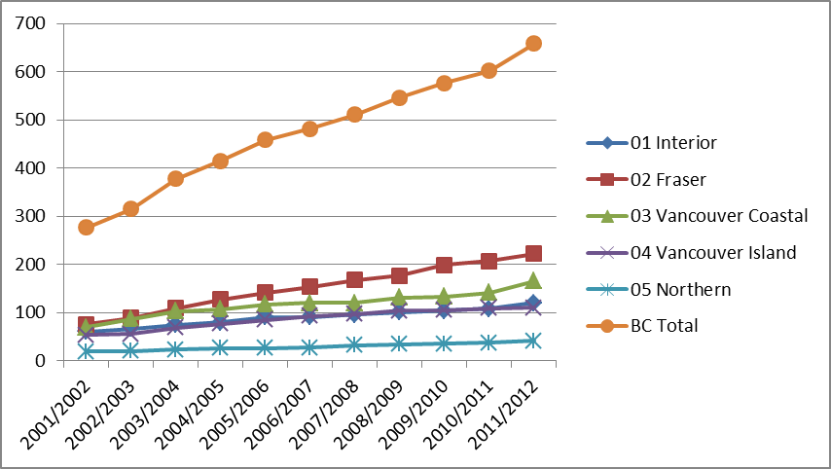
Methadone Maintenance Pharmacies by Health Authority

Slide 11
System Outcome Measures
Retention on Rx
Hospitalizations (all cause)
Mortality (all cause)

Slide 12
Percentage of patients started on MMT retained at 12 months

Slide 13
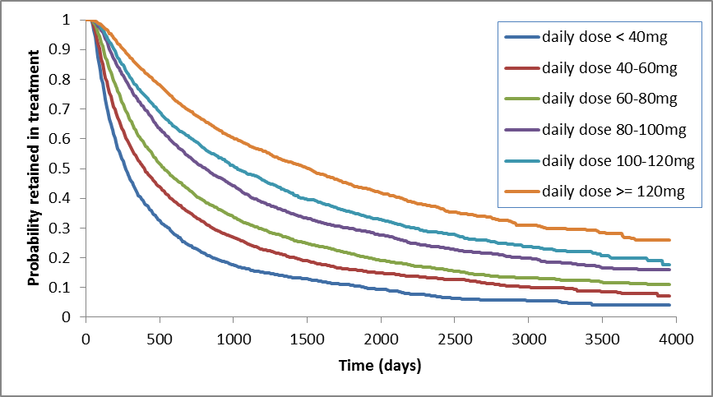
Effect of daily dose on methadone maintenance treatment retention

Slide 14
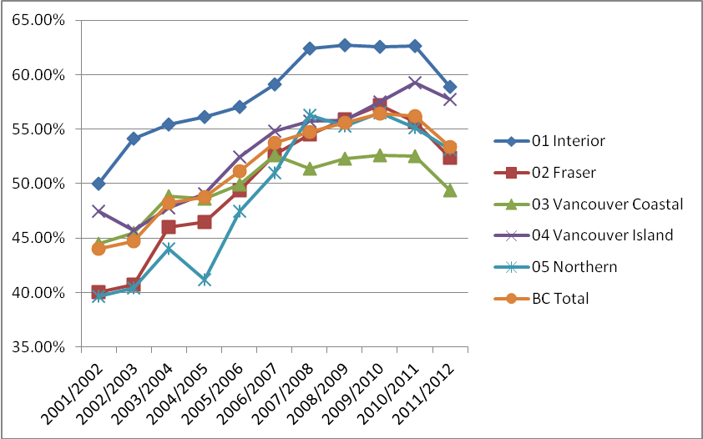
Adherence to minimum effective stabilization dose guideline

Slide 15
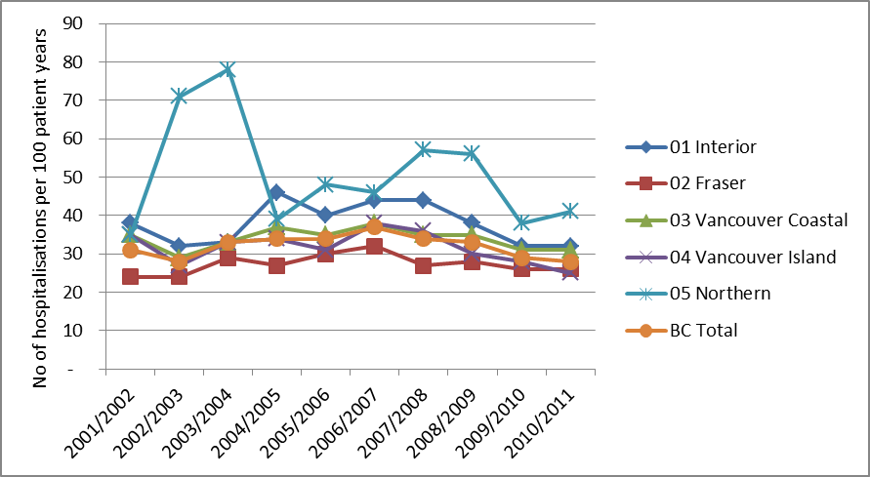
Hospitalizations per 100 Person Years During MMT

Slide 16
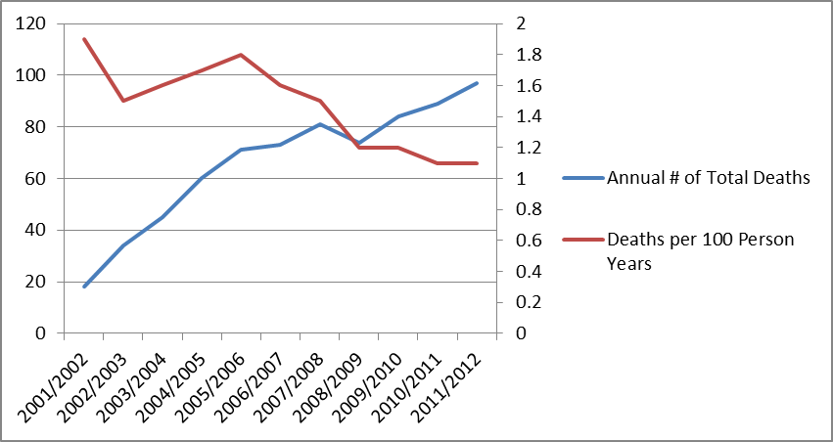
All-cause Mortality During Methadone Maintenance Treatment

Slide 17
Conclusion
MMT – significant growth over the past decade
> access to MMT and other harm reduction initiatives → lower incidence HIV infection among people who inject drugs
There are areas of the system where progress is stagnant or reversing!
Solutions - needed

