Slide 1
Land Based Investment
Planning 2012/13
Fertilization Workshops
February 08 and 15, 2012
Monty Locke, Al Powelson, and Regional Contacts FLNRO

Slide 2
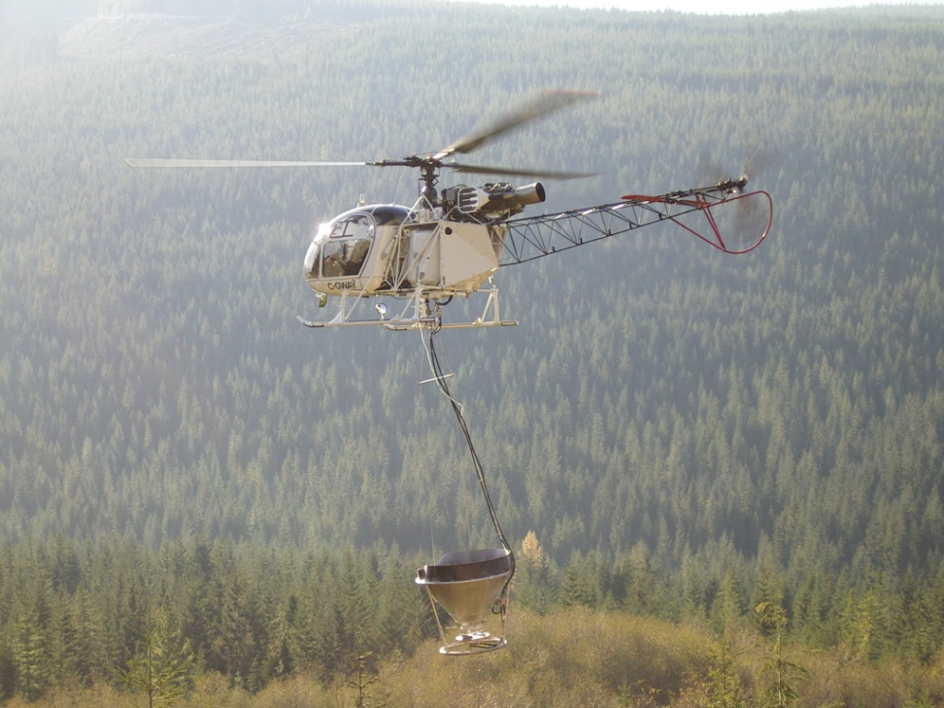
Overview
LBIS Purpose and Goals
Investment Categories
Planning Structure
LBIS Timelines
Timber supply mitigation Investment
Planning for the Interior and Coast
Draft Fertilization by MU
Fertilization Contacts and Roles

Slide 3
Purpose of the LBI Strategy
To guide ongoing resource investments and short-term targeted investments in British Columbia’s natural resources to realize environmental sustainability and economic prosperity.

Slide 4
LBIS Goals
Actively manage a portfolio of natural resources to uphold and enhance their value
Mitigate impacts due to catastrophic environmental disturbance or human action
Act on immediate needs/emerging priorities to enable the use of B.C.’s natural resources and contribute to the achievement of economic, social, and environmental benefits

Slide 5
LBIS Investment Categories
Forest Health
Tree Improvement
Inventory (VRI/Site productivity)
Ecosystem Based Management
Fire Management
Invasive Plants
Ecosystem Restoration
Range
Recreation
Fish
Wildlife

Slide 6
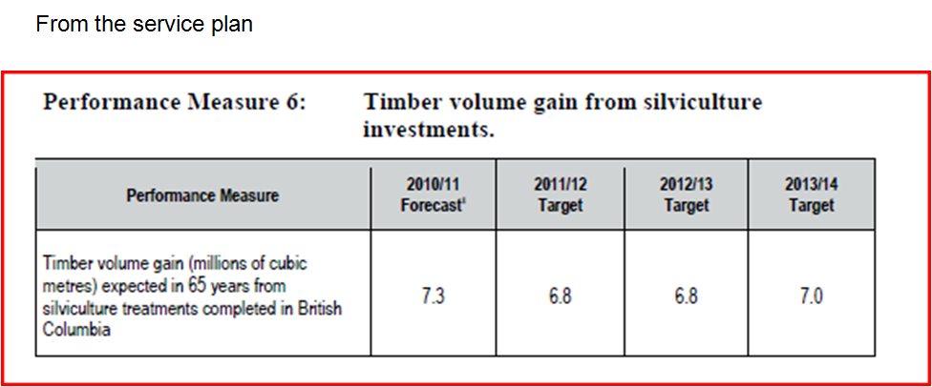
LBIS Investment Categories
FFT – Current Reforestation
FFT – Timber Supply Mitigation

Slide 7
Chief Forester
Overall LBIS planning and delivery
Timber Supply Mitigation
Visual
EBM
Invasive Species
Fish Passage
Fire management
Ecosystem Restoration
regional planning teams
regional planning teams
Province wide planning team (includes regional specialists)
Province wide planning team (includes regional specialists)
EBM planning group
Invasive Species Working Group
Fish Passage working group
Regional Fire management specilists
Forest District-facilitated Multi-sector Ecosystem Restoration Steering Committees
Inventory
Watershed
Deputy Minister
Current Reforestation (FFT)
FFT
Forest Health
Province wide planning team (includes regional specialists)
Range
Provincial planning group (Districts)
Recreation
Provincial Planning group (Districts)
Executive Director – Corporate Initiatives
LBIS Strategic Direction
Notes:
Deputy ultimately responsible
CF forester responsible for Planning and delivery
Executive Director (CID) responsible for strategic direction

Slide 8
Proposed District and Regional roles in planning
FLNRO Regional Specialists Staff
    identifying strategic gaps and opportunities
    collaboration with Investment Category leads, and RPB in the recommendation of tactics required to achieve provincial goals, objectives, indicators, and targets.
    balancing activity proposals to optimize achievement of regional indicators and targets in alignment with provincial goals and priorities.
    collaborating with RPB in the development of cost caps
  Communicating provincial and regional indicators, targets, and tactics; Supporting the Land Based Investment planning process – Coordinate, provide advice for, and participate, the design of tactics for the respective region.
FLNRO District Staff
    Strategic planning at the local level – identification of priority treatment areas in the context of provincial priorities , tactical planning and overview analysis of eligible ground (does not include surveys)
    Assisting regional staff specialist or investment category leads in the recommendation of tactics required to achieve provincial goals, objectives, indicators, and targets.
  Communicating provincial, regional, and District outputs, targets, and tactics ; Supporting the Land Based Investment planning process – provide advice for, and participate, the design of tactics for the respective District
  First Nations consultation process – review of information sharing done by delivery agents to ensure it is adequate for LBI project to proceed.
BCTS/Timber Tenure Licensees/Recipients/Consultants
  Enabled (but not required) to engage in Land Based Investment planning, monitoring and other activities, partnered with the FLNRO or other government agencies.

Slide 9
Timelines for Decisions
March 1st upcoming fiscals Annual Operation Plan finalized
March 31st release of next fiscals LBIS (dependent on date of release of provincial budget)
April 1st launch next fiscals operating plan and begin planning for updating 5-year plan and development of the following fiscals annual operating plan.

Slide 10
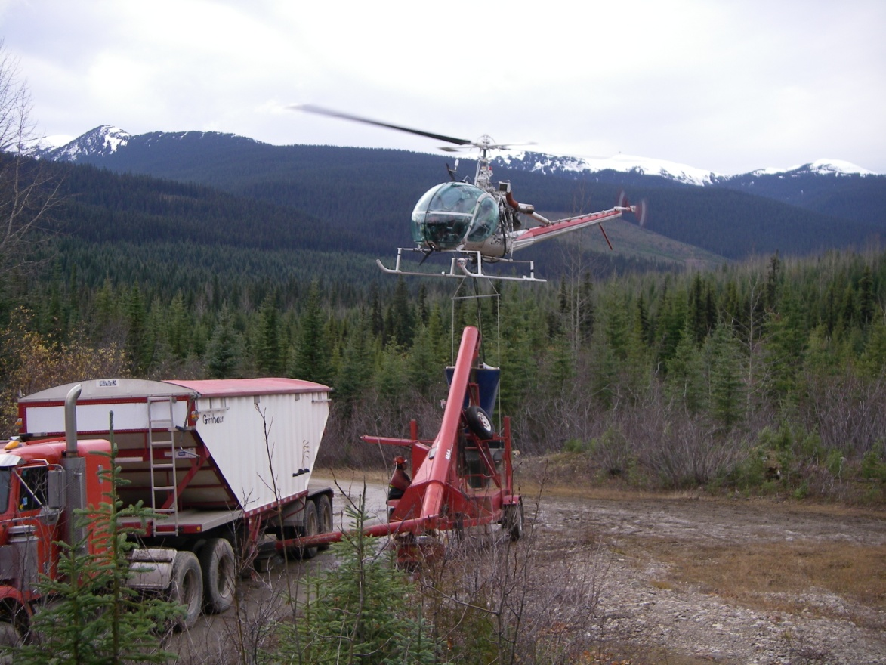
Timber Supply Mitigation
  Objectives
    Mitigate mid-term timber supply shortfalls
    Address Constrained timber supply on coastal northwest and southwest
  Targets 2012/13
    Fertilize 24,000 ha
    Juvenile Space and backlog brushing 3000 ha

Slide 11
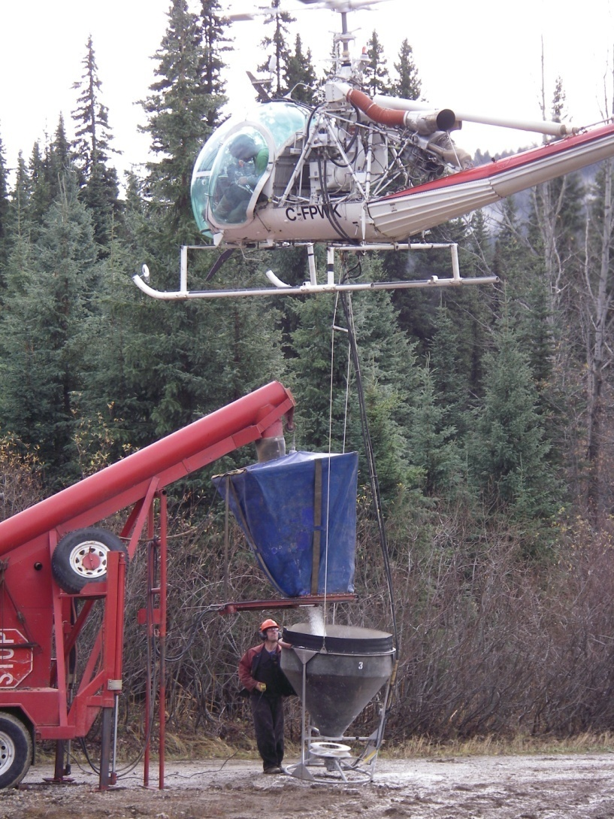
Provincial Impact
Produce 468,000 cubic metres of additional volume in 10 years.
468,000 tonnes of sequestered CO₂
Estimated GDP increase $55 million dollar at time of harvest

Slide 12
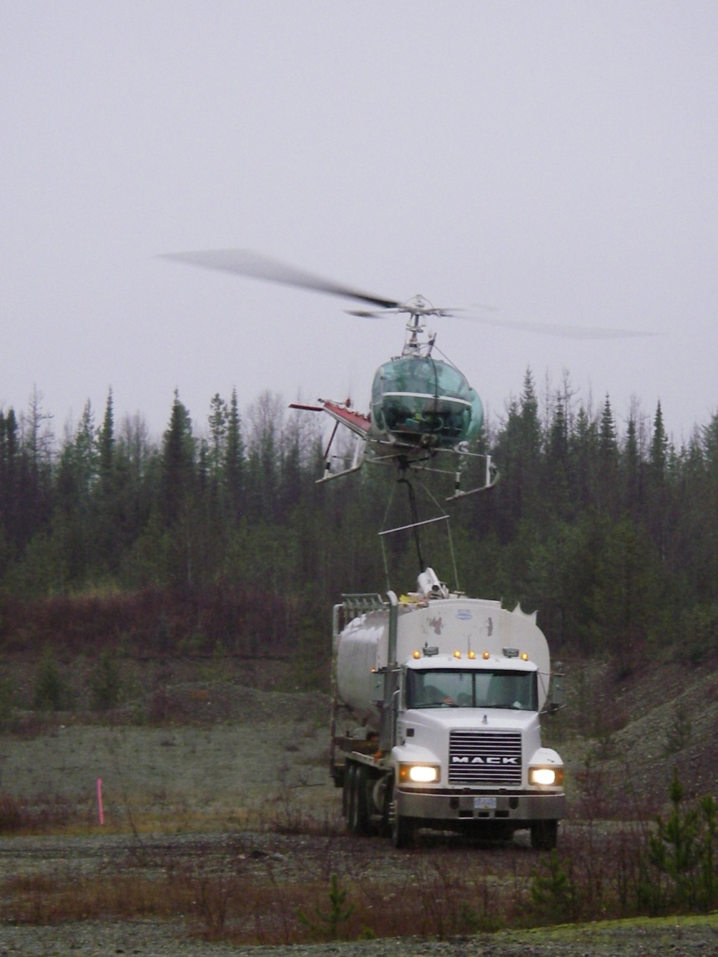
Silviculture Funding Criteria
Provincial level determination of silvicultural response to provincial level timber supply.
Regional Investment level
Determination of areas of focus
Maximization of productivity
Maximization for return on investment
Project size

Slide 13
Fertilization Targets
Treat 24,000 ha in 2012/13 and 2013/14.
An estimated 70% of the annual program will be targeted for priority Interior units for mid-term timber supply mitigation
Remaining 30% ha will be focused on Coastal units to address timber supply issues and increase production of valuable volume.
Recognize that the interior slippage is utilized on the Coast

Slide 14
TSM Investment Areas
Central Interior will focus on mitigating the reduction in the mid-term timber supply by targeting these activities within the “economic fibre-baskets” associated with the following areas:
  Priority 1: Lakes, Quesnel, Prince George, Williams Lake
  Priority 2: 100 Mile House, Merritt, Morice, Okanagan
  Priority 3: Cranbrook, Kamloops, Invermere, Arrow
Fertilization and stand tending (juvenile spacing) on coastal, southeast, and northwest forest management units with constrained timber supply and where highest return-on-investment will be achieved to improve timber availability and value.

Slide 15
Planning for Interior Regions
Includes priority areas within Skeena, Omineca, Cariboo, Thompson/Okanagan. No fertilization planned for North East region and Kootenay/Boundary for 2012/13.
Planning involved Regional and District staff setting priorities using information from silviculture strategies, silviculture opportunity maps, and licensee input.
Investments are to have a positive impact on timber availability in the mid-term and meet the LBIS Silviculture funding criteria
Planning process includes the development of a five year plan and a annual operating plan for 2012/13

Slide 16
Planning for Interior cont’
Target is 70% of provincial fertilization area or 16,800 ha;
Roll-up of Interior fertilization opportunities totalled 21,415 ha
Priority One areas still focus of majority of investment to address largest midterm timber supply drop, but recognition that opportunities in other areas as well.
Reduction to target made by focusing in regional areas on best sites, preferred species, age, return on investment, focus on larger project size

Slide 17
Draft Fertilization by MU - Interior
Region | District | MU | Area (ha) | Delivery Agent
Cariboo | Williams Lake | WL TSA | 1200 | Tolko
 | Quesnel | TSA/TFL/WL | 3000 | West Fraser/Quesnel WL Association
 | 100 Mile | TSA | 600 | West Fraser
TOR | Kamloops | TSA | 400 | District
 | Okanagan | TSA | 400 | BCTS
Omineca | PG | PG TSA | 7000 | Erafor
 |  | TFL | 1000 | Dunkley
Skeena | Nadina | Lakes TSA | 3400 | Hampton
Area total |  |  | 17,000

Slide 18
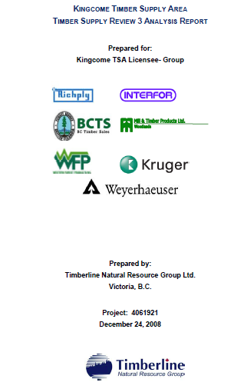
Planning for Coast Area
Coast worked with PwC to conduct a review of TSR reports, silviculture strategies, silviculture opportunity maps, interview district/ licensee staff and prepare a draft 5 year silviculture plan.
The 5 year silviculture plan identifies target areas for fertilization by management unit
Notes:
Draft plan prepared based on input from interviews and results of analysis.

Slide 19
Planning for Coast Area
Includes West Coast and South Coast Regions
Target is 30% of provincial fertilization area or 7200 ha
Historically Coast has picked up additional area due to short treatment window in Interior
Focus on management units with a mid-term timber supply shortfall or a forecast timber supply reduction due to land use constraints (e.g., visuals, spotted owl )
Investments must meet LBIS Silviculture Funding Criteria
Focus on areas with Fd or Cw leading, 40-80 years old with site index between 24 – 36
Target areas for treatment with good access

Slide 20
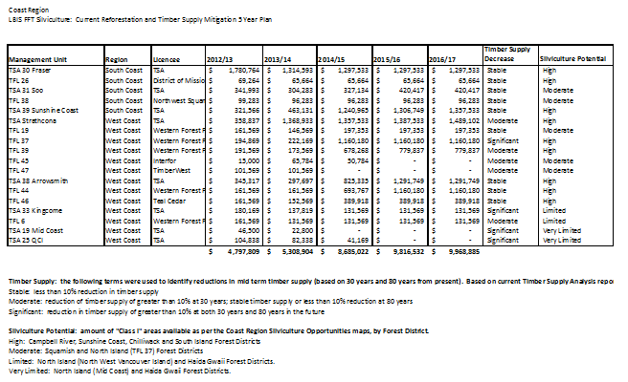
Coast Area 5 yr plan MU summary
Notes:
The 5 year plan identifies coastal management units with timber supply short falls and silviculture potential

Slide 21
Planning for Coast Area
The 5 year silviculture plan identifies approximately 8000 ha of potential fertilization which allows for 1000 ha additional treatment should there be surplus funding.
Three different budget scenarios were developed to look at the trade offs between incremental silviculture treatments

Slide 22
Draft Fertilization by MU - Coast
Region | District | MU | Area (ha) | Delivery Agent
South Coast | Chilliwack | Fraser | 1500 | Fraser Coop
West Coast | North Island | Kingcome | 1000 | BCTS
 | North Island | TFL 44, 6 | 1000 | Western
 | South Island | TFL 46 | 500 | Western
 | Campbell River | Strathcona | 1500 | Western
 | Campbell River | TFL 19,37,39,47 | 1500 | Western
Coast Area total |  |  | 7000

Slide 23
Draft 5 Year Plan – Fertilization
Region | 2012/13 | 2013/14 | 2014/15 | 2015/16 | 2016/17
Cariboo | 5,700 | 5,700 | 5,700 | 5,200 | 5,200
TOR | 530 | 2,030 | 2,030 | 2,000 | 2,000
KBR | 358 | 400 | 0 | 0 | 0
Omineca | 8,800 | 8,300 | 8,300 | 12,463 | 8,300
Skeena | 5,100 | 7,100 | 8,600 | 8,600 | 8,600
North East | 0 | 0 | 0 | 0 | 0
West Coast | 6,000 | 6,750 | 8,000 | 8,250 | 8,750
South Coast | 2,030 | 2,030 | 3,030 | 3,280 | 3,530
Total | 28,518 | 32,310 | 35,660 | 39,793 | 36,380
Notes:
.

Slide 24
Fertilization Contacts and Roles
Contact | Strategic | Delivery
Ralph Winter and Monty Locke, FLNRO | X
Regional/District staff FLNRO | X | X
Third Party Administrator (PwC) |  | X
Licensees, BCTS, Contractors |  | X

Slide 25
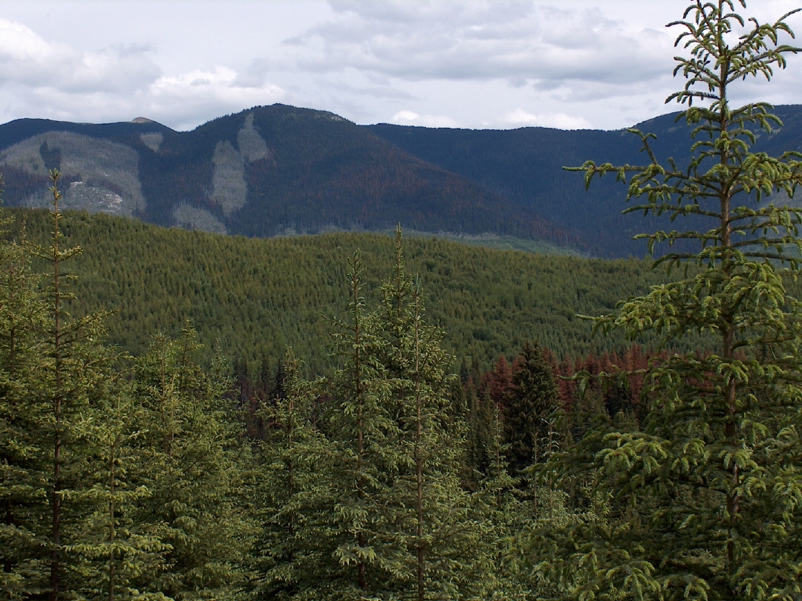
Questions?

